Slide 1
Experimental Exploration of Dynamic, Astrophysically-Relevant MHD Plasmas
Paul Bellan
Caltech
Supported by USDOE, NSF, AFOSR

Slide 2
Grad Students, Postdocs, Visitors
(past and present)
Freddy Hansen
Scott Hsu
Sett You
Shreekrishna Tripathi
Carlos Romero
Gunsu Yun
Steve Pracko
Deepak Kumar
Rory Perkins
Anna Moser
Eve Stenson
Prof. Taiichi Shikama
Zach Tobin
Bao Ha
Vernon Chaplin
Xiang Zhai
Magnus Haw
Kilbyoung Chai

Slide 3
Outline
1. make claims
2. provide evidence

Slide 4
Classic method:
1. Assume MHD equilibrium:
grad P = J x B
2. Consider perturbations about equilibrium ( get waves, instabilities)

Slide 5
Standard MHD Equilibrium
Solutions to
grad P = J x B
  Closed flux surfaces (closed field lines, i.e., no field line intercepting boundary)
  Axisymmetric -> Grad Shafranov equation: tokamaks, RFP, spheromaks

Slide 6
Perturbations about MHD equilibrium
Stable perturbations:
  Slow wave (aka Alfven, torsional, shear wave)
  Fast wave (aka magnetosonic, compressional)
Unstable perturbations
  Current-driven: kink, sausage
  Pressure-driven: Rayleigh-Taylor

Slide 9
Reality
Often there are open field lines
Often there is no equilibrium, i.e., not true to assume grad P = J x B
Get approximate force balance in some directions, big force imbalance in other directions
Result is near equilibrium in some direction (e.g., radial), acceleration in another direction (e.g., axial)

Slide 10
Jets
Jet has:
  Near force balance in radial direction
  Force imbalance in axial direction, produces flow
  Jet becomes longer in axial direction

Slide 11
Jets, cont’d
Pinching and collimation
  Magnetic flux is frozen into plasma frame
    Therefore magnetic flux is convected with flow
  Pinch effect caused by azimuthal B field
    B field is flux density, so flux compression amplifies pinch force
  Any jet slowing down compresses flux, increases pinching

Slide 12
Jets, cont’d
Stability
  Jets are subject to same instabilities as classic equilibrium if instability time scale faster than jet time scale
  Jets can kink
  New result: kink can itself become unstable
    Secondary instability (instability of an instability)

Slide 13
Basic equations of MHD
Eq. of motion
Induction equation
Ampere’s law
Mass conservation equation
Adiabatic relation

Slide 14
Basic equations of MHD
Eq. of motion
Induction equation
Ampere’s law
Mass conservation equation
Adiabatic relation
No intrinsic scale in these equations !!

Slide 15
PLUS:
boundary conditions

Slide 16
Basic jet configuration
Relevant to
Astrophysical jets
Spheromak formation
Magnetoplasmadynamic thrusters
“Building block” for solar coronal loops
Will refer to as “astrophysical jet” experiment

Slide 17
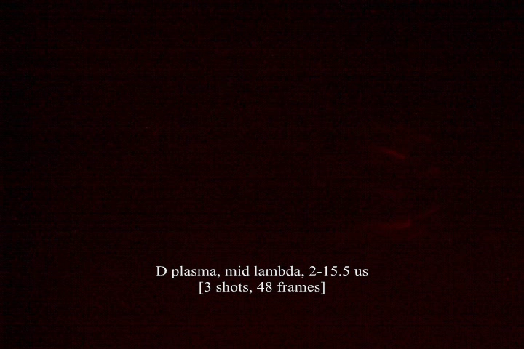


Slide 18
Setup

Slide 19
Typical experimental parameters
Experiment duration 10-50 microseconds
Electric current 30 - 150 kA
Voltage: 3-6 kV at breakdown, < 2 kV after
Input power ~50-300 megawatts
Gas: hydrogen, argon, neon, or nitrogen
Plasma density ~10¹⁵ -10¹⁷ cm⁻³
Plasma temperature ~2 eV
Magnetic field strength ~0.1 - 2 kG

Slide 20
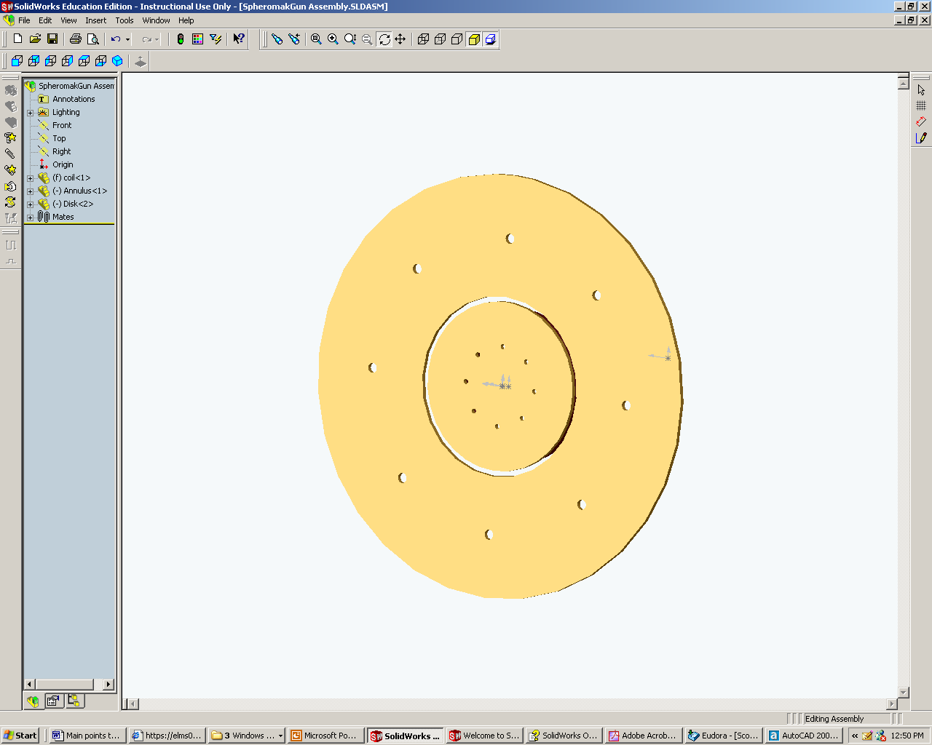
Coaxial, co-planar electrodes
Copper annulus
50.8 cm diam
Gas nozzles
Copper disk
20.3 cm diam

Slide 21
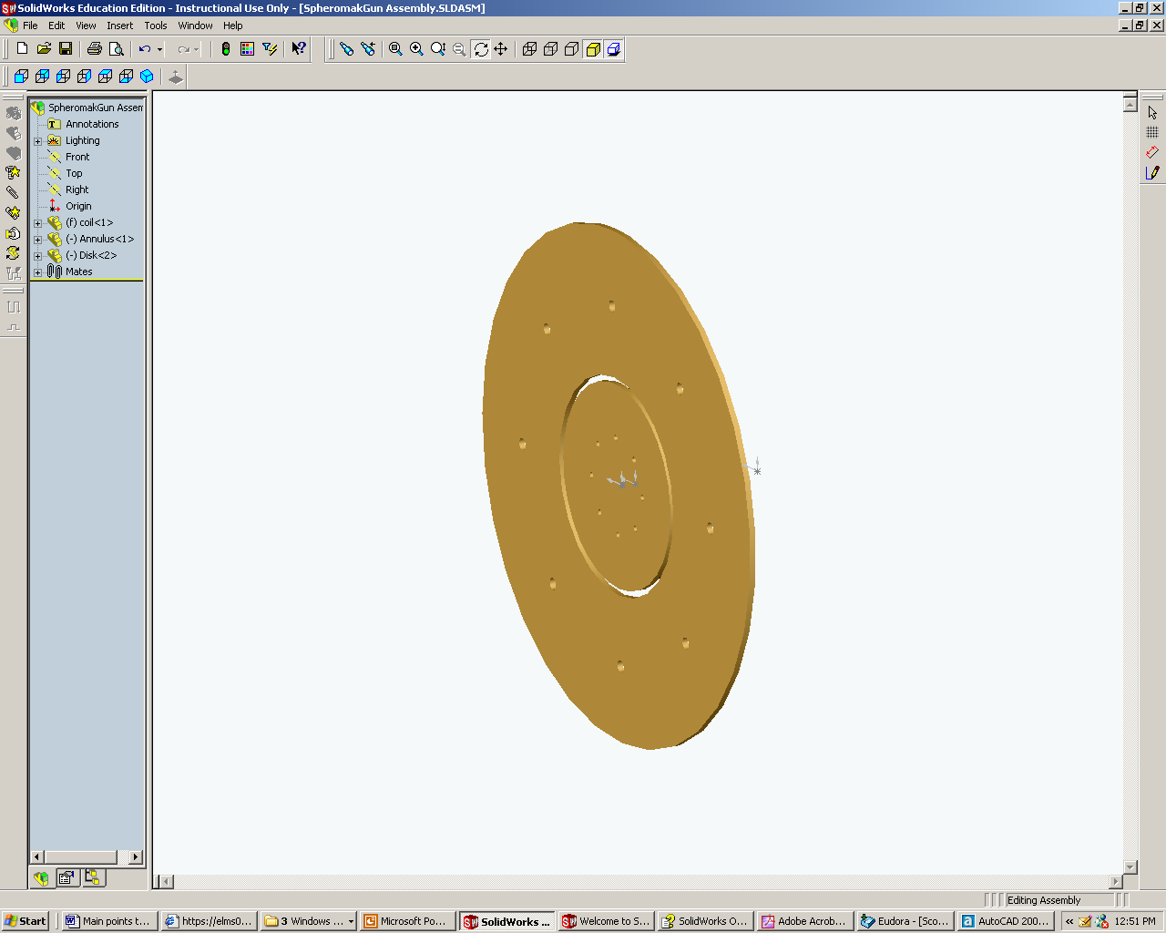

Slide 22
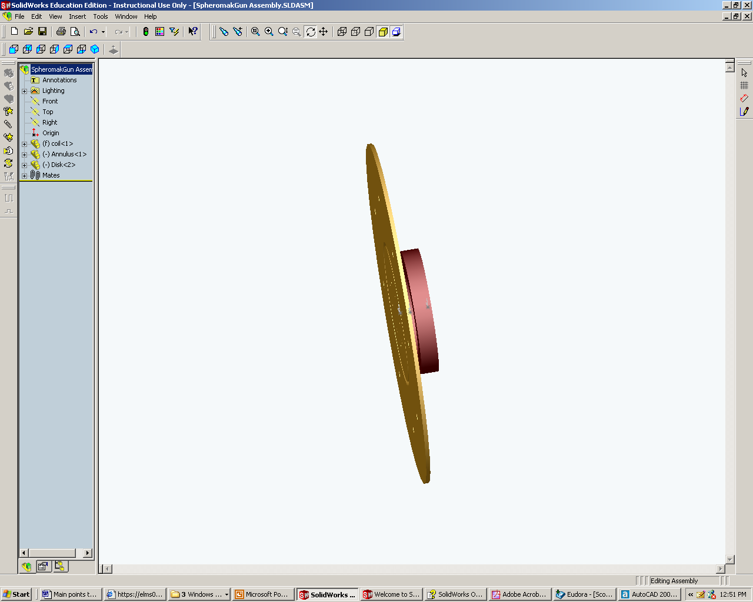

Slide 23
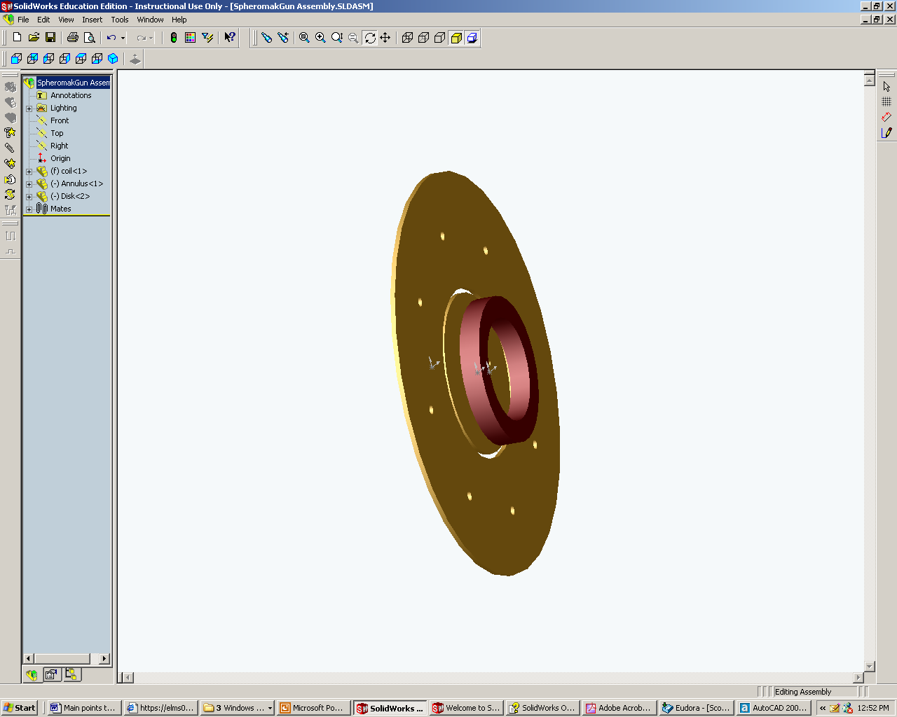
Bias field coil
makes linked
magnetic flux

Slide 24
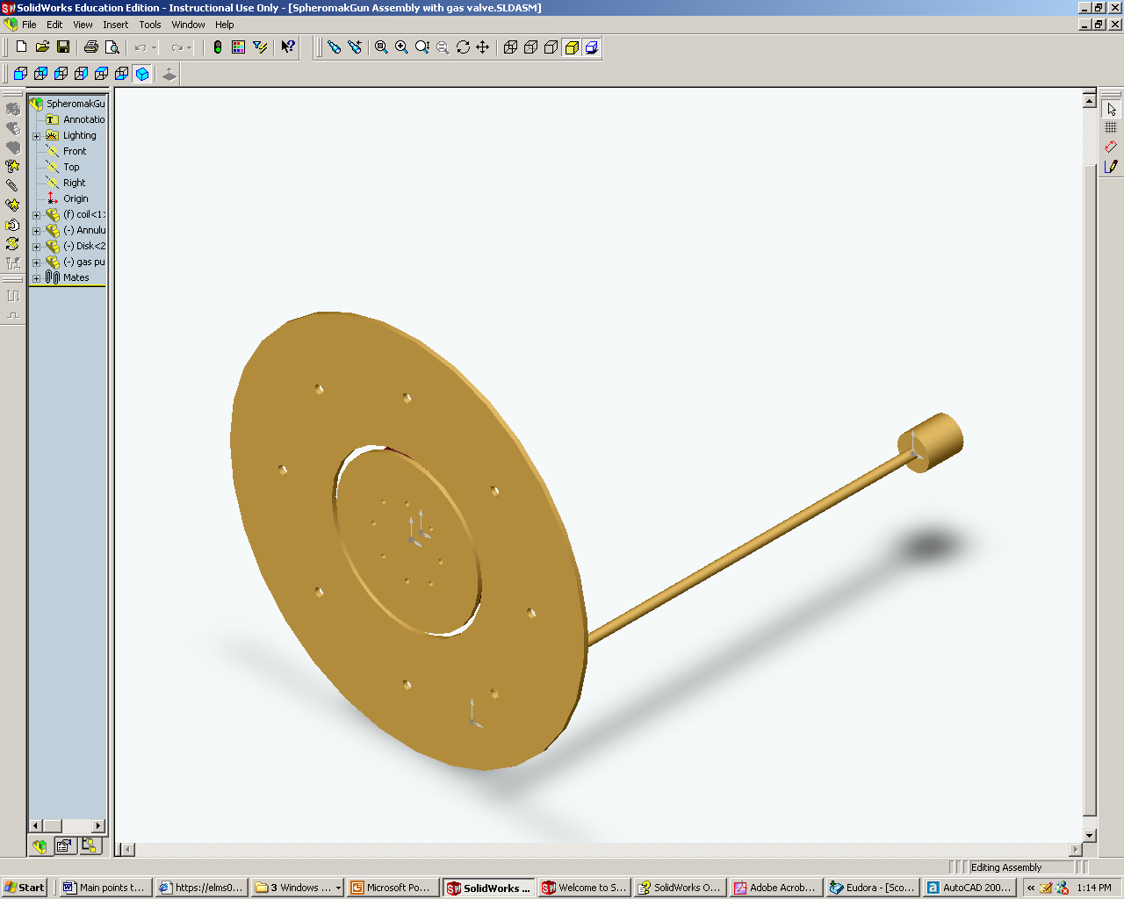
Gas puff valve
(typical)

Slide 25
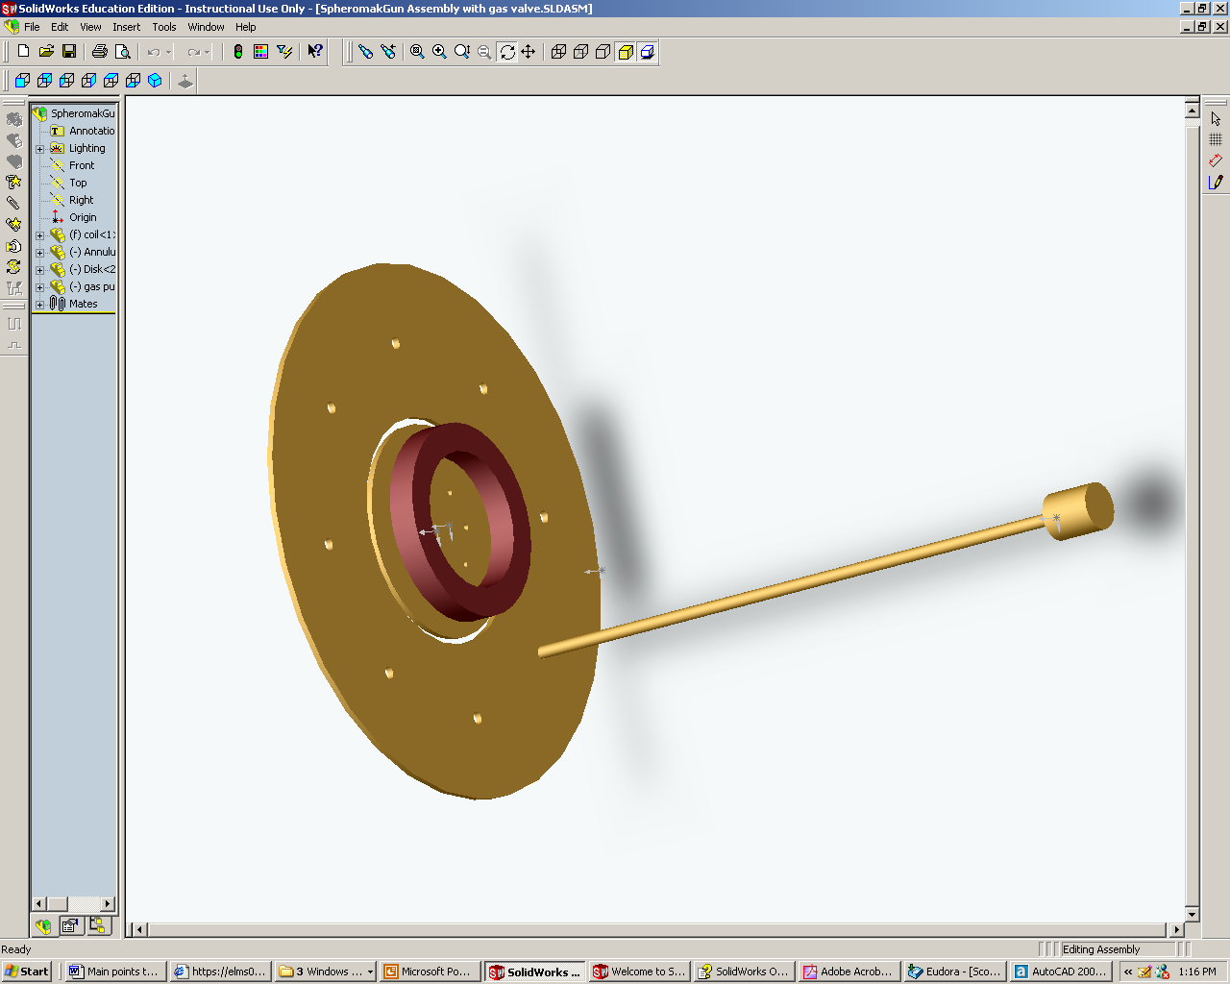

Slide 26
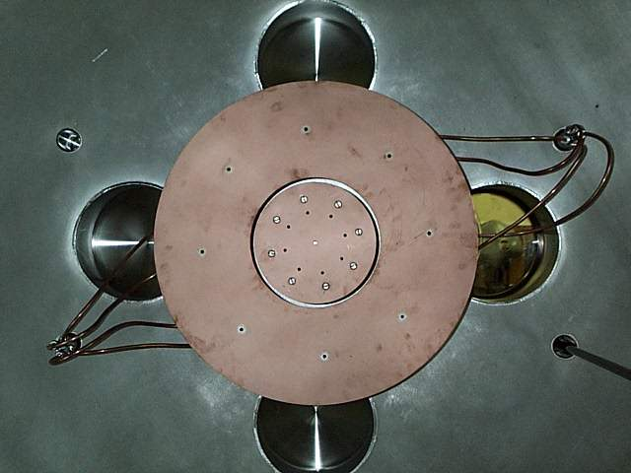
Gas nozzle
disk
annulus
50 cm
Notes:
Gas injection at 8 toroidal locations

Slide 27
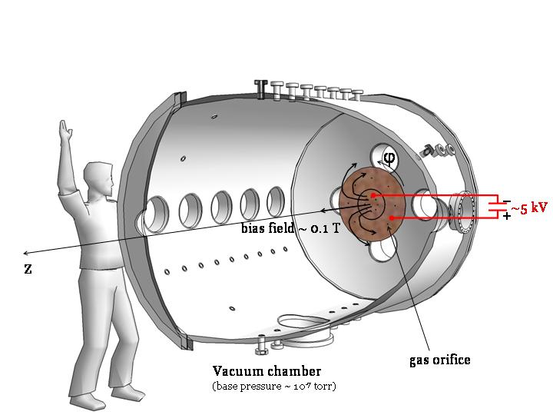

Slide 28
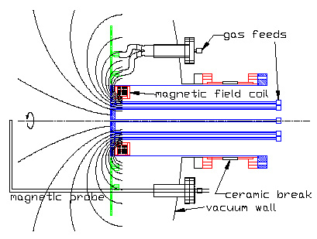
Side View
annulus
disk
Notes:
Gun design features
Cylindrical coordinate system
Experimental operation sequence (1) bias field, (2) gas puff, (3) gun discharge
Describe I-V traces

Slide 29
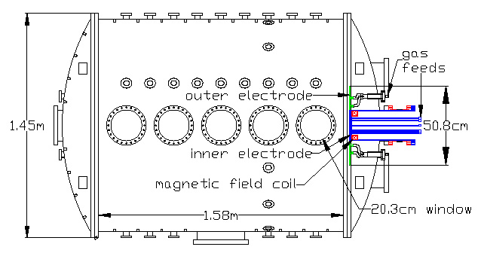
Installation

Slide 30
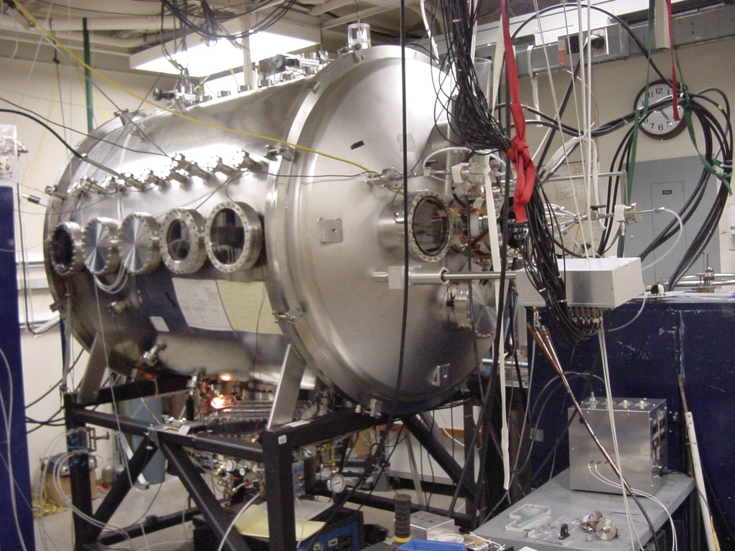

Slide 31
Sequence
Bias field
high
vacuum
Notes:
Gun design features
Cylindrical coordinate system
Experimental operation sequence (1) bias field, (2) gas puff, (3) gun discharge
Describe I-V traces

Slide 32
Puff in neutral gas
Notes:
Gun design features
Cylindrical coordinate system
Experimental operation sequence (1) bias field, (2) gas puff, (3) gun discharge
Describe I-V traces

Slide 33
Apply high voltage across gap between disk and annulus

Slide 34
Breakdown, “spider leg formation”
Notes:
Gun design features
Cylindrical coordinate system
Experimental operation sequence (1) bias field, (2) gas puff, (3) gun discharge
Describe I-V traces

Slide 35
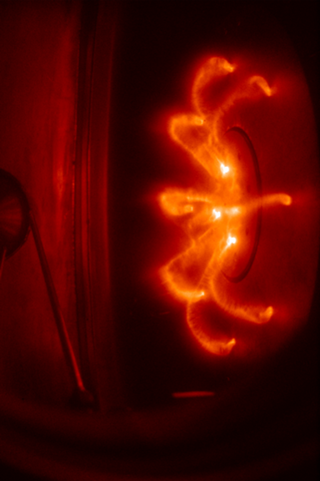
Spider leg

Slide 36
MHD physics
Anti-parallel currents repel

Slide 37
Spider legs get bigger
Notes:
Gun design features
Cylindrical coordinate system
Experimental operation sequence (1) bias field, (2) gas puff, (3) gun discharge
Describe I-V traces

Slide 38
Notes:
Gun design features
Cylindrical coordinate system
Experimental operation sequence (1) bias field, (2) gas puff, (3) gun discharge
Describe I-V traces

Slide 39
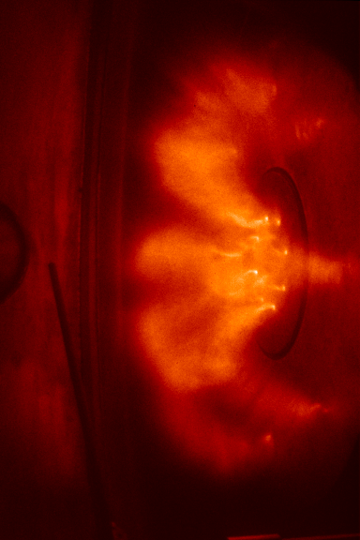

Slide 40
MHD physics
Parallel currents attract

Slide 41
Spider legs merge to form central column
Notes:
Gun design features
Cylindrical coordinate system
Experimental operation sequence (1) bias field, (2) gas puff, (3) gun discharge
Describe I-V traces

Slide 42
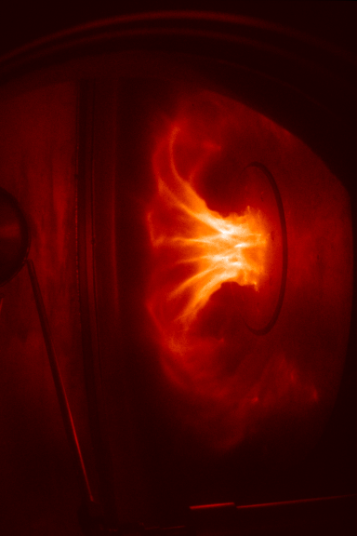

Slide 43
Central column lengthens
I ~ 100 kA
Notes:
Gun design features
Cylindrical coordinate system
Experimental operation sequence (1) bias field, (2) gas puff, (3) gun discharge
Describe I-V traces

Slide 45
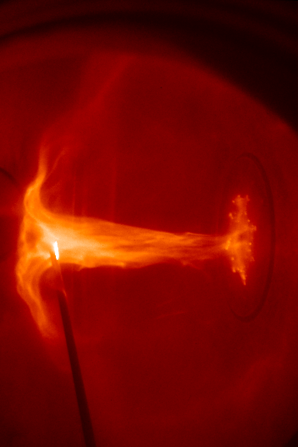

Slide 46
Doppler Shift Measurement
Velocities ~ 15-60 km/s observed
Red shift
seen
when
viewing
from
this end
Blue shift
seen when
viewing from
this end

Slide 47
Doppler Shift Measurement
Velocities ~ 15-60 km/s observed
Red shift
seen
when
viewing
from
this end
Blue shift
seen when
viewing from
this end

Slide 48
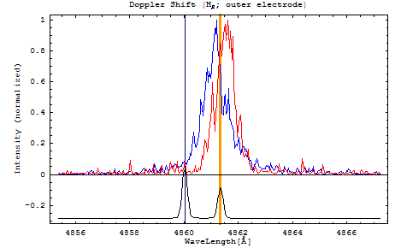

Example of Doppler shift data
D_{b}
H_{b}
hydrogen, deuterium
calibration lines
from reference lamp

Slide 49
Acceleration and collimation in astrophysical jet context
Simplified picture
Because jets are long and narrow, radial MHD equilibrium occurs first
  Magnetic pinch balances radial pressure gradient
This results in axial pressure gradient
  Axial pressure gradient accelerates jet
  Like squeezing toothpaste tube

Slide 50
small radius implies
large pinch force

Slide 51
small radius implies
large pinch force
implies high pressure on axis

Slide 52
small radius implies
large pinch force
implies high pressure on axis
large radius implies
small pinch force

Slide 53
small radius implies
large pinch force
implies high pressure on axis
large radius implies
small pinch force
implies low pressure on axis

Slide 54
HIGH PRESSURE
ON AXIS
LOW PRESSURE
ON AXIS

Slide 55
FLOW
HIGH PRESSURE
ON AXIS
LOW PRESSURE
ON AXIS

Slide 56
Stretching of poloidal magnetic field lines
Poloidal field line
anchored
in disk

Slide 57
Stretching of poloidal magnetic field lines
Poloidal field line
anchored
in disk

Slide 58
Stretching of poloidal magnetic field lines
Poloidal field line
anchored
in disk

Slide 59
Stretching of poloidal magnetic field lines
Poloidal field line
anchored
in disk

Slide 60
Stretching of poloidal magnetic field lines
Poloidal field line
anchored
in disk

Slide 61
Convection of toroidal field lines with jet
Poloidal current
Toroidal field line

Slide 62
Convection of toroidal field lines
Poloidal current
Toroidal field line
carried along by jet
New toroidal
field line
frozen into
new material

Slide 63
Convection of toroidal field lines
Poloidal current
Toroidal field lines
carried along by jet

Slide 64
Convection of toroidal field lines
Poloidal current
Toroidal field lines
carried along by jet

Slide 65
Convection of toroidal field lines
Poloidal current
Toroidal field lines
carried along by jet

Slide 66
Convection of toroidal field lines
Poloidal current
Toroidal field lines
carried along by jet
Injection of plasma involves associated injection of toroidal flux
Radial voltage drop at disk is rate of injection of toroidal flux

Slide 67
Collimation: injected toroidal field lines pile up
Poloidal current
Pile-up of toroidal field lines as jet velocity decreases near tip
Corresponds to amplification of toroidal magnetic field
But toroidal magnetic field provides pinch force
Thus, amplification of pinch force due to jet velocity decrease near tip
gives pinching near tip, implies collimation

Slide 68
Jet flow velocity model
Pinch converted into flow kinetic energy:
jet
Balance radial force
Equal (Bernoulli )
electrode

Slide 69
Jet flow velocity measurement
Predicted axial flow velocity at jet tip
  I = jet electric current
a = jet radius at source electrode
r = mass density at jet tip
Verified using jet time-of-flight measurement

Slide 70
Jet velocity measurements show
Kumar and Bellan, Phys. Rev. Lett. 2009

Slide 71
H plasma flow velocity vs gun current
Plasma velocity prop to current

Slide 72
Kink Instability of Central Column
Notes:
Gun design features
Cylindrical coordinate system
Experimental operation sequence (1) bias field, (2) gas puff, (3) gun discharge
Describe I-V traces

Slide 73
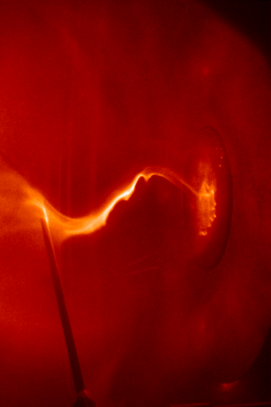

Slide 75
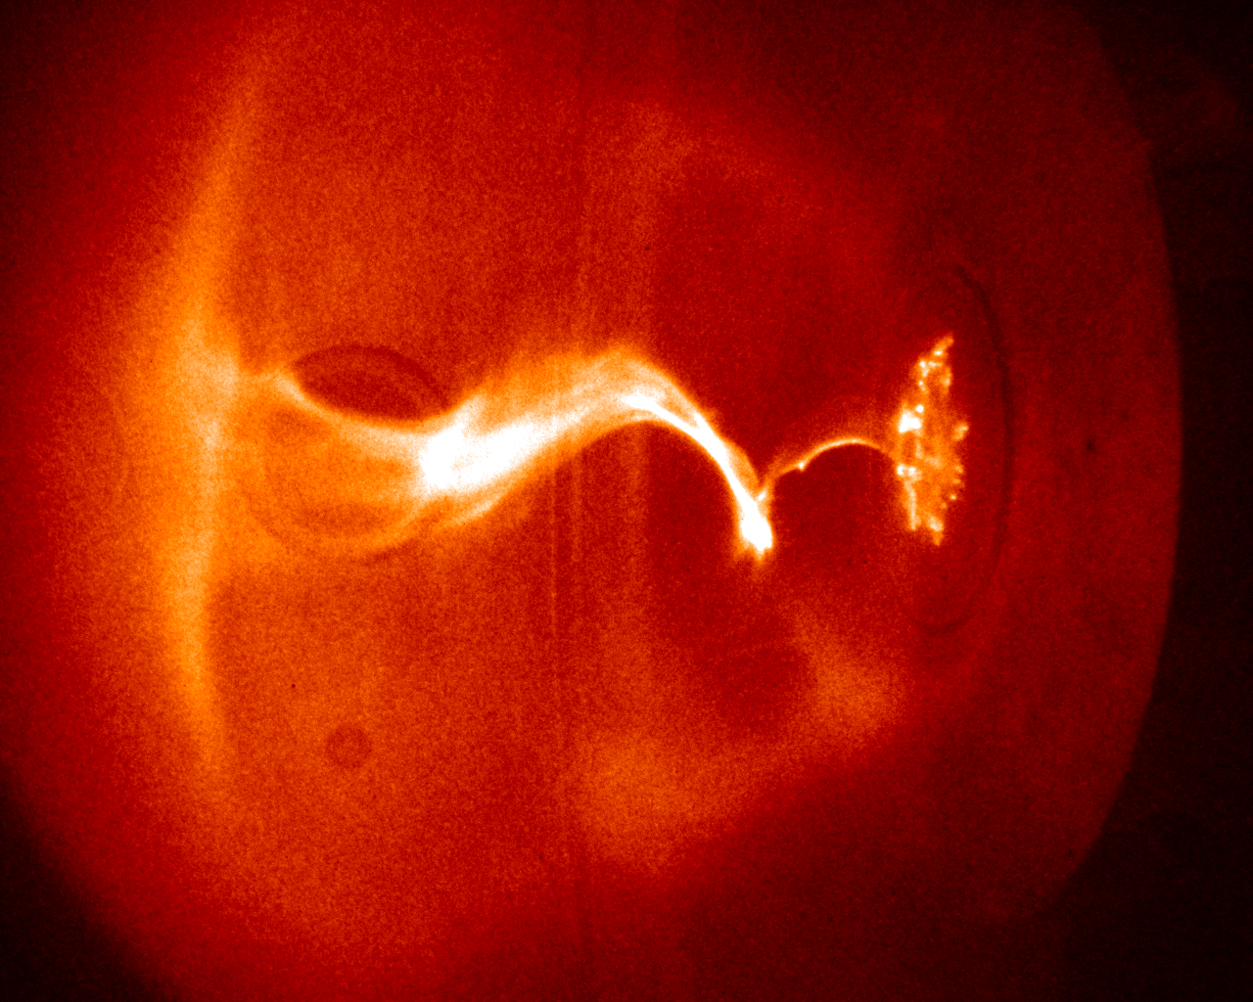
Kink occurs when central column becomes sufficiently long to satisfy instability condition q=1
S. C. Hsu & P. M. Bellan
MNRAS 334, 257 (2002)
L

Slide 76
Instability of an instability
(Moser and Bellan, Nature 2012)

Slide 77
Kink instability involves lateral acceleration of plasma
Observer sitting on plasma would be in an accelerating frame
- would feel an effective gravity
- Heavy fluid on top of light fluid causes Rayleigh-Taylor instability

Slide 78
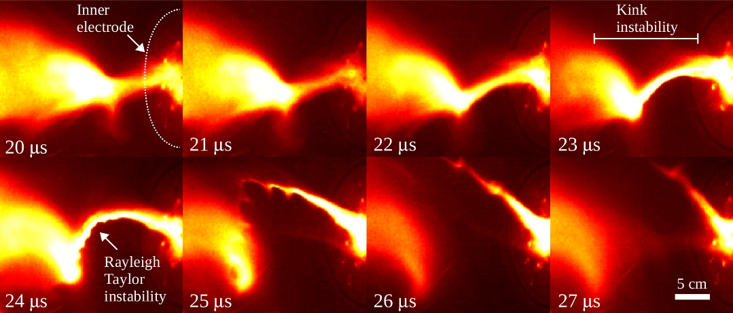

Slide 79
Movie1

Slide 80
Bi-directional jets and their relation to solar corona loops
(Stenson and Bellan, PRL 2012)

Slide 81
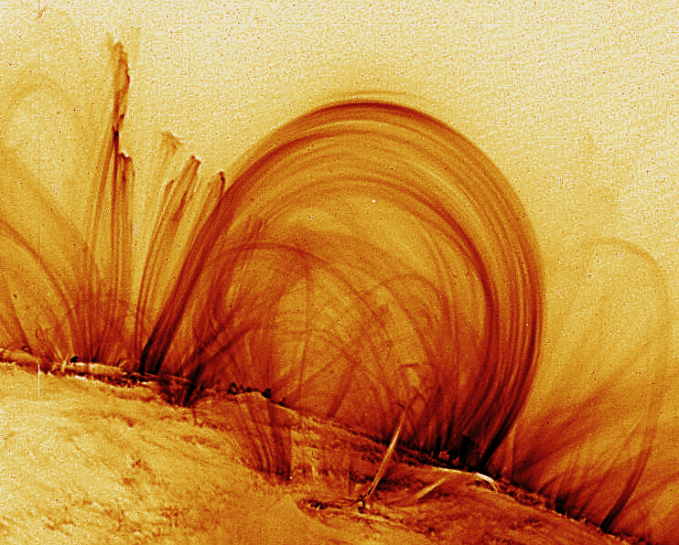
Solar loop image from
TRACE spacecraft

Slide 82
Vacuum magnetic
fields.
These are lowest
energy state.
Any perturbation
requires work.
U
Horse-shoe magnet with gap

Slide 83
Inject cloud
of hydrogen
gas with fast
valve
U

Slide 84
U
Connect large
capacitor across magnet
poles

Slide 85
Break down gas
Form plasma
Drive field-aligned current
plasma
U

Slide 86
Self field of
current causes
field lines to
(i) pinch
(ii) twist
(iii) and then...
U

Slide 87
….bulge out
Outward force
due to mutually
repelling
currents
Recall that
vacuum fields
were lowest
energy state
Current flow
U

Slide 88
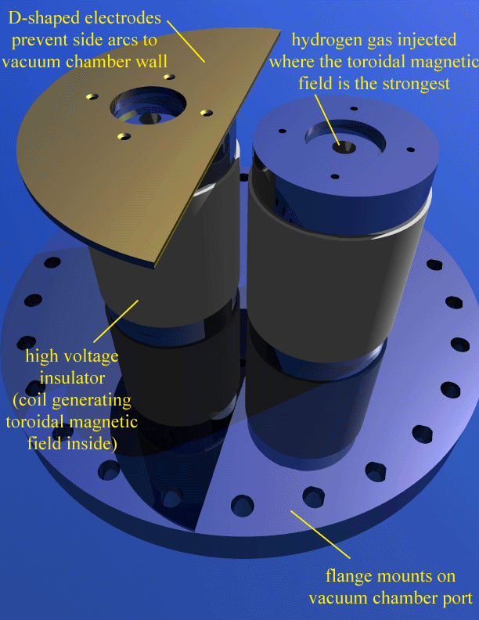

Slide 89
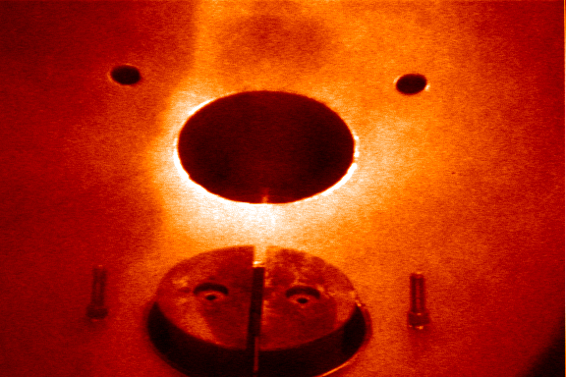
20 cm

Slide 90
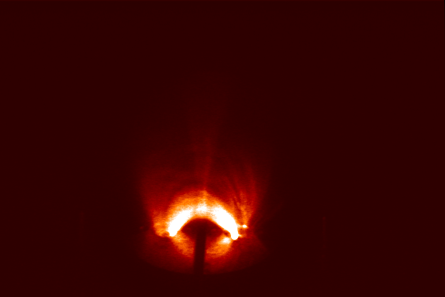

Slide 91
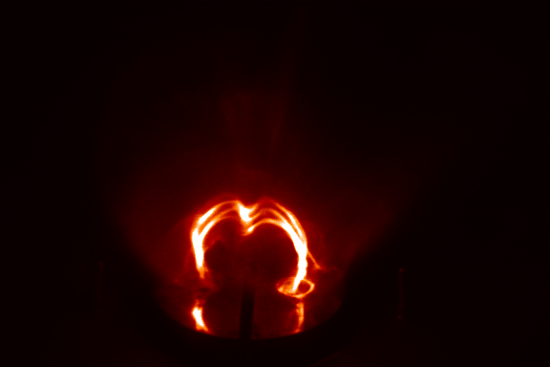

Slide 92
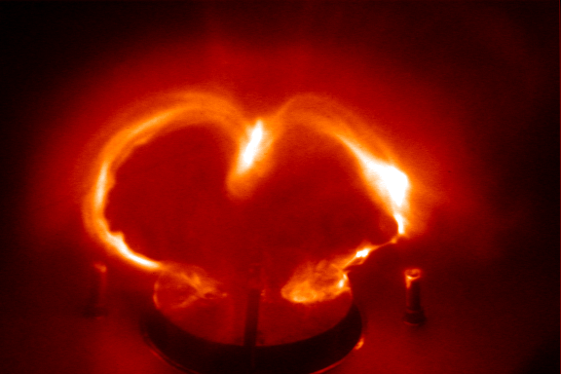

Slide 93
Gobbling and collimation
Claim: ingestion of plasma with frozen-in flux with subsequent pile-up leads to collimation
Fat flux tube ingests plasma and gets thin

Slide 94
JxB force gives axial thrust
axial flow
axial flow
current

Slide 95
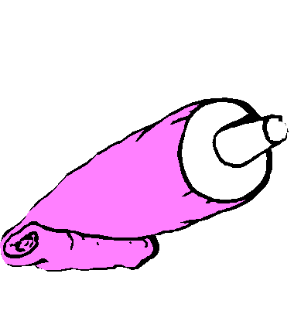
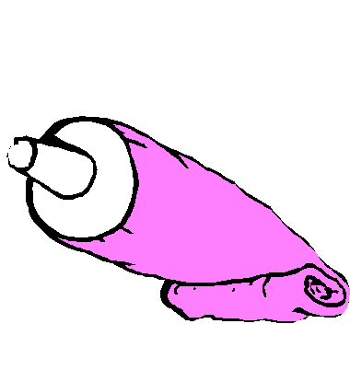
JxB force gives axial thrust
axial flow
axial flow
current

Slide 96
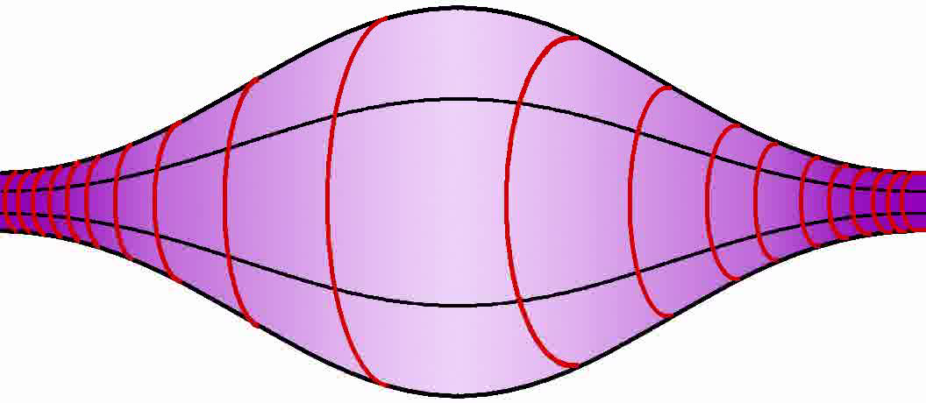
Both the hoop force expansion rate and the gobble model flow
rate are proportional to I (and hence B_{azimuthal}).
Thus, flux tube is not diluted when it expands due to hoop force.

Slide 97
Experimental validation of bidirectional flows

Slide 98
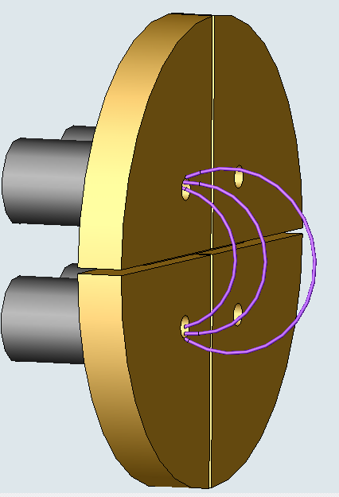
-
1) Coil-generated potential magnetic field, up to 0.3 T
2) Fast gas valves inject H₂, N₂ at footpoints
3) 3-6 kV, applied to the electrodes, ionizes the gas and drives a 40-80 kA current
magnetic field coils
(cathode)
hydrogen
nitrogen
arched magnetic field
(anode)
+
atmosphere side
vacuum side

Slide 99
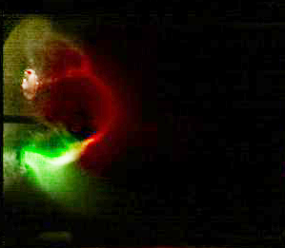
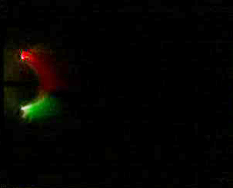
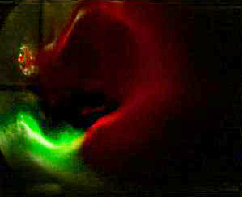
Get jets from both cathode and anode
Hydrogen jet (red) coming from top collides with nitrogen jet (green) coming from bottom
Jets follow arched expanding magnetic field
Jets are collimated
1 μs
3 μs
4.5 μs
.

Slide 100


Slide 101
Water-Ice Dusty Plasma

Slide 102
Setup
LN2
Water
vapor
Ar
Ice grain
Electrode
Electrode
Camera
He-Ne
Laser
LN2
Diaphragm
pump
Turbo
pump
Impedance
matcher
RF power supply

Slide 103
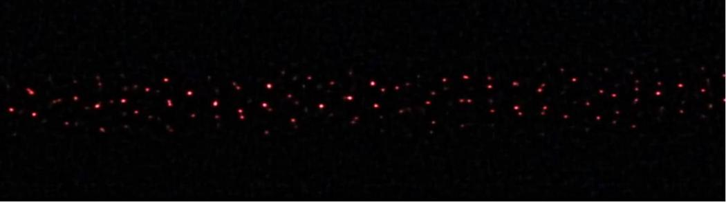

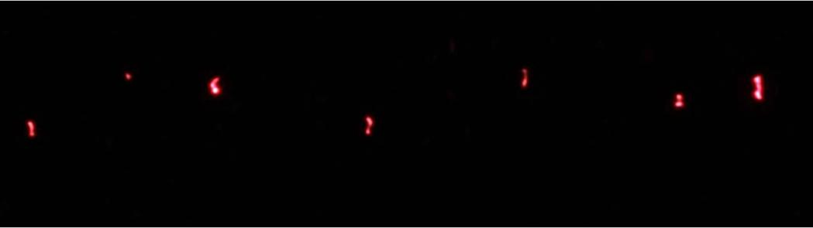
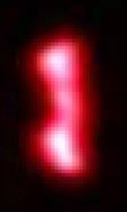
Direct imaging
Rf power: 1 W
H₂O: 5 mTorr
X2 magnification lens
r_{m}: 3 μm, ε: 1
600 mTorr
r_{m}: 25 μm, ε: 2.5
100 mTorr
70 μm
Direct imaging agrees with laser diffraction:
  More elongated and large grains at low pressure
  Grain number density is low at low pressure (10⁵ cm⁻³ → 10⁴ cm⁻³)

Slide 104
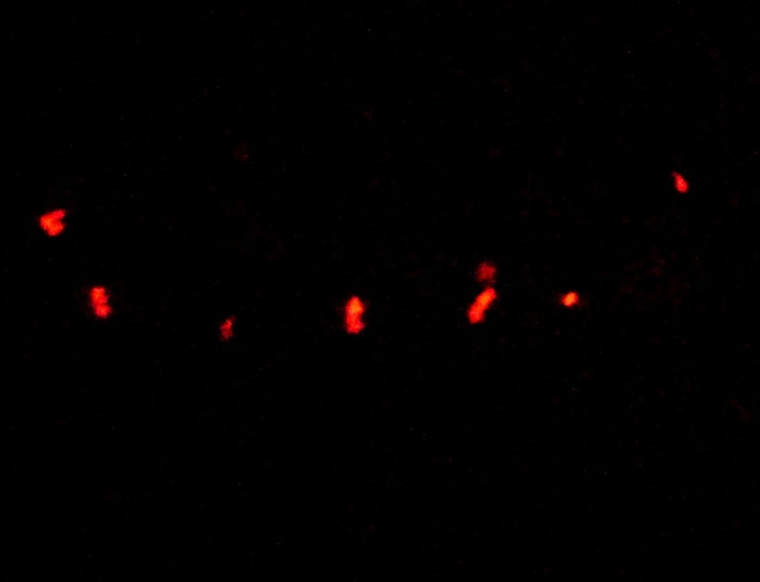




Direct imaging
Rf power: 1.5 W
H₂O: 5 mTorr
X4 magnification lens
r_{m}=35 um, ε=2.5
r_{m}=140 um, ε=4.8
composite
100 mTorr
60 mTorr
Ignite plasma at 100 mTorr then reduce background pressure
  More elongated and large grains shown

Slide 105
For publications, Google: Bellan + plasma

