Slide 1
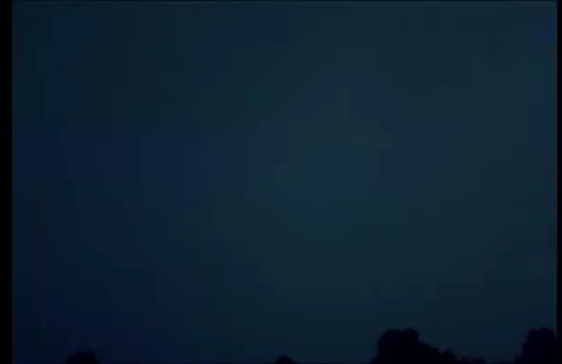

Slide 2

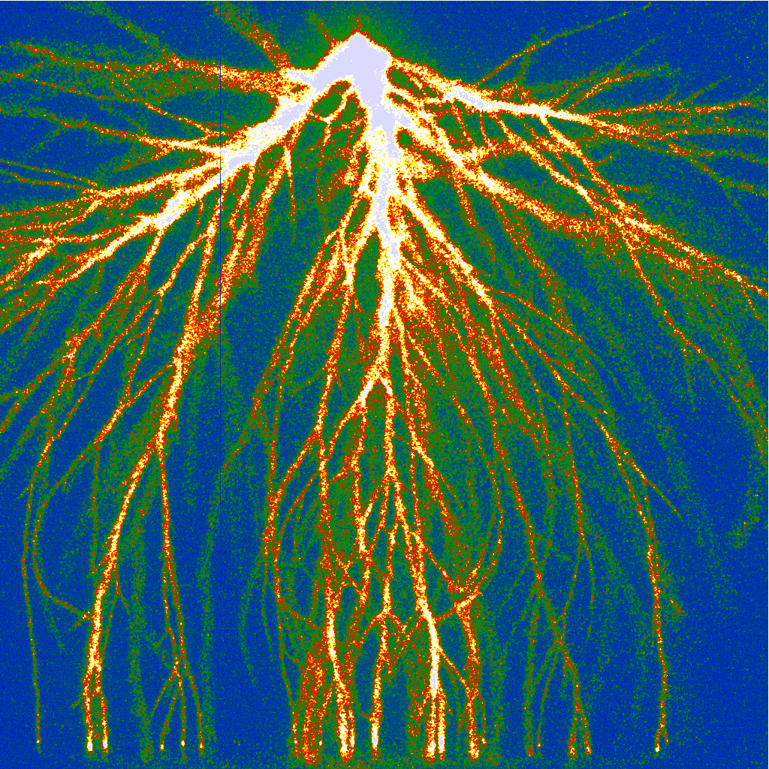
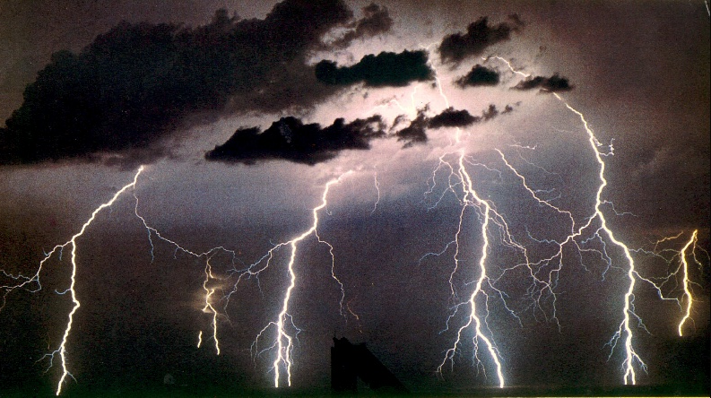
Electric breakdown in thunderstorms and plasma technology – chances and puzzles
Ute Ebert,
Centrum Wiskunde & Informatica in Amsterdam and Technische Universiteit Eindhoven
TexPoint fonts used in EMF.
Read the TexPoint manual before you delete this box.: AAAAA

Slide 3
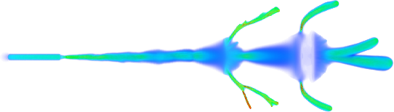
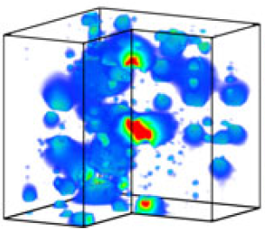
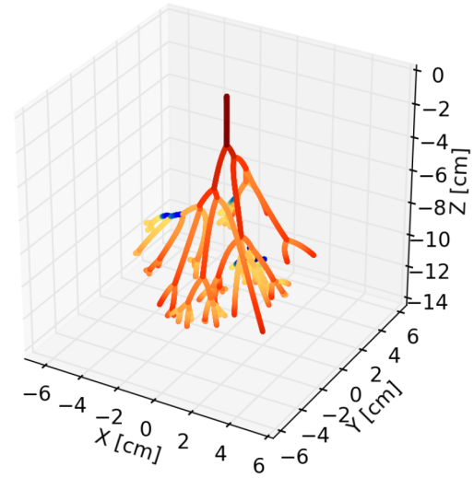
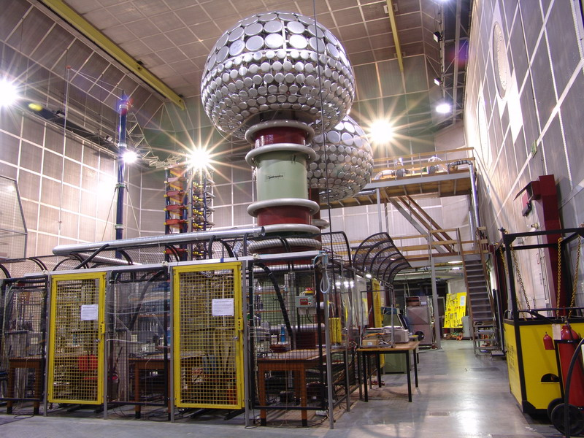
Multiscale computing: Ebert, Teunissen et al
Centrum Wiskunde & Informatica in Amsterdam and Technische Universiteit Eindhoven
Plasma physics: Nijdam, Kroesen et al
Electrical engineering: Huiskamp, Pemen et al
TexPoint fonts used in EMF.
Read the TexPoint manual before you delete this box.: AAAAA

Slide 4
I. Some thunderstorm physics
II. Initial stages of a pulsed air discharge

Slide 5

With the distributed radiotelescope LOFAR:
- Measure E-field in thundercloud
- Measure lightning evolution

Slide 6
I. Some thunderstorm physics
II. Initial stages of a pulsed air discharge

Slide 7
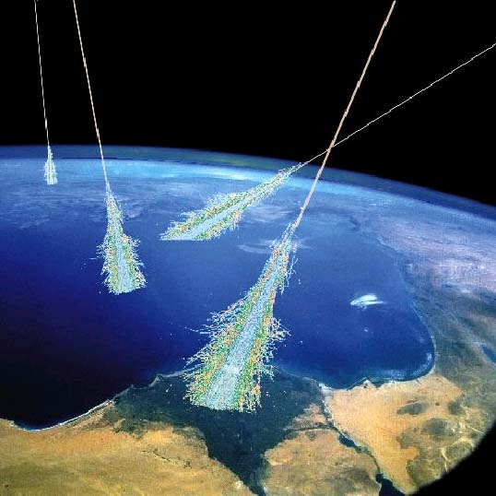
Extensive air showers

Slide 8
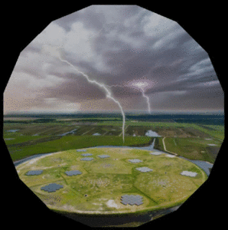
Measure E-field in thundercloud with LOFAR:
Air shower = probe
Radio telescope = detector
Nonintrusive technique!
[Schellart et al., PRL 2015, and later work by Trinh et al.]

Slide 9
Extensive air showers
can create high free electron densities
and start lightning

Slide 10
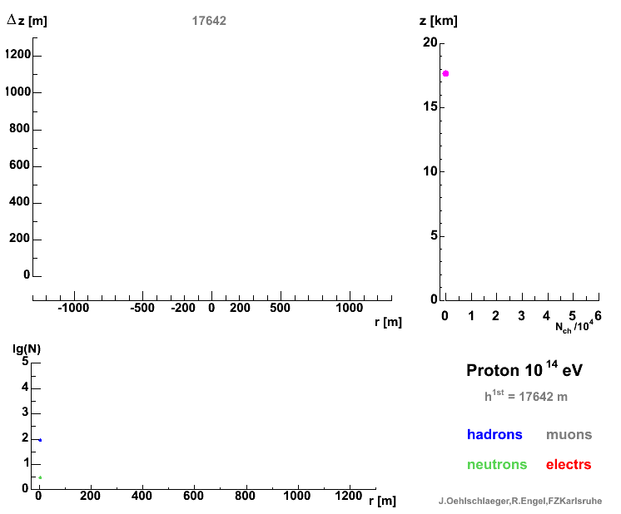
Air shower from vertical 10¹⁴ eV proton
Side view in comoving frame on particles above 100 MeV:
Hadrons muons
Neutrons elec-/positrons
[J. Oehlschlaeger, R. Engel, FZ Karlsruhe]

Slide 11
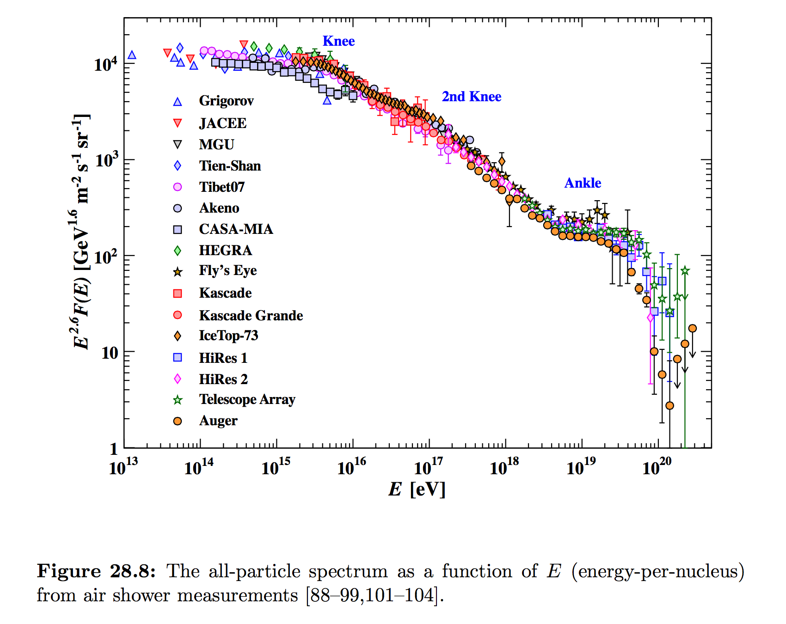
Spectrum of cosmic rays:
F(E) E^{2.6}
Window to cosmology
Relevant for thunder-storms
40/(km²s)
Protons in LHC at CERN
(14 TeV)
Solar energetic particles
(< 10 GeV)

Slide 12
Prediction, e.g.:
At 6 km altitude
once per 30 km²s:
10 e⁻/cm³ at R = 7 m,
1 e⁻/cm³ at R = 22 m
e⁻ free for < 1 us
Could explain NBEs.
[Rutjes, Ebert et al.,
subm. to JGR]
Spectrum of cosmic rays:
F(E) E^{2.6}
Window to cosmology
Relevant for thunder-storms
40/(km²s)
Protons in LHC at CERN
(14 TeV)

Slide 13
ASIM on International Space Station since April 2018
Science And INnovation with Thunderstorms (SAINT))
EU Marie-Curie-Network with 15 PhD students

Slide 14
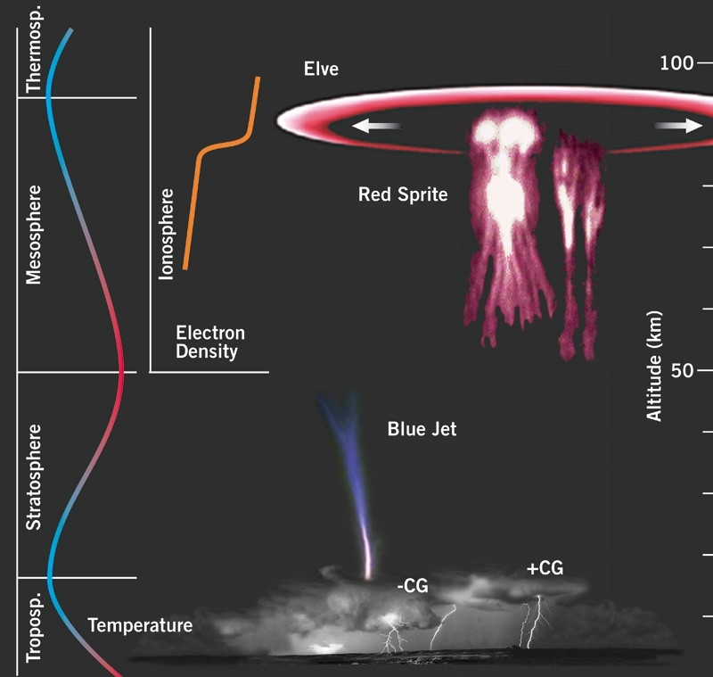
Transient luminous events: Elves, sprites, jets*
correlated with lightning strokes
Predicted in 1925,
observed since 1989.
*) Shakespeare,
Mid Summer Nights Dream

Slide 15
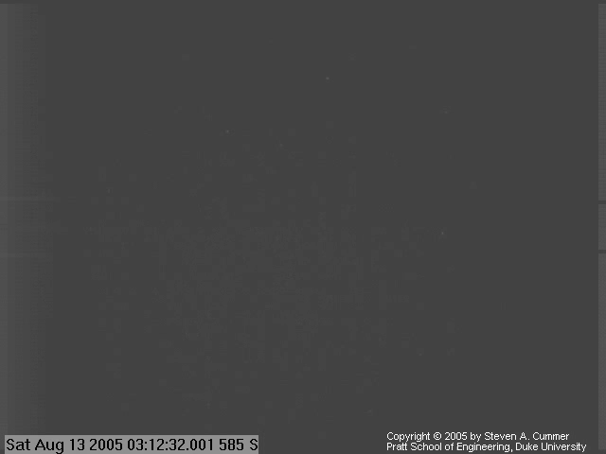
Animation – Click here

Slide 16
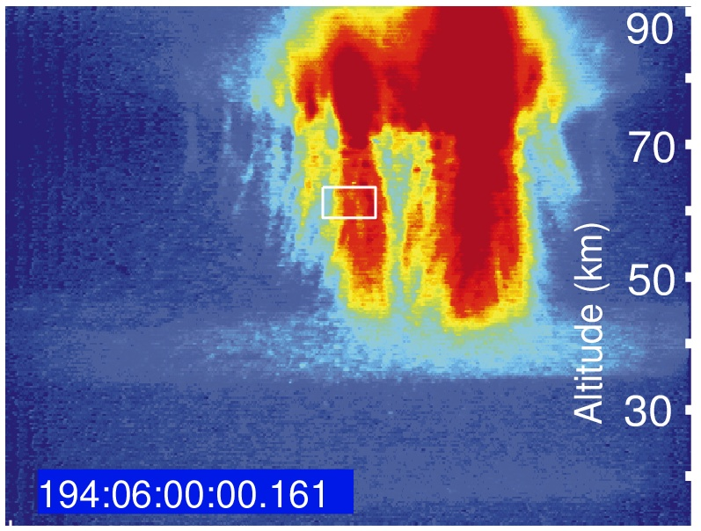
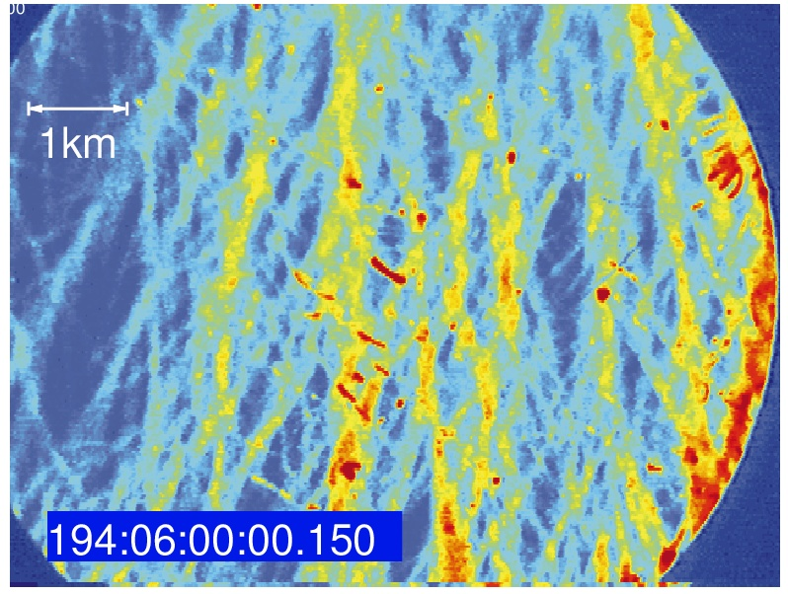
4 cm
Telescopic images of sprite discharges
[Gerken et al., Geophys. Res. Lett. 2000]
4 cm
1 bar
Approximate scaling
with air density N:
same E/N, d*N, …
Review: Ebert et al., J Geophys Res 2010

Slide 17
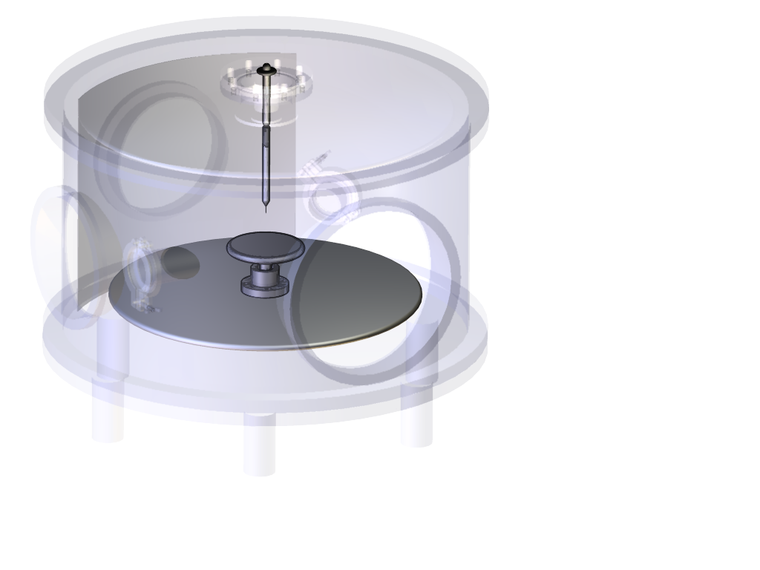
+28 kV
4 cm
Air 1 bar 300 K
exposure
300 ns

Slide 18
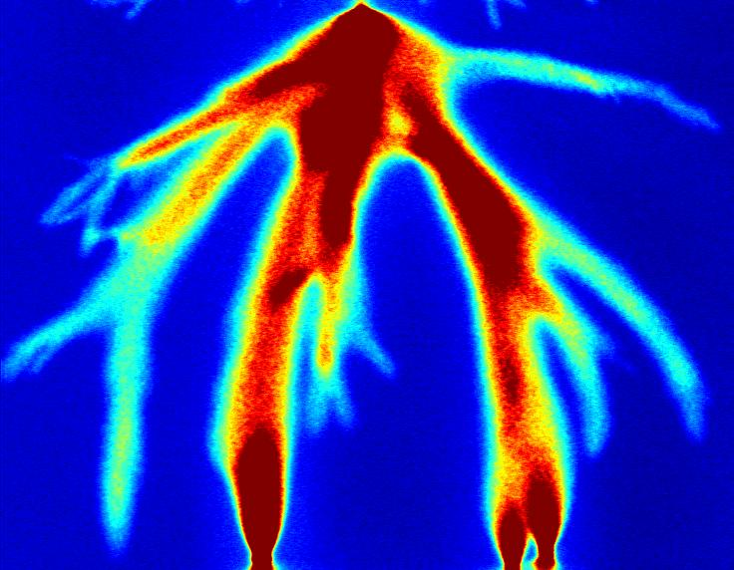
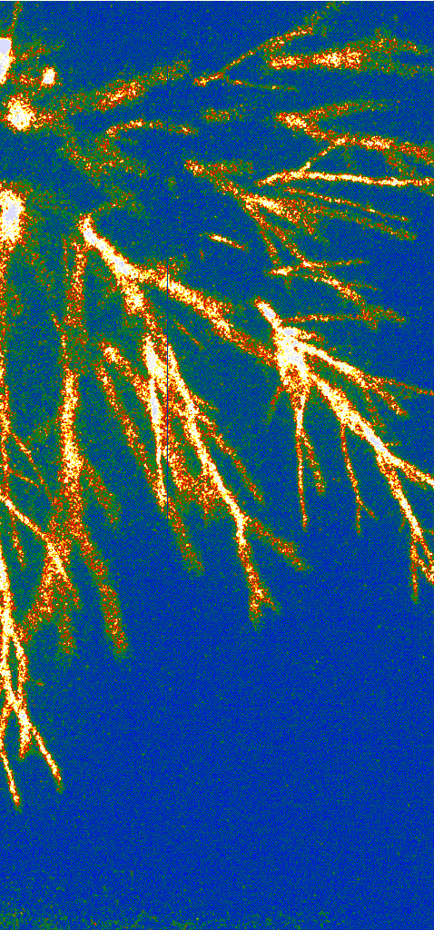
Positive streamers in 4 cm air
54 kV 28 kV
[Briels et al., J Phys D 2008]

Slide 19
+1 MV on 1 m air
~200 keV X-rays!
[Kochkin et al, JPD 2012]

Slide 20
Negative and positive streamer discharges:
Positive streamers need free electrons, electron detachment or photoionization.

Slide 21
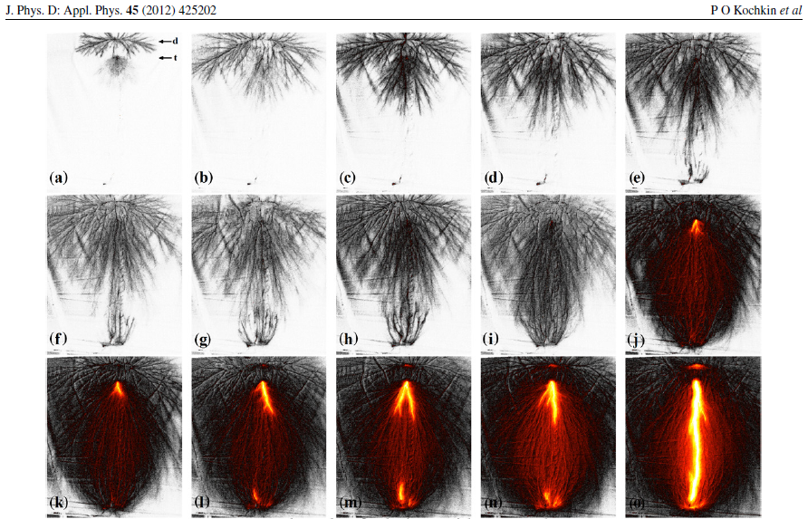
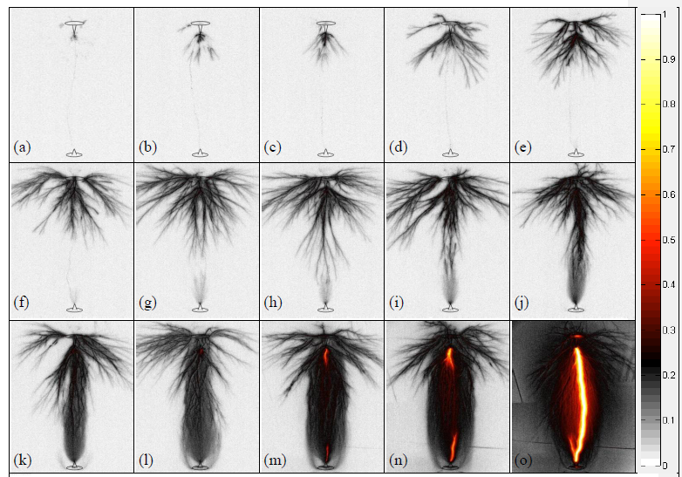
+1 MV on 1 m air
[Kochkin et al, J Phys D 2012]
-1 MV on 1 m air
[Kochkin et al, J Phys D 2014]

Slide 22
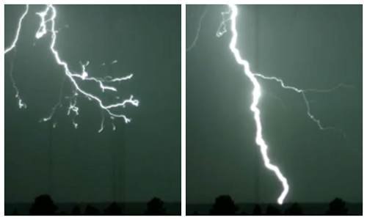
Lightning leader Return stroke

Slide 23
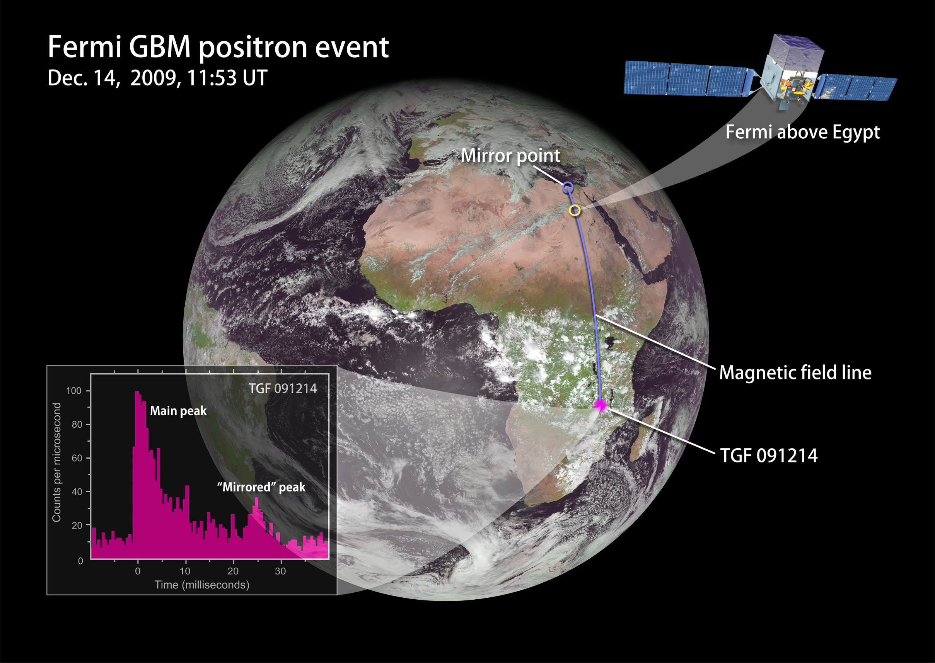
[Briggs et al., JGR 2011; NASA]

Slide 24
I. Some thunderstorm physics – conclusions
10¹⁵ - 10¹⁷ eV air showers relevant for lightning inception.
Lightning itself can produce 10⁸ eV radiation.
Lightning leaders with streamer corona only partially understood.

Slide 25
The multiple scales of discharge modeling

Slide 26
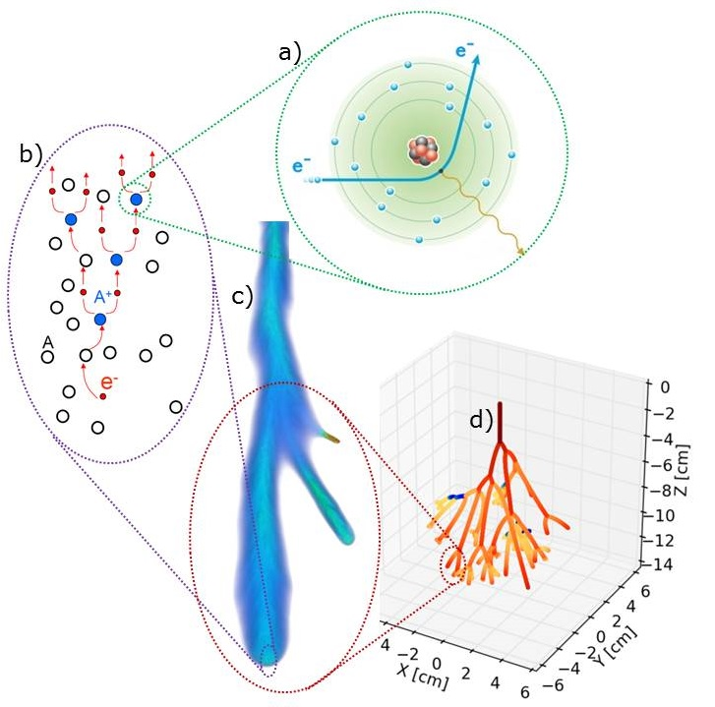
Spatial scales in initial breakdown

Slide 27
3D time dependent problem
Spatial scales: nm to m (to km)
Temporal scales: ps to min or more:
Inception
Space charge
Heating and sec. chemistry
Plasma decay
Energy scales:
0.03 eV to 200 keV (or 100 MeV)

Slide 28
Energy conversion in plasma technology
Pulsed electric power, down to nanosecond pulses
Energetic nonequilibrium electrons
collide with gas molecules (at STP)
Nonequilibrium chemistry
Corona wind
Electric breakdown
Plasma agriculture
Plasma medicine
Plasma ass. Combustion
Air cleaning
Laptop cooling?
Plasma actuators for aviation and windturbines
High voltage switching
Lightning protection
Electron runaway
?

Slide 29
I. Some thunderstorm physics
II. Initial stages of a pulsed air discharge

Slide 30
How does lightning start, if the electric field is far below breakdown?
Need electric field
+ ice particles + extensive air shower

Slide 31
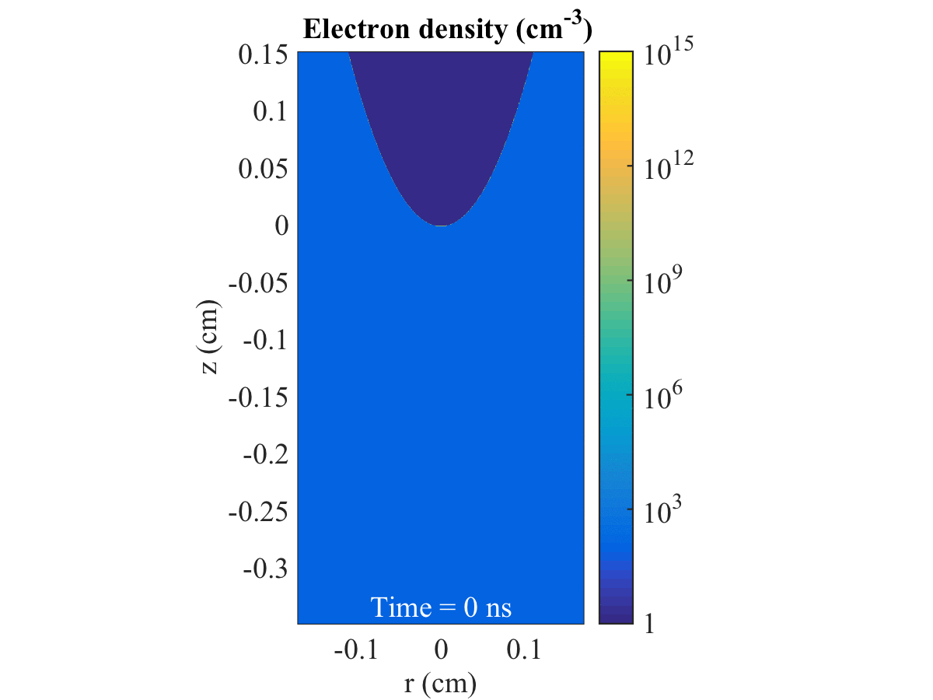
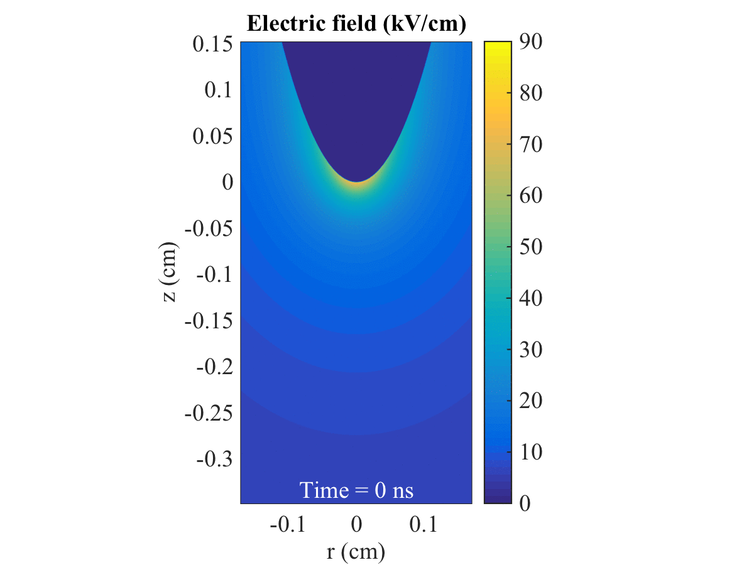
Lightning (streamer) inception below an ellipsoid ice particle
E = 0.15 E_{k} Extensive Air Shower -> 100 electrons/cm³
= 0.1 electrons/mm³?
Geoscientists:
Meek criterion?
[Dubinova, Rutjes, Ebert et al, PRL 2015]

Slide 32
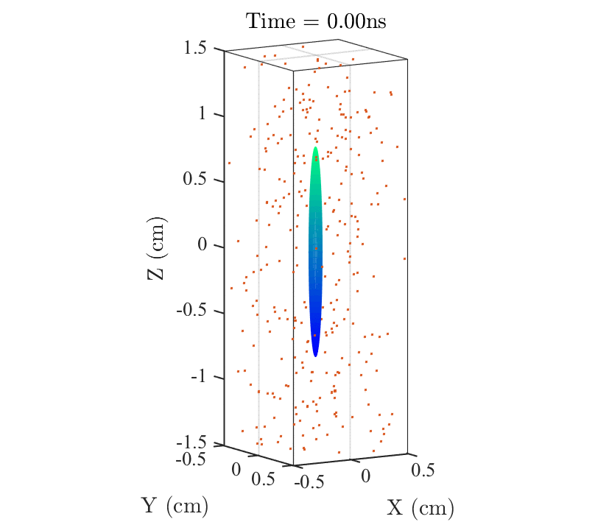
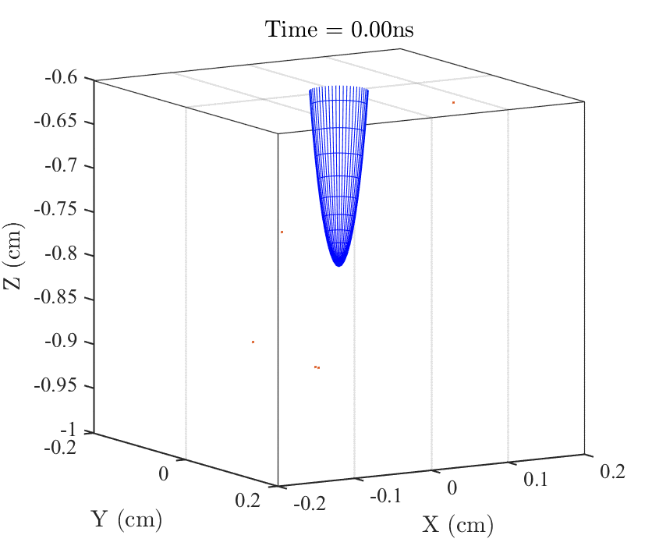
Ellipsoid ice needle (16 x 1 mm)
Background field = 0.16 E_{k}
100 free electrons / cm³
[Rutjes, PhD thesis, Eindhoven, March 2018]

Slide 33
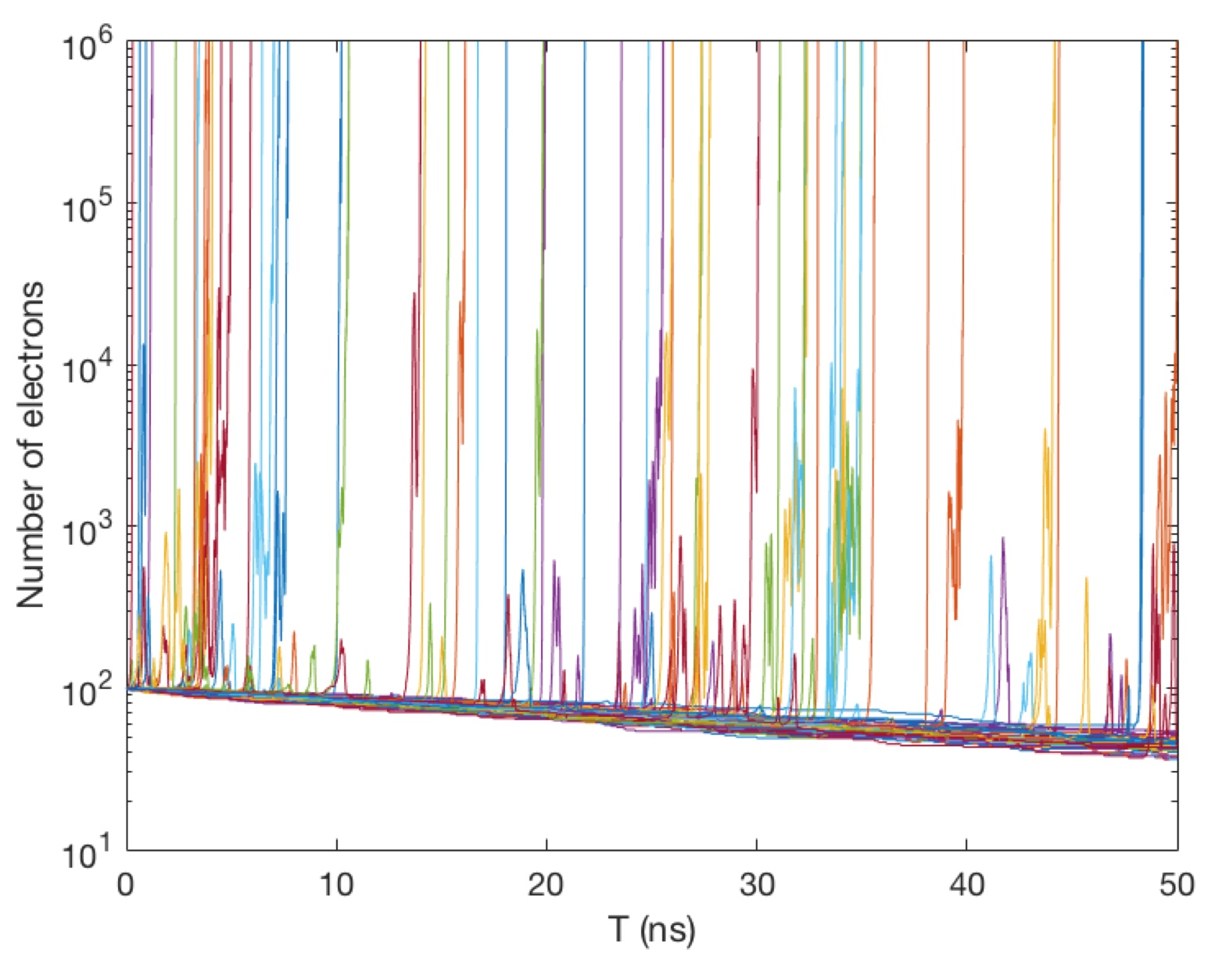


100 runs: jitter!
For 58 out of 100 runs, the discharge starts within 50 ns.
on symmetry axis
maximal electron number
per avalanche:
[Rutjes, PhD thesis, Eindhoven, March 2018]

Slide 34
Inception cloud and streamer emission

Slide 35
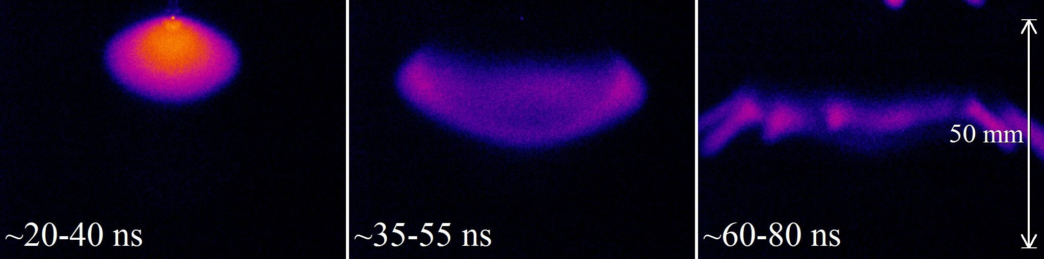
Air, 200 mbar, +35 kV
Fast growing cloud stagnation destabilization into streamers
S. Nijdam, published in [Ebert et al., Nonlinearity 2011]
[S. Chen et al., J Phys D 2015]

Slide 36
How does the discharge propagate into an electric field far below breakdown?
Discharge enhances electric field at the channel tip!

Slide 37
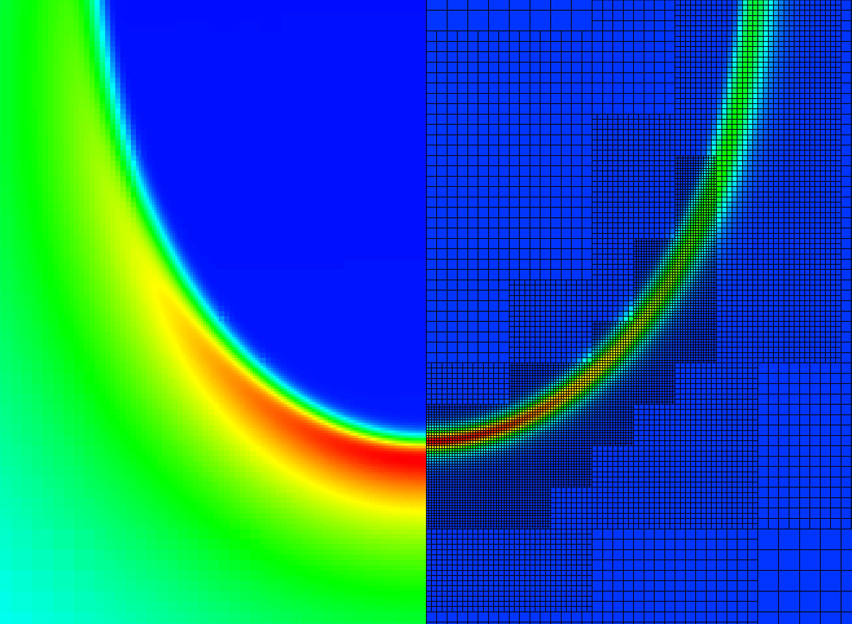
field
charge
Afivo-streamer
(code open on github)
[Teunissen, Ebert,
J Phys D (2017),
Comp Phys Comm (2018)]
Adaptive Mesh

Slide 38
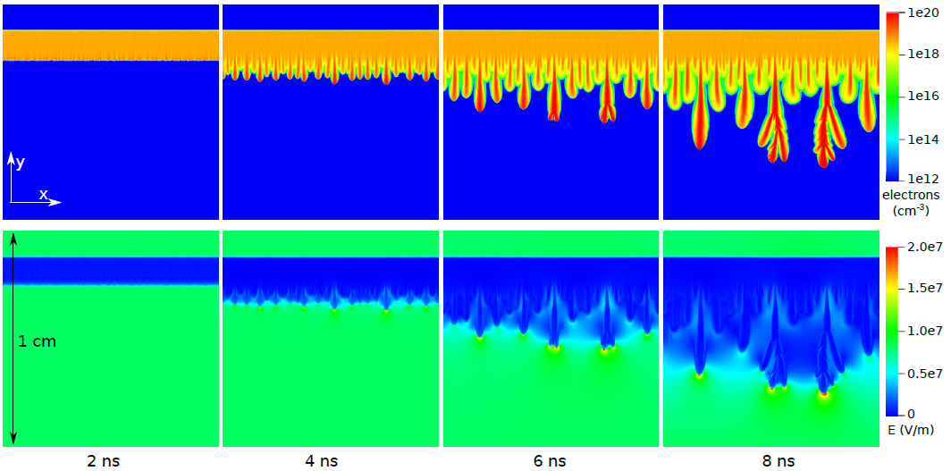
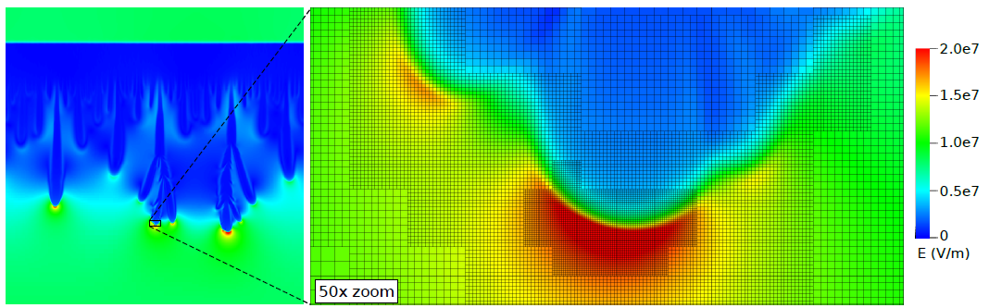
Afivo in 2D [Teunissen, CPC 2018]

Slide 39
Animation – Click here
[Teunissen, JPD 2017]

Slide 40
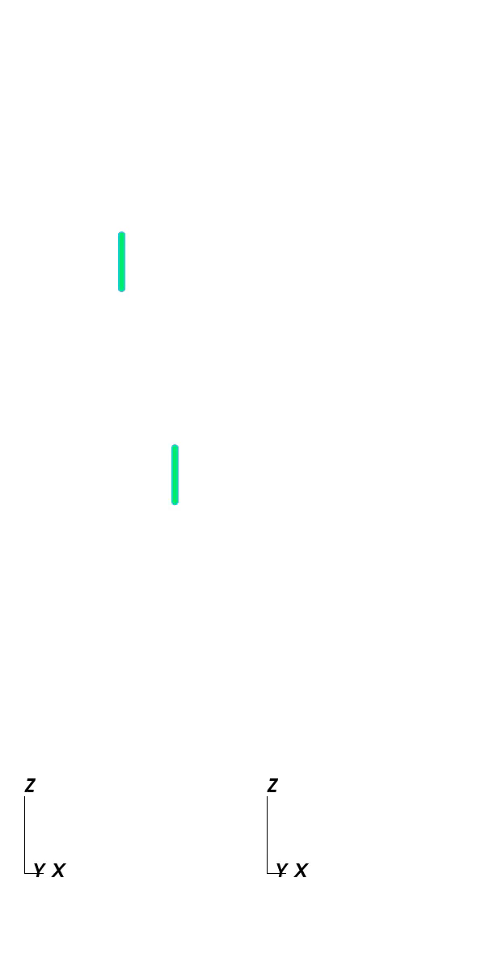
Animation – Click here
[Teunissen, JPD 2017]

Slide 41
Continuous photons
Discrete photons
2D
Cylindrical
3D
2D
Cylindrical
3D
[Bagheri, Teunissen, revised for PSST]

Slide 42
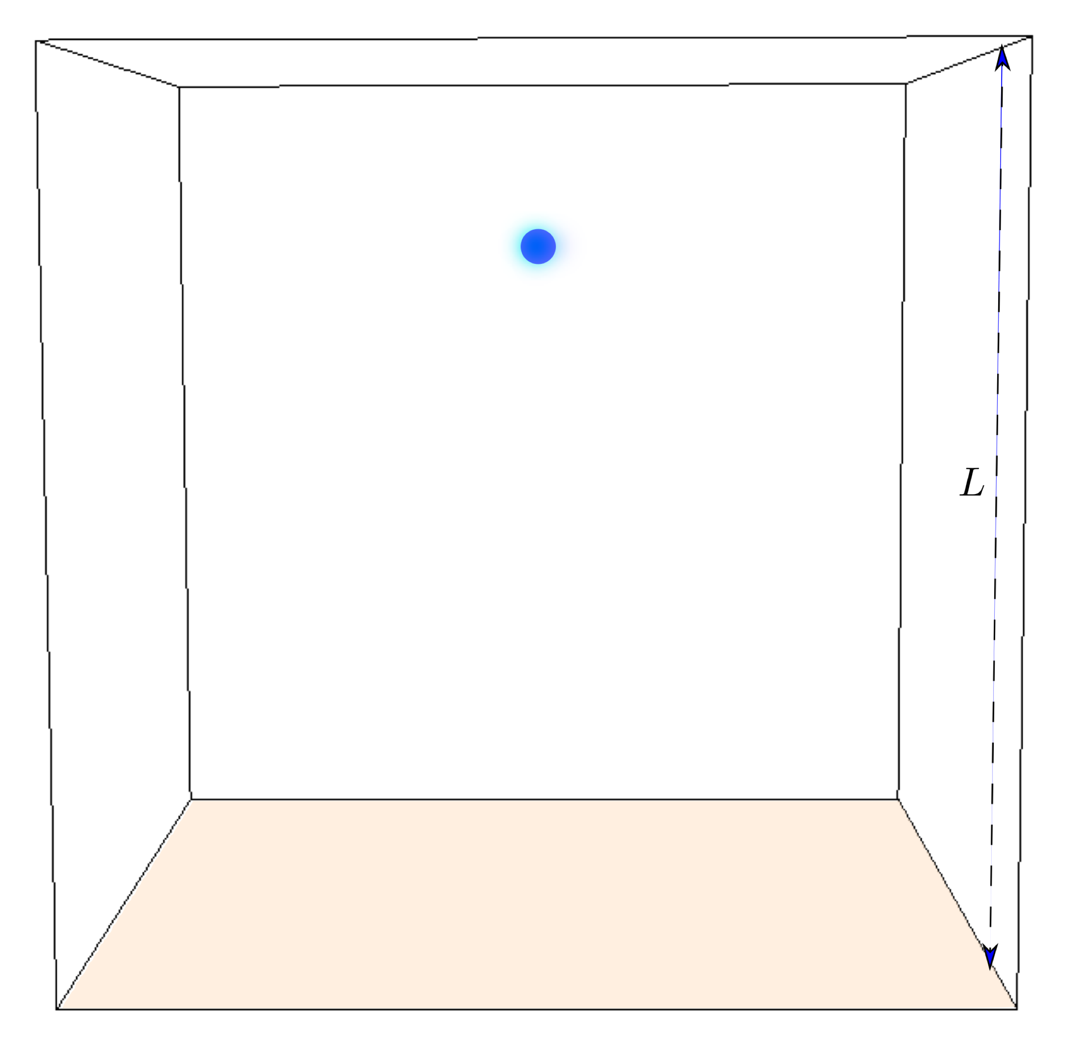
Setup to study streamer branching
Dry air at STP
Background field 15 kV/cm = E_{k}/2
No background ionization
Discrete physical photons
[Bagheri, Teunissen, Ebert, in prep.]
Seed:
Net charge + electrons
1.25 cm

Slide 43



1.25 cm
Animation – Click here
1

Slide 44



1.25 cm
Animation – Click here
2

Slide 45



1.25 cm
Animation – Click here
3

Slide 46
First steps to quantify branching
50 “experiments”
Position of first branching
31
Branching
19
Not branching
Seed position
[Bagheri, Teunissen, Ebert, in prep.]

Slide 47
Morphology
400 mbar air, +16 kV on 4 cm
[Briels et al, JPD 2008]
Symmetric branching
Asymmetric branching

Slide 48

Simplest streamer tree model with consistent charge transport
Implement more physics: streamer diameters, velocities, branching, conductivity, …
[Luque, Ebert, New J Phys, 2014]

Slide 49
Conclusions on positive discharges in air:
Discharge inception to streamer propagation: models gets quantitative.
Inception near small objects is stochastic. Correction to Meek-criterion.
2D and 3D streamer simulations consistent.
Branching is simulated in 3D with stochastic physical photons.
Outlook: More microphysics into macroscopic models:

