Slide 1
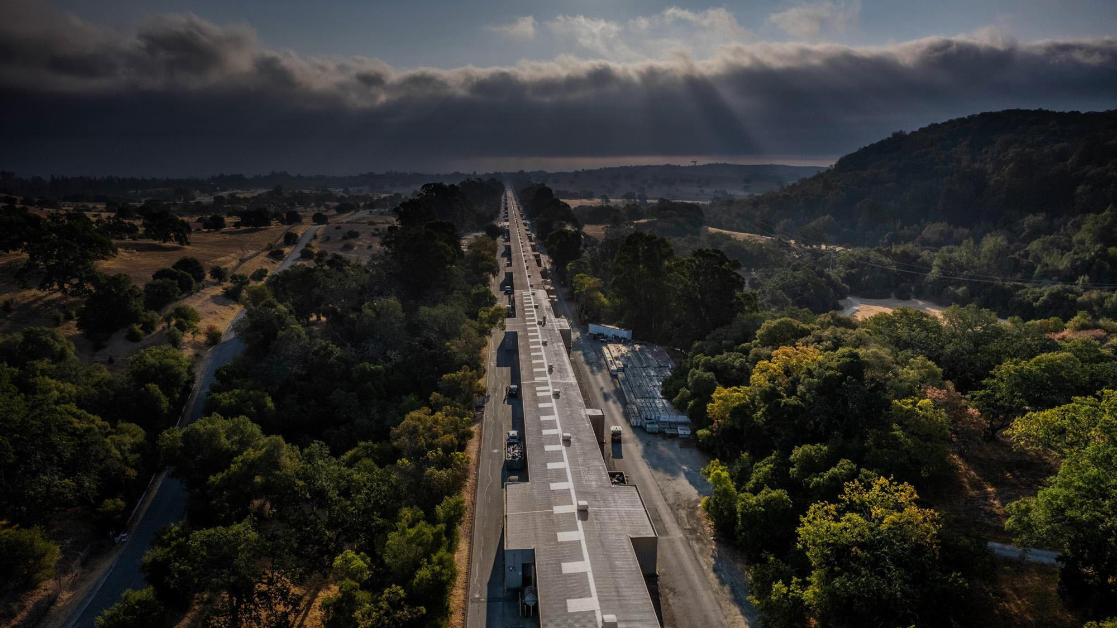


New Lens on the Frontier of Matter in Extreme Conditions
Arianna E. Gleason Staff Scientist / Fundamental Physics Directorate, SLAC
Adjunct Faculty / Earth & Planetary Sciences Dept., Stanford University
19 April 2023
Michigan Institute for Plasma Science and Engineering (MIPSE) Seminar
Winter 2023

Slide 2
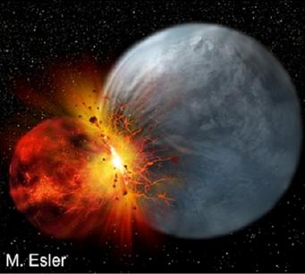
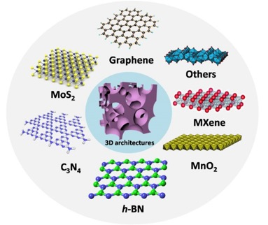
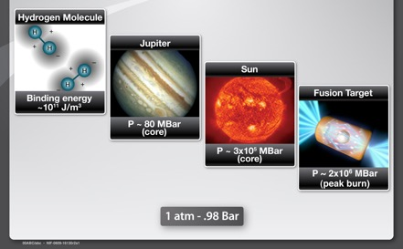
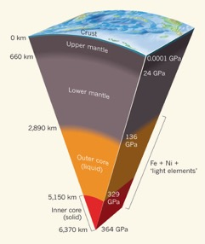
An Exciting Time in HED Science!!
Planet formation
Novel materials and far-from-equilibrium phenomena
Shen et al., 2016
High-energy density (plasma)
Planetary Interiors
Courtesy, Glenzer
Duffy, 2011
Notes:
May 2019 by MPI: Somewhat more than 4000 planets orbiting stars outside
The 18 newly discovered worlds fall into the category of Earth-sized planets.
The community must continue to tackle grand challenge experiments to master the generation, study and control of self-organized HED states at far-from-equilibrium through the action of intense fields.

Slide 3
Rapid development in Dynamic Compression Science & High Energy Density Physics at Light Sources
Extreme States of Matter:
Shock driven (high pressure – multi GPa)
High temperature (1000s of K)
Radiation environments (X-rays, ions, etc)
Gas gun, explosive, laser, magnetic, etc.
Non-repeatable/non-reversible processes
Relativistic plasma physics
Dynamic materials research
High-pressure astrophysics and planetary physics
Magnetic phenomena in condensed matter
Slide modified from Bob Cauble LLNL/HiBEF

Slide 4
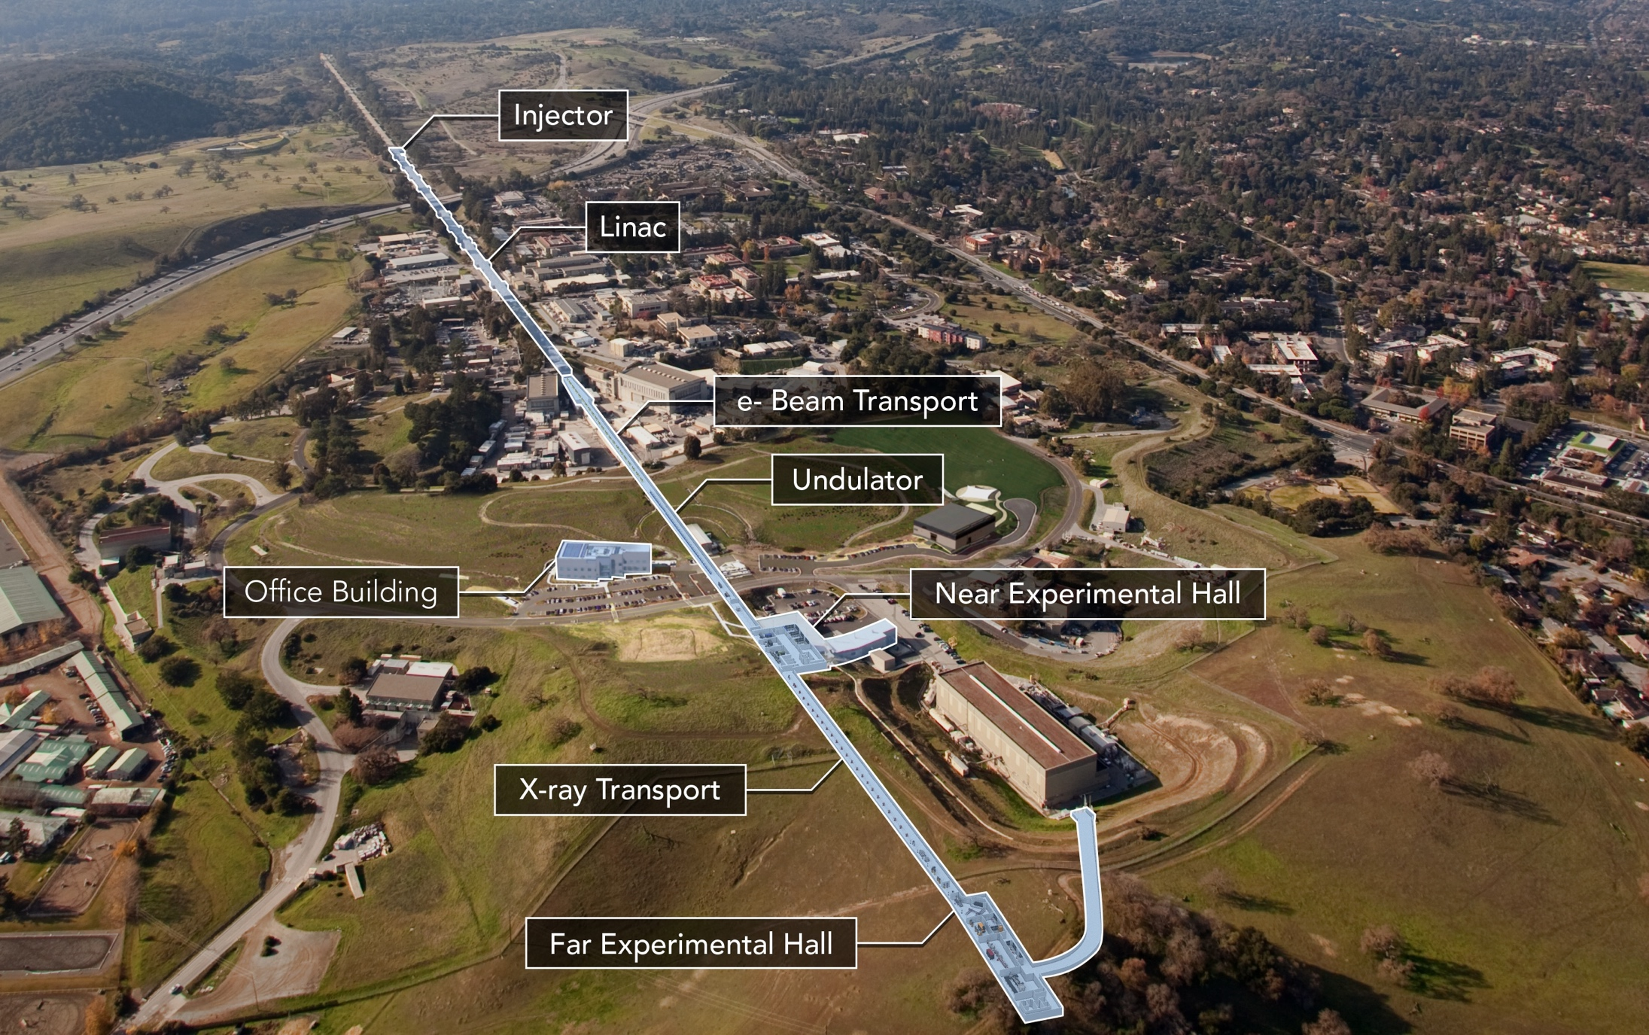

LCLS is essentially a 2-mile long atomic-scale camera with a femtosecond “shutter speed”
Photon energy = 0.25 - 25 keV
X-ray pulse length = 0.2 - 200 fsec
Bandwidth = 0.1 - 2 %
Repetition rate. = 120 Hz (1 MHz)
Machine length. ≈ 2 km

Slide 5
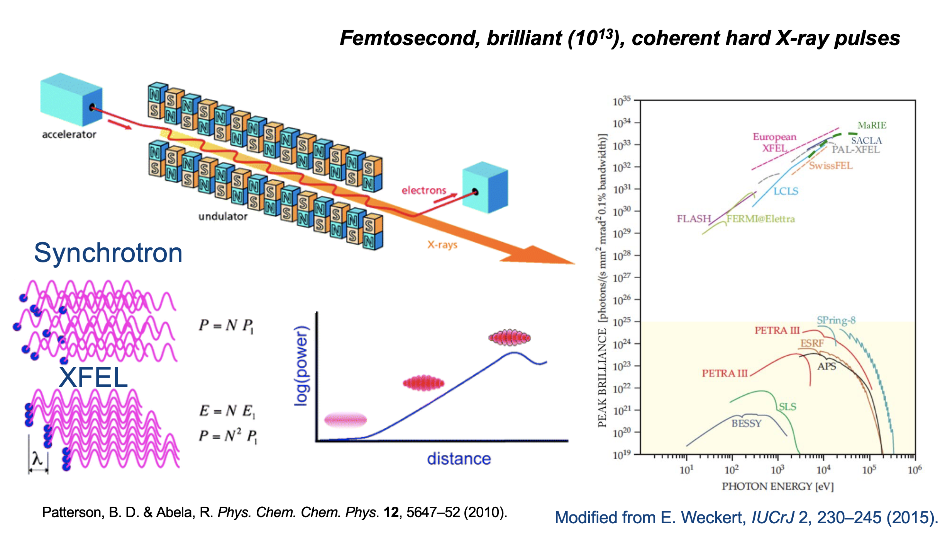
A Revolution in Light Sources Enabling a Revolution in Condensed Matter and Plasma Physics
Notes:
Don’t explain how it works but characteristics -- femtosecond analogy light to travel across a human hair, clock of x-ray laser,
Shock is fraction of nanosec

Slide 6
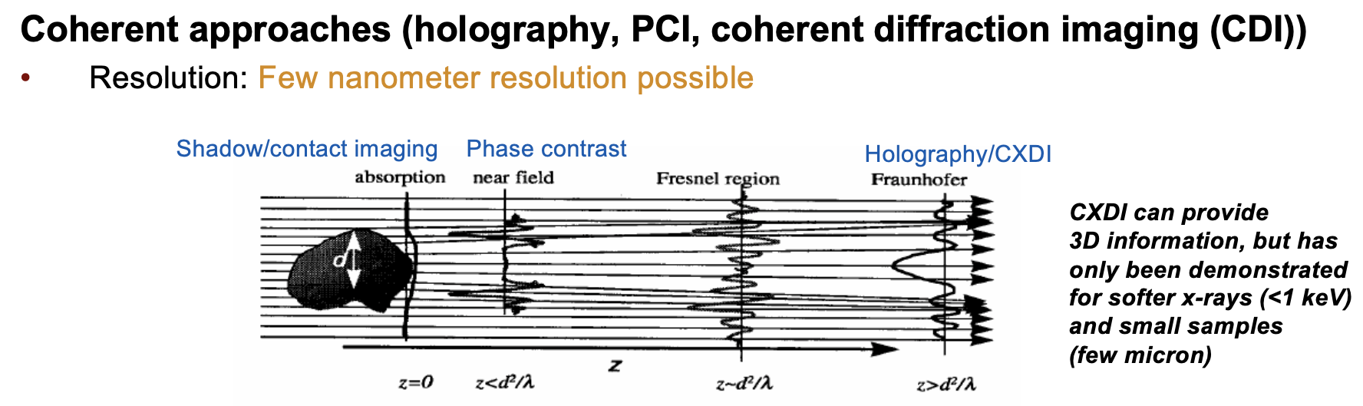
A Revolution in Light Sources Enabling a Revolution in Condensed Matter and Plasma Physics
Notes:
Don’t explain how it works but characteristics -- femtosecond analogy light to travel across a human hair, clock of x-ray laser,
Shock is fraction of nanosec

Slide 7
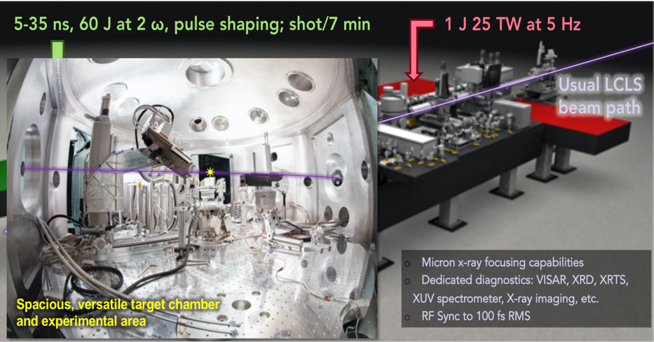
Matter in Extreme Condition (MEC) instrument optics and diagnostics
Courtesy G. Dyer

Slide 8









Laser driven shock compression + X-ray techniques take us to the frontier of HED Science
DIAGNOSTICS
DRIVE
X-ray Techniques
-Diffraction: Records lattice-level structural information from sample
-Emission Spectroscopy: Measure spin transition
-Imaging: reconstruct 2D density distribution via PCI
Streaked Optical Pyrometer
Records thermal emission from sample for calculation of absolute temperature
TARGET
Focused Laser
Profile
Reflectivity Monitor
Observes changes in sample optical properties
~10¹³ W/cm²
532nm Probe Beam
Delay Element
Interferometer
VISAR (Velocity Interferometry System for Any Reflector)
Measures Doppler shift from moving surfaces to
determine shock and particle velocities
Slide 8

Slide 9
Laser driven shock compression + X-ray techniques take us to the frontier of HED Science
DIAGNOSTICS
DRIVE
X-ray Techniques
-Diffraction: Records lattice-level structural information from sample
-Emission Spectroscopy: Measure spin transition
-Imaging: reconstruct 2D density distribution via PCI
Streaked Optical Pyrometer
Records thermal emission from sample for calculation of absolute temperature
Case Study 1: Rheology of the Earth’s inner core
TARGET
Focused Laser
Profile
Reflectivity Monitor
Observes changes in sample optical properties
~10¹³ W/cm²
Case Study 2: Void collapse in ICF ablator materials
Case Study 3: Shocking origin – the role of plasmas in the chemistry of life
532nm Probe Beam
Delay Element
Interferometer
VISAR (Velocity Interferometry System for Any Reflector)
Measures Doppler shift from moving surfaces to
determine shock and particle velocities
Slide 9

Slide 10
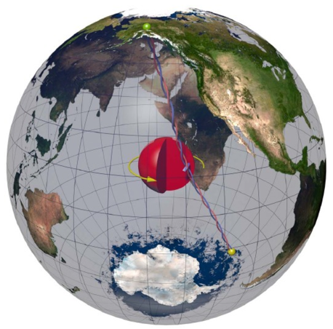
Case Study 1: : Rheology of the Earth’s inner core
Tkalcic, 2015

Slide 11
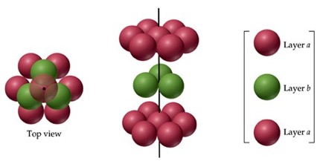
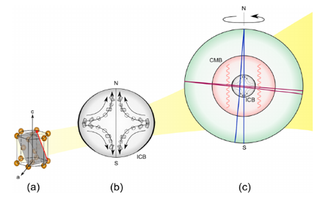
Earth’s inner core: need a multiscale model of hcp alloy plasticity
www4.nau.edu/meteorite/Meteorite/Book-GlossaryH.html
What mechanisms induce anisotropy in the inner core?
W. Mao et al., JGR 2008
Multiscale model of inner core formation and dynamics
Constraints from observations seismic anisotropy
  Fe plasticity and elasticity at inner core conditions
  → Formation model
Lincot et al., 2015

Slide 12
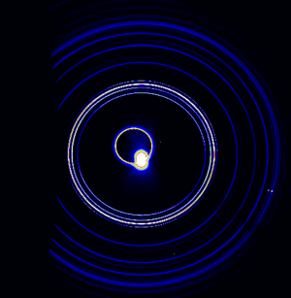
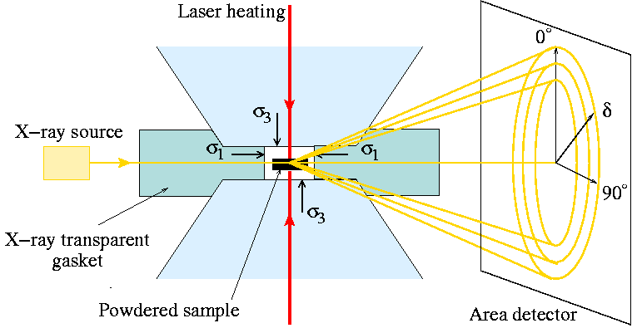
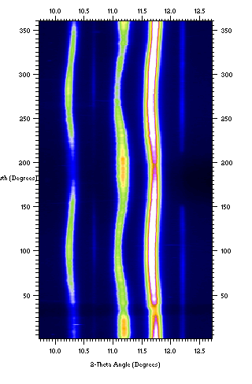
Radial x-ray diffraction as a tool to access strain and strength
Fe at 113 GPa
100
002
101
Magnitude of waviness
-- deviatoric strain & shear strength
Magnitude dependence on hkl
-- elasticity tensor
Intensity vs. azimuthal angle -- lattice preferred orientation
d-spacing

Slide 13
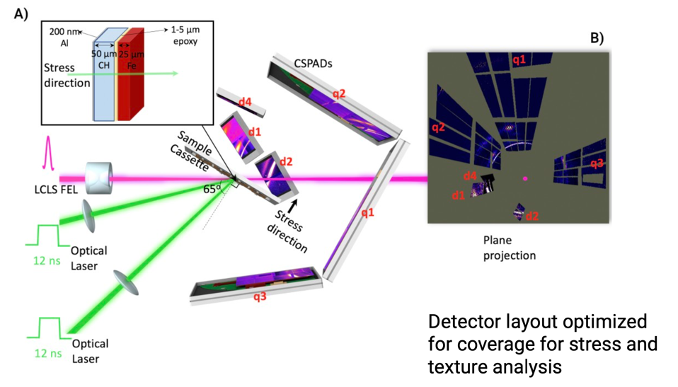
Radial x-ray diffraction adapted to dynamic compression for plasticity and strength measurements
Notes:
First measurement off axis and to optimize azimuthal coverage

Slide 14
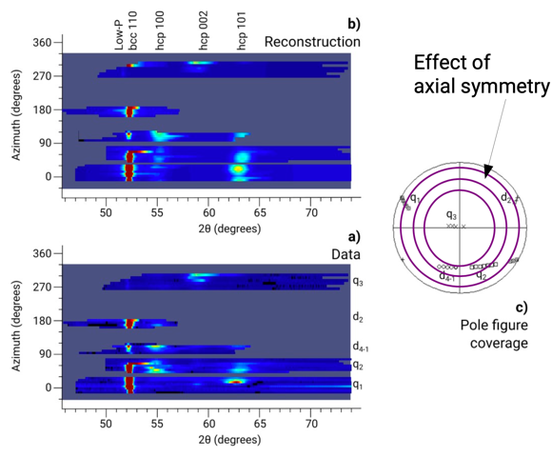
Radial x-ray diffraction adapted to dynamic compression for plasticity and strength measurements
Material analysis using diffraction (MAUD) Software to fit:
-unit cell parameters
-lattice strains
-lattice preferred orientations
Notes:
Match observable with model

Slide 15
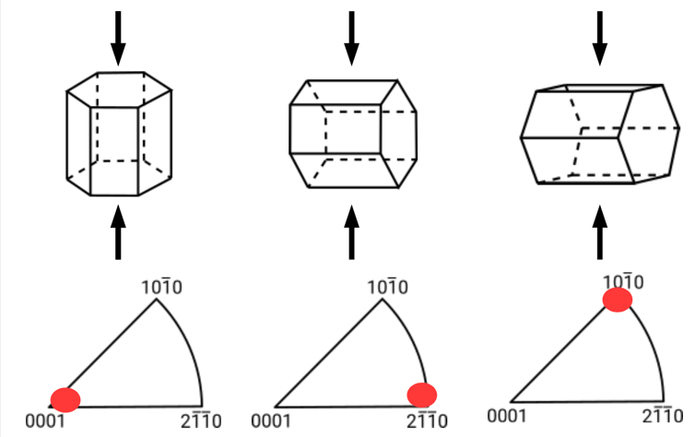
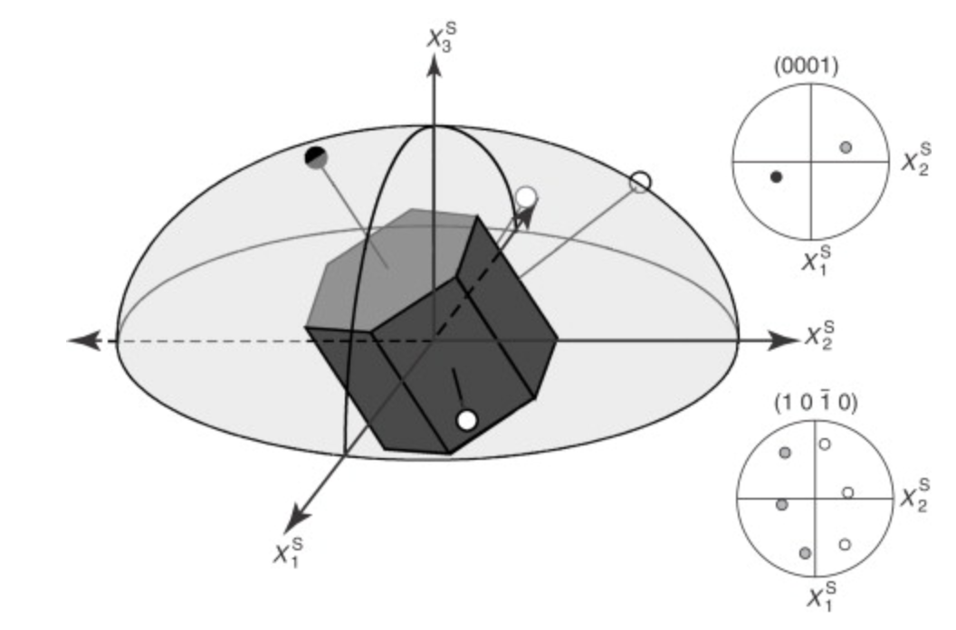
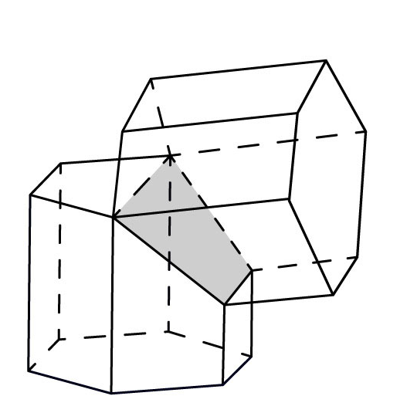
Crystalline twinning is a mechanism to relieve stress
Hcp-twinning texture
Hcp-transformation texture
Pole Figure
2D graphical representation of orientation
Sample direction relative to reference crystal system
Notes:
-Pole figures can be used to provide a graphical representation of orientation. A pole figure is a two-dimensional graphical representation of orientation, showing the orientation of a selected plane normal (a pole) with respect to the sample reference frame.
-pole figure shows the (0 0 0 1) and (101¯0) poles for a hexagonal crystal, note that there is only one pole for the (0 0 0 1) plane and three for the (101¯0) plane.
-An inverse pole figure shows the location of a sample direction relative to the crystal reference system. For pole figures the plane of interest is selected, whereas in inverse pole figures the sample direction of interest is selected -- which plane normal in the crystal is parallel to the selected sample direction.
Diffraction pattern fit to model fit to pole – pole figure description and texture oriented to center – or some axis

Slide 16
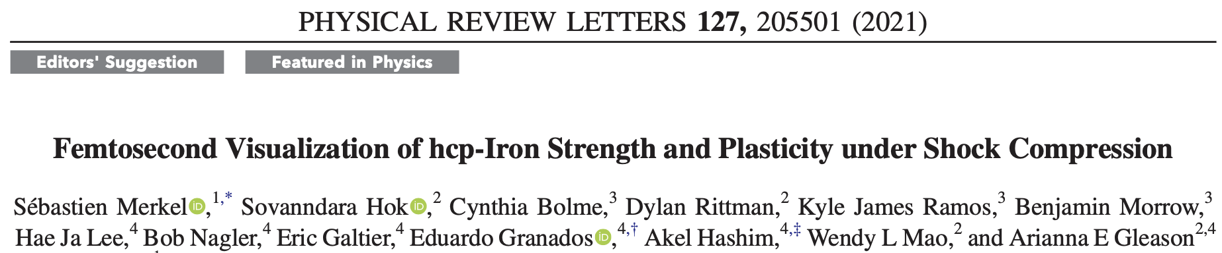
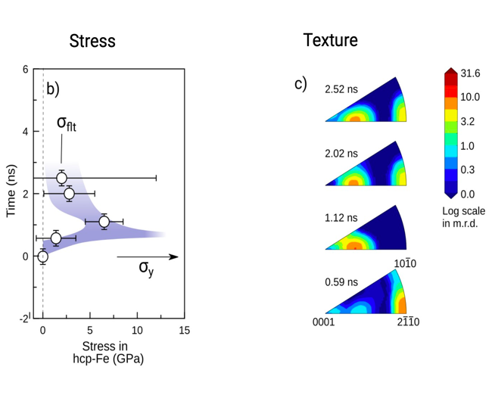
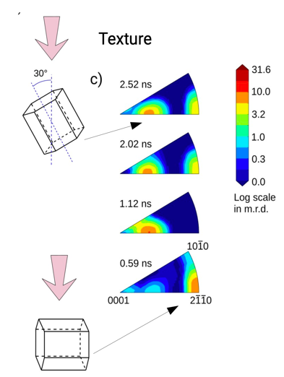
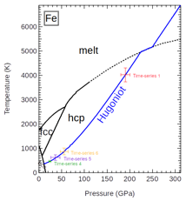
Texture shows twinning in ~500 picoseconds!
Merkel et al., PRL 2021

Slide 17
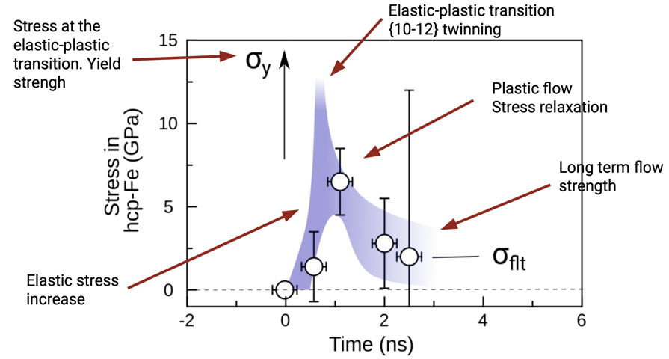
Plasticity in response to stress over time shows rapid high strength then relaxation
Merkel et al., PRL 2021

Slide 18
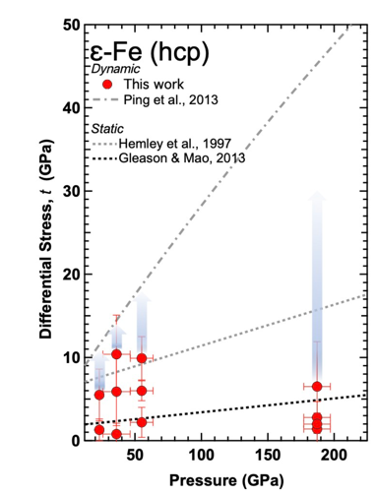
Strength of Fe at high pressure is strain-rate and time-dependent
Stress at the elastic-to-plastic transition may be several times larger than the longer-term flow strength
insufficient quantity of defects to accommodate plastic strain in the initial compression and a phonon-drag controlled defect kinetics.
Merkel et al., PRL 2021
Notes:
First measurement of strength / rXRD / transitions and mechansims and reconcile the ….

Slide 19
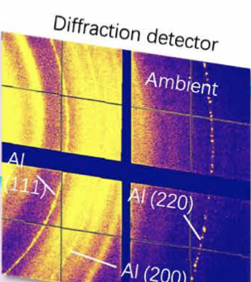
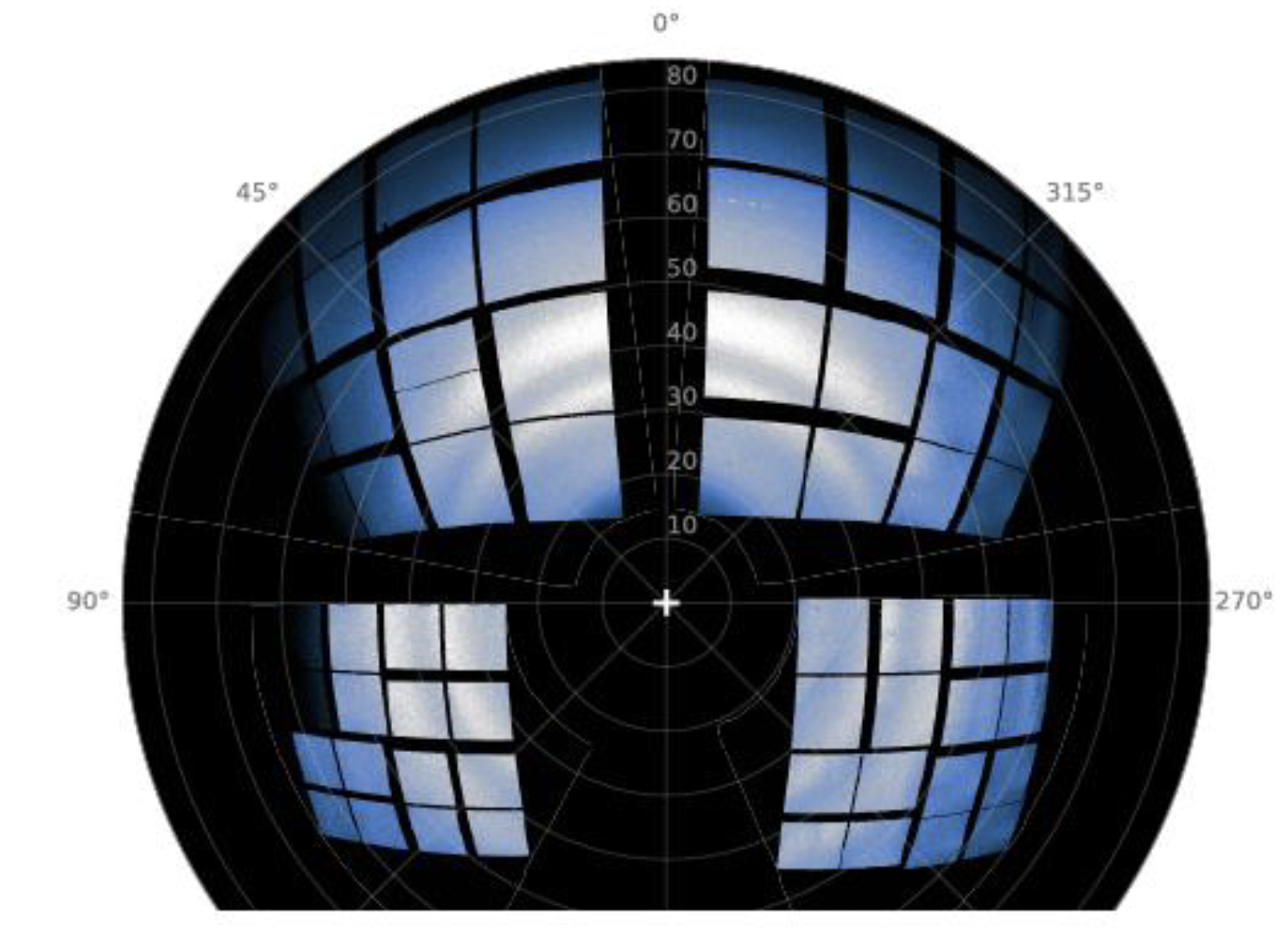
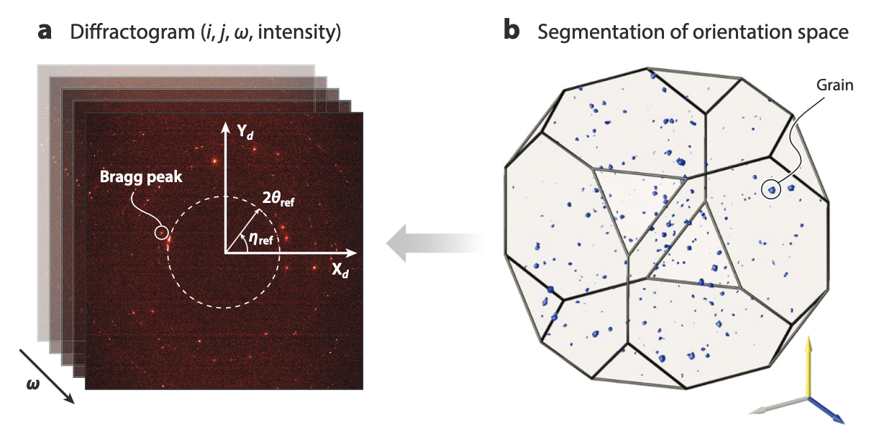
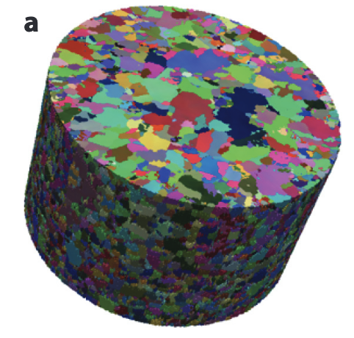
Pulling it forward! Frontier XRD platforms and needs for future science
difficulty
New phase identification
Kinetics of phase transitions
Equation of state
XRD peak shape for time-resolved dislocation density
Texture evolution for twinning & plasticity modeling
Microstructure influencing strength
S(Q, t), time-resolved structure factor and pair distribution function analysis for nearest neighbor
Standard wide angle X-ray scattering
Radial XRD
Liquid/amorphous diffraction
Dynamic 3D XRD microscopy
He et al. Sci Adv.2022
Merkel et al. Phys. Rev. Lett. 2021
Morard et al. Proc. Nat. Acad. Sci. 2020
Internal crystal orientation fields
Strain states
Grain morphology for grain growth and recrystallization
Texture for twinning & plasticity modeling
Bernier et al. Annu. Rev. Mater. Res. 2020

Slide 20
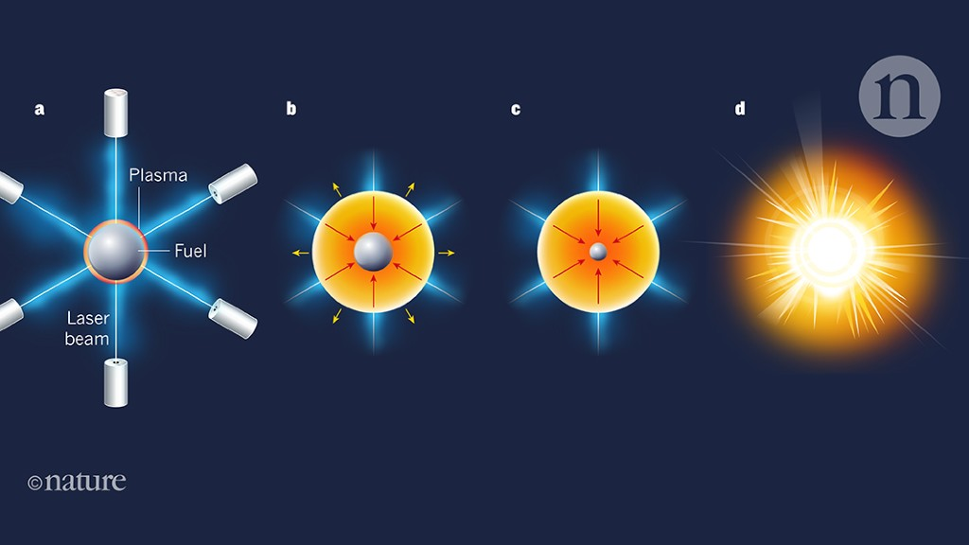
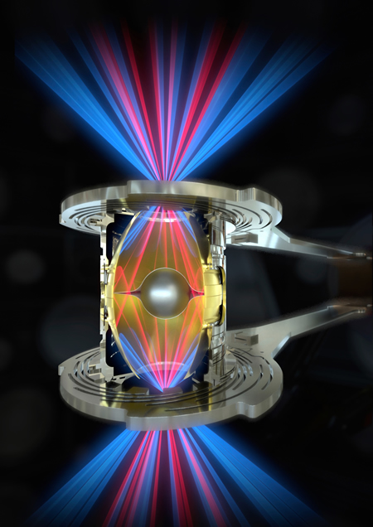

Fusion as a global clean energy solution to replace dependance on fossil fuels
Inertial Confinement Fusion (ICF) and Inertial Fusion Energy (IFE)
M. Herrmann, Nature 565, 577 (2019).
Hydrodynamic instabilities and turbulence compromise spherical implosions
images from https://lasers.llnl.gov/
H. Abu-Shawareb et al. Phys. Rev. Lett. 2022
Courtesy T. Doeppner, 2019

Slide 21
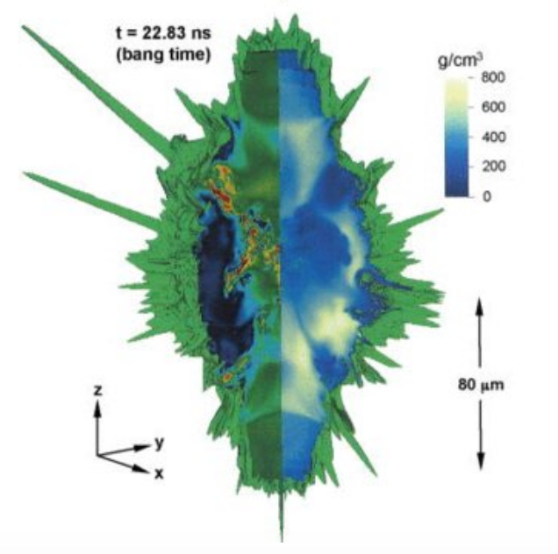
Imperfections in ablator materials degrade performance: Case study 2 – void collapse physics
Inertial Confinement Fusion (ICF) and Inertial Fusion Energy (IFE)
Micron-sized voids present in the ablator (capsule) material can seed hydrodynamic instabilities
Clark et al., Phys. Plasma 2015
Hydrodynamic instabilities and turbulence compromise spherical implosions
images from https://lasers.llnl.gov/
H. Abu-Shawareb et al. Phys. Rev. Lett. 2022
Courtesy T. Doeppner, 2019

Slide 22
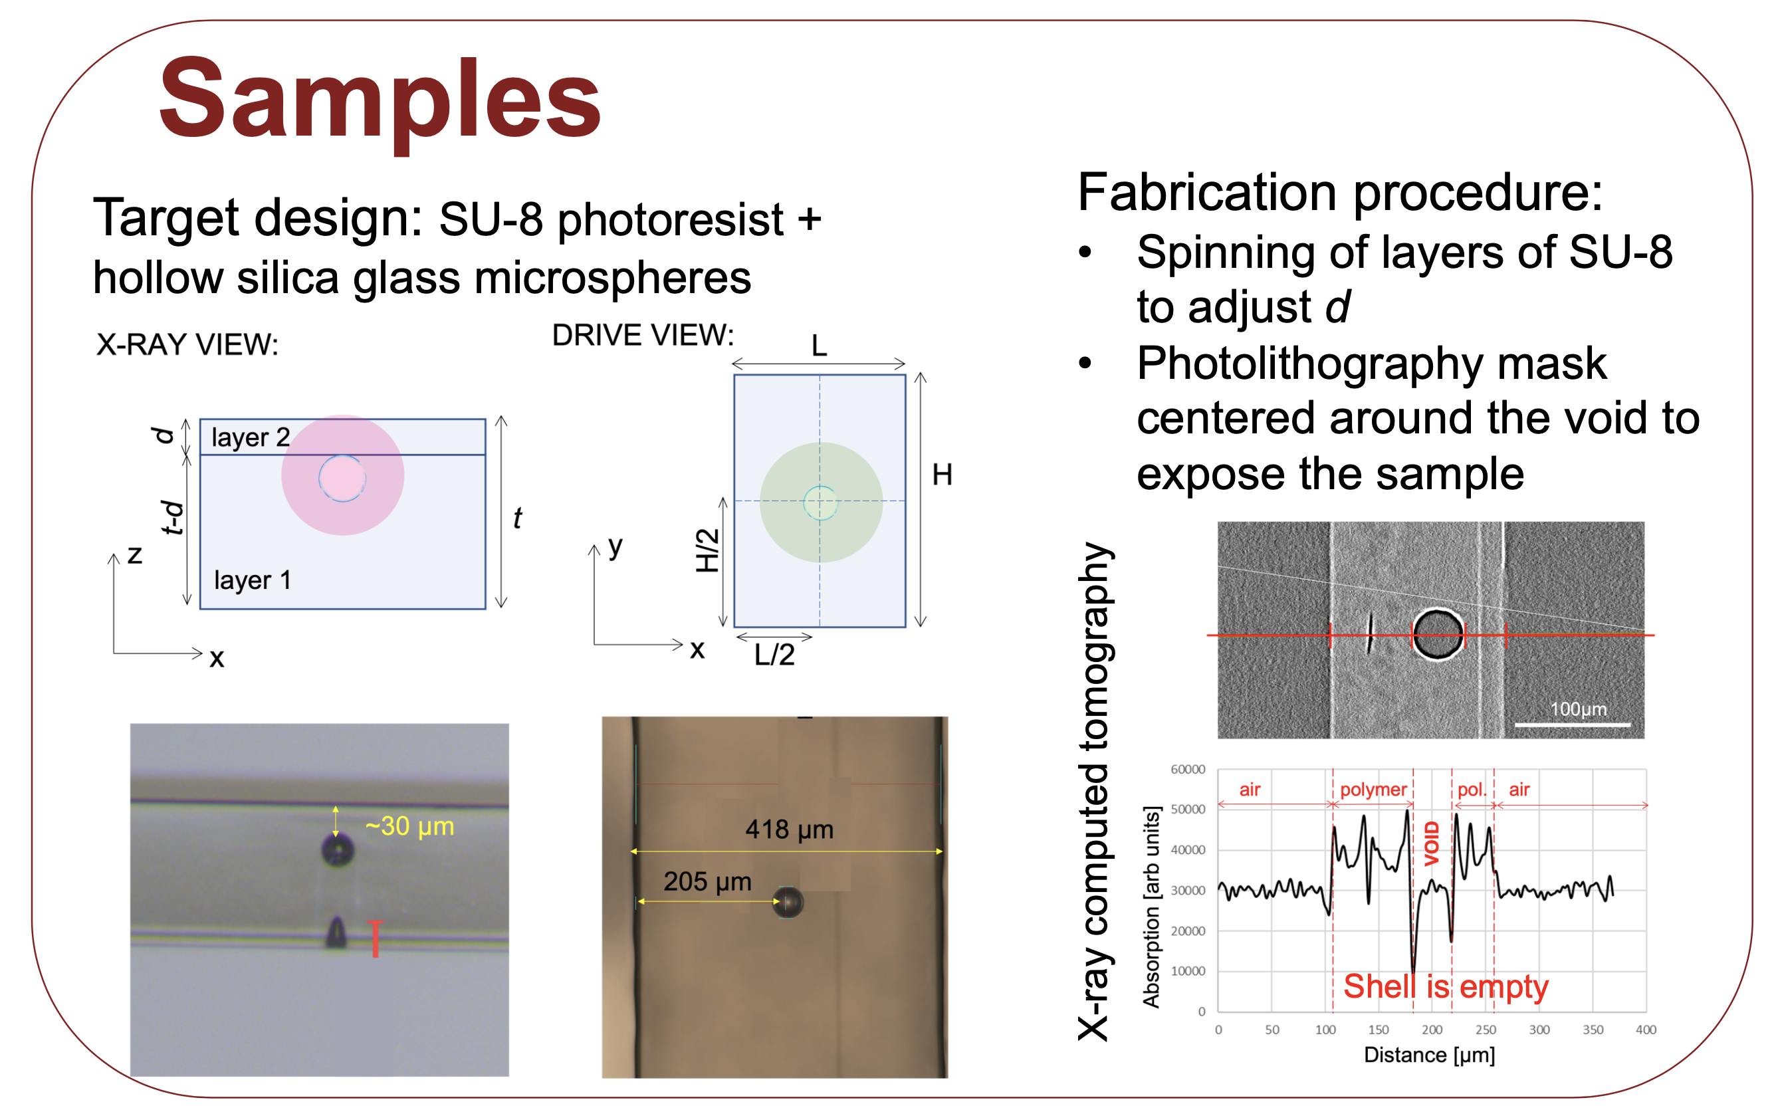
Fabricating synthetic voids: developing high quality / high quantity targetry is key for rep rated experiments
S. Pandolfi et al., ‘Novel fabrication tools for dynamic compression targets with engineered voids using photolithography methods’ Rev. Sci. Instrum., 93(10), 103502 (2022) & Editor’s Pick!

Slide 23
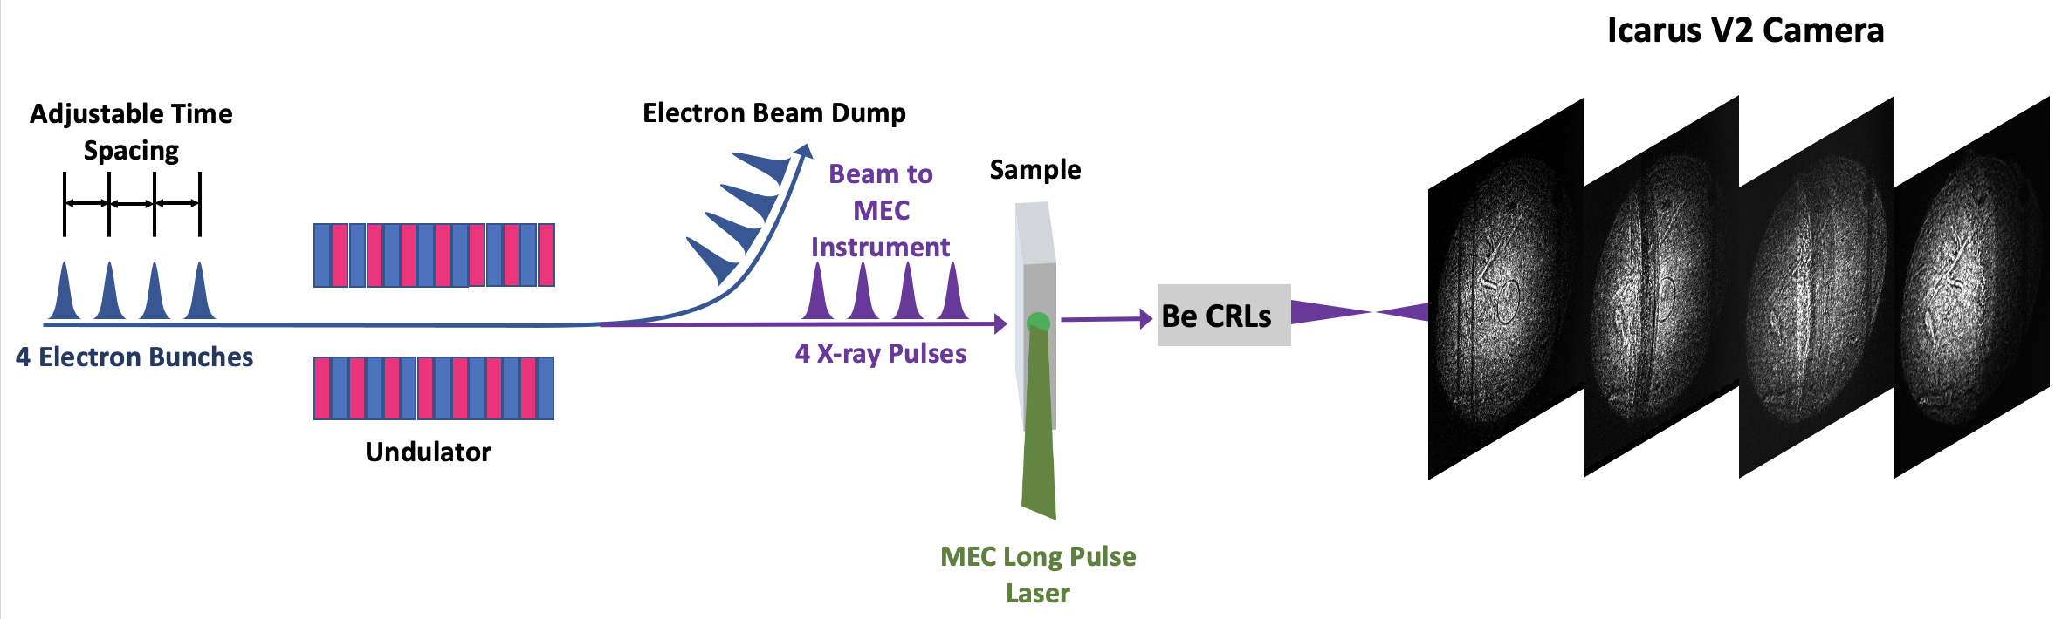
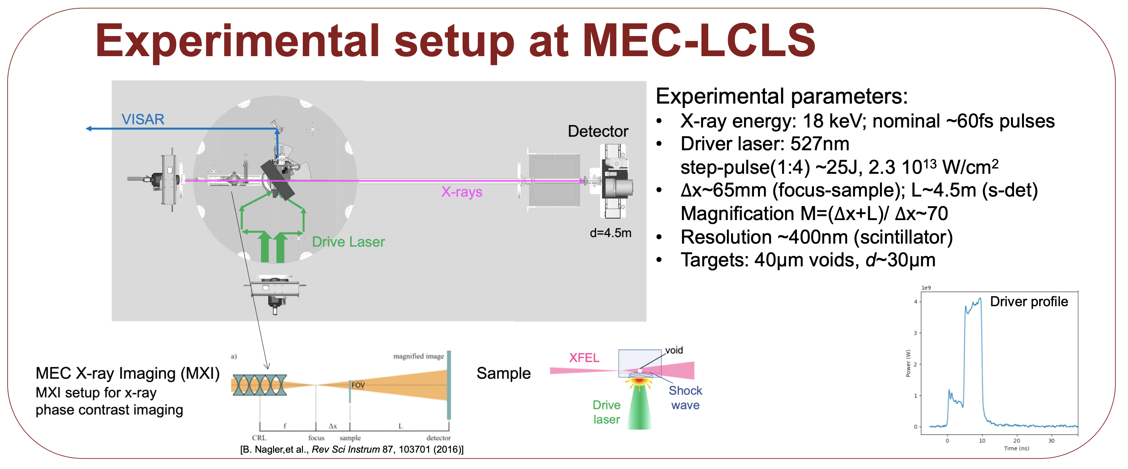
Time-resolved X-ray imaging is enabling a revolution in High Energy Density (HED) Science
4-Pulse, direct imaging at 9 keV
D. Hodge et al. SPIE Proc. 1183908 (2021); Optics Express 30(21), 38405 (2022).
Goal: Compare with hydrodynamic simulations and obtain mass density maps to refine physics models for developing predictive capabilities
Single-shot, phase contrast imaging, 18 keV

Slide 24
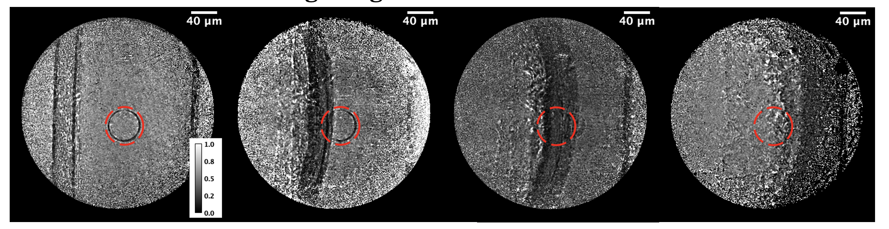
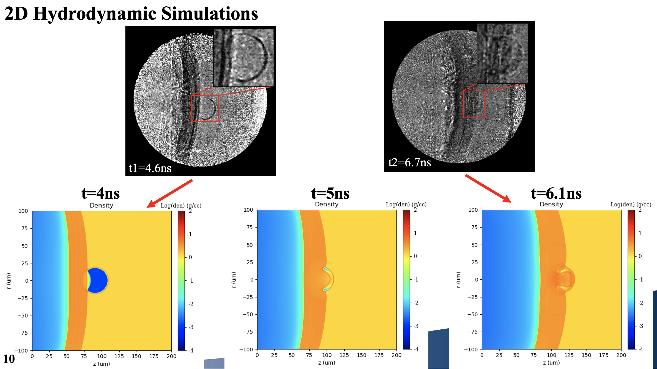
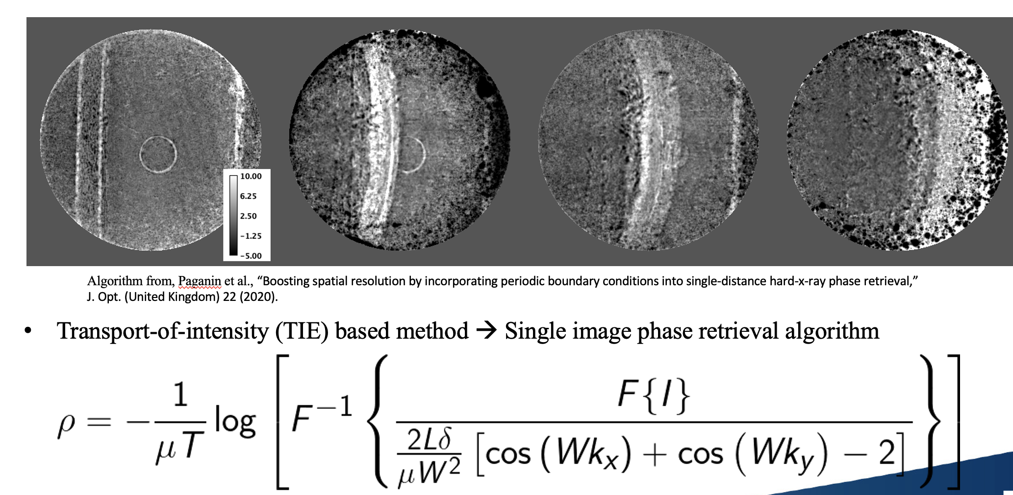
Void collapse: 4-pulse train results shows need for careful background subtraction shot-to-shot
Combination of Principle Component Analysis + Image Alignment for Flat-Field Correction
D. Hodge et al., ‘Multi-frame, ultrafast, x-ray microscope for imaging shockwave dynamics’ Optics Express, 30(21), 38405 (2022).
Preliminary results: Average Projected Mass Density Maps, 700 nm spatial resolution with Icarus
2D xRAGE Hydrodynamic simulations: David Montgomery, LANL & Kelin Kurzer-Ogul, Univ. Rochester
Andrew Leong, LANL

Slide 25
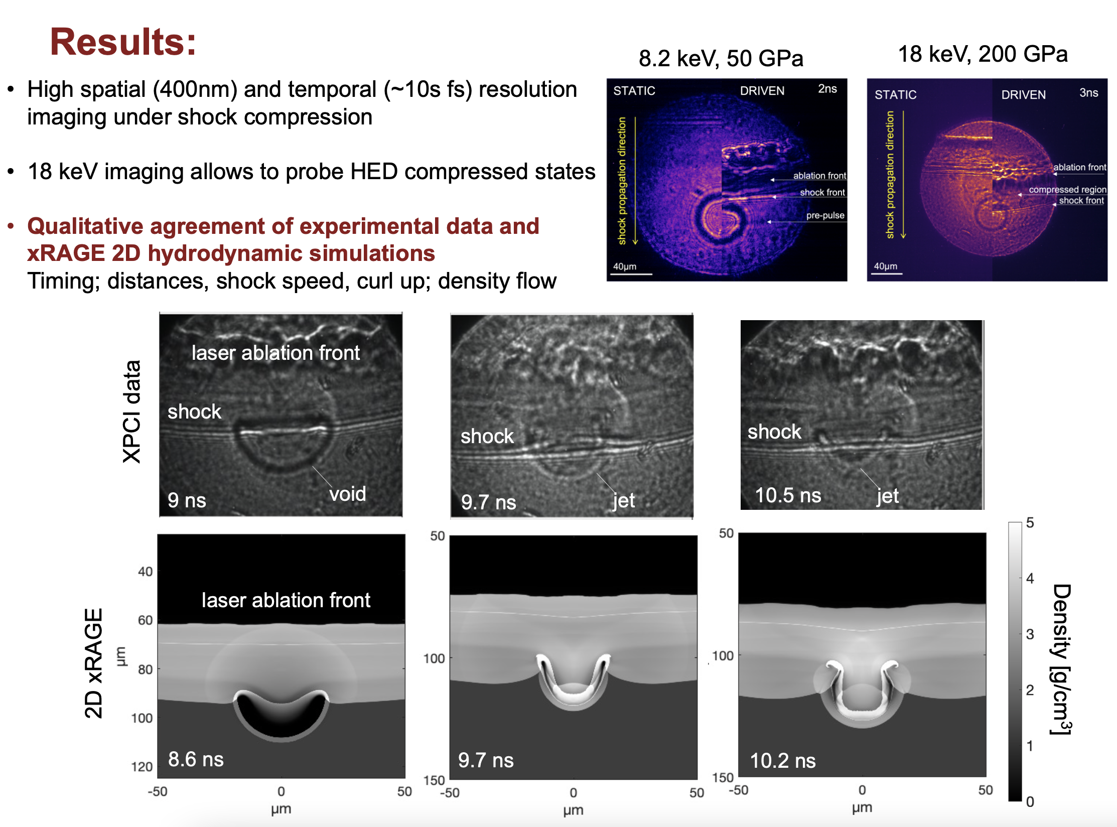
Void collapse: single-shot results show improved clarity at 18 keV
D. Hodge et al., ‘Visualization of shocked material instabilities using a fast-framing camera and XFEL four-pulse train’ SPIE Proc., 11839 (2021).
D. Hodge et al., ‘Multi-frame, ultrafast, x-ray microscope for imaging shockwave dynamics’ Optics Express 30(21), 38405 (2022).
Images courtesy S. Pandolfi

Slide 26
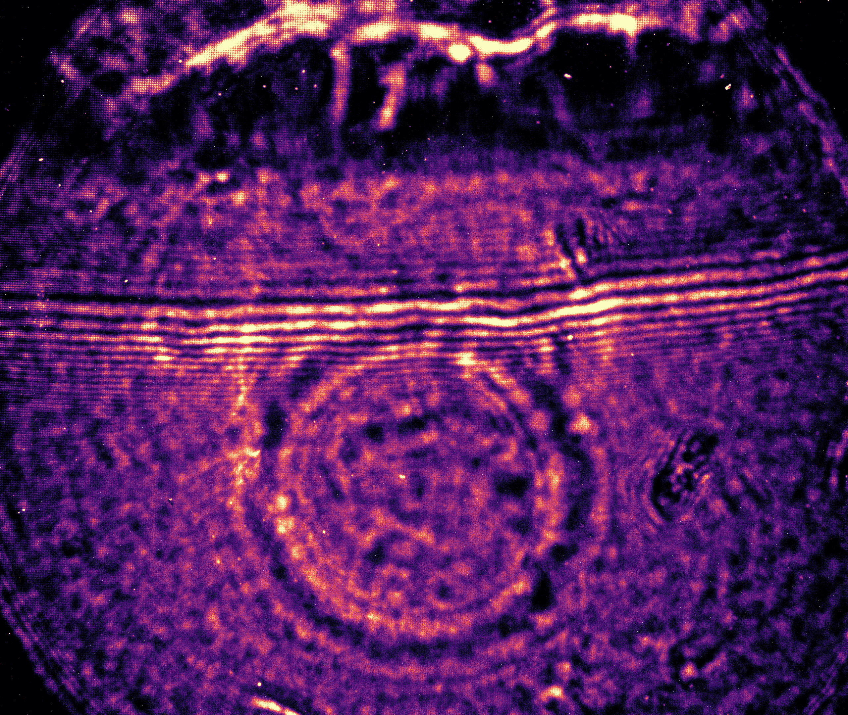
Void collapse: single-shot results show improved clarity at 18 keV
D. Hodge et al., ‘Visualization of shocked material instabilities using a fast-framing camera and XFEL four-pulse train’ SPIE Proc., 11839 (2021).
D. Hodge et al., ‘Multi-frame, ultrafast, x-ray microscope for imaging shockwave dynamics’ Optics Express 30(21), 38405 (2022).
Images courtesy S. Pandolfi

Slide 27
Void collapse: single-shot results show improved clarity at 18 keV
cavity lobes
2D xRAGE Hydrodynamic simulations: David Montgomery, LANL & Kelin Kurzer-Ogul, Univ. Rochester

Slide 28
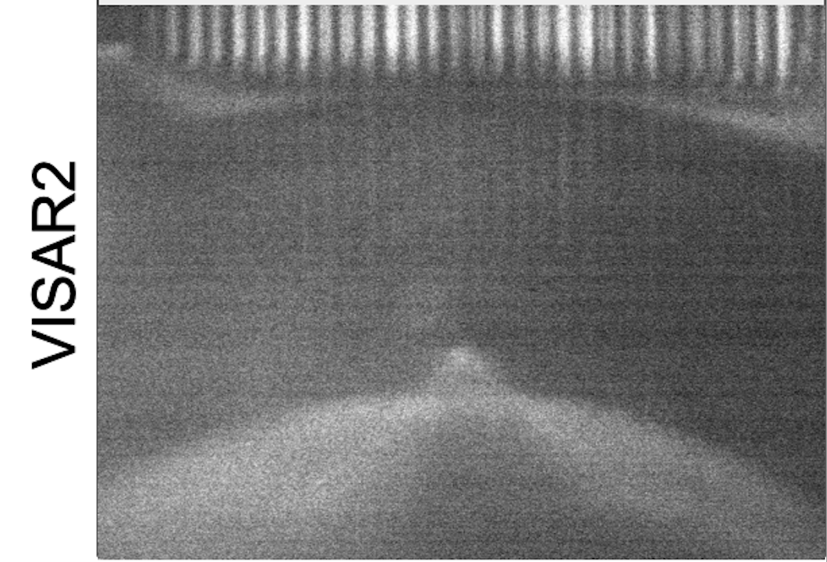
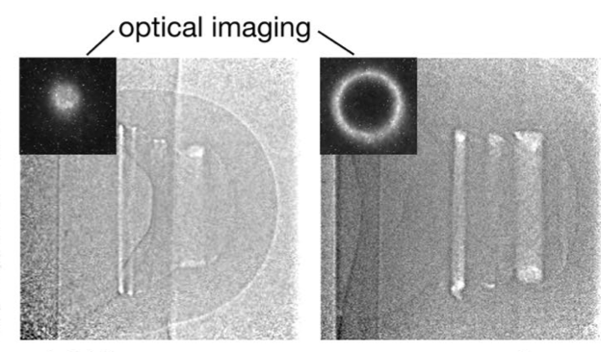
Void collapse: single-shot results show improved clarity at 18 keV
cavity lobes
Time-resolved toroidal plasma emission at ~200 GPa
Escauriza et al. Sci. Rep. 2020

Slide 29
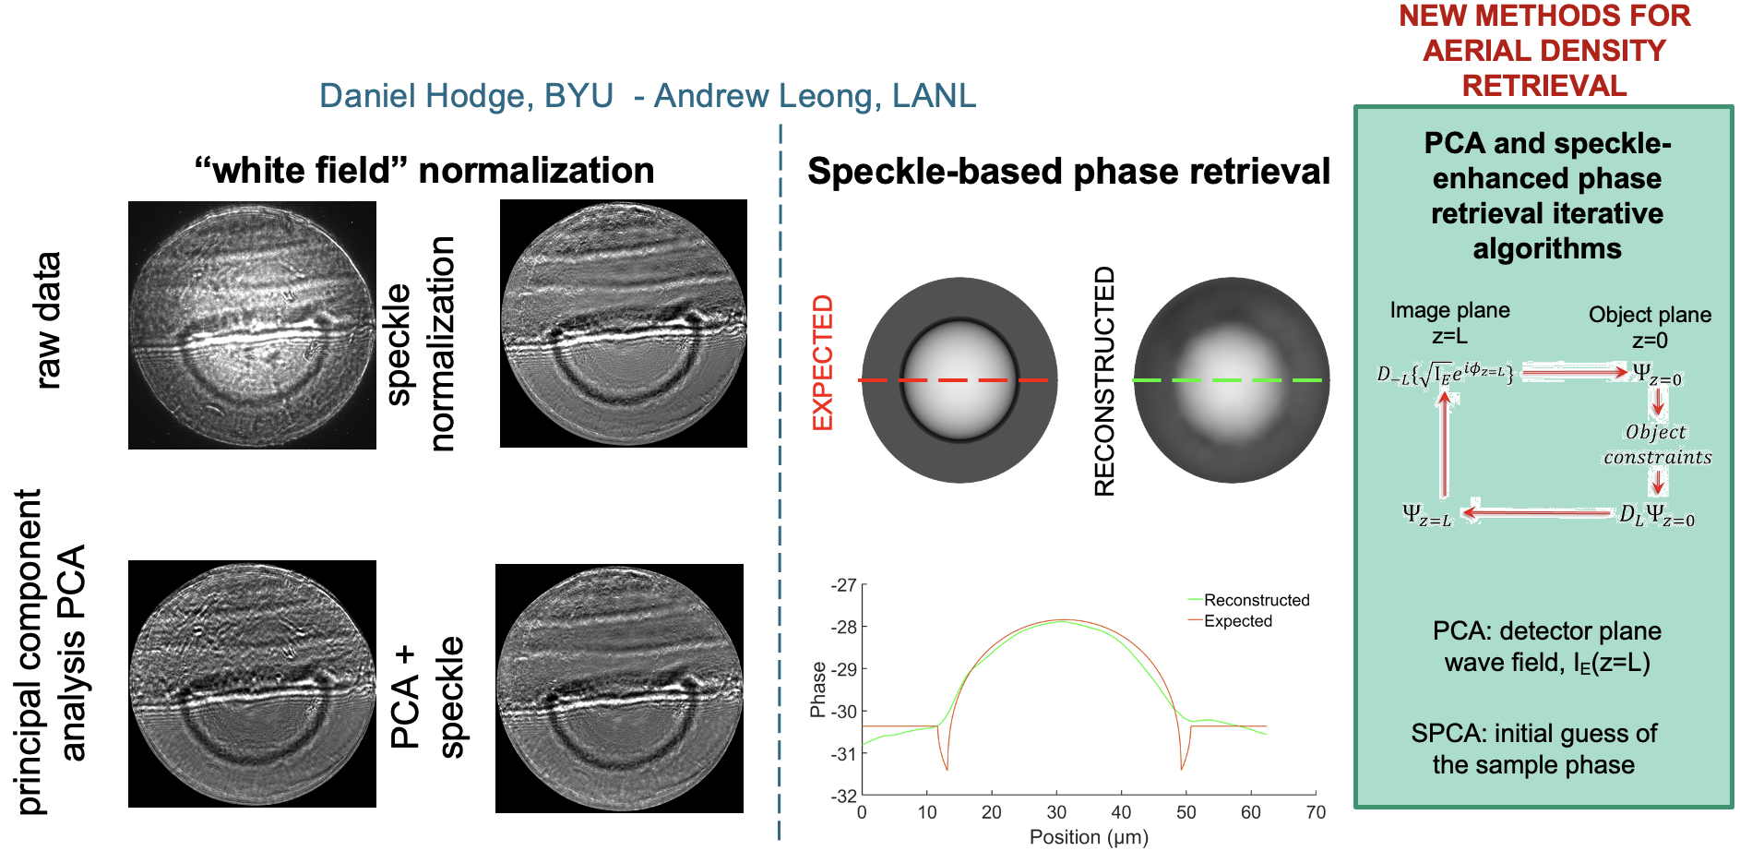
Principal component analysis (PCA) and speckle-based phase retrieval provide the path forward for density recons reconstructions
Slide courtesy S. Pandolfi

Slide 30

Void collapse data will help validate and address important questions for modeling complex radiation hydrodynamics
→Ambient condition images have been successfully reconstructed & refinements ongoing
-next: shock images
→Physics model refinement
-radiation transport
-strength effects
-transport properties
-optical laser coupling
-thermal transport
Slide courtesy S. Pandolfi

Slide 31
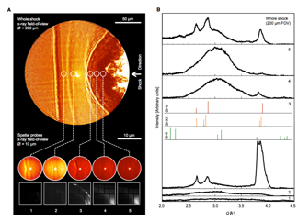
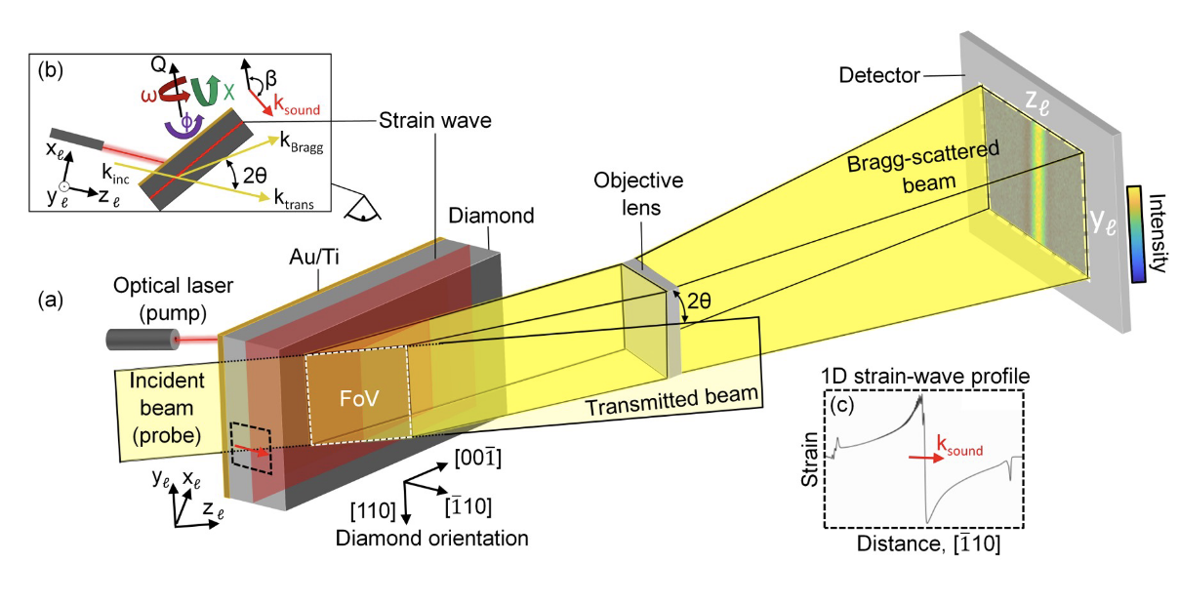
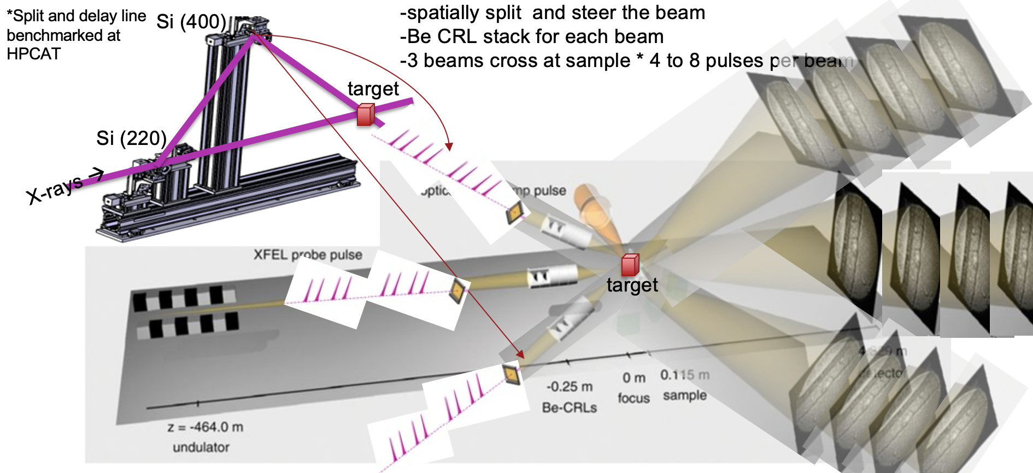
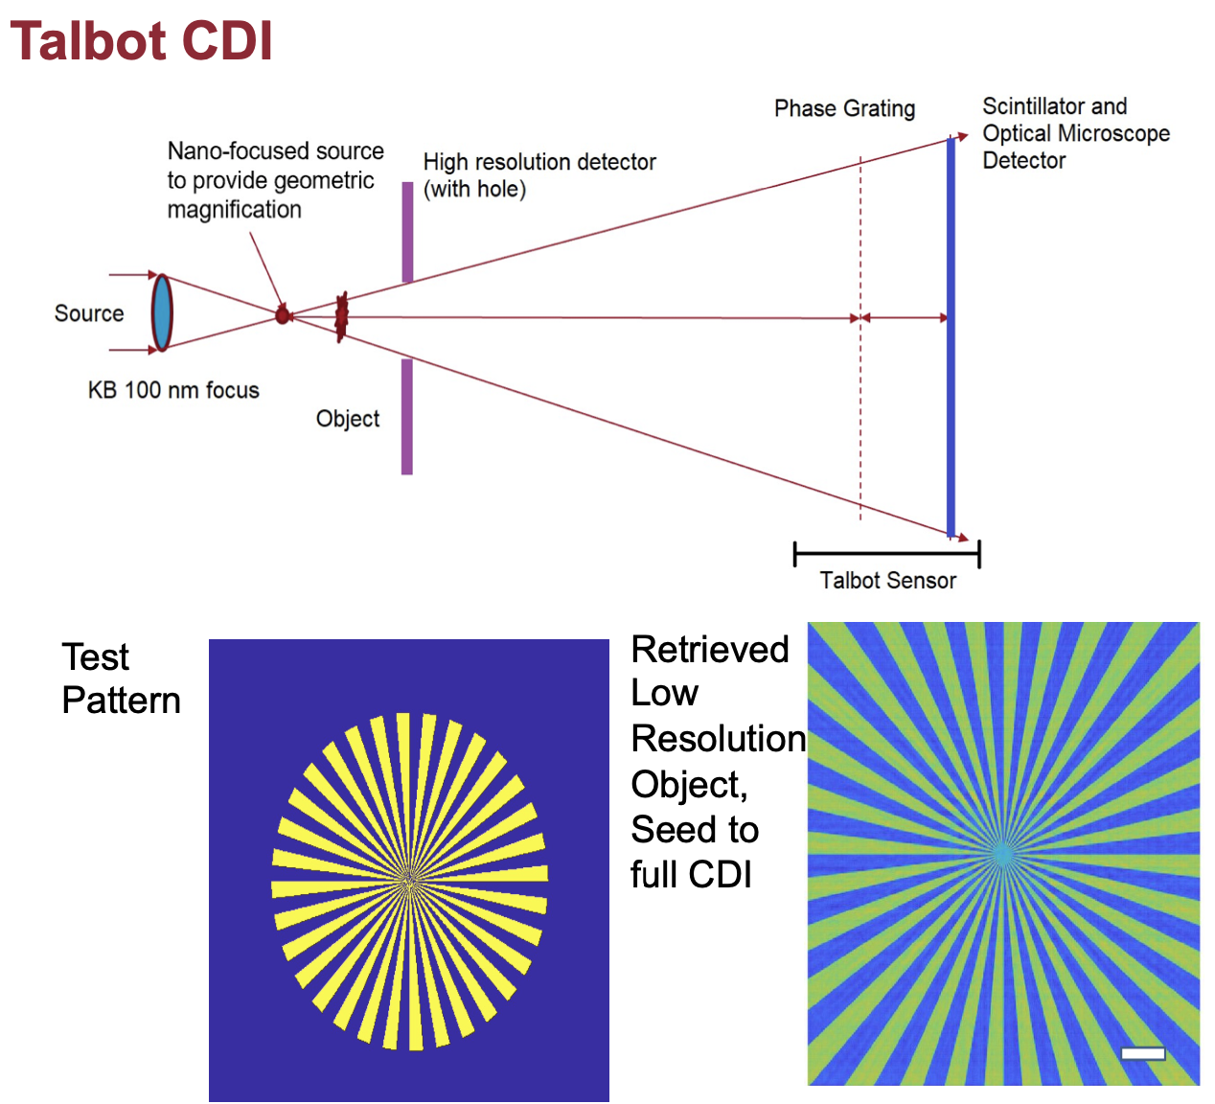
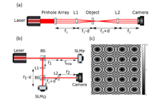
Pulling it forward! Frontier X-ray imaging platforms and needs for future science
Combine direct- or phase-contrast
imaging with XRD
Dark field X-ray microscopy
Stereo PCI with pulse train
Single shot coherent diffractive imaging (CDI)
  →Talbot CDI
  →time-resolved ptychography (or ptycho-tomography)
Pinpoint phase, density and microstructure in a single-shot down to sub um resolution
Image mobility of dislocations, map microstructure, local strain fields
Toward 3D image reconstruction in a single shot
Brown et al. Sci Adv.2019
difficulty
Holstad et al., arxiv, 2021
Wengrowicz et al, 2019

Slide 32
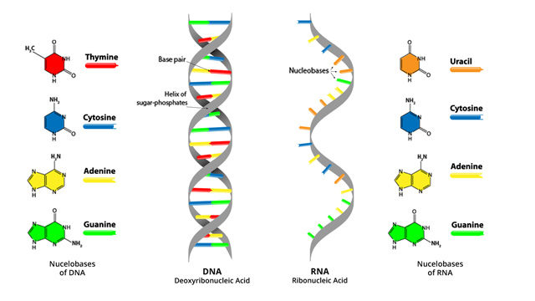

Life requires the build up of complex molecules
→ amino acids: RNA & DNA with a clear chain structure
Simple
Complex
Common Common RNA
Elements Molecules
Carbon: C
Hydrogen: H
Oxygen: O
Nitrogen: N
CH₄ methane
NH₃ ammonia
H₂O water
CO carbon monoxide
CO₂ carbon dioxide
But how did this chemical complexity and chain structure come about?
Notes:
Amino acids are important biological molecules that serve as the basic molecular building blocks of proteins
All amino acids have a similar basic structure with different amino acids differing only in the specific structure that lies in the chemical group or side carbon chain labeled “R”.
life on Earth uses slightly over 20 different amino acids. - homochirality, all LEFT handed for LIFE
over 70 different amino acids have been identified in meteorites.
--need the catalyst, need to the template
Amino acids are known to be present in primitive meteorites and many of these amino acids show the presence of excess deuterium (heavy hydrogen). Excess deuterium is an indicator of the presence of extraterrestrial materials, clearly demonstrating that extraterrestrial organic amino acids exist, survive planetary accretion, and are delivered to the Earth’s surface. Thus, the abiotic production of amino acids in space, along with sugars, polycyclic aromatic hydrocarbons (PAHs), and nucleobases, may play a key role in the seeding of the surfaces of new planets with many of the building blocks needed to start life throughout the universe. It is interesting to note that, while meteorites are known to deliver over 70 varieties of amino acids to the Earth, modern life on the Earth uses only 20 of these. Why living systems use the particular amino acids they do is not currently understood.
-reminder that life is built amino acids/DNA/RNA chain molecules with clear chain structure;
-how this came about?

Slide 33


Mineral surfaces can promote biomolecular self-assemblies → Templating!
Notes:
we examine how mineral surfaces can template and promote prebiotic chemical and biomolecular self-assemblies that were likely an essential stage in the origin of life on Earth by presenting case studies from nanoscience and surface science, such as organization of small organic monolayers on mineral surfaces, secondary structure changes of nucleic acids upon mineral surface binding, assembly of peptide amyloids by mineral surfaces, and mineralization of new mineral surfaces by self-assembled chemical systems. Self-assemblies such as folded proteins or DNA double helices

Slide 34

Life requires the build up of complex molecules
→ Case Study 3: Role of Plasmas in the Chemistry of Life
1. Miller-Urey experiments
  Amino acid formation from electrical discharge in simple gases
2. Hyperthermophilic microorganism
evolution
  Simple magma gases mix with dissolved metals at high temp, e.g., extremophiles
3. Impact synthesis
  Amino acid formation during impact plasma process & host rock mineralogy is important to build up molecular complexity
Collisions:
Dust grains
Meteorites
Asteroids
Planetesimals
Planets
How did the biological information get encoded?
https://www.wikiwand.com/en/Abiogenesis
Notes:
3. not steady state extreme environments – it’s a short lived dynamic process, examples in meteorites – tools at slac
Observations suggest that the majority of organic compounds introduced on Earth by interstellar dust particles are considered principal agents in the formation of complex molecules, thanks to their peculiar surface-catalytic activities. Studies reported in 2008, based on ¹²C/¹³C isotopic ratios of organic compounds found in the Murchison meteorite, suggested that the RNA component uracil and related molecules, including xanthine, were formed extraterrestrially. In 2011, a report based on NASA studies of meteorites found on Earth was published suggesting DNA components (adenine, guanine and related organic molecules) were made in outer space
The earliest origin of life coincides with the end of the late heavy bombardment, indicating that the relatively frequent impact events would be highly relevant for prebiotic chemical evolution.^{17,18} To date, these impact plasmas have been identified as being conducive to the production of complex prebiotic molecules including sugars and nucleobases.^{3,4}.This is directly in line with the NASA Astrobiology Strategy 2015, specifically under aim 1 “Identifying Abiotic Sources of Organic Compounds”

Slide 35

Meteorites reveal another way to make life’s components
Meteorites: rocky remnants of asteroids or comets that land on Earth, Solar System Uber!
Requirements:
-prebiotic chemical precursors
-formation mechanism for complex
molecules & amino acid diversity → RNA
-template left- or right-handedness
of amino acids via specific mineral structures
✓
✓
✓
Notes:
Amino acids found in meteorites: Amino acids are known to be present in primitive meteorites and many of these amino acids show the presence of excess deuterium (heavy hydrogen). Excess deuterium is an indicator of the presence of extraterrestrial materials, clearly demonstrating that extraterrestrial organic amino acids exist
In 2019, scientists reported detecting, for the first time, sugar molecules, including ribose, in meteorites, suggesting that chemical processes on asteroids can produce some fundamentally essential bio-ingredients important to life, and supporting the notion of an RNA world prior to a DNA-based origin of life on Earth
abiotic amino acid formation chemistry, as preserved by meteorites, is strongly dependent on the availabiity of amino acid precursors, temperature and water activity, and the mineralogical composition of the parent body.
✓
In addition to the generation of necessary prebiotic chemical precursors, there is growing recognition that minerals may have played a role in both the formation of simple organic molecules such as formaldehyde and, possibly, in the formation of molecules as complex as RNA, through reactions mediated by minerals, in particular clays (Brack, 2006). Ferris (2006, 2005) showed that the clay mineral montmorillonite is able to catalyze a variety of organic reactions, in particular the formation of RNA, and Fraser et al. (2011) suggested that the interlayer space in clays leads to the formation both of RNA oligomers and the selection of left-handed amino acids. It has also been hypothesized that clays could act as initial templates for the earliest self-replicating molecules (Cairns-Smith, 1966; Ponnamperuma et al.,1982; Brack, 2006). Importantly, clays are ubiquitous products of meteorite impact events on Earth, being generated during the hydrothermal phase (Naumov, 2005; Osinski et al.,2013) (see Section 2.2), an origin that has also been proposed to account for at least some of the clay detections on Mars (e.g., Newsom, 1980; Schwenzer and Kring, 2009; Tornabene et al.,2013).

Slide 36



From Formamide NH₂COH to Nucleobases via Impact Plasma Disassociation
C
Started with Formamide:
-abundance
-simultaneous formation of all four nucleobases
-need the right catalyst for templating
→silica SiO₂
→limestone CaCO₃
→clays (kaolinite, montmorillonite)
→alumina Al₂O₃
→zeolite (aluminosilicate)
→anatase TiO₂
Walroth et al.
Notes:
sufficient amounts of formamide in star-forming regions of dense molecular clouds

Slide 37



From Formamide NH₂COH to Nucleobases via Impact Plasma Disassociation
PALS: 150 J, 350ps, 1.5 um, 0.4 TW
4500 K
100 ns
0.1 sec
Notes:
We proposed that the building blocks of biomolecules were formed from formamide in the plasma during the high-energy density event.
A During the laser-induced dielectric breakdown (LIDB) in gas, that was generated with a laser pulse energy of 150 J (with a time interval of ∼350 ps and a wavelength of 1.315 μm) and a power of 0.43 TW, all of the manifestations that are characteristic of a high-energy density event occurred, such as an astonishing rise in temperature to several thousand K, the formation of a shock wave and the generation of secondary hard radiation (UV−VUV, XUV, and X-Ray).32 In this type of model experiment, the dielectric gas mimics the atmosphere in which relatively hot, dense plasma is formed, and the solid ice or liquid sample represents the impactor itself (a comet or asteroid).

Slide 38



Ultrafast X-ray visualization of prebiotic chemical evolution during dynamic compression
X-ray Imaging
X-ray Spectroscopy
X-ray Diffraction
-microstructure & density changes
-temperature constrains
-void collapse
-bonding changes
-visualize chemical dynamics
Walroth et al.
-Atomic-level structure
-phase identification

Slide 39


Dynamic compression of formamide ice combined with Ultrafast X-ray Absorption/Emission Spectroscopy (XAS/XES)
Soft X-rays: 200-500 eV
Buades et al., 2018
Walroth et al.
-core electrons get excited
-chemical bonding
-time-resolved changes in bonding!
C K-edge
N K-edge
O K-edge
-compare to Density Functional Theory, in collaboration with Nir Goldman, LLNL
X-ray Absorption Emission
Kvashnina, 2006
Notes:
Different core electrons have distinct binding energies

Slide 40


LCLS-II for Ultrafast Chemical Dynamics + Shockwaves
https://lcls.slac.stanford.edu/lcls-ii
LCLS-II, ChemRIXS end-station: superconducting linac, will provide a major jump in capability – moving from 120 pulses per second to 1 million pulses per second, and enable access to C-edge spectroscopy!!
https://lcls.slac.stanford.edu/instruments/neh-2-2/science-drivers
Notes:
Inside the cryomodules, strings of super-cold niobium cavities will be filled with electric fields that accelerate electrons to nearly the speed of light. This superconducting technology will allow LCLS-II to fire X-rays that are, on average, 10,000 times brighter than LCLS in pulses that arrive up to a million times per second.

Slide 41


Evolution of prebiotic to biotic materials via shock wave interaction at the femtosecond scale
Previous LCLS experiment at the former Soft X-ray (SXR) end-station deployed for McGrane (SXRLR5816).
-O K-edge
-N K-edge
4500 K
?
Ferus et al. 2014

Slide 42

Evolution of prebiotic to biotic materials via shock wave interaction at the femtosecond scale
Meteorite + formamide
Modified from Uemura et al., 2020
Walroth et al.
4500 K
?
Ferus et al. 2014
Notes:
-molecular behavior in plasmas to identify what governs product selectivity in the presence of different minerals
-after impact plasma has cooled, collect debris for high-performance liquid chromatography-mass spectrometry
→ predict prebiotic chemical evolution!!

Slide 43


Silicate shock metamorphism enabling mineral templating
Stoffler and Langenhorst, 1994
Gleason et al., 2017
-New constraints on impact crater mineralogy and shock stages
Notes:
…..BUT, let’s get a little closer to real geology and take a look at the shock compression of crystalline quartz (dominant rock forming mineral in the Earth’s crust!)

Slide 44

Evolution of prebiotic to biotic materials via shock wave interaction: whole view
X-ray Imaging
shock wave!
X-ray Spectroscopy
chemistry!
X-ray Diffraction
crystal structure for templating!

Slide 45











Thank you for your attention!!
Collaborators:
Stanford University Wendy Mao, Silvia Pandolfi, Tom Carver, Dylan Rittman, Sovanndara Hok
SLAC Hae Ja Lee, Bob Nagler, Eric Galtier, Eric Cunningham, Yanwei Liu, Kenan Li, Anne Sakdinawat, Philip Hart, Matt Seaberg, Eric Cunningham, Dimitri Khaghani, Sharon Vetter, Franz-Joseph Decker, Eduardo Granados, Akel Hashim, Roberto Colina-Ruiz (now at ALS, LBNL), Richard Walroth (now at Genetech Inc.)
BYU Richard Sandberg, Daniel Hodge
LANL Cindy Bolme, Pawel Kozlowski, Kyle Ramos, Michael Powell, David Montgomery, Ben Morrow, Andrew Leong
LLNL Matthew Dayton (now at Advanced hCMOS Systems), Nir Goldman
University of Rochester Kelin Kurzer-Ogul, Jessica Shang, Hussien Aluie
Universite de Lille Sebastien Merkel
CIW, Geophysical Lab Andrew Steele
Funding:
DOE: FES, ECA 2019
NNSA: LANL LDRD, C2
NSF: Geophysics
Notes:
The history of mankind is hung on a timeline of exploration and this is what's next.

