Slide 1

Microplasmas excited by microwave frequencies
Jeffrey Hopwood
Tufts University
Department of Electrical and Computer Engineering
Medford, MA 02155 USA

Slide 2
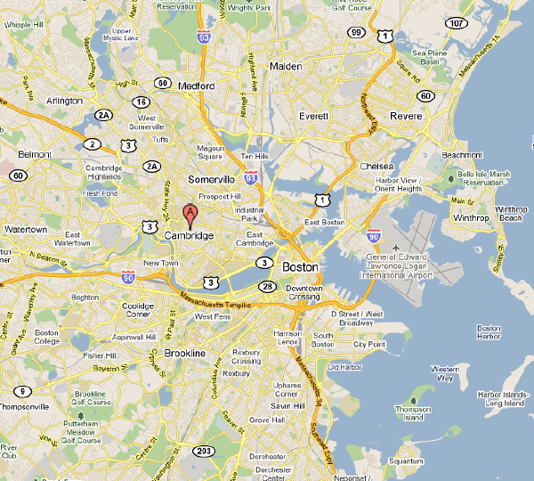
Tufts University
Tufts
Harvard
M.I.T.

Slide 3
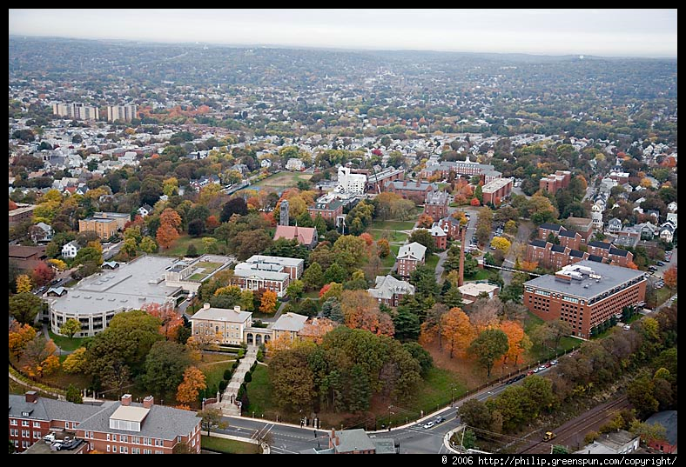
Tufts University

Slide 4
Acknowledgments
National Science Foundation
  CBET-0755761
Department of Energy
  DE-SC0001923
DARPA
  Microscale Plasma Devices program
  FA9550-12-1-0006
Schlumberger-Doll Research Corp.
  Alan Hoskinson, Asst. Research Prof.
  Shabnam Monfared, Postdoc
  Chen Wu, PhD candidate
  Stephen Parsons, PhD candidate
  Naoto Miura, PhD’12
    National Instruments, Tokyo
  Jun Xue, PhD’10
    Applied Materials
  Felipe Iza, PhD’04
    Professor, U. Loughborough, UK
  Undergraduate Research Assistants: Michael Grunde, Mical Nobel, Kevin Morrissey, and Atiyah Ahsan

Slide 5
Outline
Overview and Motivation
Microplasmas driven at microwave frequency
  Principle of operation
  Diagnostics
Microplasma deposition using C₂H₂ + He
Arrays of microplasmas (1-D and 2-D)
Conclusion
Gas Sensors based on microplasma

Slide 6
Outline
Overview and Motivation
Microplasmas driven at microwave frequency
  Principle of operation
  Diagnostics
Microplasma deposition using C₂H₂ + He
Arrays of microplasmas (1-D and 2-D)
Conclusion

Slide 7
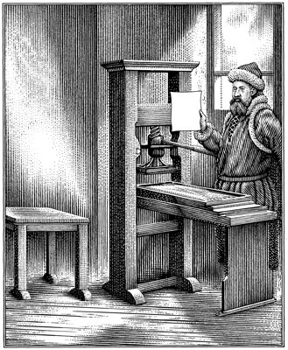
Motivation
Historically, technology has been introduced as a batch process
Simple and robust, but slow and costly
www.inkart.com
Notes:
2
2

Slide 8
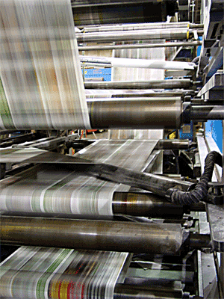
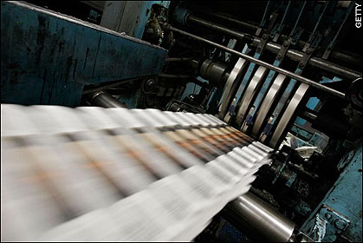
Motivation
Continuous processing follows as technology advances
High volume production and lower costs

Slide 9

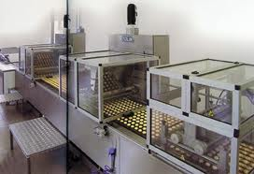
Motivation
stories.mnhs.org
www.orioncoat.com
Batch Processing
Continuous Processing

Slide 10
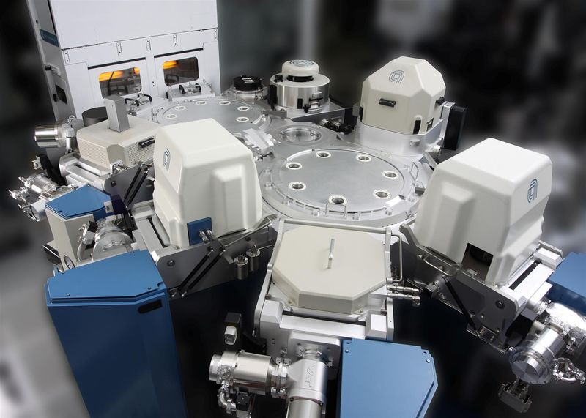
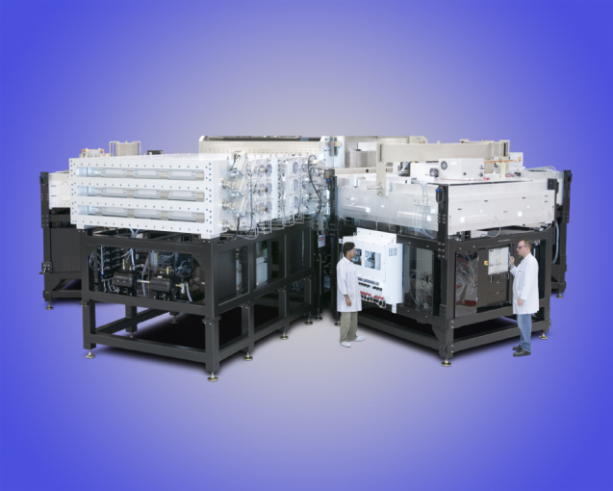
Motivation
amat.com
Single wafer per batch
High value, low throughput
-chips-
Single panel per batch
Low value, low throughput!!!
-panels-

Slide 11
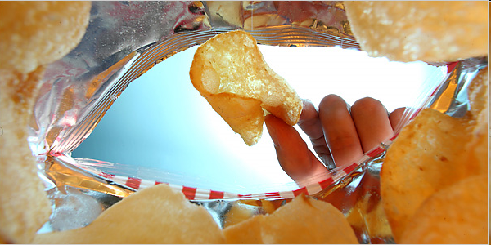
Motivation

Slide 12
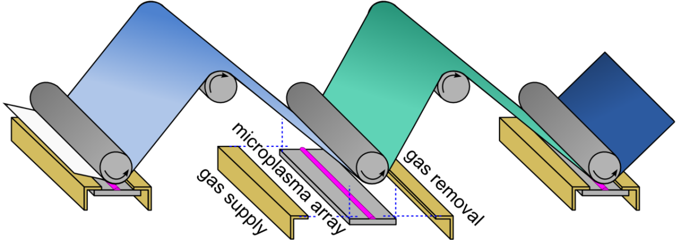
Goal: Atmospheric Pressure Roll Coating
cleaning
deposition
encapsulation
Roll-to-roll materials processing at 1 atm using microplasma arrays

Slide 13
Challenges
Plasma Temperature
  Typically atmospheric plasmas are very hot and incompatible with low-cost substrates
Plasma Stability
  Ionization overheating instability causes the atm plasma to constrict into a small arc
  Negative resistance → difficult to operate in parallel
  Pulsed plasmas are mostly ‘off’ when operated in kHz
Energy flux
  Plasma processing is driven by ion kinetic energy
  Difficult to achieve k.e. due to ion collisions at 1 atm.

Slide 14
Outline
Overview and Motivation
Microplasmas driven at microwave frequency
  Principle of operation
  Diagnostics
Microplasma deposition using C₂H₂ + He
Arrays of microplasmas (1-D and 2-D)
Conclusion

Slide 15
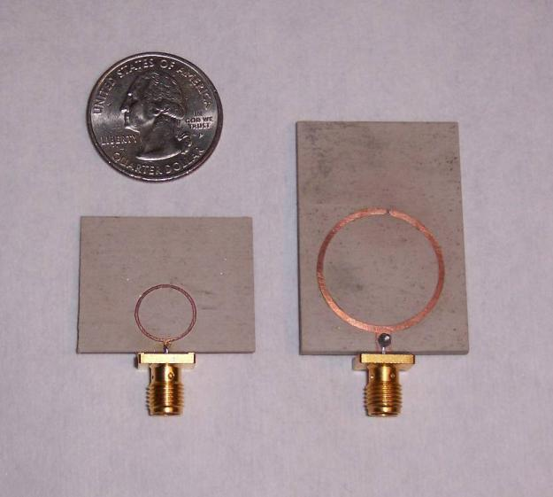

Introduction
Microwave Split Ring Resonator
20-200 μm discharge gap
1.8 GHz
0.9 GHz

Slide 16
E-fields in split-ring resonators
no plasma
25 um discharge gap
|E|~10⁷ V/m at 1 W

Slide 17
Microwave frequency
Coplanar, Capacitively-Coupled Plasma
Massive ions do not respond
to microwave electric fields (ω > ω_{pi})
No sputtering of the electrodes.
+/-
-/+
+
+
+
+
…electrons are partially confined
within the plasma:
Average displacement < 10 μm @ 1 GHz
Notes:
electron drift velocity ~ 10 km/s with a half period of 1 ns (500 MHz) gives a displacement of 10 um.

Slide 18
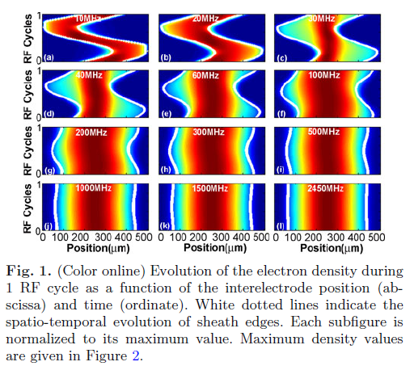
The role of frequency
simulations by F. Iza, Loughborough University, UK
← 500 um →
← 500 um →
← 500 um →
10 MHz
1.0 GHz
F Iza et al, Eur. Phys. J. D 60, 497–503 (2010)

Slide 19
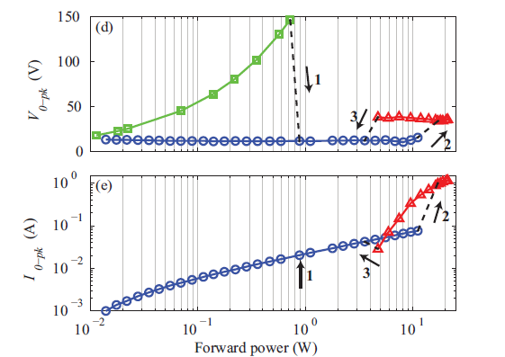
Current-Voltage Behavior
Ignition: V_{pk} = 150 volts
Normal Operation: V_{pk} = 20 v (I_{pk} = 10 mA, P_{ave} = 1 W)
no plasma
ignition
1 atm, non-flowing argon gas, 1 GHz
1 – microplasma ignition
2 – microplasma attaches to ground
3 – microplasma retreats to gap

Slide 20
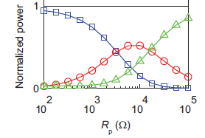
Microplasma Stability of the split-ring resonator – HFSS model
Power reflected from resonator
Power absorbed by the plasma
Power losses
Arc (R_{p}~10Ω) ←
Extinguished
(R_{p}→∞)
R_{p} = Plasma resistance ~ 1/n_{e}

Slide 21
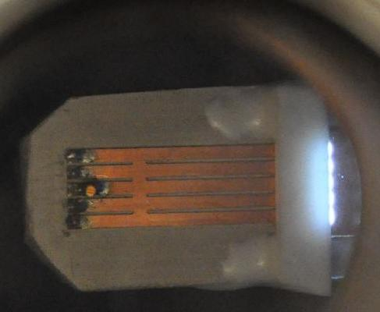
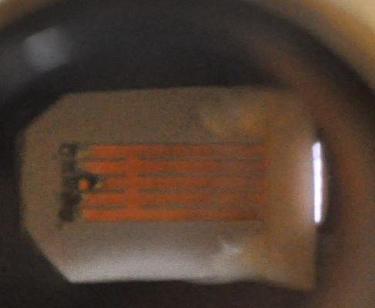
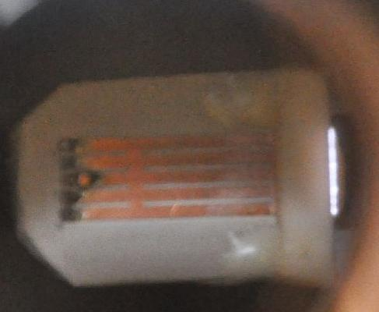
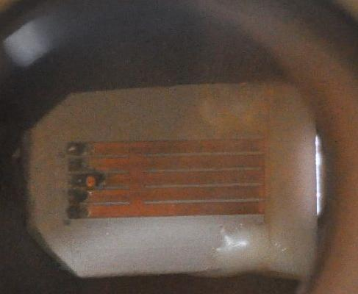
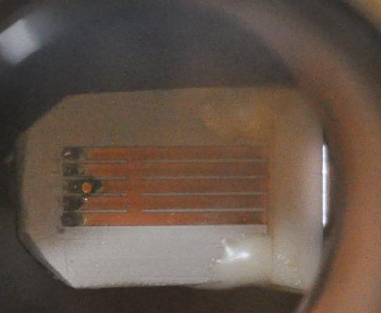
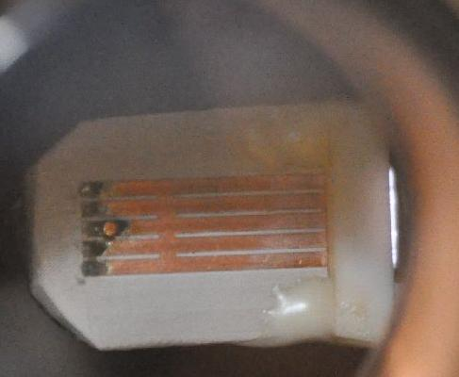
Low voltage + High frequency =
2000+ hours of operation
5-element microplasma array -- 1 atm argon, 0.4 W, copper electrodes.
Day 0 (0 hrs.)
Day 10 (240 hours)
Day 23 (550 hours)
Day 44 (1030 hrs.)
Day 58 (1370 hrs.)
Day 85 (2020 hrs.)

Slide 22
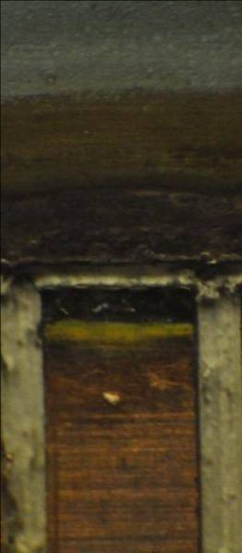
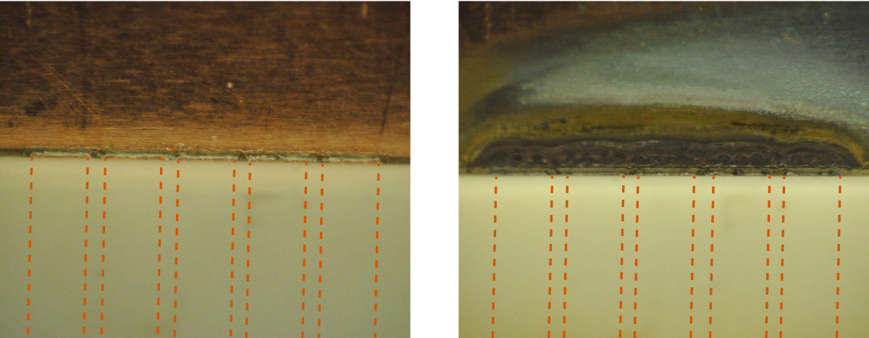
Close-ups: 2000 hours of operation
The dielectric and electrode structures are unaffected
Copper surfaces are discolored, with some black coating likely due to carbon deposition (from PTFE circuit board)
ground
0 hours
After 2020 hours
ground electrode
gap=
100μm
limiter covers resonators
resonator

Slide 23
Basic Properties
n_{e} ~ 2x10¹⁴ cm⁻³ (1 W, 1 atm) Torch: 4x10¹⁴cm⁻³ @ 100W* DBD/jet: ~10¹¹cm^{-3 **} MHCD: ~10¹⁵cm^{-3 ***}
  T_{rot} = 400 K (Ar + 1%N₂); 600K (air)
Pressure: 0.01 Torr – 2 atm
  air, nitrogen, oxygen, argon, helium, …
Power: 0.15 – 15 W
V_{electrode} ~ 20 v (DC microcavity and DBD ~ 300 v, RF jet ~ kV)
No gas flow required for stabilization
No ballast (resonantly stabilized)
No dielectric barrier required
No matching network (frequency tuning)
*Spectrochimica Acta Part B 54 1999. 1253-1266
**Eur. Phys. J. D 60, 489–495 (2010)
***J. Appl. Phys., Vol. 85, No. 4, 15 February 1999

Slide 24
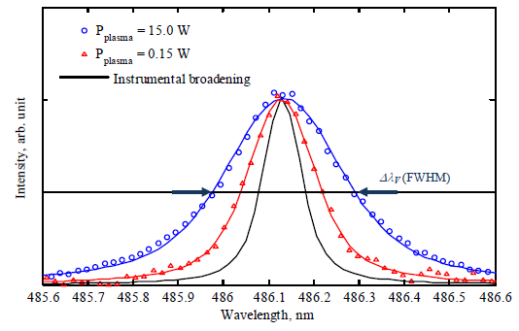
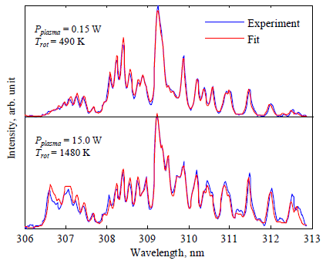
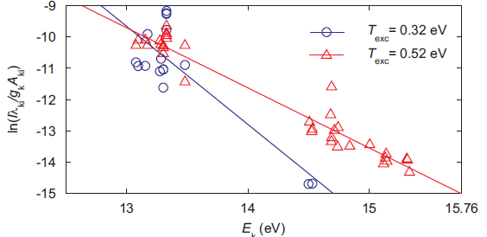
Microplasma Properties (Ar @ 1 atm)
Electron density (Stark broadening of H_{β})
Gas temp. (OH rotational fitting)
N_{e} = 10¹⁵ cm⁻³
N_{e} = 5x10¹³ cm⁻³
0.15 W
15 W
Excitation temp. (Boltzmann plot)
N. Miura and J. Hopwood, EPJ D 66(5), 143-152 (2012).

Slide 25
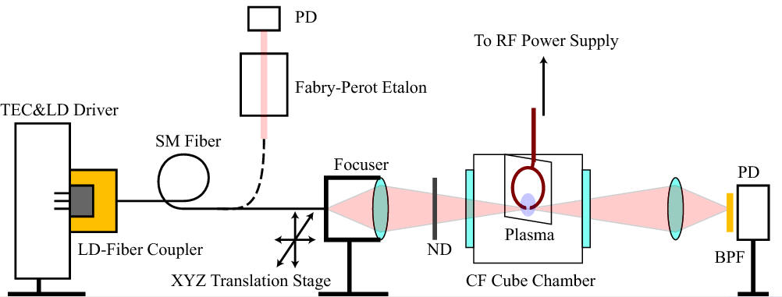
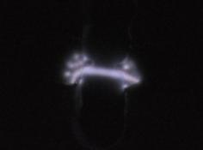
Spatially-Resolved Gas Temperature and Ar Metastable Density
by Scanned Laser Diode Absorption (LDA)
801.4 nm
Ar^{m} - 1s₅

Slide 26
Ar(1s₅) + hν_{(801.4nm)} → Ar(2p₈)
I₀ : Incident
Absorption line shape
I_{t} : Transmitted
(Absorbed)
Laser Intensity
kl
λ: Wavelength
λ: Wavelength
Integral
Broadening
Line integrated density:
Gas Temperature: T_{g}

Slide 27
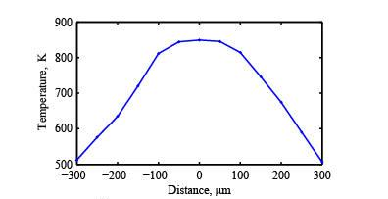
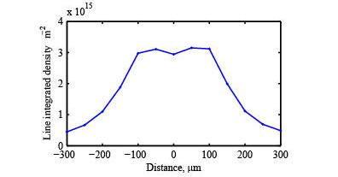
Spatially-Resolved Gas Temperature and Ar Metastable Density
by Scanned Laser Diode Absorption (LDA)
801.4 nm
Ar^{m} - 1s₅
1 atm, Ar
1 atm, Ar
N. Miura and J. Hopwood, J.Appl. Phys., Jan 2011.

Slide 28
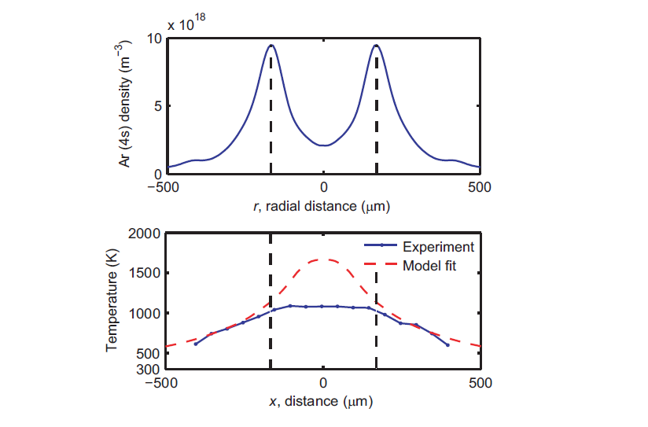
Spatially-resolved Gas Temperature and Ar Metastable Density
by Laser Diode Absorption (LDA)
Ar(1s₅) = 10¹³ cm⁻³
Abel inverted data
N. Miura and J. Hopwood, J.Appl. Phys., Jan 2011.

Slide 29
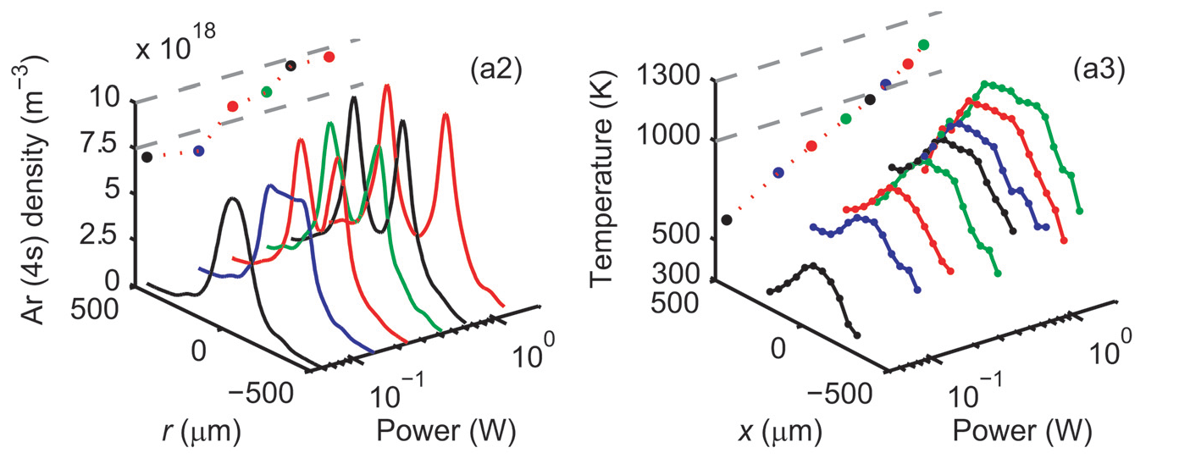
Higher absorbed power results in more metastable depletion from the core region
and higher gas temperatures

Slide 30
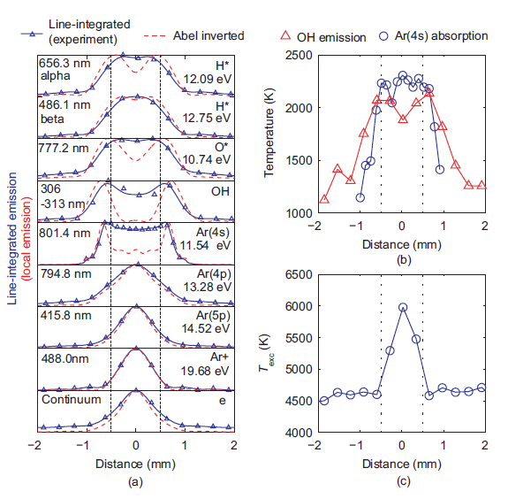
High Power Data (9 W) argon at 1 atm

Slide 31
Depletion of species at ‘high’ power
Ionization or dissociation by centrally-peaked electron density
  Ar^{m} + e → Ar⁺ +2e
  OH + e → O + H + e
Hot core has a depleted neutral density?
Hot core has reduced resonant radiation trapping???
  Ar^{r} → Ar + hν → Ar^{r} →Ar^{m}
hν
Ar

Slide 32
Outline
Overview and Motivation
Microplasmas driven at microwave frequency
  Principle of operation
  Diagnostics
Microplasma deposition using C₂H₂ + He
Arrays of microplasmas (1-D and 2-D)
Conclusion

Slide 33
Experimental Configuration
glass substrate
spacers
plasma source
gas plenum
plexiglas enclosure
(vented to atm)
helium
helium + 1% C₂H₂

Slide 34
Ion Flux vs. SRR-to-substrate distance stainless steel probe (r=75um, l=500um); probe length is deconvolved
typ. ICP ion flux
Hard DLC, impervious to acetone
Soft films, removed by acetone
Notes: 1 liter/min helium, 2 watts of microwave power

Slide 35
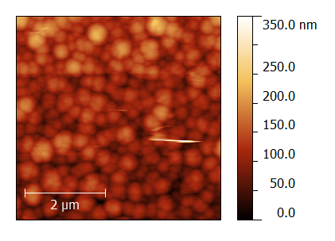
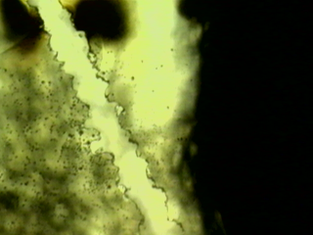
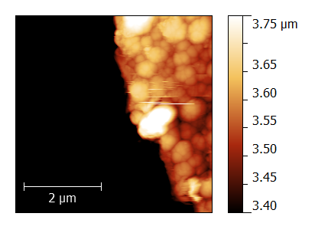
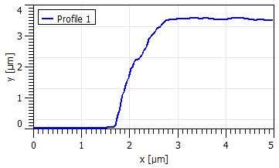
Film topology and deposition rate
Diamond tip
induced delamination
optical
AFM
AFM
Time 30 s
Power 3.5 W
Spacer 270 um
Total flow 1000 l/min
C₂H₂ fraction 0.05%
Deposition Rate 7 um/min.

Slide 36
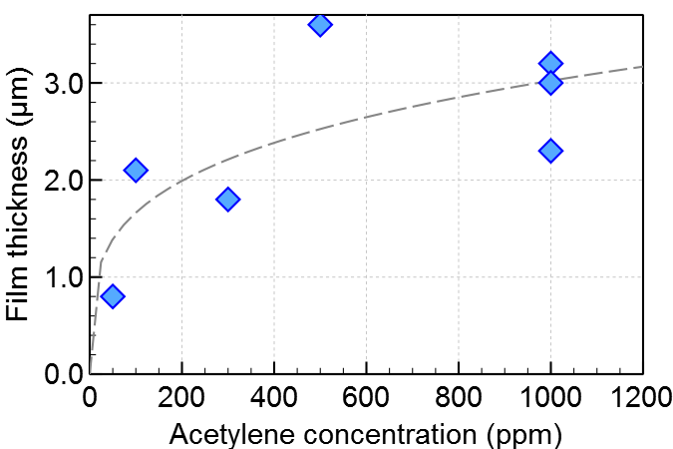
Deposition Rates
Typ. 4-7 μm/min.
30 sec.

Slide 37
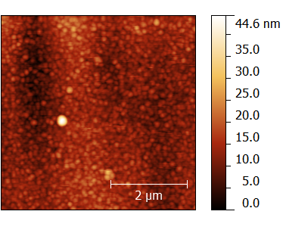
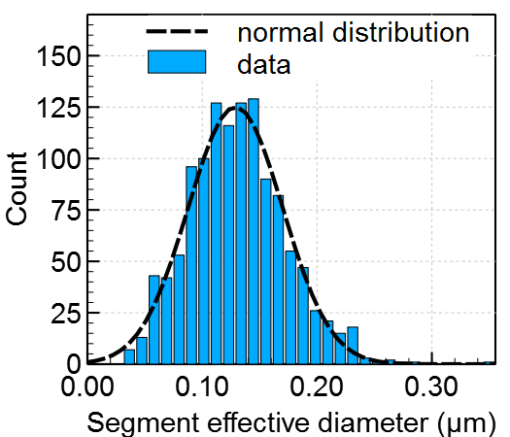
Grain size methodology
Contrast enhancement followed by watershed segmentation
Resulting grain sizes typically follow a normal distribution

Slide 38
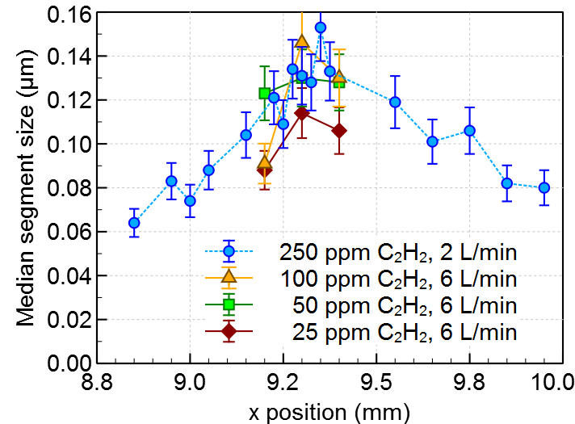
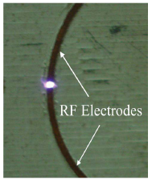
Grain Size
Smaller grains at the peripheral regions
Weakly dependent on concentration
Independent of flow (i.e., gas residence time)
→unlikely to be gas-phase nucleation of particles
1 mm
1 mm
x
y

Slide 39
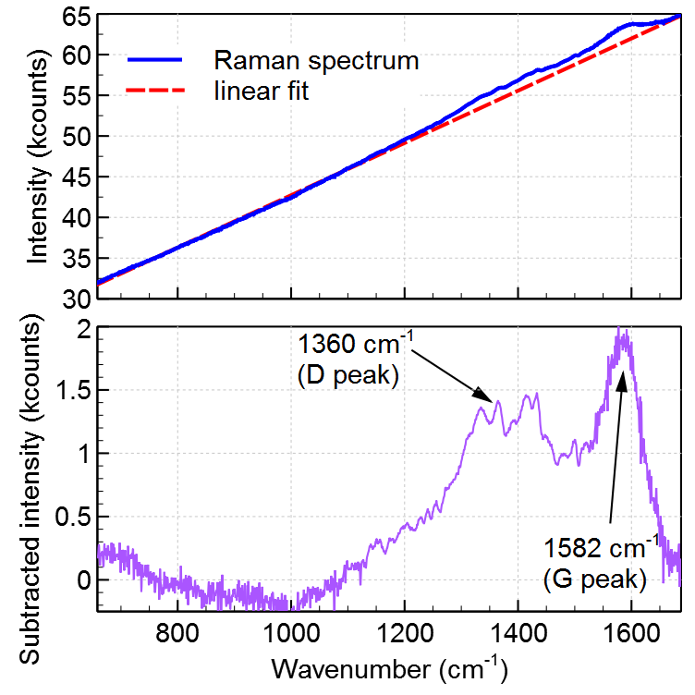
Raman Spectroscopy
D and G peaks typically observed for both DLC and polycrystalline graphite
D (1360 cm⁻¹) and G (1582 cm⁻¹) peaks are present
Significant fluorescence from glass substrate

Slide 40
DLC Observations
Typically, DLC film deposition requires ion bombardment energy of ~100 eV (e.g., low pressure PECVD)
1 atm: frequent ion-neutral collisions limit ion energy < 1 eV!
Two possibilities for energetic deposition at 1 atm:
100 eV
1 eV
⁺
⁺
⁺
⁺
⁺
⁺
⁺
⁺
1 Pa
1 atm
*
Ar* ~ 11.5 eV
  Very high ion fluxes: energy flux = ion flux * ion energy
*
*
*
*
⁺
*
*
*
*
*
*
*
*
*
Microplasma ion flux is 5x10¹⁷ cm⁻²s⁻²
→ 25x that of an ICP or DBD
Energy delivered by metastable states: Ar*→Ar + energy
Microplasma [Ar^{m}] is >10¹³ cm⁻³
~100x that of an ICP or DBD

Slide 41
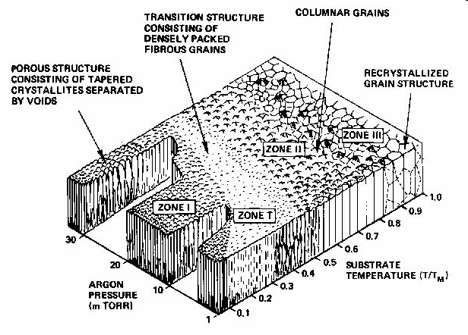
Thorton’s view on (ion) energy
Zone Model
increasing substrate
energy (temp.)
increasing ion (or sputtered neutral) energy

Slide 42
Outline
Overview and Motivation
Microplasmas driven at microwave frequency
  Principle of operation
  Diagnostics
Microplasma deposition using C₂H₂ + He
Arrays of microplasmas (1-D and 2-D)
Conclusion

Slide 43

Goal: plasma processing of flexible substrates at 1 atm
Problem:
½ wavelength ~ plasma size (usually)

Slide 44
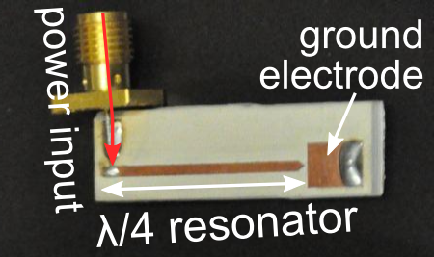
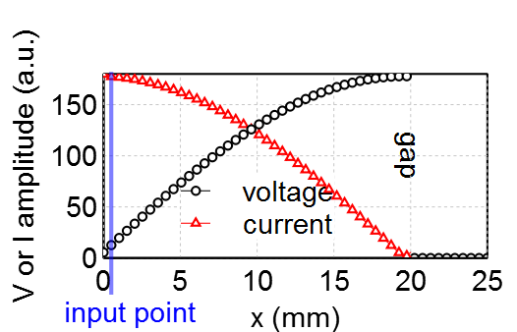
A scalable geometry
Split-ring resonator→ Quarter-wave resonator
V/I = 50 Ω

Slide 45
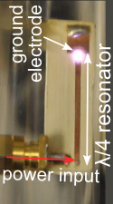
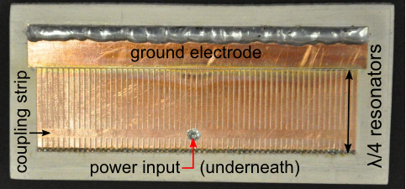
Single Resonator → 1D array
Resonant power sharing allows operating an array from a single microwave source
Each microplasma is stabilized by it’s resonator
Resonant power sharing
60 quarter-wave resonators: 75mm long
Wu, Hoskinson, and Hopwood, Plasma Sources Science and Technology 20, 045022 (2011).

Slide 46
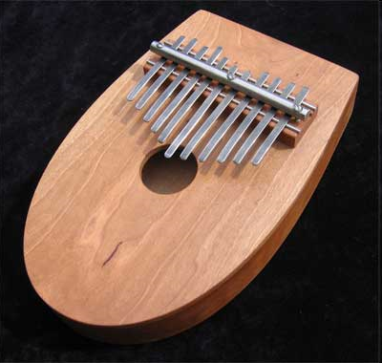
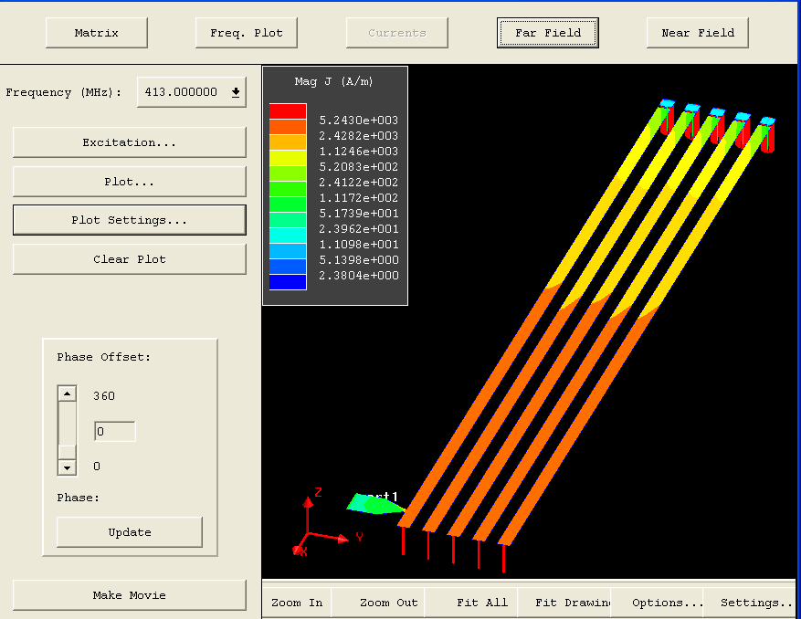
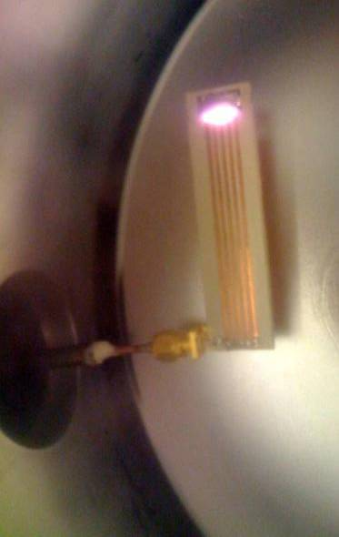
Coupled microwave resonators
matched resonators share power from a single power source
Thumb Piano
Five Microwave Resonators

Slide 47
Coupled Mode Theory and Simulation
A single, driven resonator shares energy very efficiently with other identical resonators according to CMT:
The amplitude of resonator m changes in time due to…
Damping/energy loss (decreases)
Energy input (increases)
Energy coupling from all
other resonators, n≠m.
(increases)

Slide 48
Coupled Mode Theory and Simulation
a single input
See: H. A. Haus and W. Huang, Proc. IEEE 79, 1505 (1991) and
A. Karalis, J. D. Joannopoulos and M. Soljačić, Ann. Phys. 323, 34 (2008).
Amplitude of m^{th} resonator
A system of p resonators results in a p x p eigenvector/eigenvalue problem (F→0)
The p eigenvalues are the resonance frequencies of the coupled resonator system.
The p eigenvectors provide the amplitudes of each resonator.

Slide 49






C. Wu, A. Hoskinson, J. Hopwood, Plasma Sources Sci Technol, 2011

Slide 50


Input port
88 resonators
Dielectric layer
Ground plane
ε_{r} = 10
Note: λ/2 = 9 mm!

Slide 51
Array Stability
Operation of (micro) plasmas in parallel is difficult due to negative differential resistance
Any perturbation causes one microplasma to take more current at a reduced voltage
Three solutions
  Ballast resistors
  Transient discharges (capacitive ballast)
  Strongly coupled resonators

Slide 52


Array Stability
Parallel Operation of Microplasmas (DC)
v
Si
H.V.
Ballast resistances formed in lightly doped Si

Slide 53
Array Stability
Parallel Operation of Microplasmas (DBD)
A.C.
J. G. Eden et al. J. Phys. D: Appl. Phys. 39 (2006) R55–R70
Ballast capacitances formed by a dielectric layer

Slide 54

Array Stability
Parallel Operation of Microplasmas (DBD)
Transient plasma propagation is shown by 2D maps of the optical emission [1] from a 10*10 pixel segment of the DBD microcavity microplasma array plotted in false color. The temporal evolution of the initial burst of the emission in argon at f =10 kHz, p=750torr, and Vpp=780 V is shown. (Δt=200 ns)
J. Waskoenig, D. O’Connell, V. Schulz-von der Gathen, J. Winter, S.-J. Park, and J. G. Eden, “Spatial dynamics of the light emission from a microplasma array”, Appl. Phys. Lett. vol. 92, 101503, 2008

Slide 55

Array Stability
1D microwave resonator array
Ignites uniformly on central resonators, then expands to outermost resonators (~ 20 ns)
Continuous operation after ignition
Much faster than DBD arrays (~ 200ns)
50 Torr

Slide 56

Array Stability
1D microwave resonator array

Slide 57
Dimensional Scaling: 2D arrays

Slide 58

2D Arrays

Slide 59



2D microplasma array (5x5)
Teflon spacer
ground strip
5 mm
resonator ends
5 mm
750 Torr argon
472 MHz
5.9W
150 μm
See: Alan Hoskinson and Jeffrey Hopwood, Plasma Sources Science and Technology 21 052002 (2012).

Slide 60
Conclusion
A stable high-density microplasma can be sustained by <1 W of microwave power at low gas temperature
  operation for 2000+ hours
DLC deposition is possible at 1 atm
  - low particle energy, but high energy flux
Arrays of microplasmas are possible using a single microwave source
  - power sharing among resonators stabilizes the parallel cw operation of discharges
Stable microplasma arrays may lead to roll coating at 1 atm

Slide 61
Questions

Slide 62
Gas Chromatography and Emission Spectroscopy using a Microplasma
Application: sensing sulfur compounds in natural gas and oil in the field
Problem: differential thermal detectors used with low-cost gas chromatographs are insensitive to H₂S.
Solution: flow the effluent of a gas chromatograph through a microplasma and measure the emission spectra vs. time.

Slide 63

Emission Spectrometry Configuration
: 700 Torr
0.3 or 1.0w
500 ppm methane (Airgas)
500 ppm n-butane (Airgas)
515 ppm carbon dioxide (Airgas)
100 ppm hydrogen sulfide (Scott)
Hoskinson and Hopwood, JAAS 26(6), 1258 – 1264 (2011)

Slide 64


Results: CH₄ and C₄H₁₀
CH 431nm
DL ~ 2 ppm

Slide 65


Results: C0₂
O – 777nm
DL ~ 3 ppm

Slide 66


Results: H₂S
S – 924 nm
DL ~ 0.7 ppm

Slide 67

Results: with 0.3% air contamination a surrogate for a device in the field
DL(CH₄): 2 ppm → 10 ppm
DL (H₂S): 0.7 ppm → 2 ppm

Slide 68

GC Demonstration
Synthetic natural gas
Microplasma + OES
http://en.wikipedia.org/wiki/Gas_chromatography

Slide 69


GC demonstration
GC
Lab-built gas chromatograph @ 120 C
Divinylbenzene 4-vinylpyridine-coated column
Helium flow: 6 mL /min. @ 1 atm
No make-up gas
2 μL sample injection: 10% synthetic natural gas in helium
Hoskinson and Hopwood, JAAS 26(6), 1258 – 1264 (2011)

Slide 70


Commercial Gas Sensors using Microplasma and OES

Slide 71
Gas Sensors
Improvement on thermal conductivity detection for field-portable sensors through separation in time and emission wavelength

Slide 72
Conclusion
A stable high-density microplasma can be sustained by <1 W of microwave power at low gas temperature
  operation for 2000+ hours
DLC deposition is possible at 1 atm
  - low particle energy, but high energy flux
Arrays of microplasmas are possible using a single microwave source
  - power sharing among resonators stabilizes the parallel cw operation of discharges
Stable microplasma arrays may lead to roll coating at 1 atm

