Slide 1

Coding Plasma Chemistry for Cellular Metabolism
Michael Kong
Old Dominion University, Virginia

Slide 2
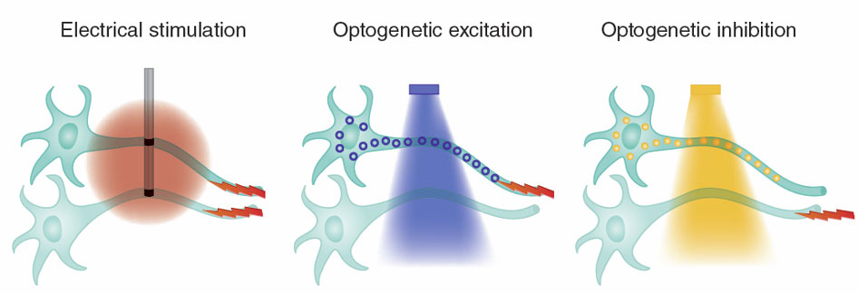
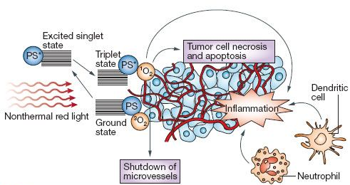
Gas Plasma as a Novel Therapy
Examples of physics-based therapies (… in addition to imaging and diagnosis)
Materials – bone and tissue repair, implants...
Pulsed electric field – spinal cord injury; tumor ablation, pacemakers
Light – optogenetics, laser surgery, photodynamic therapy (PDT)
Electricity
Light
Oxygen (ROS)
Reactive Oxygen Species
(ROS)
Deisseroth K et al (2011) Nat Methods 8: 26 – 29.
Castano AP et al (2006) Nat Rev Cancer 6: 535 – 545.

Slide 3
Plasma Therapy | Plasma Medicine
Reactive Oxygen Species (ROS)
H₂O₂, OH•, O₂-•, HOO•, ¹O₂•, O₃
Reactive Nitrogen Species (RNS)
NO•, ONOO^{-•}; O=NOOH•, NO₂, NO₃.
cell death,
cell proliferation
protein and lipid oxidation
cytokine release
…
Already FDA approved
argon plasma coagulation
plasma tissue ablation
Clinical Trials
chronic wound healing
skin diseases (pilots)
Laboratory Studies
wound healing
cancer (many kinds)
tissue regeneration
microbial disinfection
gene delivery…
Photodynamic Therapy (PDT):
First observation in 1900,
Niels Finsen won a Nobel Prize in 1903
116 years on..
→ Huge potential and huge challenge!
Kong MG et al (2011) J Phys D: Appl Phys 44: 174018;
Fridman G et al (2008) Plasma Process Polym 8: 503 – 533.
Kong MG et al (2009) New J Phys 11: 115012.
Graves DB (2012) J Phys D: Appl Phys 45: 263001.
Dolmans D EJGJ et al (2003) Nat Rev Cancer 3: 380.

Slide 4
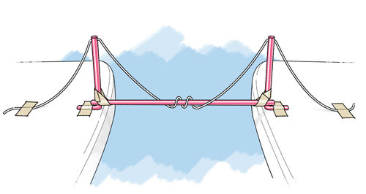
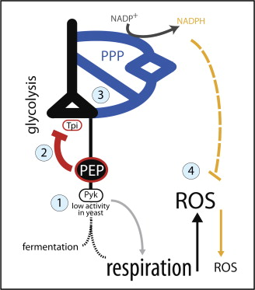
Plasma Therapy | Tool of Translation
physical science
& technology
mode of action
tool of translation
translation
space
Tissue Ablation
force, heat
chemistry
empirical
Coagulation
CAP
exogenous ROS
redox chemistry
cancer
wound healing
redox biology
regeneration
Others…
Gruning N-M et al (2011) Cell Metabolism 14: 415 – 427.

Slide 5
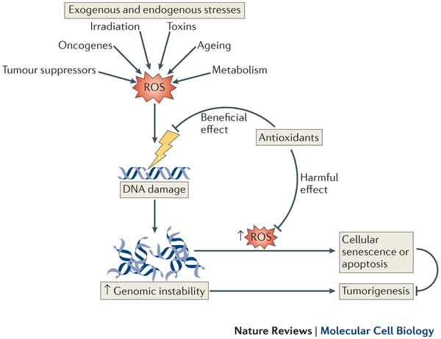
Confusion and Multifacts
ageing
diseases
Holmstrom KM and Finkel T (2014) Nat Rev Mol Cell Biol. 15: 411 – 421
Turrens JF (2003) J Physiol 552: 335 – 344.

Slide 6
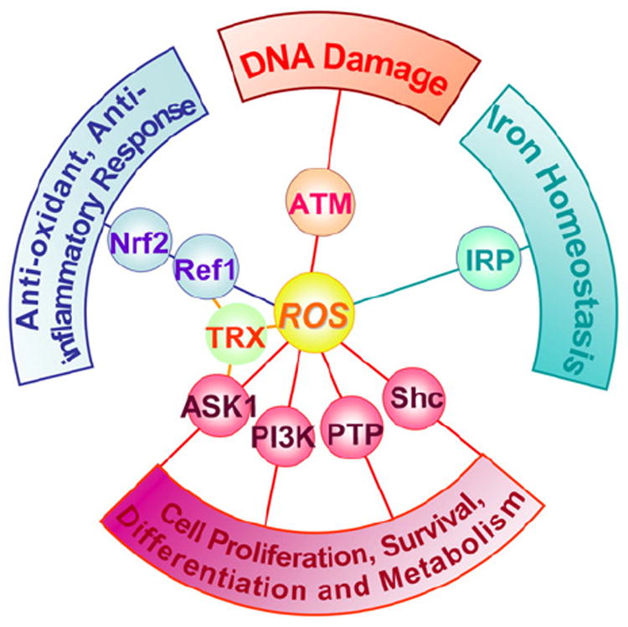
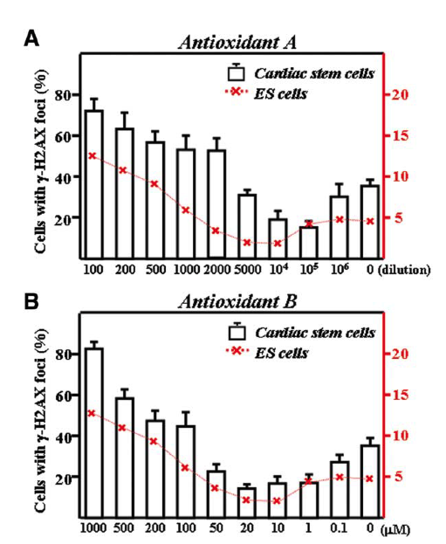
Multifaceted | Redox Regulation
Genomic Stability with little ROS
γ-H2AX foci is a marker DNA double strain breaks. Too little ROS causes DNA double strain damages. → vitamin C supplement
When to induce cell survival and when to induce DNA damage?
A wired network – CAP as a commander or a regulator? How, with doses?
Li T (2010) Stem Cells
Chlebowski RT et al (2008) J Nat Cancer Inst 100: 1581
Moertel CG et al (1985) New Engl J Med 312: 137 - 141.
Ray PD (2012) Cellular Signal. 24: 981 – 990.

Slide 7
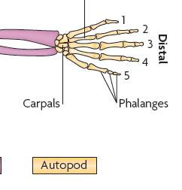
Multifaceted | Regeneration and Apoptosis
Enhanced tissue proliferation
Anti-tumor and apoptosis
ROS dose unknown,
Air plasma conditions:
1.15W; 20kV/1kHz, 2mm gap; 10 s
ROS dose qualitatively known
Air plasma conditions:
0.58W; 23kV/200Hz, 2mm gap; 6 min
Chernets N et al (2015) Tissue Eng: Part A 21: 300 - 310
Vandamme M et al (2012) Int J Cancer 130: 2185 – 2194.
Application risk – how not to proliferate tumor and how not to damage healthy tissues
Scientific unknown – what is plasma dose and what criteria with which to manipulate dose

Slide 8
Multifaceted | Dose vs Chemical Ingredients
Equivalent Dose for air and He+O₂ plasma?
at exactly the same dissipated energy
Pulsed excitation with 200ns duration at 5kHz
He+O₂(0.5%) at 4kV and Air at 5.9kV, both at 3W
He+O₂
He+O₂
Air
Air
very different optical emission spectra
→ dose and chemical compositions
Walsh JL et al (2010) J Phys D: Appl Phys 43: 032001

Slide 9
Multifaceted | Types of Intracellular ROS
Cellular responses to
different composition of ROS cocktails
The case of microbes
The case of cancer cells
High O₂⁻/H₂O₂ ratio supports cell survivals and confers drug resistance to tumor cells
Lukes P et al (2014) Plasma Sources Sci Technol 23: 015019.
Pervaiz S et al (2007) Int J Biochem Cell Biol 39: 1297
Zhu P et al (2011) Cancer Cell 19: 401.

Slide 10
Multifaceted | Current Roadblocks
Knowledge gap is a major bottleneck for innovation
CAP
exogenous ROS
cancer
wound healing
knowledge
redox chemistry
regeneration
redox biology
unknown
ROS/RNS dose
composition
timescale
…
Others…
no control
targeted effects
toxicity
reproducibility
…

Slide 11
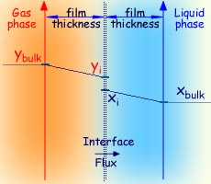
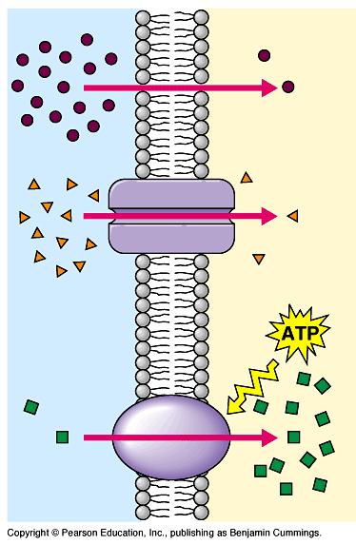
Aqueous Plasma Chemistry
Transfer of gaseous ROS, primary reactions, and secondary reactions
Gas-phase Chemistry
Liquid-phase Chemistry
Intracellular Chemistry
cellular functions
redox
signaling

Slide 12
Aqueous Chemistry | Modeling
Multiple-scale modeling
Tian W and Kushner MJ (2014) J Phys D: Appl Phys 47: 165201.

Slide 13
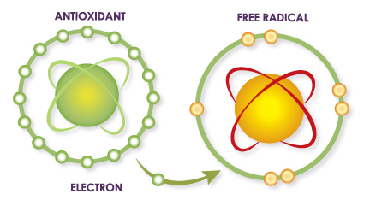
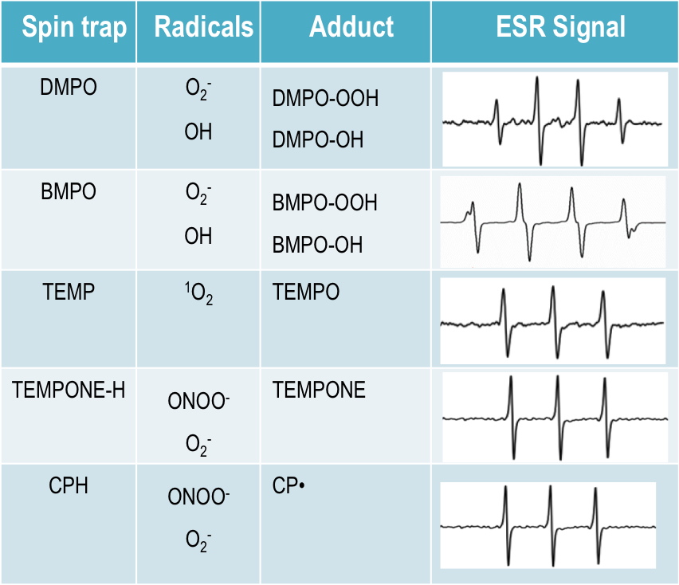
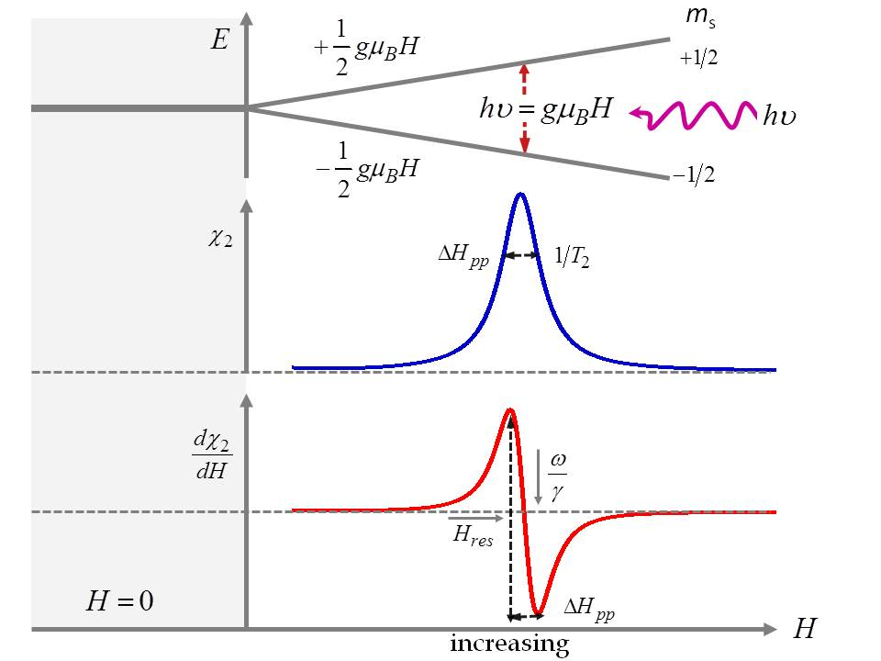
Aqueous Chemistry | Diagnostics: Radicals
Free Radicals + ESR
unpaired electrons
diamagnetic
paramagnetic
Quantitative in principle, not always specific

Slide 14
Aqueous Chemistry | A Helium Plasma Jet
Quantitative Measurement
Long-lived species:
Colorimetric probes (H₂O₂, nitrate, nitrite)
Short-lived species:
Electron-spin resonance (ESR/EPR)
Plasma Conditions
23kHz, 1.1W, and 3 slm of He.
Simulation
Include plasma region, after-glow region and bulk liquid.
No air admixture
Chen C et al (2014) Plasma Chem Plasma Process 34: 403 - 441.

Slide 15
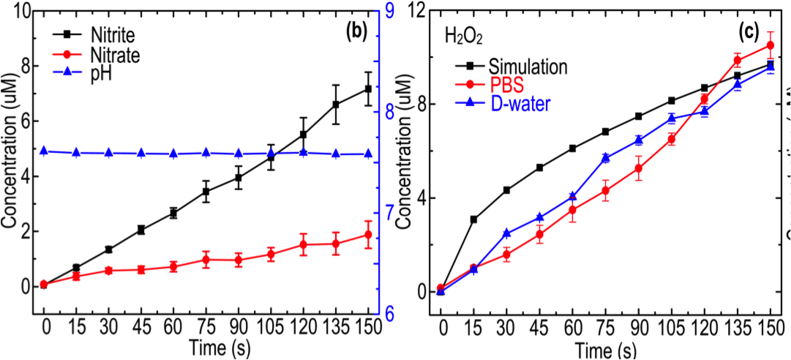
Aqueous Chemistry | Long-Lived ROS
Long-Lived Reactive Species – H₂O₂, Nitrate, and Nitrite
in phosphate buffered saline (PBS) and around physiological pH (~7.5)
Physiological concentration – for H₂O₂, it is ~100nM at pH = 7.4 in human erythrocytes;
H₂O₂ Concentration Control – a 5 s step of plasma treatment is equivalent to a H₂O₂ concentration step of ~340nM, just above the physiological H₂O₂ concentration. For other ROS, their concentration steps are even smaller. → Precision ROS control

Slide 16
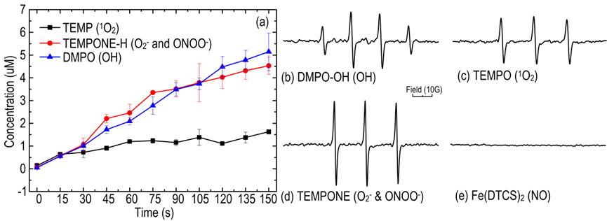
Aqueous Chemistry | Short-Lived ROS
Radicals in PBS: ¹O₂, O₂⁻, ONOO⁻ and OH
…around physiological pH (~7.5)
ESR Spectrum at the end of 150 s plasma treatment
detection limit ~ 100nM
He/Ar+O₂ | ONOO⁻/ONOOH | NO | O₂⁻ | ¹O₂ | OH
detected | ✗ | ✓ | ✓ | ✓ | ✓
concentration (μM) | ✗ | 1.6 in air plasma | 56 | 600 | 2-210
non-ESR methods | Indirectly detected or inferred, little quantitative information
Wu H et al (2012) PPP 9: 417. Tresp H et al JPD (2013) 46: 435401; Takamatus T (2014) RSC Adv 4: 399901;
Lukes P et al (2014) PSST 23: 015019; Oehmigen K et al (2011) PPP 8: 904; Naitali M et al (2010) AEM76: 7662;

Slide 17
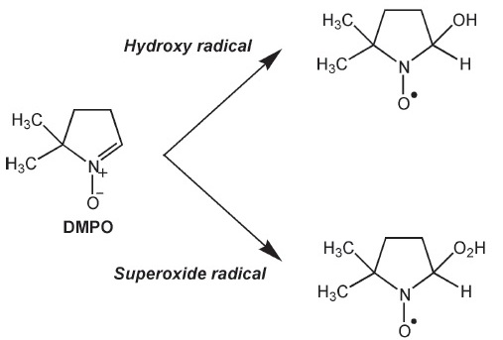
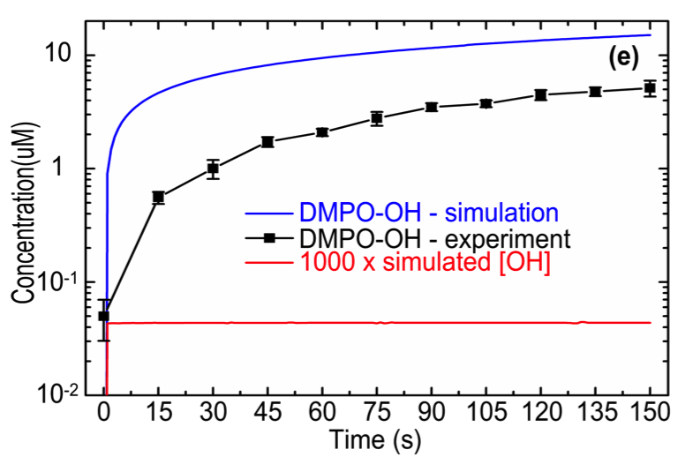
Aqueous Chemistry | Short-Lived ROS: Case of OH
Spin-trapping adducts data
An issue with timescales
OH• radicals are generated, lost very quickly (ns scale), and replenished. Not all generated OH• molecules contribute to a steady-state OH• concentration, if it is reached.
Spin-trapping adducts are stable and do not account for the loss of OH radicals. The half-life between DMPO-OH and OH• is ~10 orders of magnitude.
OH• lifetime | A few ns
DMPO adduct time | 10 min
DMPO reaction with OH• | k_{OH•} > 10⁹ M⁻¹ s⁻¹
DMPO reaction with O₂^{-•} | k_{O2-•} < 10² M⁻¹ s⁻¹
DMPO-OH signals have contribution from both OH• and O₂^{-•}. At pH = 7.4, OH dominates. The O₂^{-•} concentration is not insignificant.
Janzen EG and Blackburn B (1968) JACS 90: 5909.

Slide 18
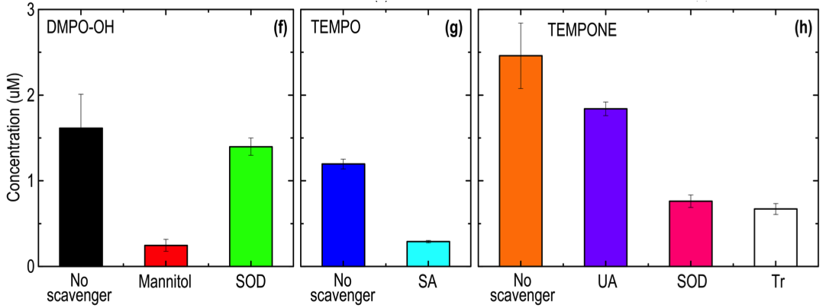
Aqueous Chemistry | Chemical Composition Profile
Improving Specificity
DMPO-OH:
for OH• and O₂^{-•}
Mannitol and SOD
scavenge OH• and O₂^{-•} respectively
TEMPO:
for ¹O₂•
scavenged by
sodium azide (SA).
TEMPONE: for ONOO^{-•}, O₂^{-•}
and HOO•. Scavenged by uric acid (UA, for ONOO^{-•}), SOD (O₂^{-•}) and trolox (Tr, for HOO•, the protonated form of O₂^{-•}
ESR | He+O₂ | ONOO⁻/ONOOH | ¹O₂ | O₂⁻ | HOO | NO | OH | H₂O₂ | nitrite | nitrate
concentration (μM) | 0.5 - 1 | 0.7-1 | 1-2 | 1-2 | <0.1 | <0.1 | 10-11 | 7 | 2
At pH ~ 7.4 – 7.6, plasma treatment = 150s; dissipated electrical power = 1.1W.
A defined cocktail of ROS/RNS with known composition and precision dose control (340nM steps)

Slide 19
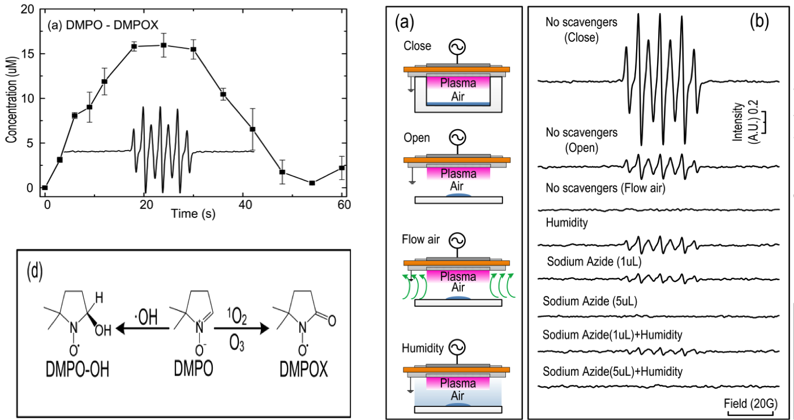
Aqueous Chemistry | Surface Air Plasmas
An environment of multiple ROS
– an unprecedented challenges to spin traps
DMPO-OH is oxidized to DMPO-X

Slide 20
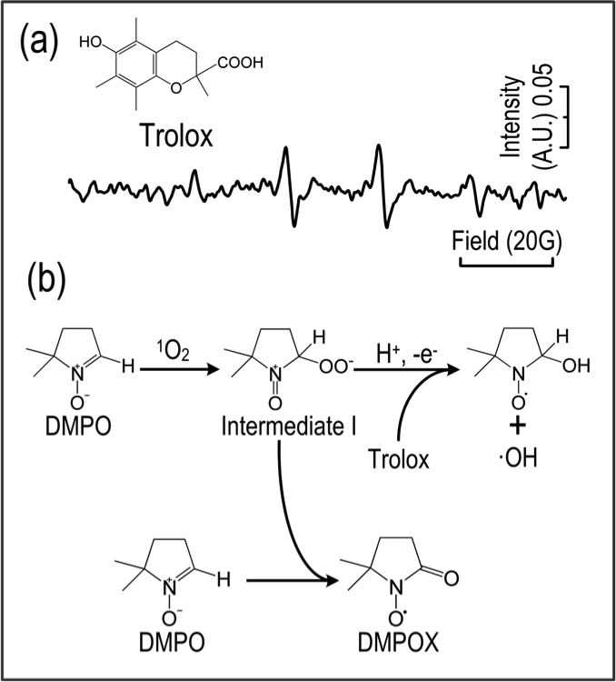
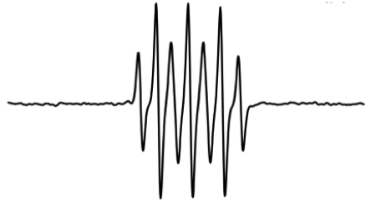
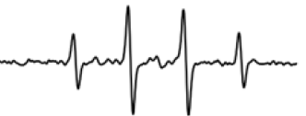
Aqueous Chemistry | Spin Traps; Scavengers
DMPO-Scavenger Interactions
¹O₂ scavenger
DMPO-X pattern
DMPO-OH pattern
The interactions between spin traps and scavengers. (a) the signal of DMPO-OH appears after the addition of Trolox and the proposed reaction mechanism (b).

Slide 21
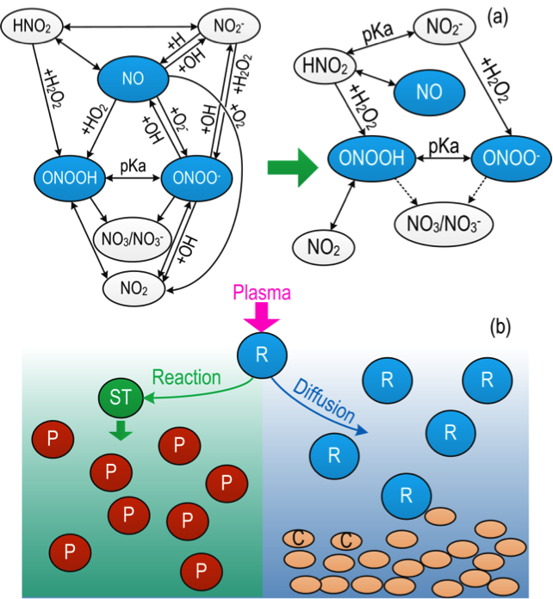
Aqueous Chemistry | Chemical Pathway
endogenous ROS/RNS
Chemical composition (types)
Concentration profile (amount)
Sites of generation and action
…
exogenous ROS/RNS
Chemical composition (types)
Concentration profile (amount)
Penetration depth + pattern
Temporal profiles
Selected chemical pathways: Spin traps (ST), cell (C) R: plasma generated radicals; P: products by spin traps and radicals

Slide 22
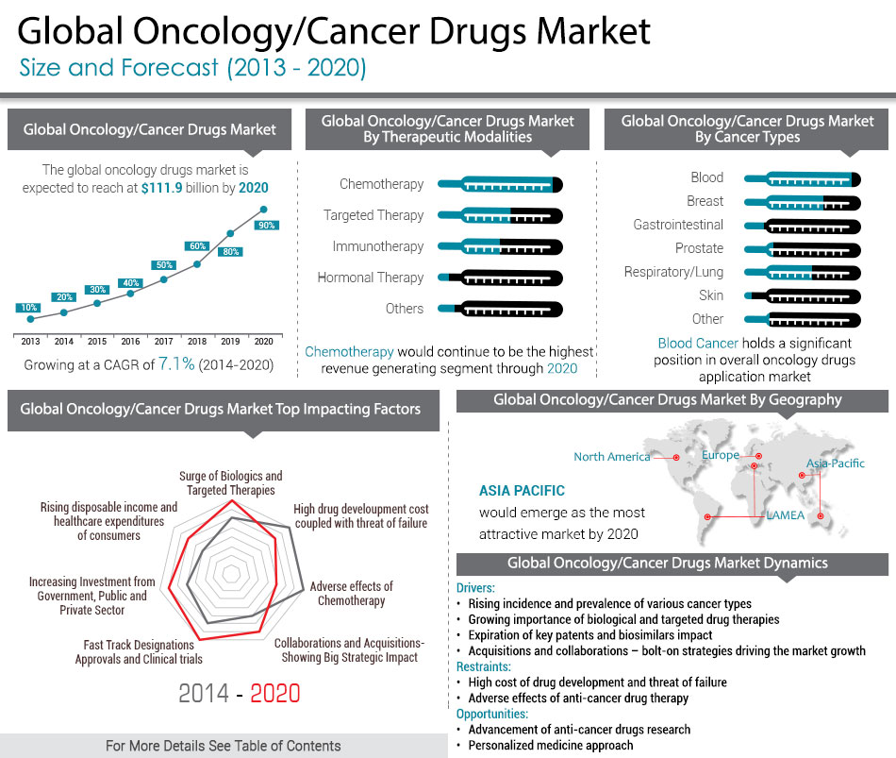
Metabolism: the Case of Leukemia
Cancer therapies
Surgery
Radiation therapy
Chemotherapy
Immunotherapy
Targeted therapy
Precision medicine
Hormone therapy
Stem cell therapy
Targets changes in cancer cells that drive cancer, using small molecules and antibodies, and is the foundation of precision medicine
Global oncology/cancer drug market: size and forecast (2013 – 2020)
from Nat Institute of Cancer
https://www.alliedmarketresearch.com/oncology-cancer-drugs-market; visited on 02/16/2016

Slide 23
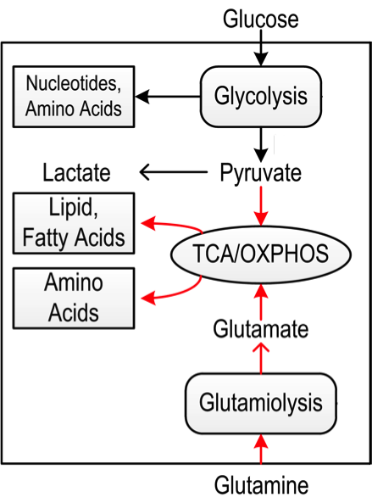
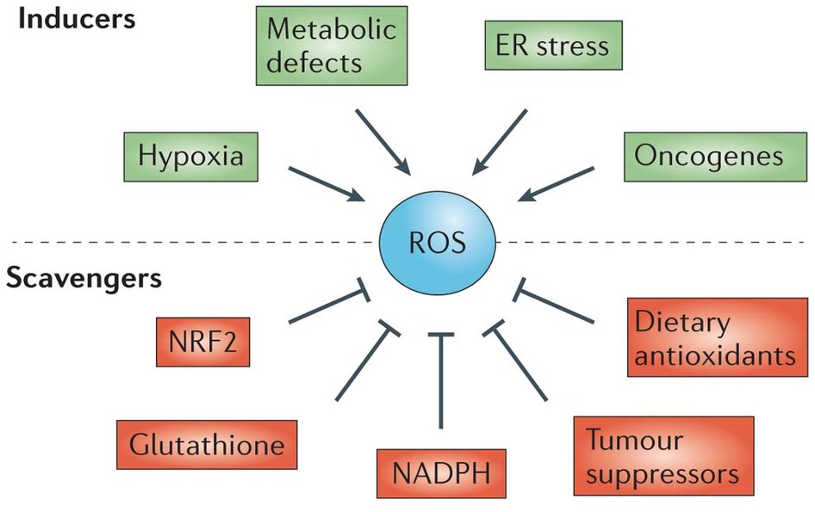
Cancer Metabolism| Redox Regulation
Redox Regulation
Cancer cells – more metabolism activities, more ROS, and greater burden on cellular antioxidant capacity.
Therapeutic opportunities – greater oxidative stress to cancer cells than normal cells with exogenous ROS
TCA: tricarboxylic acid cycle
OXPHOS: oxidative phosphorylation
Glutamiolysis → cellular antioxidant
Red arrow: altered paths of cancer cells
Cairns RA et al (2011) Nat Rev Cancer 11: 85; Ward PS and Thompson CB (2012) Cancer Cell 21: 297;
Deberadinis RJ et al (2015) Cell 148: 1132. Galluzzi L et al (2013) Nat Rev Drug Discov 12: 829.
Trachootham D et al (2009) Nat Rev Drug Discov 8: 579; Gorrini C et al (2013) Nat Rev Drug Discov 12: 931

Slide 24
Cancer Metabolism| CML and TKI
Cancer: chronic myeloid leukemia (CML)
Targets: tyrosine kinase
Small molecules: tyrosine kinase inhibitors (TKI), e.g. Gleevec, one of the most successful targeted therapies of all cancers
Problems: drug resistance. Gleevec-resistant T315 mutations.
Cells: murine cell lines Ba/F3 (healthy),
Ba/F3 p210 (cancer cells)
Ba/F3 T315I (drug resistant cancer cells)
in-vitro efficacy is known to possess high probability
of being reproduced clinically
Unknown: T315T cells are under greater oxidative stress
Plasma: Ar+O₂ plasma jet (converged from some 12 plasma conditions to achieve selectivity)
ESR | Ar+O₂ | ONOO⁻/ONOOH | ¹O₂ | O₂⁻ | HOO | NO | OH | H₂O₂ | nitrite | nitrate
concentration (μM) | 0.5 - 3 | 1-3 | 2-6 | 2-6 | <0.1 | <0.1 | 14-20 | 12-16 | 4-8

Slide 25
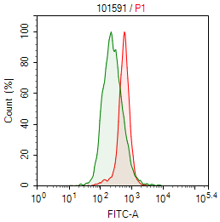
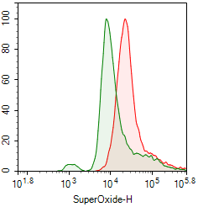
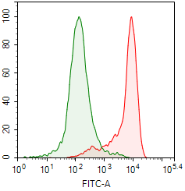
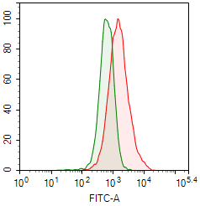
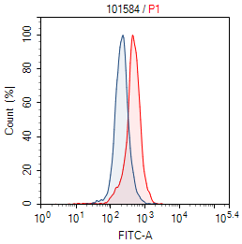
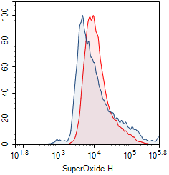
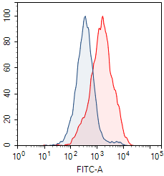
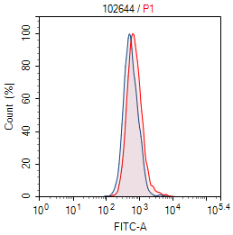
Cancer Metabolism| Intracellular ROS
Measured at one hour after plasma treatment
T315I
ROS (H₂O₂/OH•) OH• etc)
O₂^{-•}
NO•
ONOO^{-•}
Ba/F3

Slide 26
Cancer Metabolism| Intracellular ROS
Measured at one hour after plasma treatment
L
ML
MH
H
Intracellular ROS levels (measured with flow + dyes) |  | H₂O₂/OH
 | Ba/F3 | 254%
 | T315I | 273%
O₂⁻
145%
679%
peroxynitrite
132%
990%
NO
226%
1092%
extracellular ROS concentration (μM) (measured with ESR) | OH | H₂O₂ | O₂⁻ | HOO | peroxynitrite | NO | nitrite | nitrate
 | <0.1 | 14-20 | 2-6 | 2-6 | 0.5 - 3 | <0.1 | 12-16 | 4-8
Membrane-permeability | v. low | v. low | v low | v low | very low | high
Biological half-life (s) | 10⁻⁹ | 10⁻⁵ | 10⁻⁶ |  | ~1 | <1
No obvious transfer function of ROS from extracellular to intracellular. Two possible reasons:
Half-life and cellular antioxidants
  abundant cellular antioxidants
  (e.g. SOD for O₂⁻, catalase for H₂O₂)
Secondary reactions
  2HNO₂ → NO• + NO₂+H₂O; O₂^{-•} + NO• → ONOO^{-•}
  O=NOOH• ←→ OH• + NO₂
  OH• + ONOO^{-•} → NO• + OH⁻ + O₂
Liu ZC et al (2015) JPD 48 495201; Brisset JL et al (2012) PCPP 32: 655; Lukes P et al (2014) PSST 23: 015019.

Slide 27
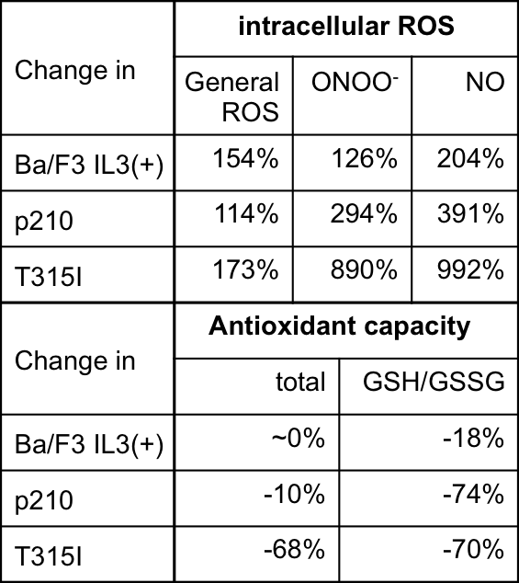
Cancer Metabolism| Cellular Antioxidant
plasma
 | measured at 6h
 | Total | GSH/GSSG
Ba/F3 | No change?!
p210
T315I
measured at 24h
Total | GSH/GSSG
0% | -18%
-10% | -74%
-68% | -70%
GSH: reduced glutathione
GSSH: oxidized glutathione
GSH is not effectively renewed.
To study other antioxidants, e.g. NADPH

Slide 28
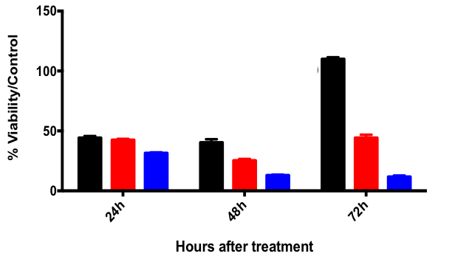
Cancer Metabolism| Selectivity and Applicability
XTT Results (confirmed with brdu, data not shown)
Ba/F3, the healthy cells, are little damaged
Ba/F3
Ba/F3 p210
Ba/F3 p210 T315I
Delayed effects – (1) apoptosis is usually observed after 24 – 48 hours; (2) antioxidant response needs time to take place
T315I is drug resistant
FDA approved TKIs | Cancer types
Imatinib, dasatinib, nilotinib, bosutinib | CML, acute lymphoma leukemia, GIST (gastrointestinal stromal tumor)
Gefitinib, Crizotinib | NSCLC (non-small cell lung carcinoma)
Erlotinib | Lung
Lapatinib | Breast, others
Sunitinib, sorafenib, Pazopanib | Renal, prostate, hepatocellular, soft tissue sarcoma, GIST
Regorafenib | Colorectal
Vandetanib, Cabozantinib | Medullary thyroid

Slide 29
Cancer Metabolism| Cell Survival and Drug Resistance
Cancer cells have multiple routes of evading drug actions and hence developing drug resistance. One common route is the PI3k/Akt/mTOR pathway that is central to cell survival.
For CML, the PI3K/Akt/mTOR pathway is involved in its drug resistance.
Inhibition of one or more nodes of the pathway is an important therapeutic targets for circumventing drug resistance for CML.

Slide 30
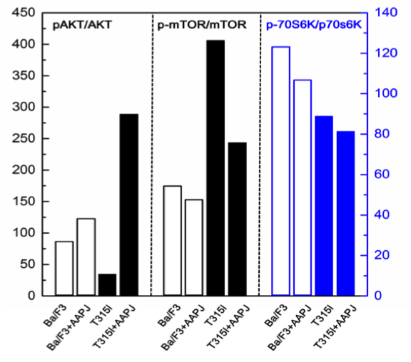
Cancer Metabolism| Overcoming Drug Resistance
CML – Western blotting measured at 6hr after plasma treatment, showing reduced activities of mTOR and p70s6K.
This is being repeated at 24hr.
Western blotting measured at 24hr after treatment of human glioblastoma brain cell lines (U251SP) with plasma activated medium, showing simultaneous inhibition of Akt and mTOR.
Tanaka H et al. (2012) Plasma Med 2: 207

Slide 31
Cancer Metabolism| Plasma-modulated metabolism
Exogenous plasma ROS
H₂O₂ | 14-20μM
nitrite | 12-16μM
nitrate | 4-8μM
O₂^{-•} | 2-6μM
OH• | <100nM
NO• | <100nM
ONOO^{-•} | 0.5- 3μM
Cancer
Regeneration
Others…

Slide 32
towards precision plasma biomedicine
Molecular Understanding
Redox Regulation
Biological Efficacy
+ Translation
Aqueous Plasma Chemistry
Gaseous Chemistry
Plasma Technology
Addressable Applications
Cancer
Regeneration Medicine
…

Slide 33
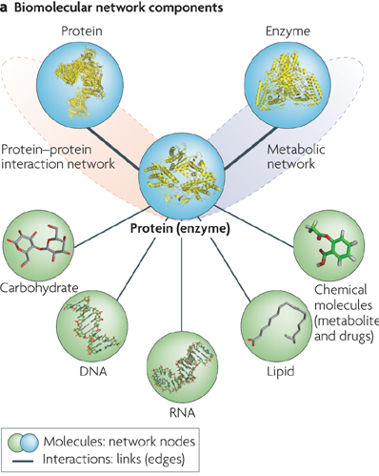
Precision Medicine| Plasma-modulated metabolism
Where do we (physicists/engineers) stop?
Interactions of plasma ROS cocktail with biomolecules (proteins) are a new game to everyone
ROS/RNS
- regulators
biomolecules
the regulated
Functionality
Yamada T and Bork P (2009) Nat Rev Cell Biol 10: 791 – 803.

Slide 34
Precision Medicine| Plasma ROS Interaction with A-β

Slide 35
Precision Medicine| A-β under attack by O₂⁻
O₂⁻ molecules are attracted to hydrogen bonds (weaker than covalent bonds) and capable of eliciting bone breakage. Implication of structural changes and mutation, possibly.

Slide 36
Precision Medicine| A-β under attack by H₂O₂
H₂O₂ molecules are ineffective in bone breakage. They produce reactive oxygen intermediates (ROI) that are attached to peptides, for example, peptide-(H₂O₂)n, H₂O₂-peptide-O₂—H₂O₂-O₂-peptide. These ROI are short-lived and undergo dynamic attachment/detachment with peptides.

Slide 37
Acknowledgement
Co-PI: Dr Hai-Lan Chen
Researchers
Francis Li
Scott Pendleton
Sudhir Bhatt
Chen Chen
Xiaofei Zhang
Carlo Rotta
Jacob Manjarrez
Previous researchers
James Walsh
Danny Bayliss
Collaborators
Bill Keevil, Southampton University
Felipe Iza, Loughborough University
Gilbert Shama, Loughborough University
Paul Lu, UCSD
Cam Carter, Air Force
Bish Ganguly, Air Force
Dingxin Liu, Xi’an Jiaotong University

