Slide 1
Compact High-brilliance Synchrotron Source Driven by a Tabletop Laser
C. McGuffey ª, W. Schumaker ª, S. Kneip ^{b}, F. Dollar ª, A. Maksimchukª, A. G. R. Thomas ª, and K. Krushelnick ª
(a) University of Michigan, Center for Ultrafast Optical Science
(b) Imperial College, London
Michigan Institute for Plasma Science & Engineering seminar
2010.09.29

Slide 2
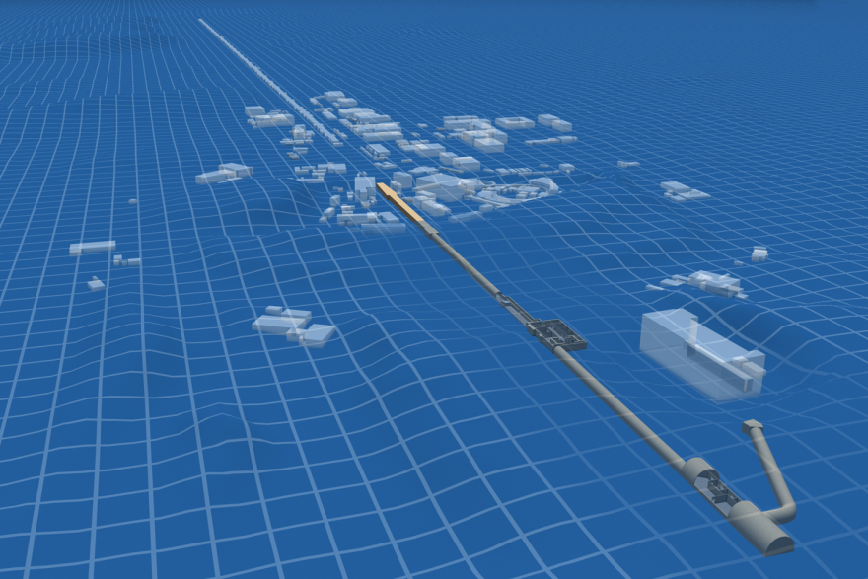
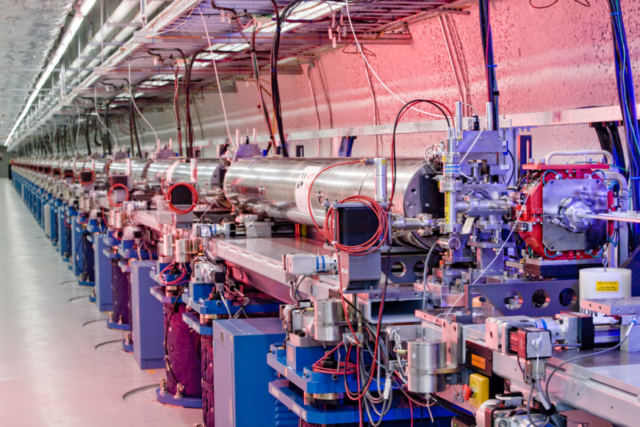
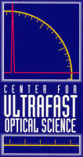
Extreme light sources in high demand
Linac Coherent Light Source (SLAC)
3 km total length
$379M upgrade
100 fs x-ray pulses @ 120 Hz
up to 8 keV
Advanced Photon Source (ANL)
Spectral brightness 5x10¹⁹ photons/s/mm²/mrad²/0.1%BW up to 40 keV
Advanced Light Source (LBNL)
Diamond (U.K.)
European Synchrotron Radiation Facility (France)
lcls.slac.standford.edu

Slide 3
Overview
Introduction to Laser Wakefield Acceleration (LWFA) and radiation generation
Characterization of synchrotron radiation
Radiography demonstration

Slide 4
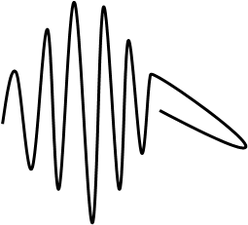
Linear wakefield
The ponderomotive force of the laser expels electrons.
The stationary ions provide a restoring force, so that electrons behind the laser oscillate at the plasma frequency.
Electrostatic fields as strong as 100 GeV/m due to space charge
Color indicates electron density
e⁻

Slide 5
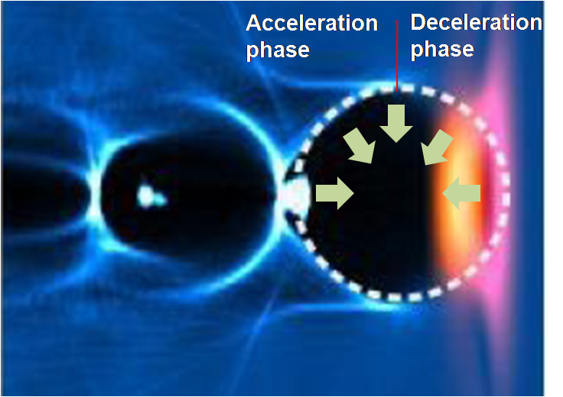
Bubble regime
With ultrashort laser pulses, a regime can be reached in which all electrons are expelled, leaving a single spherical ion bubble.
The electrostatic field provides a strong accelerating force as well as a centripetal radial force.

Slide 6
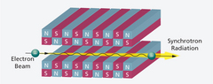
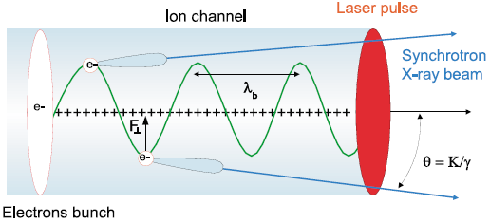
Synchrotron radiation from an undulator
http://www.psi.ch
Undulation within the bubble
A. Rousse, K. T. Phuoc, R. Shah, et al. Phys. Rev. Lett. 93, (2004)
A. G. R. Thomas and K. Krushelnick. Phys. Plasmas 16, (2009)

Slide 7
Overview
Introduction to Laser Wakefield Acceleration (LWFA) and radiation generation
Characterization of synchrotron radiation
Radiography demonstration

Slide 8
LWFA undulator at UM
Radiation collimated in 11 mrad beam
Radiographs resolve features as thin as 5 µm
S. Kneip, C. McGuffey, J. L. Martins, et al. accepted to Nat. Phys.

Slide 9
LWFA undulator at UM
Peak spectral brilliance is 10²³ ph/s/mrad²/mm²/0.1%BW due to high degree of collimation and assumed 30 fs duration
S. Kneip, C. McGuffey, J. L. Martins, et al. accepted to Nat. Phys.

Slide 10
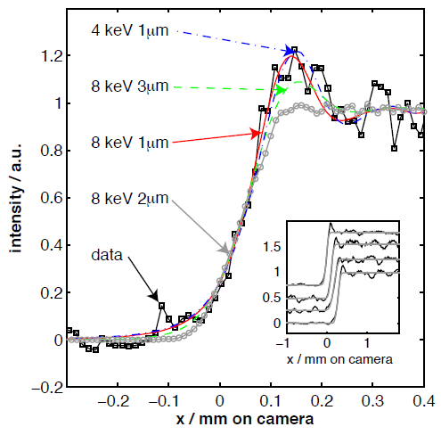
LWFA undulator at UM
Cleaved crystal casts shadow on detector
Source size can be determined by steepness of shadow
Best fit to 2.1±0.7 µm HWHM source size
S. Kneip, C. McGuffey, J. L. Martins, et al. accepted to Nat. Phys.

Slide 11
Overview
Introduction to Laser Wakefield Acceleration (LWFA) and radiation generation
Characterization of synchrotron radiation
Radiography demonstration

Slide 12
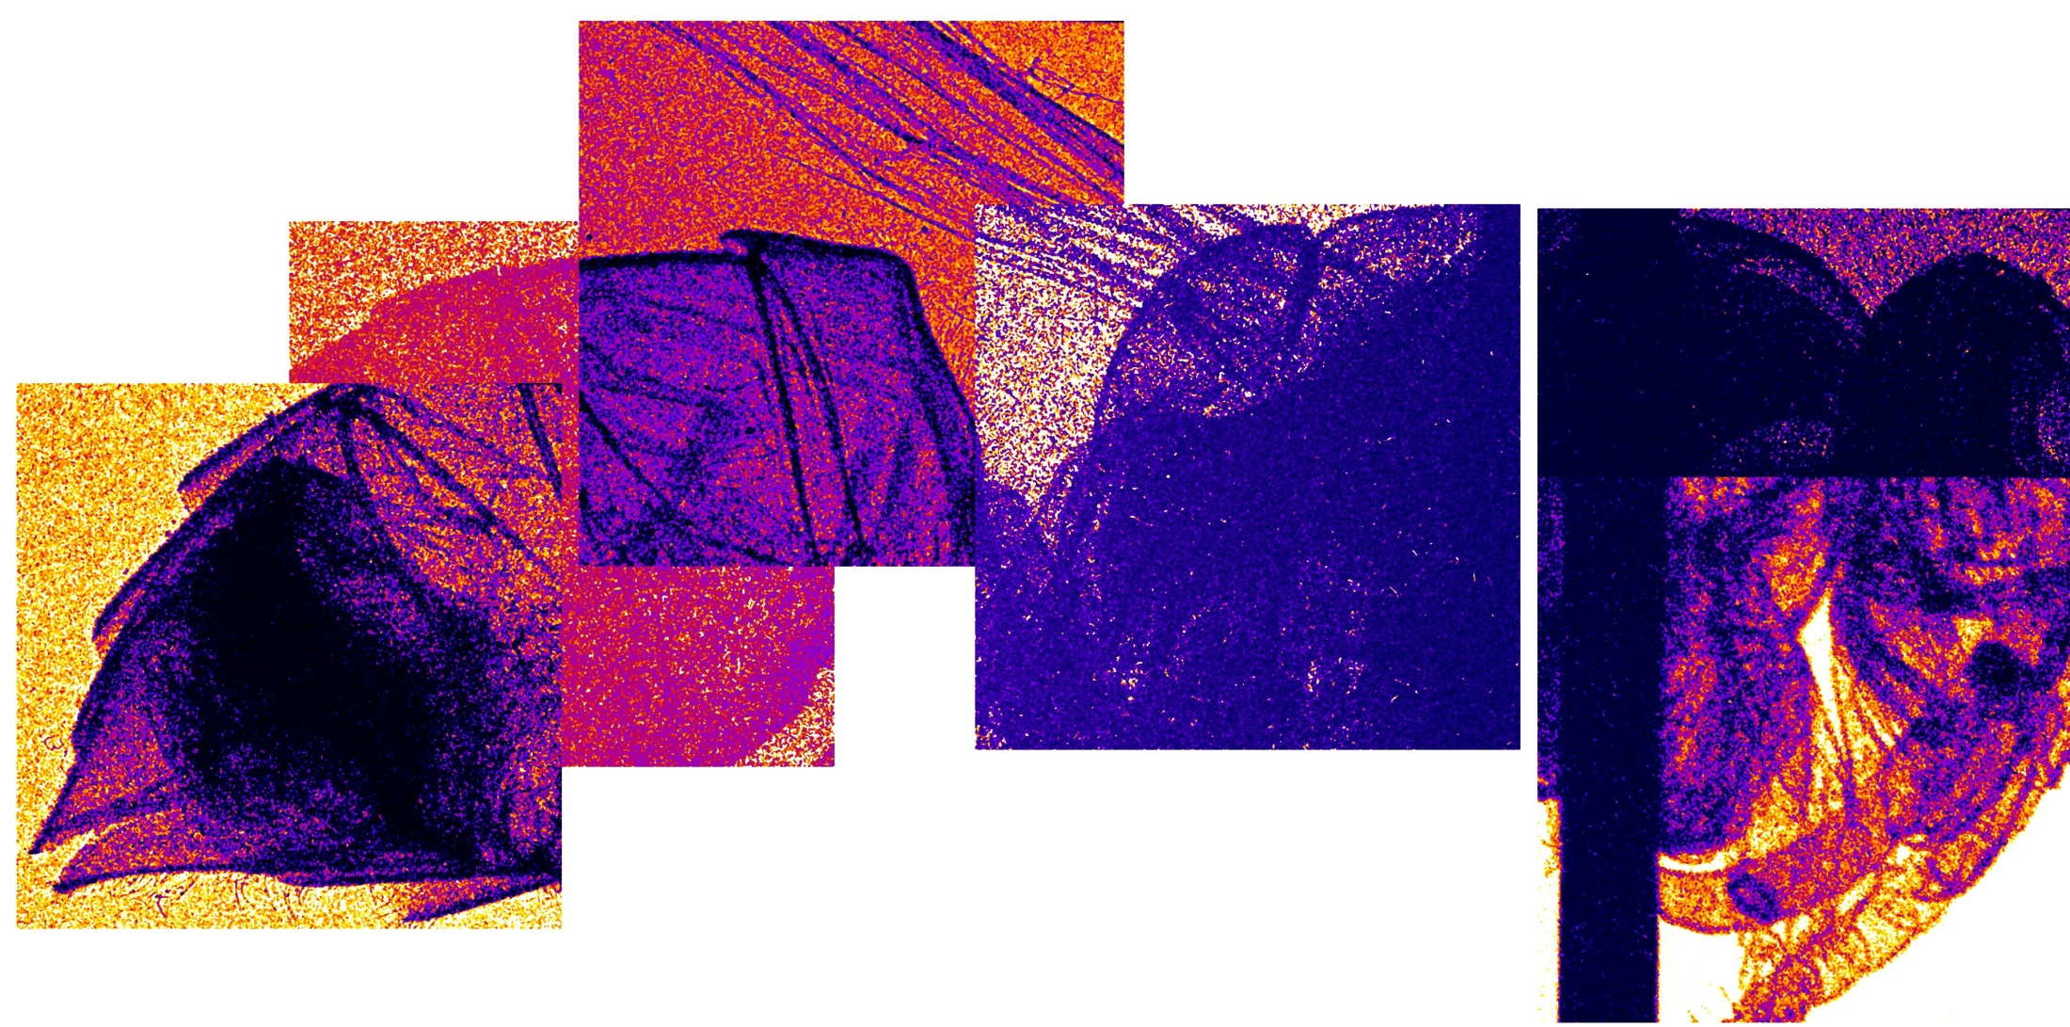
Yellowjacket Radiograph

Slide 13
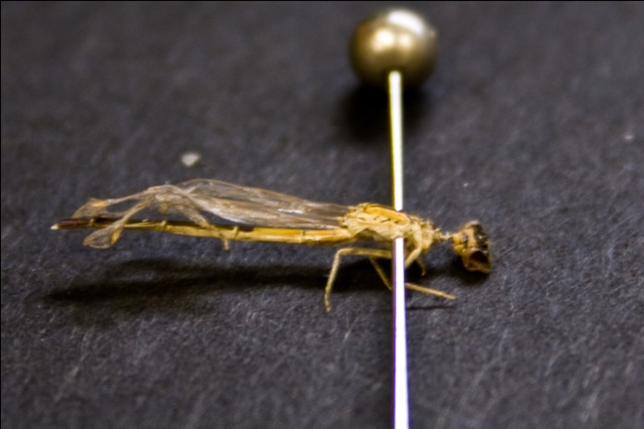
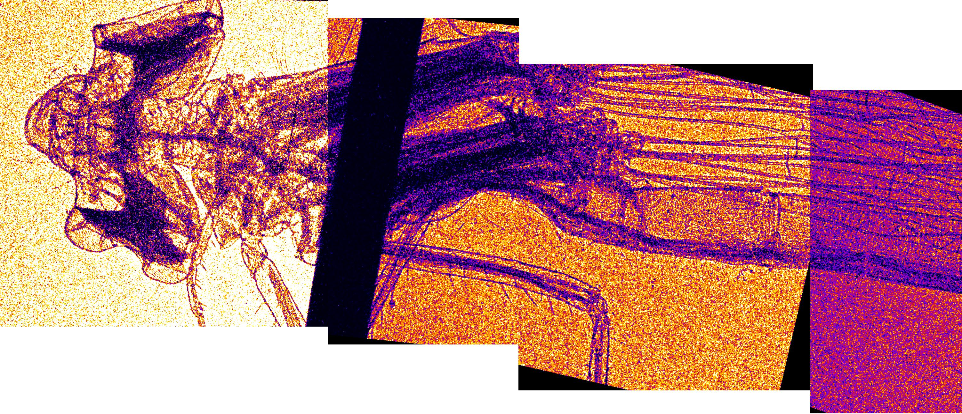
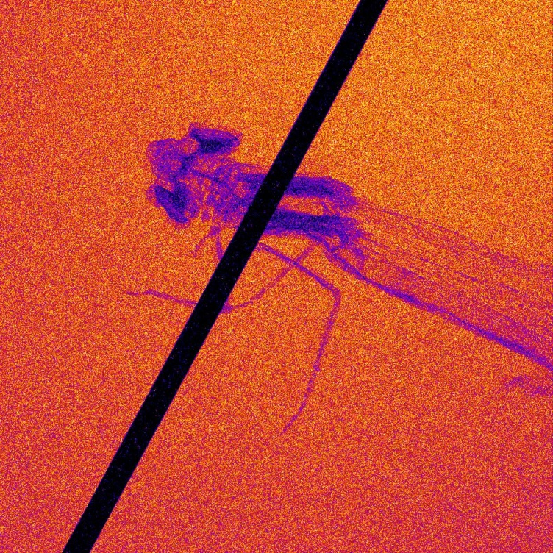
Damselfly Radiograph

Slide 14
Summary
LWFA can merge a ~100m accelerator + ~m undulator into a single ~cm stage.
X-ray peak brilliance is comparable to existing accelerator facilities.
Radiographs demonstrate phase-contrast imaging, few μm features resolved.
This source cannot compete with the rep-rate or scale of a user facility accelerator, but could be useful for university or single-user facilities.

