Slide 1
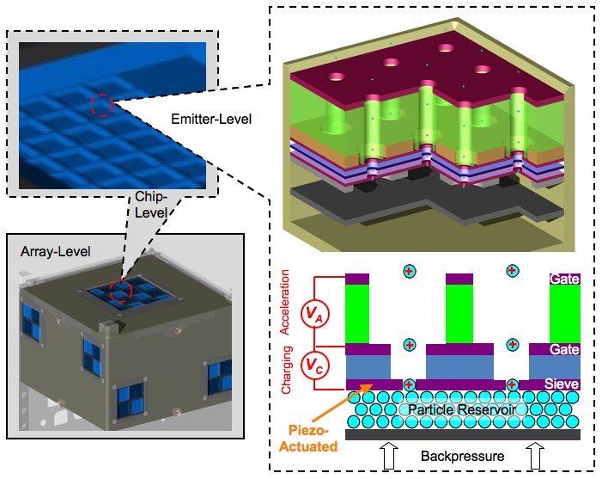
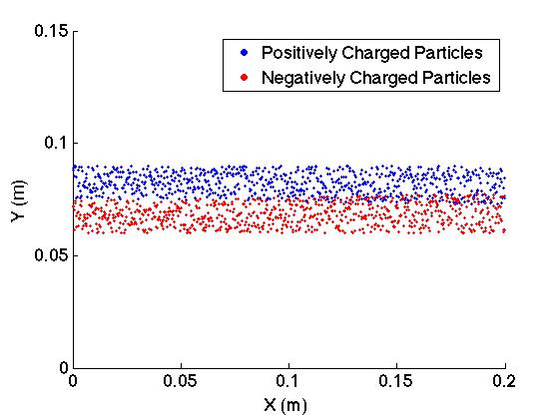
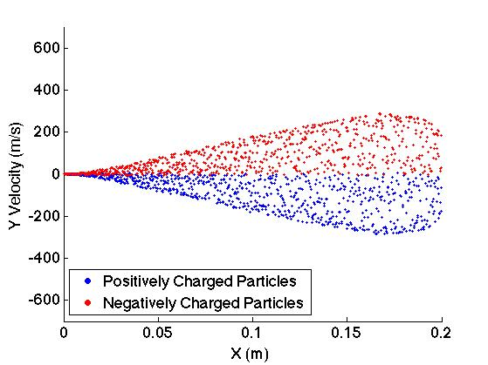
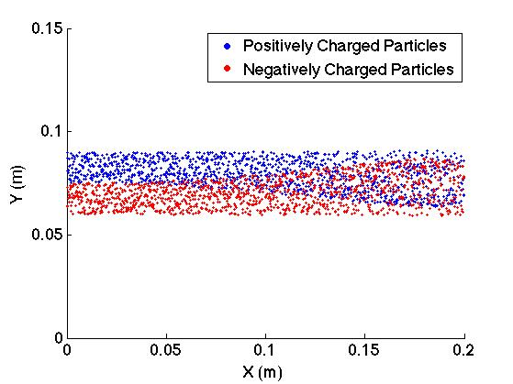
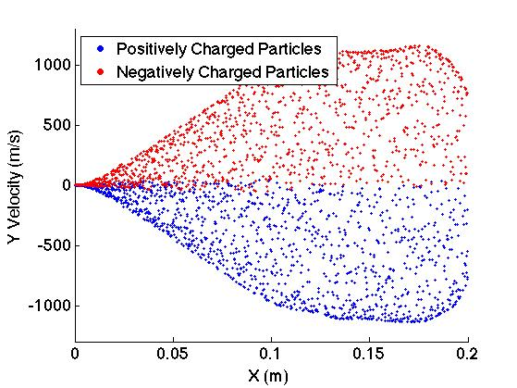
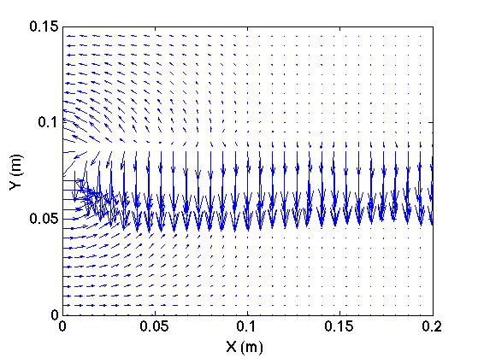
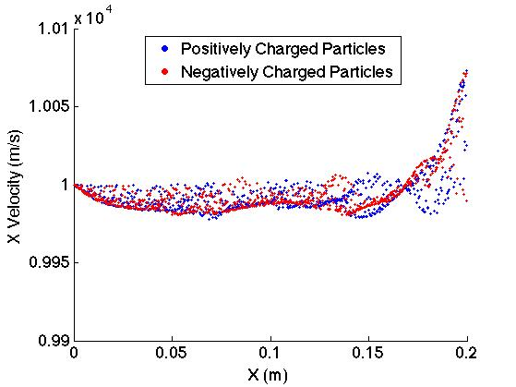
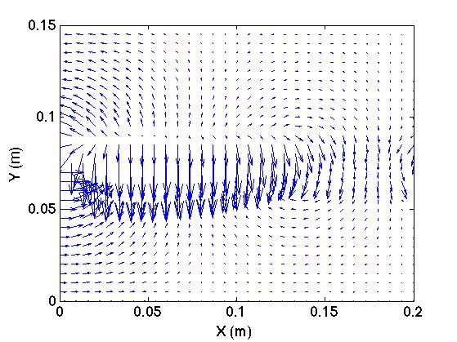
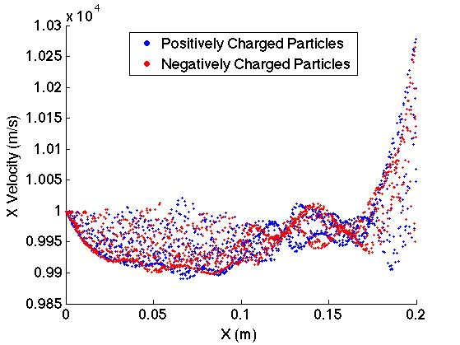
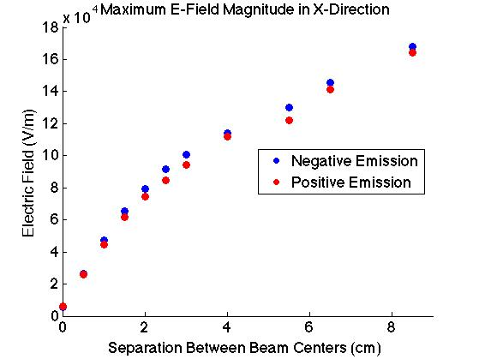
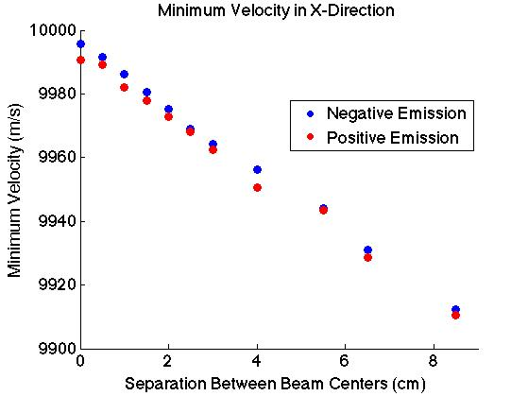
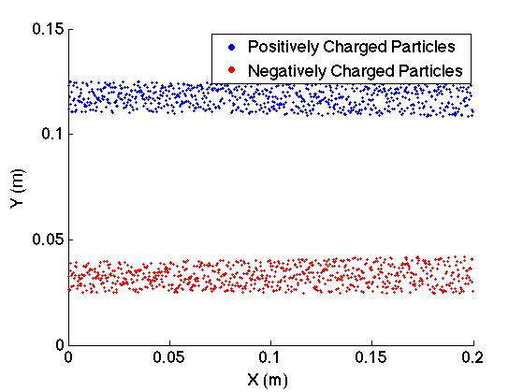
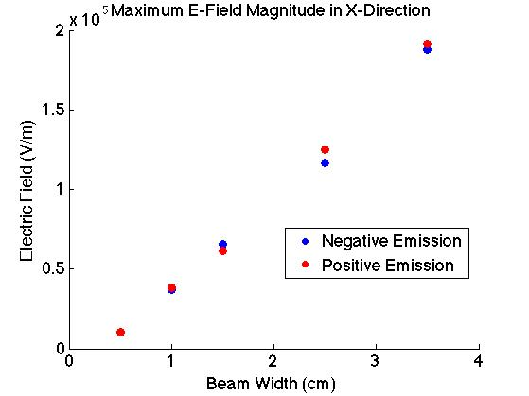
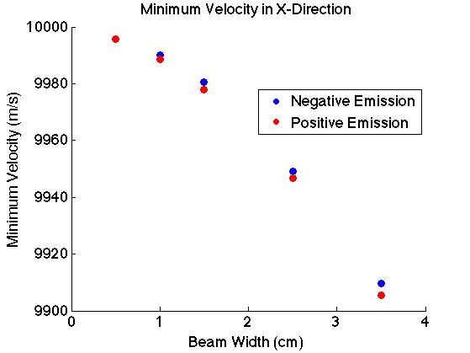
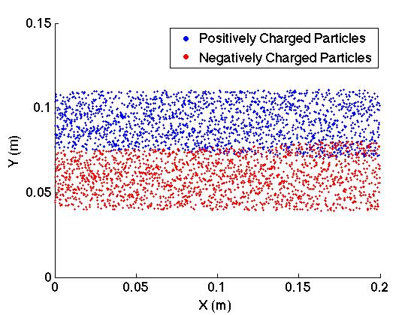
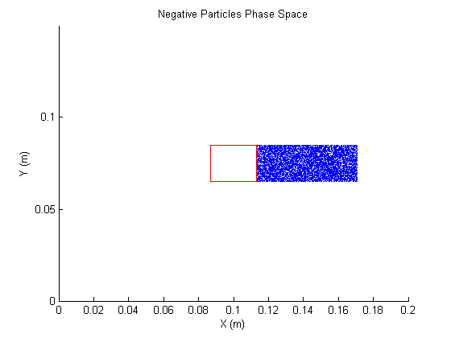
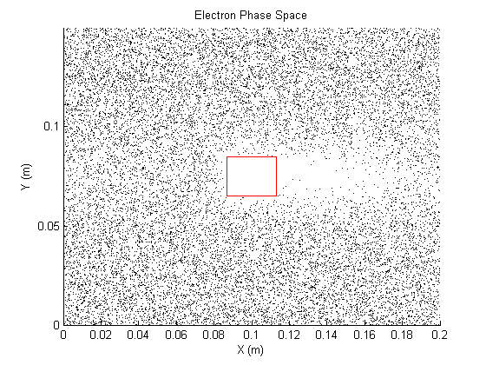
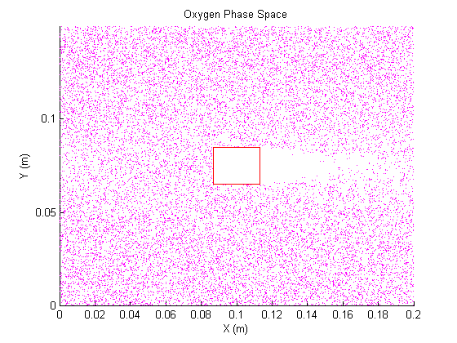
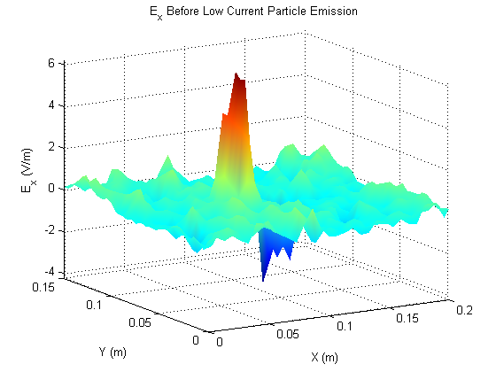
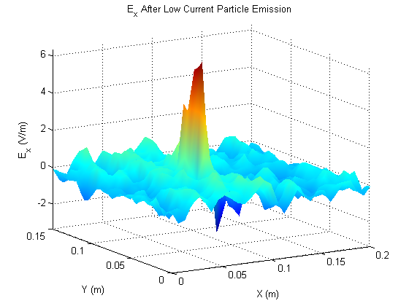
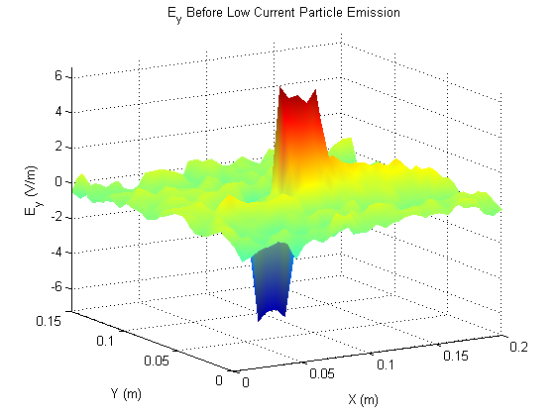
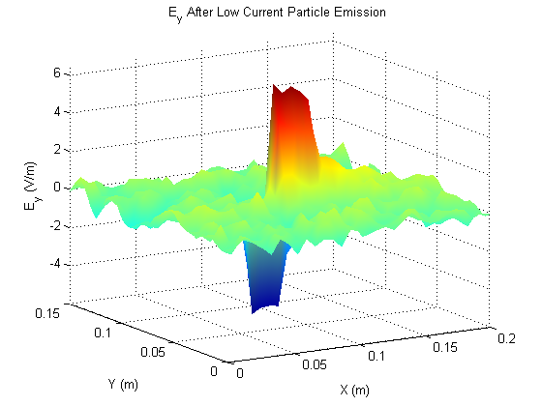
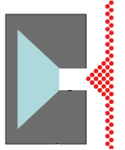
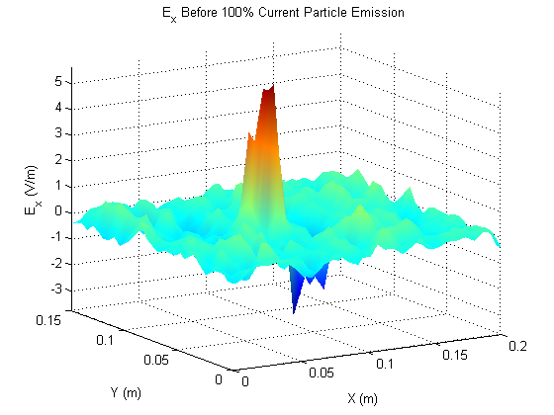
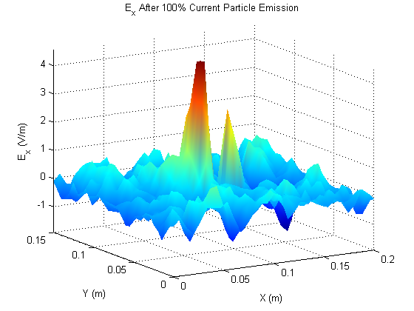
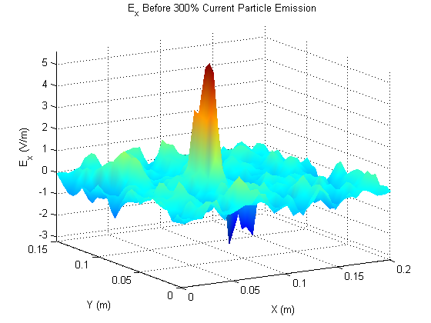
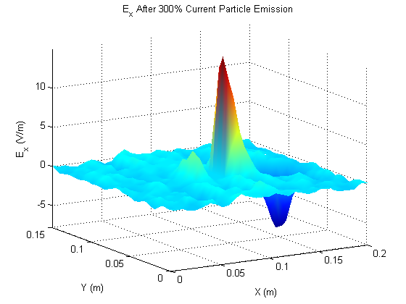
Simulation of Using Background Plasma to Neutralize for Charged Particle Thrusters on Nanospacecraft
David C. Liaw¹, Thomas M. Liu², and Brian E. Gilchrist³
1 EECS/RadLab at the University of Michigan, 2 PEPL at the University of Michigan 3 EECS/AOSS at the University of Michigan
Motivation
Results to Date
The Nanoparticle Field Extraction Thruster (NanoFET) is an electric propulsion device that charges and accelerates nanoparticles using electrostatic fields and MEMS structures.
Can NanoFET and other particle thrusters, e.g. colloidal thrusters, neutralize both the emitted beam and spacecraft while maintaining performance without an electron source?
Through emission of positive and negatively charged particles
Through neutralization from background plasma
Emitted net neutral beam with beam propagating left to right shown when the beam gets to the edge of the simulation space for 200 nm solid polystyrene particles with a specific charge of 100 C/kg (left) and 50 nm hollow polystyrene particles with a specific charge of 1000 C/kg. Diagnostics shown: Particle propagation (top left), electric field (bottom left), velocity in the y direction vs x position (top right), and velocity in the x direction vs x position (bottom right).
As particles propagate, the image charge induced axial electric field local to the emitter causes decrease in velocity, with maximum velocity drop of 0.22% relative to the initial emission velocity for the 200 nm solid polystyrene particle.
Radial electric field between beams only slowly draws beams together over 0.2 m of simulation space.
This indicates that the heavy, equally massed particles are slow to move.
Emitting particles with a higher specific charge will result in a larger drop in velocity due to the image charge induced axial electric field; however, the beams converge more readily, making the resulting beam more neutral.
Reducing beam separation and beam width will result in reducing the image charge induced axial electric field and the drop in the initial emission velocity.
Emission of a low current negatively charged particle beam into steady-state ambient plasma
Wake effect to the right as plasma & particles are flowed to the right w/o perturbation of plasma
Individual E-field components, E_{x} (left 2), E_{y} (right 2), before (1 and 3), and after (2 and 4) emission
No significant change in E-field except E_{x} to the right of the spacecraft due to the emission of negatively charged particles: E_{x} drop of 21%
Emission of a high current negatively charged particle beam into steady-state ambient plasma
Beam current on par with plasma current (left 2), beam current 3 times plasma current (right 2)
With large emission current, there is a large electric field build up around the emitted beam which continues to grow as the current grows, eventually becoming very significant.
X vs Y Particle Propagation
Resulting Velocity (VY vs X) in m/s
X vs Y Particle Propagation
Resulting Velocity (VY vs X) in m/s
Electric Field
Resulting Velocity (VX vs X) in m/s
Electric Field
Resulting Velocity (VX vs X) in m/s
Conceptual Nanospaceraft with NanoFET
Three Possible Neutralization Methods
Three possible neutralization methods
Time-varying, common emitter structure
Spatially separated, constant steady-state emission
Single beam emission into ambient plasma (large –’s are particles)
How do each of the emission methods behave?
Will thrust performance be degraded?
Why is neutralization needed?
Without neutralization in an electric propulsion system, the spacecraft will charge up creating a virtual cathode situation.
Other options are hollow cathode neutralizers and field
emitter array cathodes.
Hollow cathodes increase complexity of the system
as well as decrease efficiency by up to 20%.
E_x Positive Emission
Beam Separation
E_x Negative Emission
E_x Positive Emission
Beam Width
E_x Negative Emission
Beam Width
Evaluation Methodology
Simulations are done in OOPIC PROTM, a 2.5 dimensional object-oriented particle-in-cell simulator based on XOOPIC Physics Package developed at UC-Berkeley.
Parameters to control are: time step, coordinate system, simulation space, mesh, electrostatic model, particle characteristics, emitter characteristics, plasma density and composition, thermal temperature, drift velocity, and boundary characteristics
We chose the following parameters:
200 nm polystyrene particles->4.4*10⁻¹⁸ kg and 7.32*10⁻¹⁶ C->specific charge of ~100 C/kg compared to
50 nm hollow polystyrene particles->4.45*10⁻²⁰ kg and 4.46*10⁻¹⁷ C->specific charge of ~1000 C/kg
Plasma density of 6.7*10³ cm⁻³ (electrons and atomic oxygen ions) and temperature of 0.1 eV
Current density of 1 A/m² in spatial-varying case or 1.6 uA/m² into ambient plasma
Particle exhaust velocity of 10⁴ m/s ->1000 s Isp, plasma drift velocity of 7500 m/s
Time step of 5*10⁻⁸ s, Cartesian coordinates, electrostatic model
Equipotentials on spacecraft walls, charge-bleeding dielectrics on simulations walls
Conclusions
Care must be taken in using self-neutralization of charged particle thruster, e.g. colloidal thrusters.
Neutralization possible through beams with narrow width and close separation.
Velocity degradation at high thrust/current density levels.
High electric field can be created external to thruster between positive & negative particle populations.
For nanosatellite applications, may have negligible effects due to low current density levels.
NanoFET must emit at low current levels to match plasma number density
Nanospacecraft charges slightly negatively due to the ambient plasma (floating potential)
Helps to mitigate the image charge effects and accelerate negative particles away
Higher plasma current density should draw ions to help neutralize emitted beam

