Slide 1
SiO₂ ETCH PROPERTIES AND ION ENERGY DISTRIBUTION IN PULSED CAPACITIVELY COUPLED PLASMAS SUSTAINED IN Ar/CF₄/O₂*
Sang-Heon Song^{a)} and Mark J. Kushner^{b)}
^{a)}Department of Nuclear Engineering and Radiological Sciences
University of Michigan, Ann Arbor, MI 48109, USA
ssongs@umich.edu
^{b)}Department of Electrical Engineering and Computer Science
University of Michigan, Ann Arbor, MI 48109, USA
mjkush@umich.edu
http://uigelz.eecs.umich.edu
4th Annual MIPSE Graduate Symposium
September 25, 2013
* Work supported by the Semiconductor Research Corp. and DOE Office of Fusion Energy Science.
Notes:
Good morning, my name is Sang-Heon Song.
The topic of my presentation is “electron and ion energy distribution control using pulse power in capacitively coupled plasma”.
This work is supported by DOE plasma science center and semiconductor research corporation.

Slide 2
AGENDA
Motivation for controlling energy distribution of electron and ion
Description of the model
Typical pulsed plasma properties
Self induced dc bias
Ion energy distribution
Etch profile simulation
Concluding remarks
University of Michigan
Institute for Plasma Science & Engr.
02/16
Notes:
Here is the agenda.
We will start with motivation for controlling energy distributions of electron and ion, and briefly describe the model used in this investigation.
Then we present results in terms of typical pulse plasma properties.
The energy distributions are investigated with varying pulse repetition frequency and duty cycle and blocking capacitor size.

Slide 3
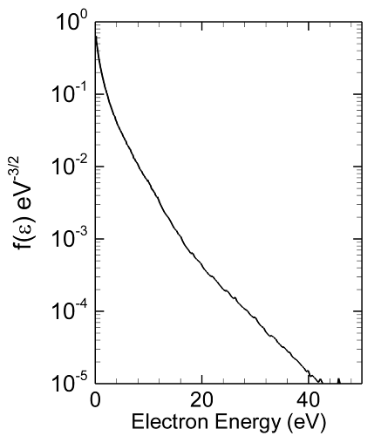
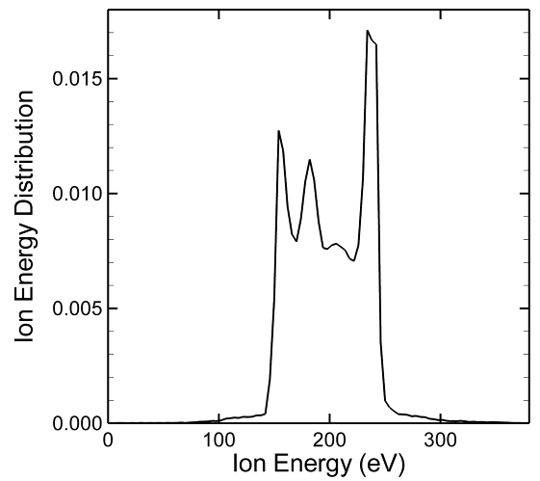
CONTROL OF ENERGY DISTRIBUTION
Controlling the generation of reactive species for device fabrication benefits from customizing the electron energy distribution (EED).
EED
IED
Control of etch rates, critical dimension (CD), selectivity is then determined by the ion energy distribution (IED) striking on the material surface.
University of Michigan
Institute for Plasma Science & Engr.
03/16
Notes:
The generated species in the plasma are ultimately determined by electron energy distribution because the reaction rate coefficients come from the electron energy distribution times velocity and cross section.
The surface modification is a function of the ion energy distribution.
So one of the most important and challenging plasma science problems is to control the distribution functions of electron’s and ion’s energy.

Slide 4
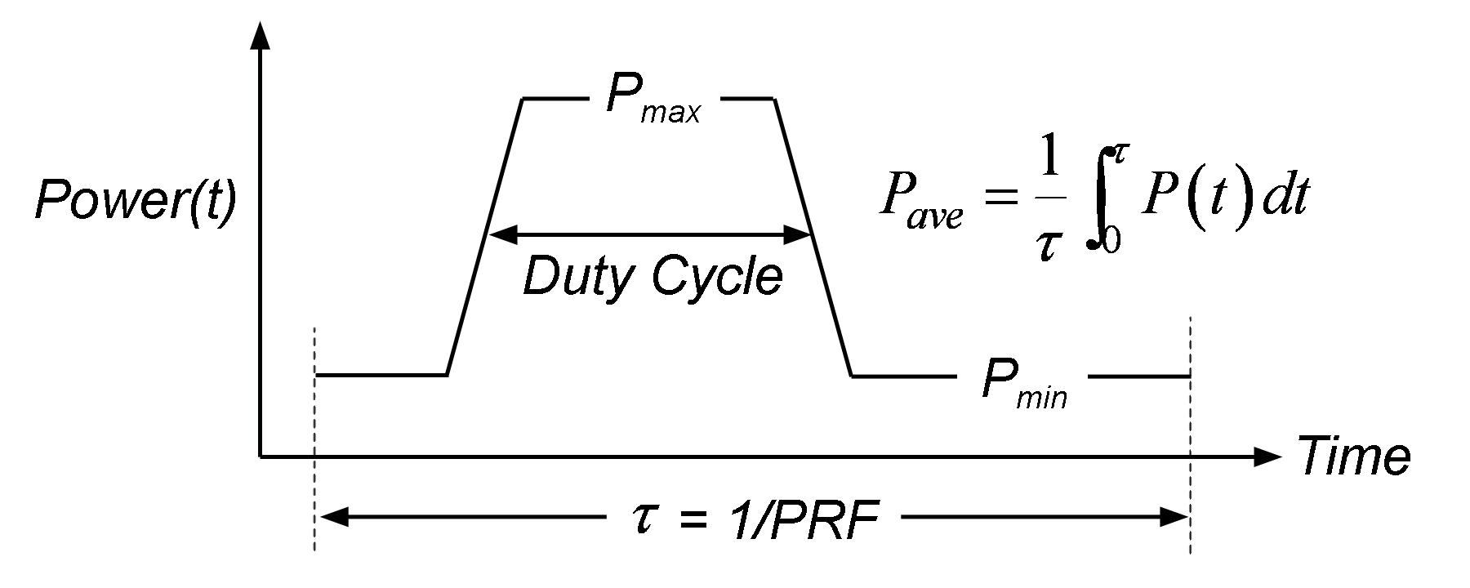
PULSE POWER
Use of pulse power provides a means for controlling f(ε) of both electrons and of ions, and so control etch properties.
Pulsing enables ionization to exceed electron losses during a portion of the ON period – ionization only needs to equal electron losses averaged over the pulse period.
Duty-cycle = 25% – 75%, PRF = 50 kHz
Constant Voltage = 250 V (HF, 40 MHz), 250 V (LF, 10 MHz)
University of Michigan
Institute for Plasma Science & Engr.
04/16
Notes:
So what we would like to do is to investigate the possibilities of using pulse plasmas as a means to control the distribution functions and etch properties.
We are going to look at pulsed capacitively coupled plasma with the duty cycle which is a fraction of the powers on period and a pulse repetition frequency which is how many times per second will repeat this wave form.

Slide 5
HYBRID PLASMA EQUIPMENT MODEL (HPEM)
T_{e}, S_{b}, S_{s}, k
Fluid Kinetics Module
Fluid equations
(continuity, momentum, energy)
Poisson’s equation
Electron
Monte Carlo Simulation
E, N_{i}, n_{e}
Fluid Kinetics Module:
Heavy particle and electron continuity, momentum, energy
Poisson’s equation
Electron Monte Carlo Simulation:
Includes secondary electron transport
Captures anomalous electron heating
Includes electron-electron collisions
University of Michigan
Institute for Plasma Science & Engr.
05/16
Notes:
The model used in this investigation is a two-dimensional fluid hydrodynamics simulation in which the distribution function is solved explicitly by a Monte Carlo simulation.
The ion and neutral species are treated as fluid and electrons are treated as particle.
They have periodic communication each other.
For example, electric field and particle densities are transferred to the electron Monte Carlo simulation and the resulting source functions, rate coefficient and electron temperature are retuned to the fluid module.

Slide 6
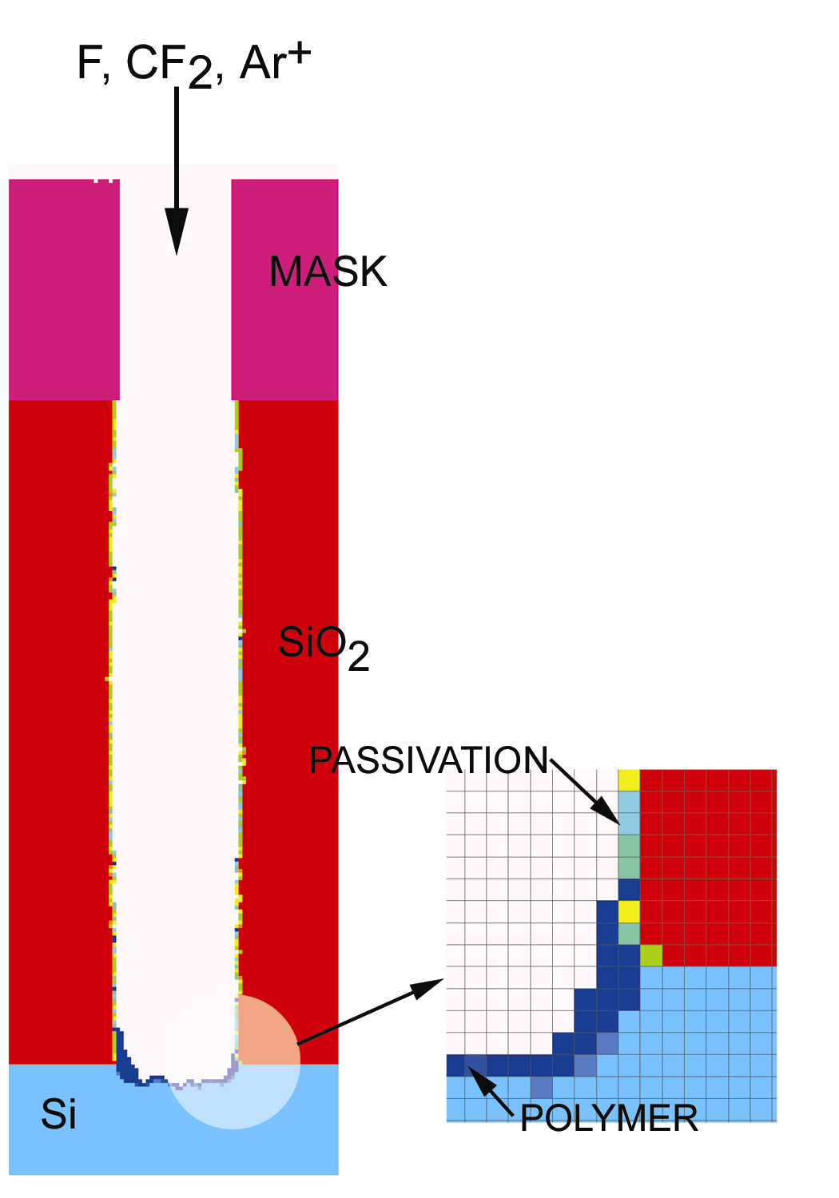
MONTE CARLO FEATURE
PROFILE MODEL (MCFPM)
The MCFPM resolves the surface topology on a 2D Cartesian mesh.
Each cell has a material identity. Gas phase species are represented by Monte Carlo pseuodoparticles.
Pseuodoparticles are launched with energies and angles sampled from the distributions obtained from the HPEM
Cells identities changed, removed, added for reactions, etching deposition.
HPEM
PCMCM
Energy and angular distributions for ions and neutrals
MCFPM
Poisson’s equation solved for charging
Etch rates and profile
University of Michigan
Institute for Plasma Science & Engr.
06/16
Notes:
For the etch profile simulation, we have another model called MCFPM.
In the HPEM, we have Plasma Chemistry Monte Carlo Module (PCMCM) which produces the energy and angular distributions for ions and neutrals striking the wafer surface.
Then these fluxes and their energy and angular distributions are used as inputs to the MCFPM.

Slide 7
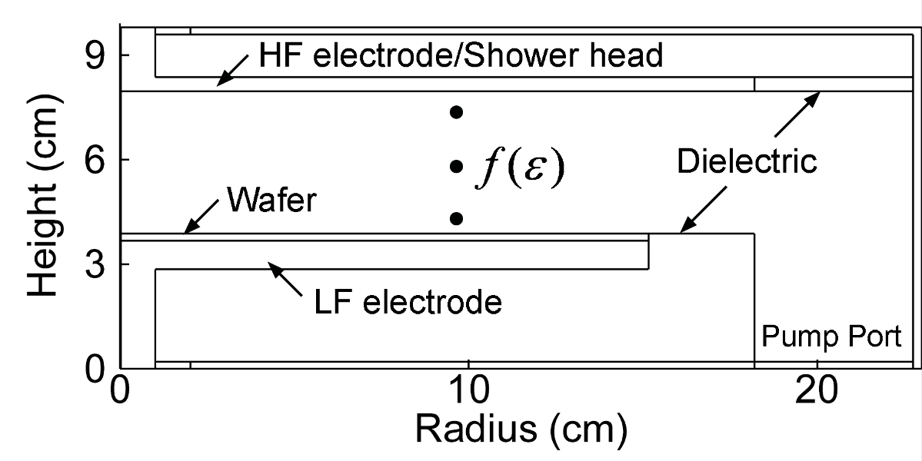
REACTOR GEOMETRY: 2 FREQUENCY CCP
2D, cylindrically symmetric
Ar/CF₄/O₂ = 75/20/5, 40 mTorr, 200 sccm
Base conditions
Lower electrode: LF = 10 MHz, 250 V
Upper electrode: HF = 40 MHz, 250 V
Either LF or HF is operated in pulse mode
University of Michigan
Institute for Plasma Science & Engr.
07/16
Notes:
Here is the geometry for dual frequency capacitively coupled plasma which will be sustained in Ar/CF4/O2 at forty mTorr with 200 sccm.
10 MHz power is applied to the lower electrode and 40 MHz power is applied to the upper electrode.
One of them is operated in pulse mode.

Slide 8
PLASMA POTENTIAL & dc BIAS
Maximum ion energy = Plasma Potential – “dc” Bias
When LF is pulsed, the dc bias is positive in the afterglow due to the relatively small electron flux to the substrate which is grounded in the afterglow.
HF pulsed
LF pulsed
PRF = 50 kHz, Duty-cycle = 25%
LF = 10 MHz, 250 V
HF = 40 MHz, 250 V
University of Michigan
Institute for Plasma Science & Engr.
08/16
Notes:
Now we move on to the ion energy distribution control.
The ion energy is determined by the difference between plasma potential and dc bias.
Red is plasma potential oscillating in rf cycle and this black is dc bias.
The plasma potential oscillates zero to 300 V and dc bias oscillated from negative 200 to zero.
Since the ions are accelerated to the electrode by the potential difference between the plasma and electrode, the ion energy distribution can be controlled by the blocking capacitor size in pulse operation.

Slide 9
IED: PULSING HF & LF
Due to the temporal change of the dc-bias, IEDs can be controlled by the choice of pulsing HF or LF.
IED extends to higher energy when the HF is pulsed, while it shifts to lower energy when the LF is pulsed.
250 V (10 MHz), 250 V (40 MHz)
University of Michigan
Institute for Plasma Science & Engr.
09/16
Notes:
As a result, the ion energy distributions can be manipulated by the size of blocking capacitor whether high frequency or low frequency power is pulsed, in a manner that is not attainable with cw operation.
For example, when pulsing low frequency power, there are two peaks; one large sharp peak at the low energy and small broad peak at high energy.
This high energy peak comes from the power-on stage, and the low energy peak comes from the power-off stage.
So the shape of distribution is controlled by the blocking capacitor size.
Whereas, the ion energy is not sensitive to the blocking capacitor size with cw operation because the dc bias is not modulated in cw mode.

Slide 10
IED vs. DUTY CYCLE: HF PULSED
Since the temporal modulation of dc bias follows up the envelope of the plasma potential fluctuation, the energy range of IED doesn’t change by much with different duty cycles.
However, in general, the maximum ion energies are larger with pulse operation of HF.
PRF = 50 kHz
250 V (10 MHz, CW), 250 V (40 MHz, pulsed)
University of Michigan
Institute for Plasma Science & Engr.
10/16
Notes:
In pulse mode operation, we have another degree of freedom with duty cycle.
In this particular case of pulsing HF, the modulation of dc bias pretty much follows up the envelope of the plasma potential fluctuation, so that the IED doesn’t change by much with different duty cycles.

Slide 11
IED vs. DUTY CYCLE: LF PULSED
Since the high energy peak in the IED comes from the power-on stage and the low energy peak comes from the power-off stage, the amplitude of each peak can be manipulated by duty cycle.
PRF = 50 kHz
250 V (10 MHz, pulsed), 250 V (40 MHz, CW)
University of Michigan
Institute for Plasma Science & Engr.
11/16
Notes:
However, with pulsing low frequency power, there are two peaks in the distribution.
Each of the peaks comes from different stage of pulse period.
As a result, the duty cycle affects significantly on the shape of the distribution.
For example, the low energy peak is produced in the power-off stage, so that the amplitude of the peak is getting larger with lower duty cycle.
Whereas, the high energy peak is produced in the power-on stage, so that the amplitude of the peak is enhanced with larger duty cycle.

Slide 12
ETCH PROFILE vs. DUTY: HF PULSED
Etch time = 1000 sec
Feature width = 75 nm
Aspect Ratio (AR) = 13
Etch profile is not significantly affected by duty cycle when the HF power is pulsed because of the similar energy range of IED.
250 V (10 MHz, CW)
250 V (40 MHz, pulsed)
Blocking capacitance = 10 nF
University of Michigan
Institute for Plasma Science & Engr.
12/16

Slide 13
ETCH PROFILE vs. DUTY: LF PULSED
Etch time = 1000 sec
Feature width = 75 nm
Aspect Ratio (AR) = 13
As duty cycle decrease, etch rate decreases and profile becomes tapered sidewall due to enhanced low energy component in IED at lower duty cycle.
250 V (10 MHz, pulsed)
250 V (40 MHz, CW)
Blocking capacitance = 10 nF
University of Michigan
Institute for Plasma Science & Engr.
13/16
Notes:
This is an example of etching profile simulation.
As a result of different ion energy and fluorine flux, different etching profiles are obtained with various duty cycles.
From this animation, the etch rate appears to be fastest with CW, but the average power dissipation is different for each case.
So for the fair comparison, we need to normalize it by power.

Slide 14
ETCH RATE vs. DUTY: PULSING HF & LF
With pulsing HF power, the power normalized etch rate increases with smaller duty cycle because the ion energy is maintained.
However, with pulsing LF power, the normalized etch rate decreases due to enhanced low energy ions at the smaller duty cycle .
PRF = 50 kHz
250 V (10 MHz), 250 V (40 MHz)
University of Michigan
Institute for Plasma Science & Engr.
14/16
Notes:
So here is the power normalized etch rate.
With pulse operation of HF, the power normalized etch rate increases as the duty cycle decreases because fluorine atoms are more produced at the lower duty cycle.
Whereas, with pulsing LF, the etch rate decreases as duty cycle decreases because the ion energy is small at the lower duty cycle.

Slide 15
ETCH PROFILE vs. DUTY: PULSING HF & LF
CD ratio is defined as CD in the middle of the profile over CD at the bottom.
A/B > 1 means bowing or tapered sidewall.
A/B < 1 means undercut.
A/B = 1 means vertical etch profile.
With pulsing HF, the etch profile is maintained as vertical, whereas with pulsing LF it becomes tapered sidewall profile due to enhanced low energy ions at smaller duty cycle.
EPD + OE50%
PRF = 50 kHz
250 V (10 MHz), 250 V (40 MHz)
University of Michigan
Institute for Plasma Science & Engr.
15/16

Slide 16
CONCLUDING REMARKS
IEDs can be manipulated using pulse power in a manner that is not attainable with CW excitation mode.
Fine amplitude control of peaks in IED can be achieved by varying duty cycle when the LF power is operated in pulse mode.
As duty cycle decreases, the power-normalized etch rate increases with pulsing HF whereas it decreases with pulsing LF due to the different energy ranges of IED.
In terms of etching profile, tapered etch profile is observed with pulsing LF due to the low energy component in IED.
University of Michigan
Institute for Plasma Science & Engr.
16/16
Notes:
In conclusion, the electron and ion energies can be controlled by pulse power.
High energy electrons can be produced with smaller duty cycle.
High energy ions can be produced with puling high frequency power.
Low energy ions can be produced with pulsing low frequency power.
The etch rate is faster with pulsing HF but the etch quality is better with pulsing LF.

