Slide 1
CHARACTERISTICS OF ION ENERGY DISTRIBUTION IN DUAL- FREQUENCY CAPACITIVELY COUPLED PLASMAS*
Yiting Zhang and Mark. J. Kushner
Department of Electrical and Computer Engineering,
University of Michigan, Ann Arbor, MI 48109, USA
(yitingz@umich.edu, mjkush@umich.edu)
http://uigelz.eecs.umich.edu
MIPSE 2013
* Work supported by SRC 2071.025, National Science Foundation and Lam Research.

Slide 2
AGENDA
Motivation for controlling ion energy distributions
Description of the models
IEADs and plasma properties for dual-frequency Ar, Ar/CF₄/O₂ plasma
Dual-frequency power coupling with etching profile
Phase shift
Concluding remarks
University of Michigan
Institute for Plasma Science & Engr.
Y.Z_MPISE13_01

Slide 3
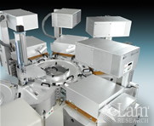
DUAL FREQUENCY CCP SOURCES
Dual frequency capacitively coupled discharges (CCPs) are widely used for etching and deposition in the microelectronics industry.
High frequencies produce higher electron densities at moderate sheath voltage and higher ion fluxes with moderate ion energies.
Low frequencies contribute to the quasi-independent control of the ion flux and energy.
Coupling between the dual frequencies may interfere with independent control of plasma density, ion energy and produce non-uniformities.
LAMRC 2300 Flex dielectric etch tool
• A. Perret, Appl. Phys.Lett 86 (2005)
University of Michigan
Institute for Plasma Science & Engr.
Y.Z_MIPSE13_02

Slide 4
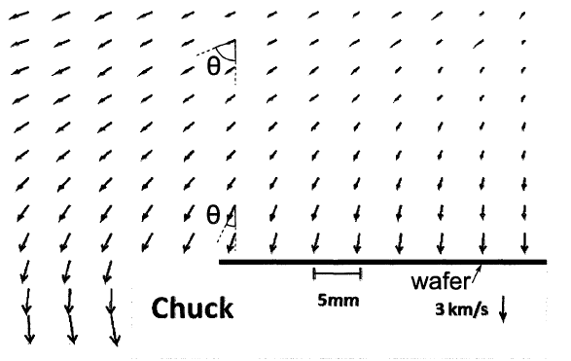
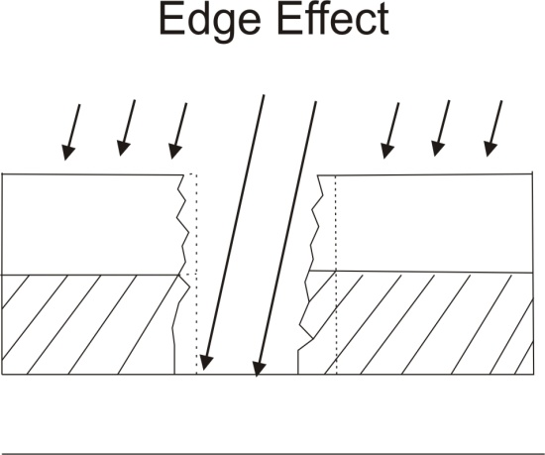
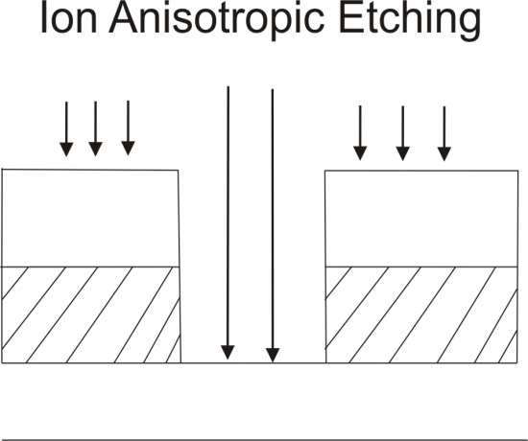
ION ENERGY AND ANGULAR DISTRIBUTIONS (IEAD)
Control of the ion energy and angular distribution (IEAD) incident onto the substrate is necessary for improving plasma processes.
A narrow angle, vertically oriented IEAD is necessary for anisotropic processing.
Edge effects which perturb the sheath often produce slanted IEADs.
Ion velocity trajectories measured by LIF (Jacobs et al.)
S.-B. Wang and A.E. Wendt, JAP
B. Jacobs, PhD Dissertation
University of Michigan
Institute for Plasma Science & Engr.
Y.Z_MIPSE13_03

Slide 5
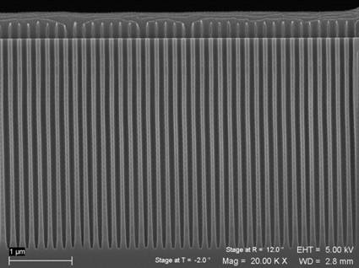
CONTROL OF IEADs
As the size of transistors shrink, the critical dimension requirements of semiconductor fabrication become more stringent, and therefore more precise control of IEADs becomes important.
This computational investigation addresses plasma dynamics and control of IEADs onto wafers in dual frequency CCPs.
Controlling the power ratio and phase difference between dual-frequencies to customize IEADs and etching profiles will be discussed.
SEM of a high aspect ratio profile
University of Michigan
Institute for Plasma Science & Engr.
Y.Z_MIPSE13_04
Notes:
5

Slide 6
HYBRID PLASMA EQUIPMENT MODEL (HPEM)
EETM
FKM
PCMCM
MCFPM
Monte Carlo Simulation f(ε) or Electron Energy Equation
S_{e}(r)
Continuity, Momentum, Energy, Poisson equation
Monte Carlo Module
Feature
Profile
Model
N(r)
E_{s}(r)
Electron Energy Transport Module（EETM):
Electron Monte Carlo Simulation provides EEDs of bulk electrons.
Separate MCS used for secondary, sheath accelerated electrons.
Fluid Kinetics Module (FKM):
Heavy particle and electron continuity, momentum, energy and Poisson’s equations.
Plasma Chemistry Monte Carlo Module (PCMCM):
IEADs in bulk, pre-sheath, sheath, and wafers.
Recorded phase, submesh resolution.
Inputs for Monte Carlo Feature Profile Model.
University of Michigan
Institute for Plasma Science & Engr.
Y.Z_MIPSE13_05

Slide 7
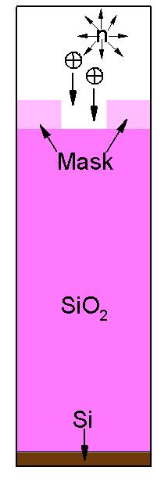
MONTE CARLO FEATURE PROFILE MODEL (MCFPM)
Using Monte Carlo techniques address plasma surface interactions and evolution of surface profiles.
Pseudo-particles are launched towards the wafer with ions and neutrals energy and angular distributions obtained from HPEM.
Energy and angular distributions for ions and neutrals obtained by HPEM
Electric potential is solved using Successive Over Relaxation (SOR) method.
Each cell in the mesh has a material identity, which will be changed removed, added for reactions, etching deposition.
MCFPM
Predicts etch profile and etch rates
University of Michigan
Institute for Plasma Science & Engr.
Y.Z_MIPSE13_06

Slide 8
REACTOR GEOMETRY
Capacitively coupled plasma with multi-frequency rf biases on bottom electrode.
2D, cylindrically symmetric.
Ar plasma: Ar, Ar(1s_{2,3,4,5}), Ar(4p), Ar⁺, e
Base case conditions:
Ar, 30 mTorr, 1000 sccm
2 MHz, 300 W; 60 MHz, 300 W
Etching Chemistry:
Ar/CF₄/O₂=75/20/5, 30mTorr, 500 sccm
(Note: Y:X = 2:1)
Actual aspect ratio
University of Michigan
Institute for Plasma Science & Engr.
Y.Z_MIPSE13_07
Notes:
8

Slide 9
PLASMA PROPERTIES
Majority of power deposition that produces ions comes from HF.
LF power deposition is primarily ion acceleration in the sheath.
T_{e} is fairly uniform in the reactor due to high thermal conductivity.
The electrons come from two sources: bulk ionization and sheath accelerated secondary electrons.
With large HF power, bulk ionization is dominant.
Ar, 30 mTorr, 1000 sccm,
300 W, 2 MHz; 300 W, 60 MHz
University of Michigan
Institute for Plasma Science & Engr.
Y.Z_MIPSE13_08
Notes:
9

Slide 10
Ar⁺ IEAD FROM BULK TO SHEATH
IEAD on wafer
With similar HF and LF power, the IEAD shows effects of dual-frequency.
The 2 MHz produces the double peaks and the 60 MHz produces the modulations.
The final ion energy striking substrate depends on both sheath potential and ion transit time.
The ion transit time is determined by sheath thickness which can be estimated by shape of IED from bulk to wafer.
IED on wafer
IED from bulk to wafer
Ar, 30 mTorr, 1000 sccm,
300 W, 2 MHz; 300 W, 60 MHz
University of Michigan
Institute for Plasma Science & Engr.
Y.Z_MIPSE13_09
Notes:
10

Slide 11
PLASMA DENSITY vs POWER
With larger HF power, the electron density significantly increases since HF mainly contributes to ionization.
Increasing LF power has little effect on [e] since electron heating scales with ω². Majority of additional power results in ion acceleration.
Uniformity increases with higher ionization.
Increase HF Power
Increase LF Power
University of Michigan
Institute for Plasma Science & Engr.
Ar, 30 mTorr, 1000 sccm
Y.Z_MIPSE13_10

Slide 12
HIGH FREQUENCY POWER
Changing HF/LF voltage ratio will strongly affect the IEADs.
With increase in HF power (300 W to 1200 W), the energy width ΔE shrinks and double peaks merge towards average sheath potential.
Increasing in n_{e} with power brings about large current. In order to keep LF power constant, the voltage of LF drops.
Ar, 30 mTorr, 1000 sccm
University of Michigan
Institute for Plasma Science & Engr.
Y.Z_MIPSE13_11
Notes:
12

Slide 13
LOW FREQUENCY POWER
The LF power is mainly deposited into the sheath – the width of IED increases with LF power.
During the cathodic LF cycle, increase in sheath potential accelerates ions to higher energy.
During anodic LF cycle, sheath potential is dominated by HF which is unchanged – and so modulation of IED persists.
Ar, 30 mTorr, 1000 sccm
University of Michigan
Institute for Plasma Science & Engr.
Y.Z_MIPSE13_12
Notes:
13

Slide 14
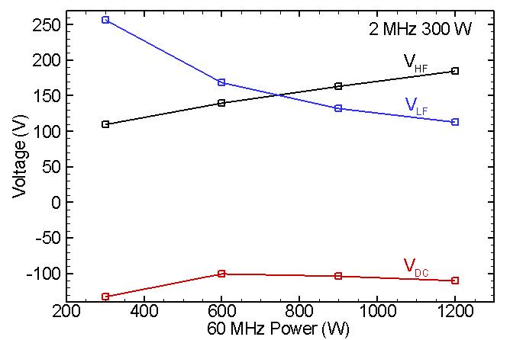
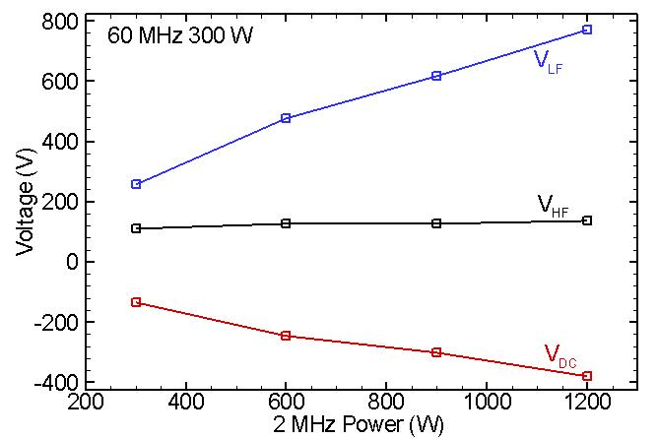
VOLTAGE vs POWER
With increase in power, the corresponding V_{HF}/V_{LF} or V_{HF}/V_{LF} increases. However, due to the power scaling with frequency, the increase in V_{HF} is smaller than V_{LF}.
DC self bias is proportional to sheath voltage (sum of V_{HF} and V_{LF}).
University of Michigan
Institute for Plasma Science & Engr.
Ar, 30 mTorr, 1000 sccm
Y.Z_MIPSE13_13
Notes:
14

Slide 15
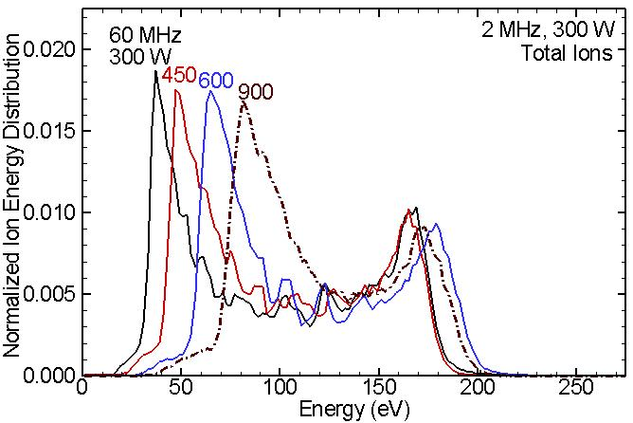
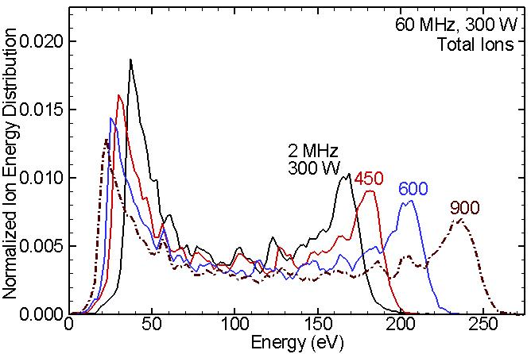
AR/CF₄/O₂ ION TOTAL ENERGY vs POWER
The trend of IEDs with power varying in AR/CF₄/O₂ plasmas match with pure argon case.
Increase HF Power
Increase LF Power
University of Michigan
Institute for Plasma Science & Engr.
Y.Z_MIPSE13_14

Slide 16
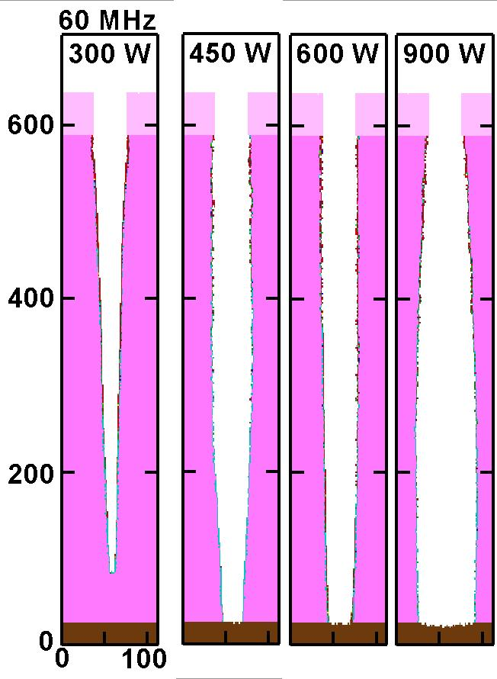
ETCH PROFILE vs HIGH FREQ POWER
Fixed 2 MHz, 300 W.
Critical Dimension (CD)= 37 nm
Aspect Ratio (AR)= 15
Etch rate increases with high frequency power increase due to higher F/CF_{x} ratio.
Undercutting increases with power (long over-etch here.)
The sidewall slope can be improved by adjusting F/CF_{x} ratio.
Unit: nm
Ar/CF₄/O₂=75/20/5,
30mTorr, 500 sccm
University of Michigan
Institute for Plasma Science & Engr.
Y.Z_MIPSE13_15

Slide 17
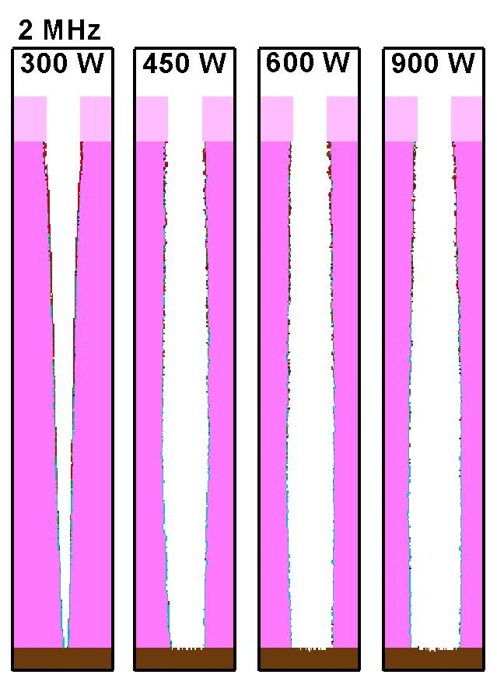
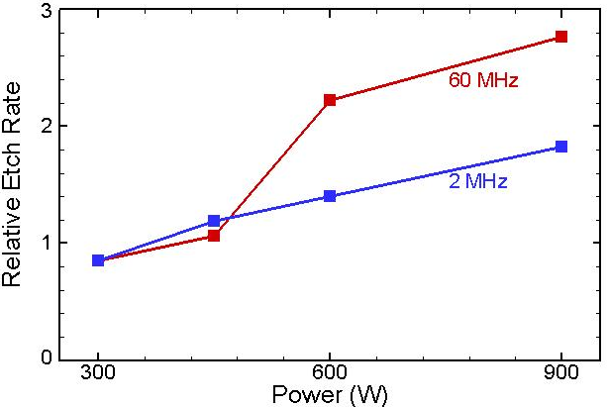
ETCH PROFILE vs LOW FREQ POWER
Fixed 60 MHz, 300 W.
The etch rate linearly increases with low frequency power due to average ion energy increasing linearly.
With large low frequency power, the etch profile becomes bowed due to ion trajectory distortion.
Ar/CF₄/O₂=75/20/5,
30mTorr, 500 sccm
University of Michigan
Institute for Plasma Science & Engr.
Y.Z_MIPSE13_16

Slide 18
PLASMA UNIFORMITY vs. Δ-PHASE
Definition OF Δ-Phase
With same amount of power, higher HF increases power density and improves uniformity.
The phase difference between the LF and HF modulates the dynamics of the plasma potential.
However, no significant difference is observed in time averaged plasma properties.
University of Michigan
Institute for Plasma Science & Engr.
Ar, 30 mTorr, 1000 sccm
Y.Z_MIPSE13_17

Slide 19
IEDs vs Δ-PHASE
Phase difference between LF and HF modulates sheath potential and electron dynamics during rf period.
Energy of HF modulated peaks in IED depend on relative phase between LF and HF.
By dynamically controlling phase difference, a smooth time averaged IED can be produce without significant HF modulation.
Ar, 30 mTorr, 1000 sccm
University of Michigan
Institute for Plasma Science & Engr.
Y.Z_MIPSE13_18

Slide 20
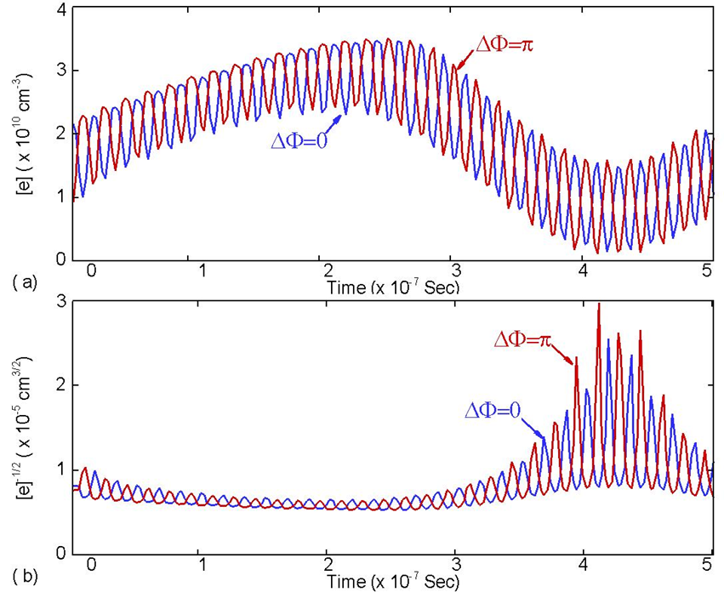
SHEATH THICKNESS vs. Δ-PHASE
When LF and HF are close in frequency, the phase shift may perturb sheath properties. Sheaths for 2+20 MHz depend on phase.
Sheath thickness (scales with [e]^{-1/2} ) is larger in cathodic LF cycle, and so brings about less modulation in high energy peak of IED.
Time Averaged
Time Dynamic
300 W, 2 MHz
300 W, 60 MHz
Asymmetric
Symmetric
University of Michigan
Institute for Plasma Science & Engr.
Y.Z_MIPSE13_19

Slide 21
CONCLUDING REMARKS
For dual frequency CCPs sustained in Ar,
Increasing HF power will increase the plasma density as well as shrink ΔE into average sheath potential.
Increasing LF power will mainly dissipate power within sheath, and therefore extend the IEAD energy width with little change in composition of fluxes.
Changing phase between HF and LF in high density, thin sheath plasma will modify time averaged IEADs significantly.
With knowledge of the relationship between IEADs and settings of dual frequency rf biases, precise customization and control of IEADs can be achieved, which will improve etching process.
University of Michigan
Institute for Plasma Science & Engr.
Y.Z_MIPSE13_20

