Slide 1
Experimental Investigation of the Effects of an Axial Magnetic Field on the Magneto Rayleigh-Taylor Instability in Ablating Planar Foils*
D.A. Yager-Elorriaga, S.G. Patel, A.M. Steiner, N.M. Jordan, R.M. Gilgenbach, and Y.Y. Lau
Plasma, Pulsed Power and Microwave Lab
Nuclear Engineering and Radiological Sciences Dept.
University of Michigan
Ann Arbor, MI 48109, USA
* This work was supported by DoE Award number DE-SC0002590, NSF Grant number PHY 0903340, and by US DoE through Sandia National Labs award numbers 240985, 767581 and 768225 to the University of Michigan. This material is also based upon D.A. Yager-Elorriaga’s work supported by the National Science Foundation Graduate Student Research Fellowship under Grant No. DGE 1256260. S. G. Patel and A. Steiner were supported by NPSC fellowships through Sandia National Laboratories.

Slide 2
Overview
This poster presents the first data for planar foil ablation experiments with an axial magnetic field using helical return current posts on the 1-MA Linear Transformer Driver (LTD) at the University of Michigan
Goal is to study electrothermal (ET) and magneto Rayleigh-Taylor (MRT) instabilities in planar geometry in presence of an axial magnetic field
Abstract
Experiments are underway to study the effects an axial magnetic field on the magneto Rayleigh-Taylor instability (MRT) in ablating planar foils on the 1-MA LTD at the Michigan Accelerator for Inductive Z-pinch Experiments (MAIZE) facility at the University of Michigan. For these experiments, 300 kA of current was discharged over ~100 ns into a 400 nm thick, 1 cm wide Al foil. Using helical return current posts, a peak axial magnetic field of 7.5 T was generated for 300 kA drive current. A 775 nm Ti:sapphire laser was used to shadowgraph the foil in order to observe instabilities that occurred during foil ablation. Early stages of the discharge showed smaller wavelength instability structures characteristic of the electrothermal instability while later stages, when the plasma interface decelerated due to increasing magnetic pressure, showed longer wavelength structures characteristic of MRT. The shadowgraphs showed new structures and asymmetries that were not previously present in earlier experiments without an axial magnetic field at UM.[1,2]

Slide 3
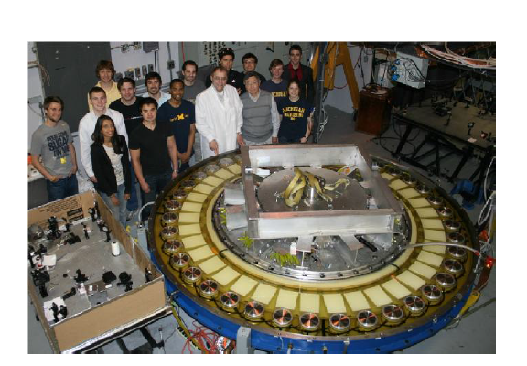
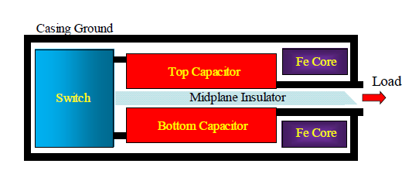
1-MA LTD at UM
Parameters
40 bricks
2 ferromagnetic cores
1.6 m ID, 3.06 m OD
0.22 m thick
Diagnostics
B-dot loops on MITL for current
150 fs, 775 nm Clark MXR Ti:Sapphire laser backlighter
Matched Load (0.1 ohm)
+100kV capacitor voltage
1 MA peak current
~100 ns rise-time
Foil load
Aluminum foil
400 nm thick
1 cm wide

Slide 4
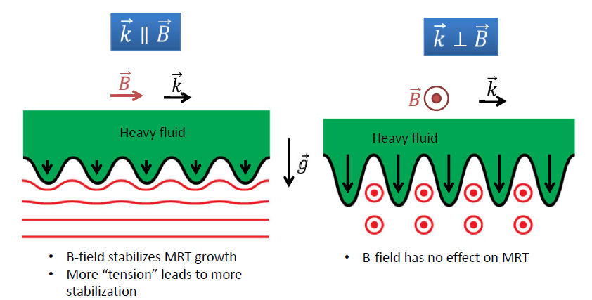
Magneto Rayleigh-Taylor Instability
The Rayleigh-Taylor (RT) instability occurs when heavy fluid is placed over light fluid in an effective gravitational field. Alternatively, RT occurs when a light fluid accelerates a heavy fluid.
The Magneto Rayleigh-Taylor (MRT) instability is the RT instability in the presence of a magnetic field. Depending on orientation of instability wavevector, the magnetic field may be stabilizing or have no effect.

Slide 5
Electrothermal Instability
The electrothermal (ET) instability occurs when a current is driven through a material with a resistivity (η) that increases with temperature (T), or dη/dT>0.
For a local increase in temperature, we have:
T increases → η increases → Increased Joule heating → T increases → → Runaway effect
Results in heated striations perpendicular to current flow on face of foil
Current
When viewed perpendicular to face of foil, the heated regions ablate and result in plasma streamers
Hot
Cold

Slide 6
Foil Ablation
Initial
ET Instability Stage
MRT Instability Stage
400 nm
a
g
a=acceleration in lab frame
g=effective gravity in plasma-vacuum interface frame
Current flow
Foil in solid state is unstable to “striation” form of ET. Heated material ablates in plasma streamers. ET characterized by smaller wavelength structures
(~0.5 mm)
As magnetic field increases, expansion of foil slows down, providing a negative acceleration and MRT unstable plasma-vacuum interface. MRT characterized by longer wavelength structures (~1-2mm)
Current pulsed through Al foil (400 nm thick, 1 cm wide, 3-5 cm long). Foil heats, expands, and begins to ablate material

Slide 7
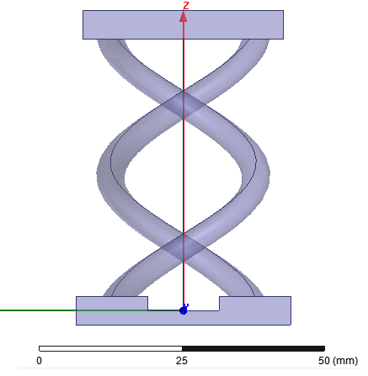
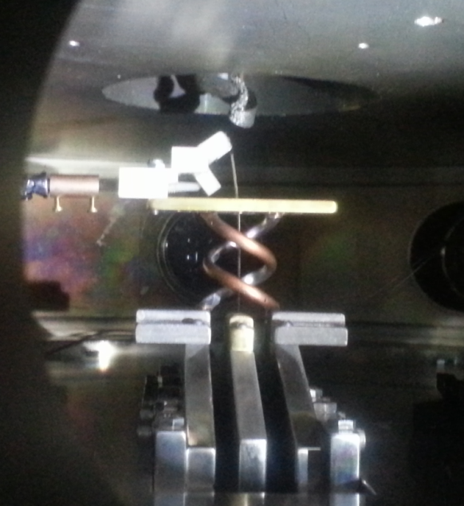
MRT Stabilization and Axial B Field
The magnetic field reduces the MRT growth rate for perturbations where wavevector k is along B
$$γ^{2}=kg−\frac{{\left(k∙B\right)}^{2}}{μ_{0}ρ}$$
Previous experiments showed k in z direction and had only B_{y} so that $k∙B=0.$
If MRT is seeded by ET such that k is primarily in the z direction, then adding an axial magnetic field produces a stabilizing $k∙B>0$
In this experiment, we create an axial magnetic with helical return current posts, so that B_{z} is proportional to the current drive and peaks at 6.5 T for 300 kA current
Laser imaging region
Foil
2 in
Current (red=drive, orange=return)

Slide 8
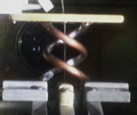
Planar vs Helical load
Planar foil load (previous experiments)
+70 kV capacitor voltage
~600 kA peak current
170 ns rise-time
4.5 nH load inductance
No axial field
Helical foil load (this experiment)
+70 kV capacitor voltage
~300 kA peak current
200 ns rise-time
33 nH load inductance
6.5 T peak axial field

Slide 9
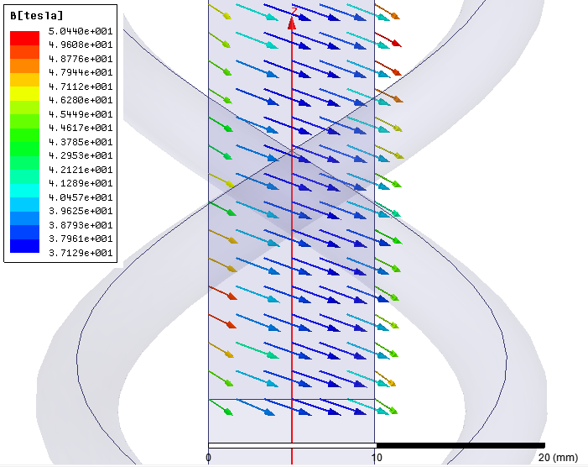
Magnetic field on foil face
Magnetic fields calculated using Ansys Maxwell
B field calculated for 600 kA current and includes B from foil
Since B_{z} depends on current, B_{z}/B_{Total} is constant throughout pulse
B field 0.5 mm from foil center

Slide 10
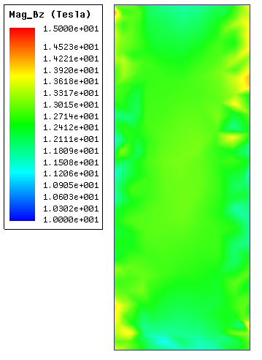
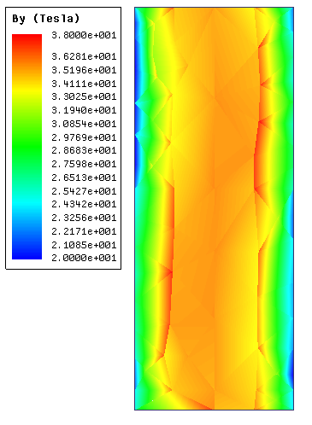
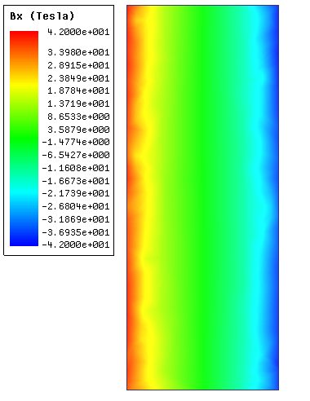
Magnetic Field on Foil Face
z
y
B_{z} uniform in foil region and ~13 T
B_{y} ranges from 20 T (edge) to 38 T (center) across foil
B_{x} ranges from 40 T to -40 T
B fields calculated 0.5 mm away from foil center. Sharp non-uniformities due to simulation mesh.

Slide 11
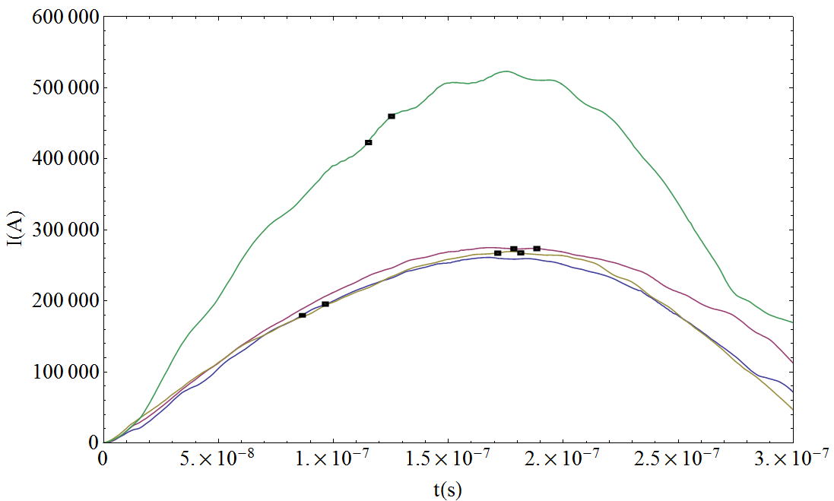
Experimental Results
This poster focuses on three shots with similar current traces to study similar plasma dynamics
Shadowgraph plasma twice during pulse with Δt=10ns
Shadowgraphs integrate plasma over 1 cm width of foil
Shot 649 (planar load)
Shot 636 (purple)
Shot 634 (gold)
Shot 639 (blue)
Shot 634, 636, and 639 are for helical load. Shot 649 is for planar load. Helical load has higher inductance and lower current.

Slide 12
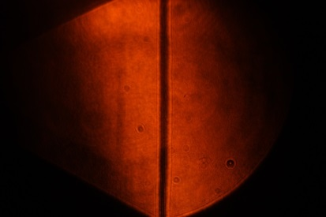
775 nm Ti:sapphire laser Shadowgraphs
Shot 639
Shot 636
Shot 634
1 cm
1
2
1
2
1
2
87 ns, 180 kA 97 ns, 196 kA 172 ns, 267 kA 182 ns, 267 kA 179 ns, 274 kA 189 ns, 275 kA
Orange lines show initial position of foil
Cameras have different response to IR laser due to removal of IR filter
Sample Preshot

Slide 13
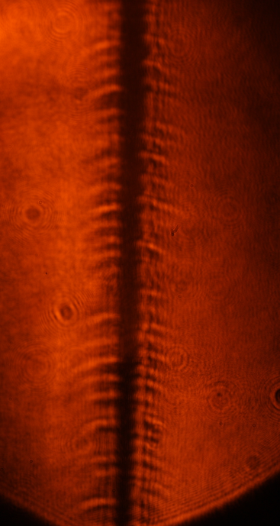
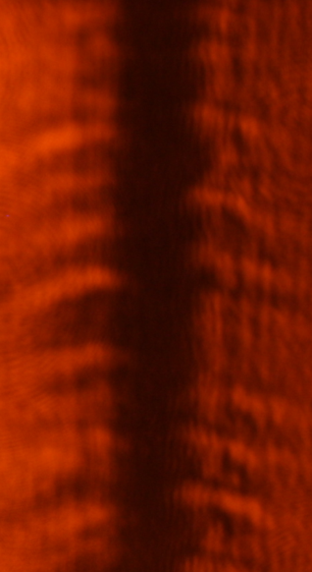
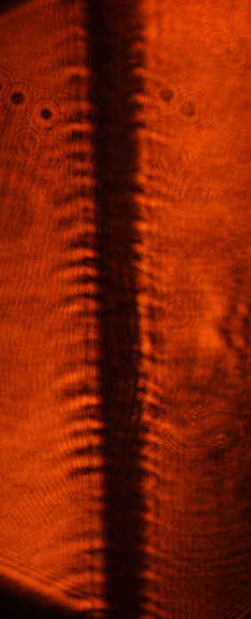
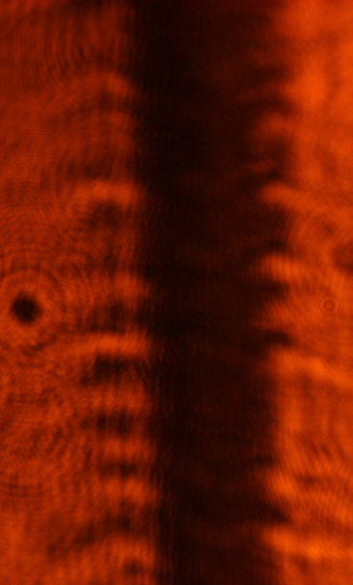
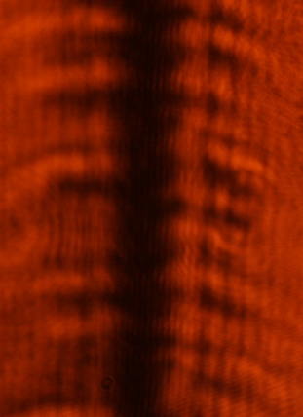
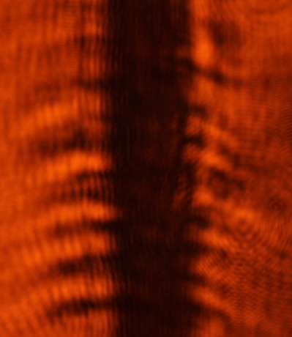
Early time features (shot 630)
Right side of foil appears to grow faster than left
Top right of foil grows faster and with a longer apparent wavelength than bottom
Instability “bumps” appear to feed streamers
Dominant wavelengths: 0.3-0.6 mm
Camera 1 87 ns, 180 kA
Camera 2 97 ns, 196 kA
1 mm
1 mm
1 mm
1 mm

Slide 14
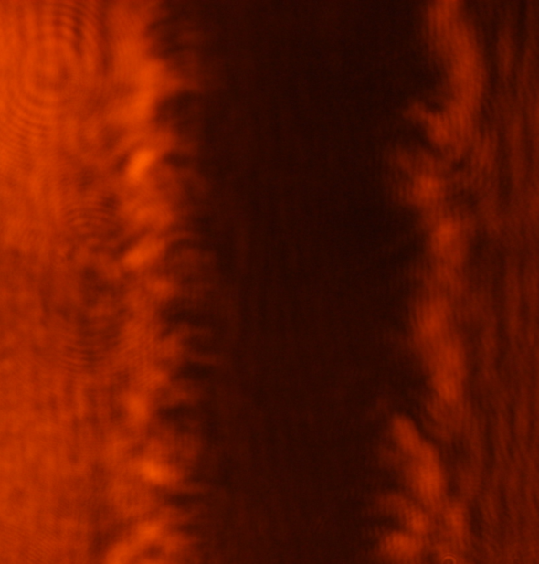
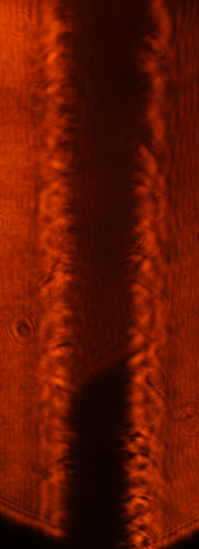
Late time features (shot 636)
Growth larger at top, consistent with early time shot
Camera 1
172 ns, 267 kA
See longer wavelength (~1 mm), possible MRT structure
5 mm
5 mm
Shadowgraphs show a lower density pattern that appears to be helical. However, this structure may also result from vertical plasma loops, or may be the lower density edge of an overlapping, longer wavelength structure.

Slide 15
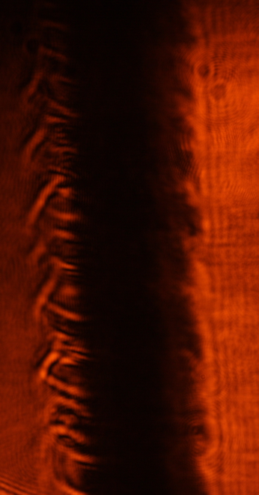
Late time features (shot 634)
Camera 2 189 ns, 275 kA
Observe different structures on right and left sides of foil, especially after peak current
See a sawtooth pattern on right side of foil (1-2 mm wavelength)
See a sharp, dense and possibly helical pattern on left
1 cm

Slide 16
Fourier Transforms
Camera 1
Camera 2
left side of foil
right side of foil
left side of foil
right side of foil
1 mm
178 ns
1 cm
188 ns
FFT lineout
172 ns
182 ns
87 ns
97 ns
FFT Method: Averaged values horizontally over a thin box along foil edge
Looked along entirety of foil to obtain spectrum all wavelengths present
Early time shows smaller wavelength features (0.3-0.6 mm) –ET?
Wavelengths increase for later times (1-2 mm), but tend to show small wavelength features –ET to MRT?
Useful for planning seeding experiments

Slide 17
MRT Growth for Foil Offset
Shot 636 showed the bulk plasma moving to the right. This may be caused by an offset to the foil: if it was initially offset closer to the left, it would experience a larger magnetic pressure on the left side of the foil and be accelerated to the right. Then:
This indicates the left interface should have a larger MRT growth for a foil moving to the right. However, the right side of the foil showed more dramatic instability development
a_{m}
Higher magnetic pressure
Lower magnetic pressure
1. The left side of the foil experiences a larger deceleration due to higher magnetic pressure
2. The left side of the foil is MRT unstable to bulk plasma acceleration to the right, while the right side is stable
→ The effective gravity and MRT growth should be larger on left interface than right
g_{m}
a_{P}
a_{m}, g_{m} – deceleration of interface and effective gravity due to magnetic pressure
a_{p}, g_{p} – acceleration of bulk plasma and corresponding effective gravity
g_{P}

Slide 18
A Possible Explanation
Consider a single MRT mode with wavevector k. This mode may be seeded by ET and is the same on both sides of the foil due to the initial 400 nm thickness (ET is characterized by ~0.5 mm wavelengths—much larger than foil thickness)
Recall the instability growth rate
$$γ^{2}=kg−\frac{{\left(k∙B\right)}^{2}}{μ_{0}ρ}$$
The stabilizing term is different on each side of the foil because the magnetic field B_{y} changes in direction across the foil
${{\left(k∙B\right)}^{2}}_{left}={\left(k_{y}B_{y}+k_{z}B_{z}\right)}^{2}$ → stronger stabilizing term
${{\left(k∙B\right)}^{2}}_{right}={\left(−k_{y}B_{y}+k_{z}B_{z}\right)}^{2}$→ weaker stabilizing term
Therefore, the left and right sides of the foil have different growth rates!
400 nm
+B_{y}
-B_{y}
Current
k_{y left}
k_{y right}

Slide 19
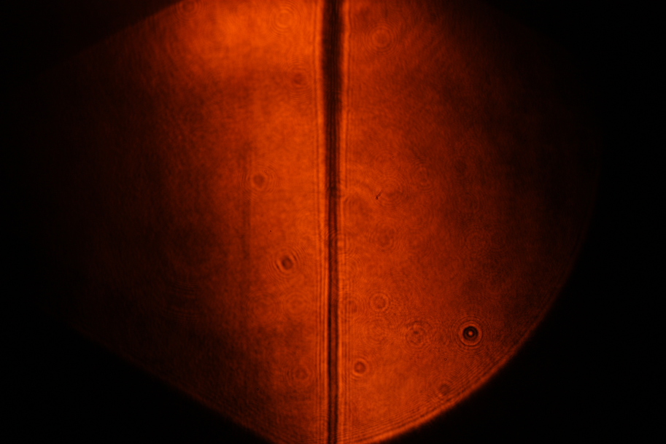
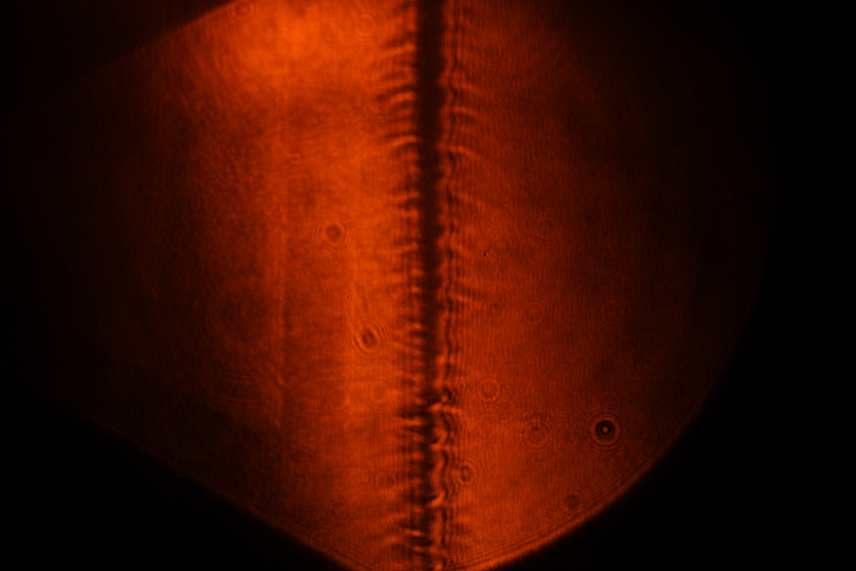
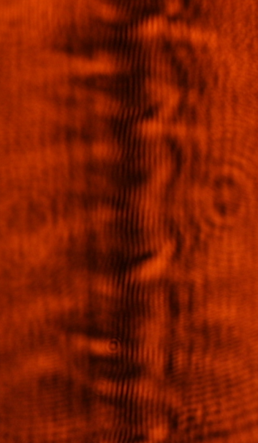
Evidence for same wavenumber
The argument on the previous slide depends on the left and right sides of the foil having the same wavenumber. Shot 637 had the best laser alignment of all our shots (however, the current for the machine was low), and shows what appears to be matching wavenumbers on the left and right side of the foil produced by a single wave developing on the foil
Preshot
Shot 637: 115 ns, 170 kA
Wavenumber on left and right due to same wave

Slide 20
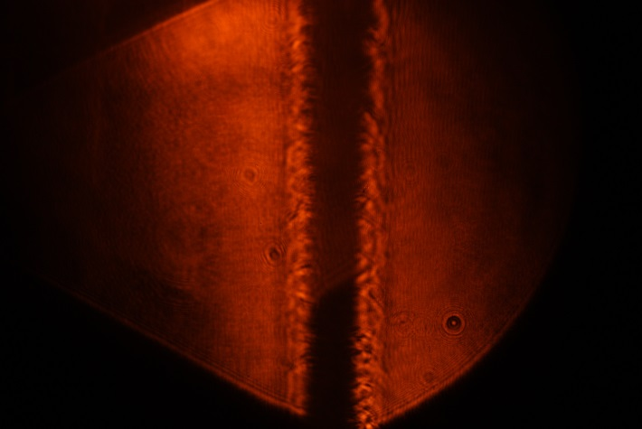
Comparison to Previous Experiment
Axial field
No axial field
1 cm
1 cm
Shot 636
172 ns, 267 kA
129 ns, 529 kA
Due to different current pulses, can only qualitatively compare to previous experiments at UM using no axial magnetic field
Previous experiments appeared to have more MRT growth. This is expected due to larger current and magnetic fields, and therefore larger effective g during MRT phase
New experiment showed new features--looping and sawtooth structures, and plasma streamers were not as apparent late in time. We also observed asymmetries on top/bottom and left/right of foil

Slide 21
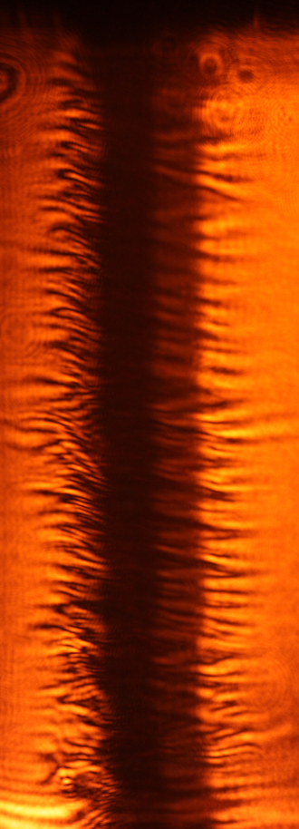
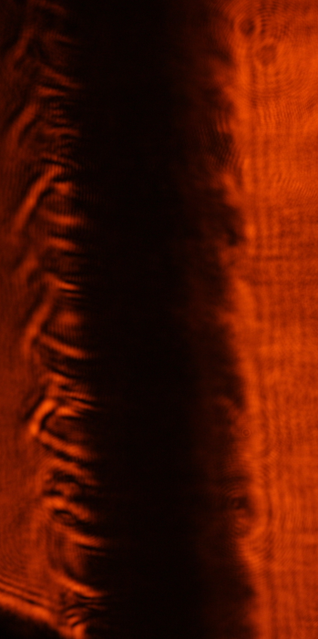
Comparison to Previous Experiment
Repeated experiment using previous planar load, same experimental configuration
No axial field
No axial field
Current using helical load was much lower, due to higher inductance
Planar load does not show helical, looping, or sawtooth structures
Both loads show differences between left and right sides of foil (initial position offset? Camera response?)
Axial Field
Axial Field
**For this planar shot, foil was offset to left (closer to left return post than right)
1 cm
172 ns, 267 kA
115 ns, 423 kA
189 ns, 275 kA
125 ns, 460 kA
Camera 1
Camera 2

Slide 22
Conclusion
Axial magnetic field changes instability structures
Helical load plasma showed differences in instability structures vertically along foil in addition to left and right sides of foil. This may be due to magnetic topology or differences in MRT stabilizing term
Top of foil expanded faster than bottom and showed longer wavelength instabilities
Right side of foil showed sawtooth structure (late in time) while left maintained looping structure
Right side of foil showed more dramatic instability development
To improve comparison, future work will use a new load hardware that allows B_{z} to change while maintaining same load inductance and current

Slide 23
References
1. “Magneto-Rayleigh-Taylor experiments on a MegaAmpere linear transformer driver”, J. C. Zier, R. M. Gilgenbach, D. A. Chalenski, Y. Y. Lau, et al, Phys. Plasmas 19, 032701 (2012).
2. “Ablation Dynamics and Instabilities of Metallic Plasmas generated using MA-Scale Current Drivers”, J. C. Zier, Ph.D. Dissertation, University of Michigan, (2011).
3. “Effects of magnetic shear on magneto-Rayleigh-Taylor instability”, P. Zhang, Y. Y. Lau, I. M. Rittersdorf, M. R. Weis, R. M. Gilgenbach, D. Chalenski, and S. A. Slutz, Phys. Plasmas 19, 022703 (2012).

