Slide 1

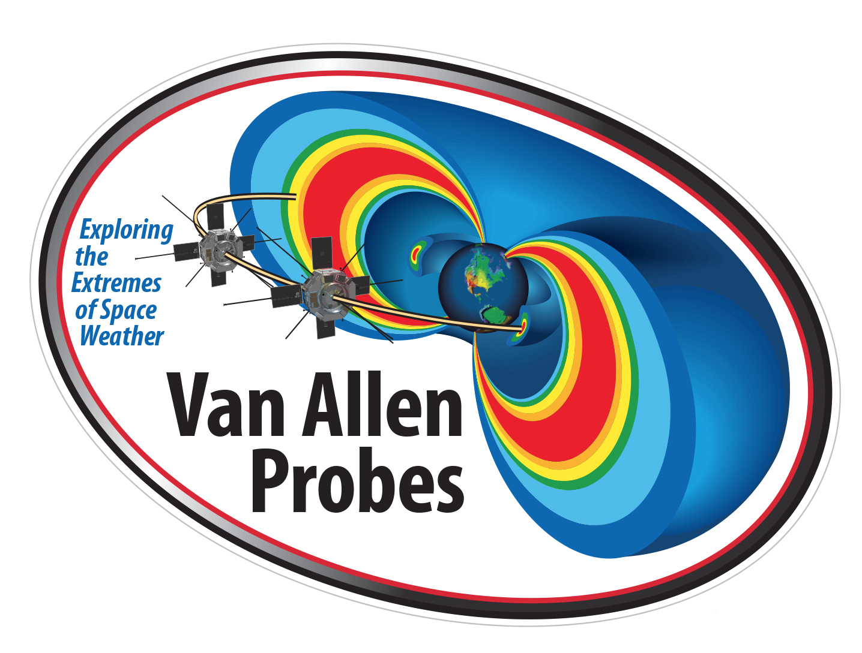



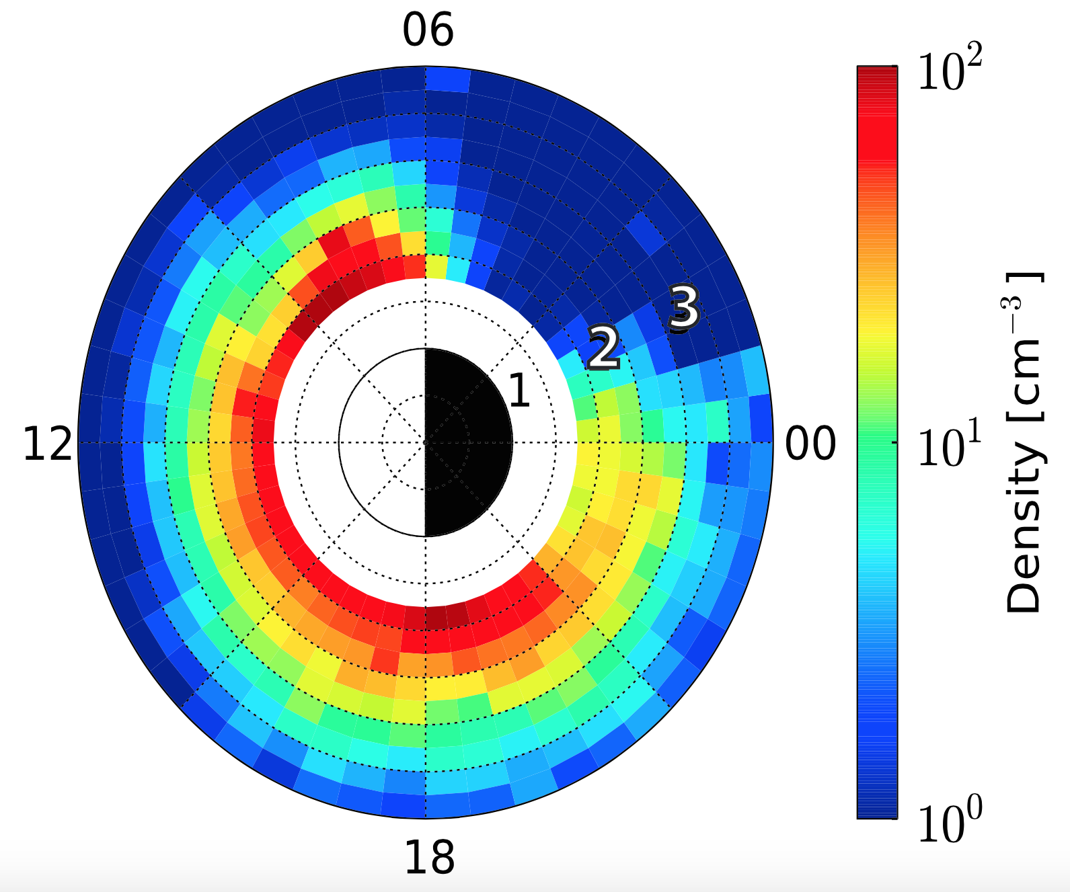

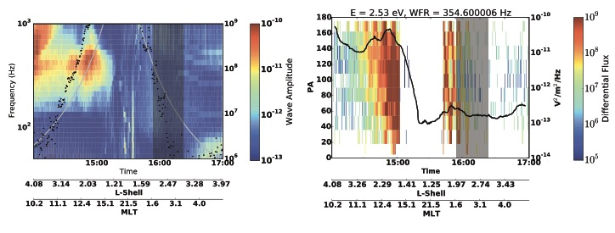
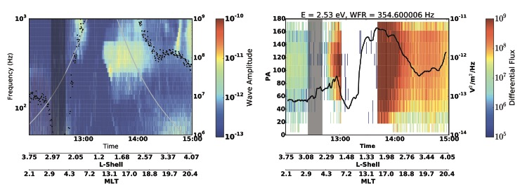
Are Plasma Waves at the Proton Gyrofrequency Scattering the High Energy (1-10 eV) Post-Midnight Plasmasphere?
¹Lois K. Sarno-Smith, ¹Michael W. Liemohn, ²Ruth M. Skoug, ²Brian A. Larsen, ³Aaron Breneman, ²Steven K. Morley, ²Geoff Reeves, ³John R. Wygant, ⁴Craig Kletzing, ¹Mark B. Moldwin, ¹Roxanne M. Katus, ¹Shasha Zou
¹University of Michigan, ²Los Alamos National Laboratory, ³University of Minnesota, ⁴University of Iowa
Background and Summary
Methodology
Known 1-10 eV Plasma loss in Post-Midnight Sector when
Kp < 3 at 2 < L < 3 – Use Van Allen Probes HOPE and EMFISIS to further explore
We develop an algorithm to sort Pitch Angle (PA) distributions so we can determine what causes the loss
We show wave amplitudes linked to 1-10 eV ion loss
From 2013-02-01 to 2014-10-01 sort HOPE H⁺ Pitch Angle Distributions by 0.25 L Shell and 0.5 MLT
Equatorial Noise Wave Activity
Algorithm allows us to determine the long term plasma behavior in different regions of space
Equatorial Noise Peak Above Proton Gyrofrequency over 2 year Period
Hit Test – High Wave Above 1e-12 nT²/m², High Particle Above 1e8 cm⁻² s⁻¹ sr⁻¹ keV⁻¹
Results of Pitch Angle Distribution Algorithm
Heightened Loss Cone at Dusk Terminator
Loss Cone at Minimum in Post-Midnight Sector – plasma already scattered
Bad = Summed Pitch Angle Distributions where there are few/no counts -> suggests depleted plasma
Case Studies of PA Spectograms vs Wave Amplitude
July 9, 2014
Left = EMFISIS
WFR spectra, silver line = cyclotron frequency, black dots = HOPE 2.5 eV flux
Right = HOPE PA spectogram with EMFISIS 350 Hz amplitude overplotted
May 6, 2013
Exploring relationship between wave amplitude at cyclotron frequency and 1-10 eV partial densities
at L = 2
Maybe be offset by several hours?
Thanks
We would like to thank the NSF, NASA, and the Rackham Graduate School for sponsoring this work.
Conclusions
Wave Activity linked to 1-10 eV particle loss, appears to be from multiple sources
Increased Asymmetric and Loss Cone Distributions across the night side – plasma severely depleted in 1-4 MLT
Strongest case study link between ion loss and wave activity at the cyclotron frequency
More work is needed to determine physics behind loss

