Slide 1
IMPACT OF ELECTRODE PLACEMENT ON RONS PRODUCTION IN ATMOSPHERIC PRESSURE PLASMA JETS*
Amanda M. Lietzª and Mark J. Kushner^{b}
^{a)}Dept. Nuclear Engineering and Radiological Sciences
^{b)}Dept. Electrical Engineering and Computer Science
University of Michigan, Ann Arbor, MI 48109, USA
lietz@umich.edu, mjkush@umich.edu,
http://uigelz.eecs.umich.edu
7th Annual MIPSE Graduate Student Symposium
Ann Arbor, MI
5 October 2016
* Work was supported by the DOE Office of Fusion Energy Science and the National Science Foundation.

Slide 2
AGENDA
Atmospheric Pressure Plasma Jets
Model Description: nonPDPSIM
Base Case – Single Powered Ring Electrode
Ionization Wave
Reactive Neutrals
Powered Electrode Placement Along Tube
1 Outer Electrode vs 2 Outer Electrode
Inner HV Electrode vs. Outer HV Electrode
Distant Radial Ground Planes
Concluding Remarks
University of Michigan
Institute for Plasma Science & Engr.
MIPSE_2016
Notes:
Application for atm discharges

Slide 3
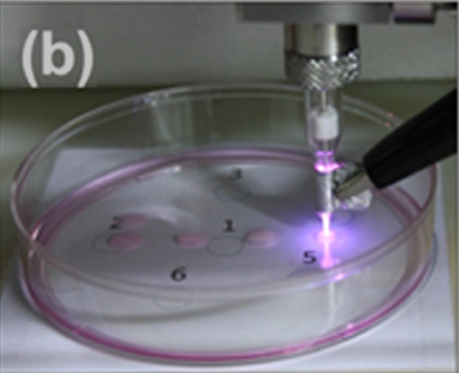
ATMOSPHERIC PRESSURE PLASMA JETS
Atmospheric pressure plasma jets (APPJs) in plasma medicine have been studied for:
Sanitizing wounds without tissue damage
Reducing size of cancerous tumors
Eradicating bacteria in biofilms
Rare gas with small amounts of O₂ to increase reactive oxygen and nitrogen species (RONS) production.
Control of RONS production is key to influencing biological systems.
• Joh, H. et al. Applied Phys. Letters, 5, 101 (2012)
• O’Connor, N. J. Applied Phys., 110, 013308 (2011)
University of Michigan
Institute for Plasma Science & Engr.
MIPSE_2016
Notes:
Application for atm discharges

Slide 4
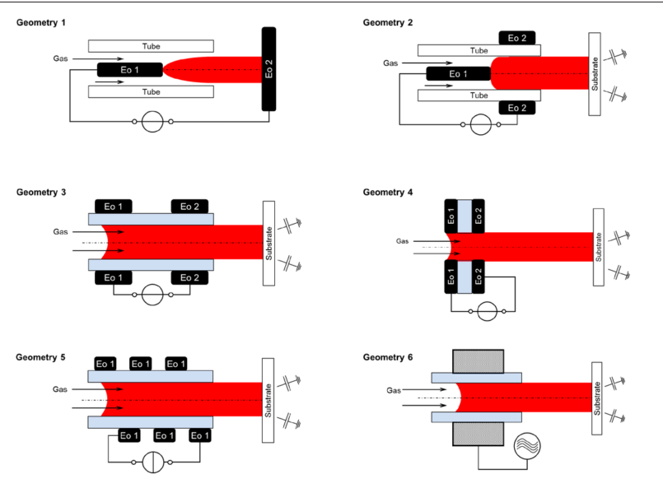
CONTROL OF RONS PRODUCTION
Many designs of APPJs differ in the arrangement of electrodes on the tube.
Comparison of these designs would allow for better selection of an APPJ design for a given application.
Side-by-side comparison of APPJs is challenging due to poorly known effects of secondary parameters.
J Winter et al PSST 24, 064001 (2015)
Objective: Computationally investigate the effect of electrode configuration on breakdown dynamics and RONS production in an APPJ with powered outer ring electrode.
University of Michigan
Institute for Plasma Science & Engr.
MIPSE_2016
Notes:
Application for atm discharges

Slide 5
MODEL:
nonPDPSIM
Plasma Hydrodynamics
Poisson’s Equation
Gas Phase Plasma
Unstructured mesh.
Fully implicit plasma transport and gas dynamic transport.
Electron temperature equation for bulk electrons with Boltzmann derived transport coefficients.
Radiation transport and photoionization.
Time slicing algorithms between plasma and fluid timescales.
Bulk Electron Energy
Transport
Kinetic “Beam”
Electron Transport
Neutral Transport
Navier-Stokes
Neutral and Plasma
Chemistry
Radiation Transport
Surface Chemistry
and Charging
Ion Monte Carlo
Simulation
Circuit Model
University of Michigan
Institute for Plasma Science & Engr.
MIPSE_2016
Notes:
5
5

Slide 6
GAS FLOW and MESH
Cylindrically symmetric
170 ns pulse, -8 kV pulse
20 ns rise time, 20 ns fall
He/O₂/N₂/H₂O (2.4/4.7/2.9 ppm), 1 atm, 2 slm into humid air
Tube ɛ_{r} = 4, 250 µm thick
Steady-state flow established before plasma
Reaction mechanism: He/N₂/O₂/H₂O, 51 species, 717 reactions
12,572 nodes, spacing 50 µm in tube
MIN MAX
Linear scale
University of Michigan
Institute for Plasma Science & Engr.
MIPSE_2016
Notes:
Humidity: xxx

Slide 7
BASE CASE: IONIZATION WAVE
-8 kV, 200 ns
S_{e} – electron impact ionization source
Plasma propagates as ionization wave (IW) from powered electrode.
As IW propagates along the tube, inner wall is negatively charged while the area by the electrode is positive.
Additional ionization source when voltage turns off.
Cathode-directed streamer forms later due to photoionization.
MIN MAX
University of Michigan
Institute for Plasma Science & Engr.
Log scale
MIPSE_2016
Notes:
Humidity:

Slide 8
BASE CASE: ROS FORMATION
41 μs
O₂*, O, OH and H₂O₂ form inside the tube
O₃ and HO₂ produced where plasma contacts air
Initial ROS production
e + O₂ → O₂* + e
e + O₂→ O⁻ + O
e + O₂→ O + O + e
e + O₂⁺ → O + O
H₂O⁺ + H₂O → H₃O⁺ + OH
At longer timescales
O + O₂ + M → O₃ + M
H + O₂ + M → HO₂ + M
OH + OH + M → H₂O₂ + M
MIN MAX
University of Michigan
Institute for Plasma Science & Engr.
Log scale
MIPSE_2016
Notes:
MENTION TIMESCALES

Slide 9
BASE CASE: RNS FORMATION
100 μs
N and NO are produced in the tube.
NO₂ and HNO_{x} are formed outside of the tube.
N atom produced initially
e + N₂ → N + N + e
e + N₂⁺ → N + N
N₂* + O→ NO + N
Much of the N produced recombines
N + N + M → N₂ + M
Reactions with ROS produce other RNS
NO + O + M → NO₂ + M
NO + OH + M → HNO₂ + M
NO₂ + OH + M → HNO₃ + M
NO₂ + OH + M → ONOOH + M
MIN MAX
University of Michigan
Institute for Plasma Science & Engr.
Log scale
MIPSE_2016
Notes:
Humidity:

Slide 10
ELECTRODE DISTANCE FROM OUTLET
-8 kV, 200 ns
n_{e} at 152 ns; S_{e} at 36 ns
For a single ring electrode jet, placing the electrode closer to the tube outlet leads to a more intense IW.
IW exits the tube sooner, greater energy deposition outside of tube.
This effect is most important for short pulses.
IW propagation time ~ pulse duration
MIN MAX
University of Michigan
Institute for Plasma Science & Engr.
Log scale
MIPSE_2016
Notes:
Mention that actual ground plane is further

Slide 11
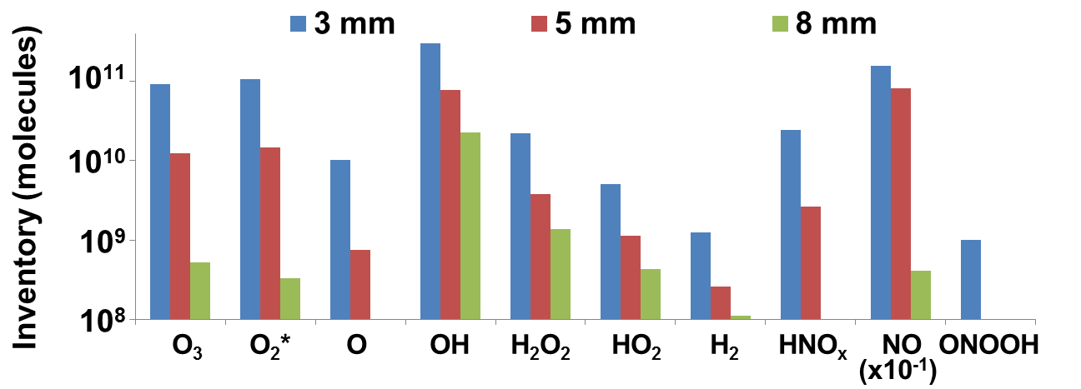
ELECTRODE DISTANCE FROM OUTLET - RONS
Inventory – volume integrated number of molecules at 220 μs
Moving electrode closer to outlet increases all RONS.
Species originating from H₂O (OH, H₂O₂, HO₂, H₂) are the least sensitive to distance to exit, as a significant amount of these species are made inside the tube, even for 3 mm.
For the other species at 3 mm, formation outside the tube dominates for all other RONS.
Only 10 ppm O₂/H₂O/N₂ in He – results would be different with an admixture.
University of Michigan
Institute for Plasma Science & Engr.
MIPSE_2016
Notes:
Mention that actual ground plane is further

Slide 12
1 RING vs 2 RING ELECTRODE IW
n_{e} at 174 ns; S_{e} at 36 ns
A grounded ring produces a faster IW, and a generally more intense plasma.
IW wave is initially faster (larger E_{z}), it slows when it passes the grounded ring to charge the higher capacitance.
Plasma is significantly more annular with grounded ring.
Animation Slide
MIN MAX
University of Michigan
Institute for Plasma Science & Engr.
Log scale
MIPSE_2016
Notes:
Humidity:

Slide 13
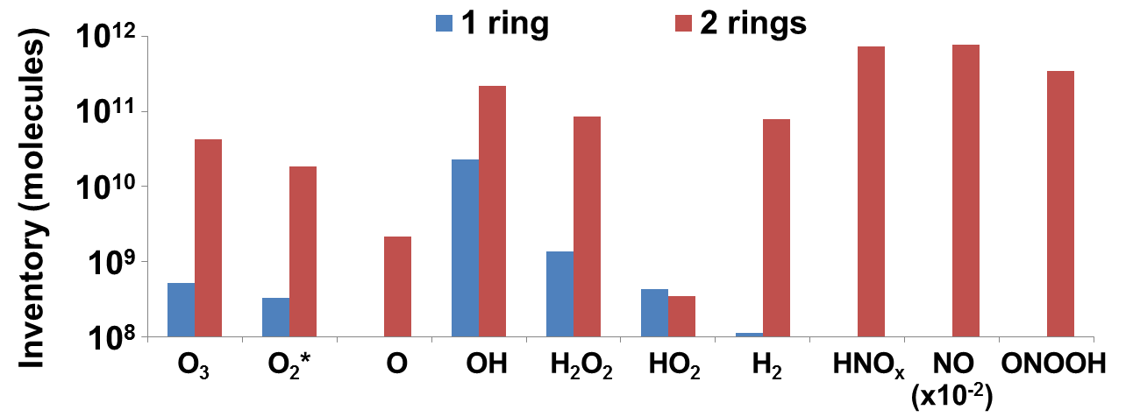
1 RING vs 2 RING ELECTRODE: RONS
Inventory – volume integrated number of molecules at 220 μs
All RONS increase when a grounded ring is added except HO₂.
Though more HO₂ is produced with 2 rings, it reacts with the elevated levels of NO, forming HNO₃ and ONOOH by 220 μs.
RONS originating from H₂O are again the less sensitive. Because H₂O has the lowest ionization potential and the pathway
H₂O⁺ + H₂O → H₃O⁺ + OH
H₂O⁺ + M⁻ → H₂O + H + M
produces OH and H.
University of Michigan
Institute for Plasma Science & Engr.
MIPSE_2016
Notes:
Humidity:

Slide 14
DISTANT GROUND PLANES - n_{e}
The presence of ground planes which are not on the tube are often not controlled.
A ground in close proximity increases E_{r} in the tube.
n_{e} profile is more annular with nearby grounds due to greater E_{r}.
Capacitance to ground increases, more charging of inner wall.
MIN MAX
University of Michigan
Institute for Plasma Science & Engr.
MIPSE_2016
Log scale
Notes:
Mention that actual ground plane is further

Slide 15
DISTANT GROUND PLANES - S_{e}
Faster IW with a nearby ground means the plasma reaches the ambient faster.
For a finite pulse duration, this allows more power deposition outside of the tube.
Here the ground is assumed to be cylindrically symmetric, this would rarely be the case for an uncontrolled ground.
This may lead to nonuniformity.
MIN MAX
University of Michigan
Institute for Plasma Science & Engr.
Log scale
MIPSE_2016
Notes:
Mention that actual ground plane is further

Slide 16
DISTANT GROUND PLANES - RONS
Most RONS decrease with increasing radial ground distance
Nearby grounds (stray capacitance of the APPJ) can increase the IW intensity.
The higher RNS (HNO_{x} and ONOOH) are particularly sensitive – 3 orders of magnitude drop from r = 0.4 to 5.4 cm.
University of Michigan
Institute for Plasma Science & Engr.
MIPSE_2016
Notes:
Mention that actual ground plane is further

Slide 17
CONCLUDING REMARKS
Electrode configuration of an APPJ can be used to control the regions of power deposition, and the resulting RONS production.
Confining power deposition inside the tube is a trade-off:
provides more control over RONS production (RONS reflect feedgas composition).
produces less RONS.
Power deposition can be confined to the tube by:
Moving the powered electrode further from the tube outlet.
Using short pulse durations.
Placing a ground electrode on the tube.
Removing any nearby grounds.
For pure He, the species originating from H₂O are less sensitive to these parameters.
University of Michigan
Institute for Plasma Science & Engr.
MIPSE_2016

Slide 18
SUPPLEMENTAL SLIDES
University of Michigan
Institute for Plasma Science & Engr.
ICPM_2016

Slide 19
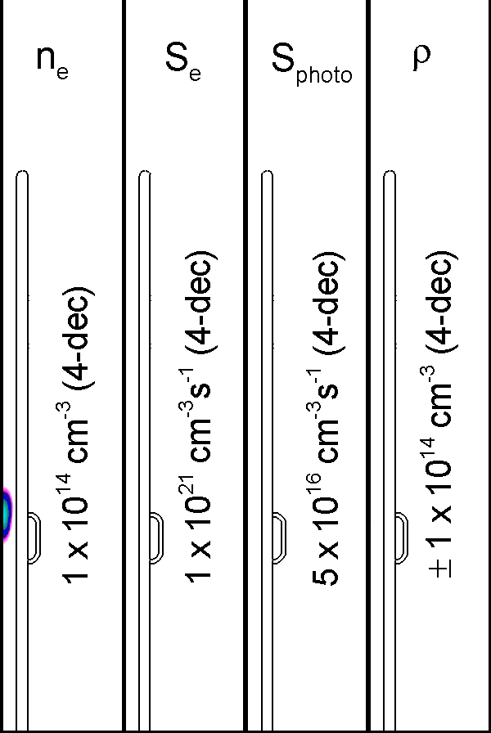
BASE CASE: IONIZATION WAVE
-8 kV, 200 ns
Plasma propagates as ionization wave (IW) from powered electrode.
As IW propagates along the tube, inner wall is negatively charged while the area by the electrode is positive.
Additional ionization source when voltage turns off.
Cathode-directed streamer forms later due to photoionization.
Simplified photoionization model includes excimer only
Photoionization hotspot at the end of tube due to high gradient of O₂/N₂/H₂O density
MIN MAX
University of Michigan
Institute for Plasma Science & Engr.
Log scale
Animation Slide
MIPSE_2016
Notes:
Humidity:

Slide 20
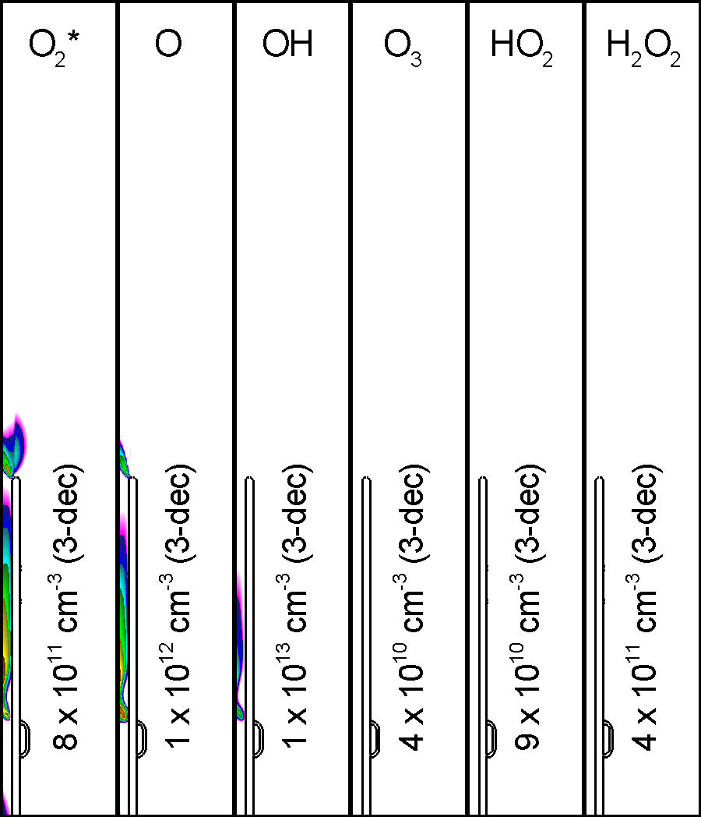
BASE CASE: ROS FORMATION
O₂*, O, OH and H₂O₂ form inside the tube
O₃ and HO₂ produced where plasma contacts air
Initial ROS production
e + O₂ → O₂* + e
e + O₂→ O⁻ + O
e + O₂→ O + O + e
e + O₂⁺ → O + O
H₂O⁺ + H₂O → H₃O⁺ + OH
At longer timescales
O + O₂ + M → O₃ + M
H + O₂ + M → HO₂ + M
OH + OH + M → H₂O₂ + M
Animation Slide
MIN MAX
University of Michigan
Institute for Plasma Science & Engr.
Log scale
MIPSE_2016
Notes:
MENTION TIMESCALES

Slide 21
BASE CASE: IONIZATION WAVE
-8 kV, 200 ns
Plasma propagates as ionization wave (IW) from powered electrode.
As IW propagates along the tube, inner wall is negatively charged while the area by the electrode is positive.
Additional ionization source when voltage turns off.
Cathode-directed streamer forms later due to photoionization.
Simplified photoionization model includes excimer only
Photoionization hotspot at the end of tube due to high gradient of O₂/N₂/H₂O density
University of Michigan
Institute for Plasma Science & Engr.
MIPSE_2016
Notes:
Humidity:

