Slide 1
ARRAYS OF MICROPLASMAS FOR CONTROLLING PROPERTIES OF ELECTROMAGNETIC WAVES*
Chenhui Qu, Peng Tian and Mark J. Kushner
University of Michigan, Electrical Engineering & Computer Science
Ann Arbor, MI 48109-2122 USA
chenqu@umich.edu, tianpeng@umich.edu, mjkush@umich.edu
MIPSE Poster, September 2016

Slide 2
AGENDA
Introduction to Microplasma Array (MPA)
Description of Model.
Scaling of Microplasma Array
Pressure, Voltage, Pulse Repetition Frequency (PRF)
Cross-talk Between Plasma Cells
Controlling Microwave Transmission with Array of Microplasma
Concluding Remarks
University of Michigan
Institute for Plasma Science & Engr.
MIPSE_Sep_2016

Slide 3
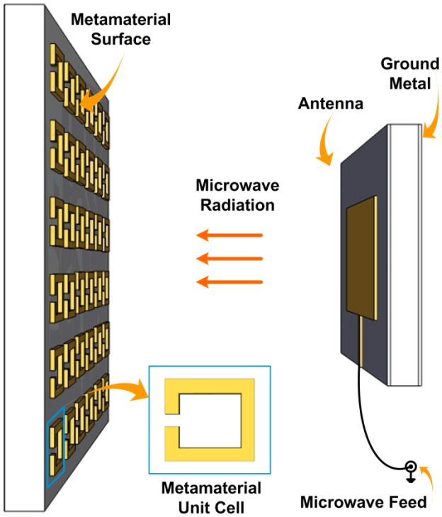
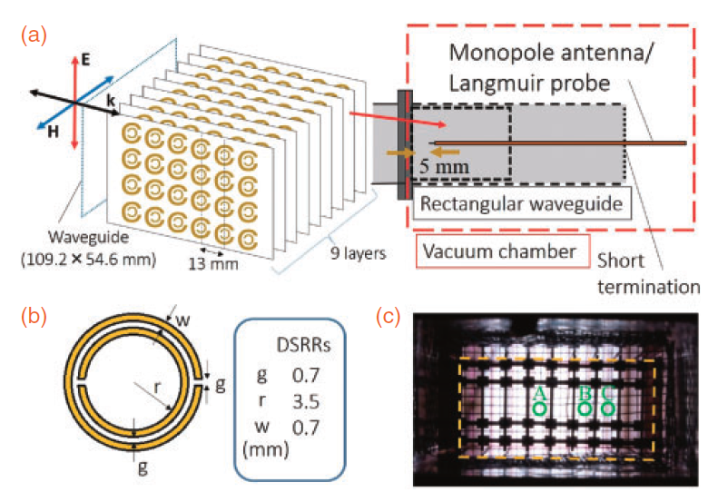
MICROPLASMAS AS METAMATERIAL
Microplasma arrays are being investigated as metamaterials for control of electromagnetic waves. Optimizing material's performance requires stringent control of microplasma properties.
Plasma material has advantages on
Tuning material’s properties
Manipulating material structure arbitrarily
Add inherent nonlinearity to the material
[2]
[1]
[1] A. Iwai & Sakai, Appl. Phys. Express 8, 056201 (2015)
[2] Singh et al. Nature Scientific Reports 4 : 5964 (2014)
University of Michigan
Institute for Plasma Science & Engr.
MIPSE_Sep_2016

Slide 4
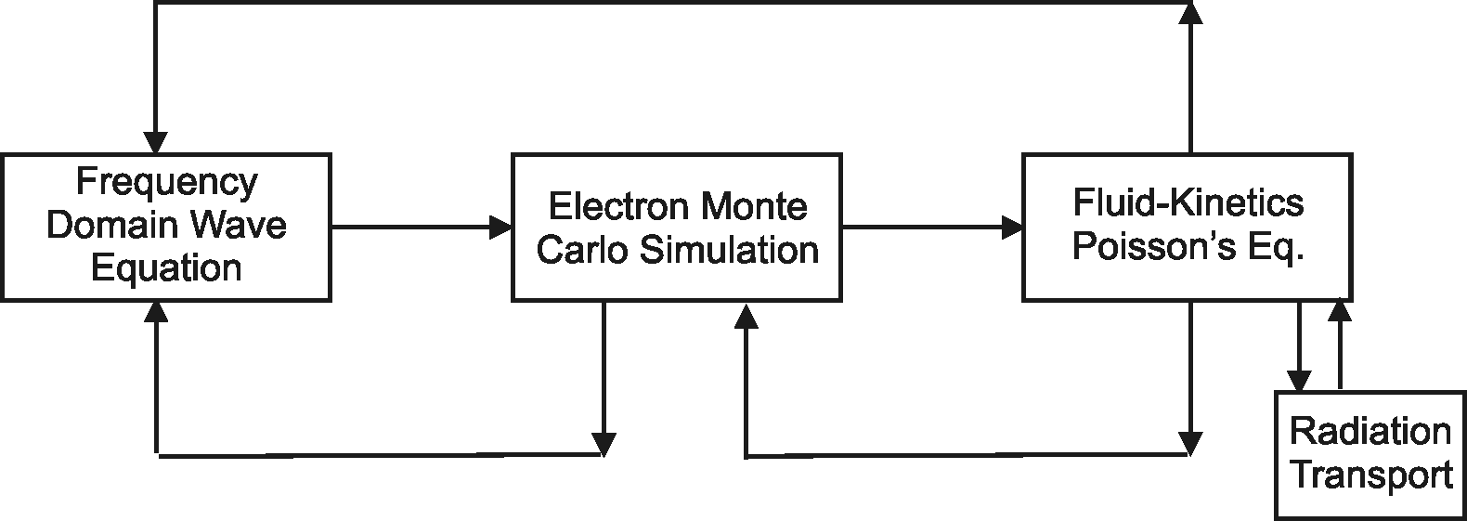
MODELING OF PULSED MICROPLASMAS
The Hybrid Plasma Equipment Model (HPEM) is a modular simulator that combines fluid and kinetic approaches.
Monte Carlo Ion/Neutral Transport
Surface
Chemistry
Module
Monte Carlo Radiation Transport
University of Michigan
Institute for Plasma Science & Engr.
MIPSE_Sep_2016

Slide 5
UNIPOLAR DC-PULSING
Short pulses (~ 10s ns) heat electrons rapidly at leading edges.
Pulsing repetition frequency is at several MHz.
Peak potential up to hundreds of volts.
Duty cycle is 20% to 60%
University of Michigan
Institute for Plasma Science & Engr.
MIPSE_Sep_2016

Slide 6
2 × 2 ARRAY OF 4 MICROPLASMA CELLS
2 × 2 symmetric configuration of sealed plasma cavity with no net gas flow.
Powered electrodes are located at the center and separated by dielectric material.
Electrodes are exposed to plasma.
Higher plasma density is enabled through beam ionization from secondary electron emission.
10s of Torr, 10s ns DC pulse with several MHz PRF, unipolar excitation.
Working gas is Ar
University of Michigan
Institute for Plasma Science & Engr.
MIPSE_Sep_2016

Slide 7
ELECTRON DENSITY, IONIZATION SOURCES
Base case: Ar, 60 Torr, 10 MHz, 30% duty cycle (30 ns pulse), -300 V
Peak [e] ≈ 1.1 × 10¹⁴ cm⁻³
Significant "exclusion zone" with expansion of cathode fall during pulse.
Bulk ionization peaks where T_{e} and [e] are at high values near the edge of cathode fall.
Ionization by secondary emission electrons is more important than by bulk electrons.
University of Michigan
Institute for Plasma Science & Engr.
MIPSE_Sep_2016

Slide 8
GAS HEATING
Profiles shown at peak-pulse.
Gas heating in microplasma is a major factor influencing scaling of plasma density.
Gas is heated immediately adjacent to electrodes due to large ion drift velocity.
Rarefaction caused by heating near electrode decreases local gas density thus reduces ionization efficiency.
Ar, 60 Torr, -300 V, 30 ns pulse length, 10 MHz PRF.
University of Michigan
Institute for Plasma Science & Engr.
MIPSE_Sep_2016

Slide 9
VOLTAGE SCALING
Ar, 60 Torr, fixed pulse length (30 ns), 10 MHz PRF.
Increasing voltage and power deposition increases T_{gas} which rarefies gas, leading to saturation in peak electron density.
Rarefaction increases particle transport and cross-talk between plasma cells.
Maximum electron density [e] is largely a function of product of voltage.
University of Michigan
Institute for Plasma Science & Engr.
MIPSE_Sep_2016

Slide 10
PRESSURE SCALING
Argon, -300 V, 10 MHz PRF, 30 to 80 Torr.
Low pressure produces low plasma density with thicker cathode fall which excludes bulk plasma.
Plasma is confined and has better uniformity at high pressure.
With higher stopping power of beam electrons, T_{gas} increases with pressure.
Plasma density saturates due to rarefaction effect of gas heating.
University of Michigan
Institute for Plasma Science & Engr.
MIPSE_Sep_2016

Slide 11
PRF AND DUTY CYCLE
Ar, 60 Torr, -300 V
Lower PRF, lower average power reduces gas temperature and regains some loss in efficiency due to rarefaction.
Increasing pulse length (higher duty cycle) with stable PRF will transit plasma to cw-like with larger cathode fall.
The cw configuration has the plasma in the center of the array.
The threshold of transition in plasma behavior is duty cycle =60%.
University of Michigan
Institute for Plasma Science & Engr.
MIPSE_Sep_2016

Slide 12
TURNING OFF ELECTRODES
Electrodes are turned off to investigate plasma interactions.
Different pair of electrodes produce similar densities with little interactions between pairs.
Drifting electrons from other pairs produce higher electron density but are not critical for sustaining neighbors.
Ar, 60 Torr, -300 V, 30 ns pulse length, 10 MHz.
MIN MAX
University of Michigan
Institute for Plasma Science & Engr.
MIPSE_Sep_2016

Slide 13
UNBALANCED POWERED
Electrodes are powered with different voltages( -300 V, -250 V).
Cathode to anode: 130 μm
Diffusion of metastable atoms help in generating high density plasma with lower power input.
In steady state the plasma densities of each cell are commensurate.
Ar, 60 Torr, 30 ns pulse length, 10 MHz.
University of Michigan
Institute for Plasma Science & Engr.
MIPSE_Sep_2016

Slide 14
MICRO-PLASMA ARRAYS IN WAVEGUIDES
Control or modulation of high frequency microwave radiation by small arrays of microplasmas was investigated.
HFSS (High Frequency Electromagnetic Field Simulation) software (www.ansys.com/Products/Electronics/ANSYS-HFSS) was used with plasma properties provided by UM simulations.
Industry standard copper waveguides are modeled with EM fields produced in frequency domain calculations.
MPA is placed in center of waveguide.
University of Michigan
Institute for Plasma Science & Engr.
MIPSE_Sep_2016

Slide 15
PLASMA ELECTRICAL PROPERTIES
Electron Plasma Frequency
Effective Permittivity
Effective Conductivity
University of Michigan
Institute for Plasma Science & Engr.
MIPSE_Sep_2016

Slide 16
WR-42 WAVEGUIDE
WR-42 intended for 18-26.5 GHz
(a) 10.668 mm × (b) 4.318 mm × (L) 75 mm
4 x 10 Microplasma array:
Radius of Plasma Cell = 400 μm
Thickness of plasma = 1 mm (L_{p})
Plasma properties:
[e] = 7.2 x 10¹⁴ cm⁻³
ν_{m} = 1.5 x 10¹¹ s⁻¹.
TE₁₀ Mode
Cutoff frequency of empty WR-42 from simulation is 14 GHz – agrees with theory
Transmission Coefficient through Waveguide (dB)
University of Michigan
Institute for Plasma Science & Engr.
MIPSE_Sep_2016

Slide 17
WR-42: MICROPLASMA ARRAY LAYOUT
Due to mode structure of TE₁₀ wave, transmission through microplasma array depends on layout of the microplasma elements.
The transmission can be controlled using the same number of microplasma elements but different arrangement.
Microplasma layout (Cross-Section View)
• 92% • 84%
20 GHz Transmission
University of Michigan
Institute for Plasma Science & Engr.
MIPSE_Sep_2016

Slide 18
WR-12 WAVEGUIDE
WR-12 intended for 60-90 GHz
(a) 1.549 mm × (b) 3.3099 mm × (L) 17 mm
7 x 15 Microplasma array:
Radius of Plasma Cell = 80 μm
Thickness of plasma = 0.5 mm
Plasma properties:
[e] = 7.2 x 10¹⁴ cm⁻³
ν_{m} = 1.5 x 10¹¹ s⁻¹.
Microplasma Array
TE₁₀ Mode
Cutoff frequency of empty WR-12 from simulation is 48.4 GHz – agrees with theory
Transmission Coefficient through Waveguide (db)
University of Michigan
Institute for Plasma Science & Engr.
MIPSE_Sep_2016

Slide 19
WR-12: PLASMA ARRAY FILLING OF WAVEGUIDE
Fill waveguide from bottom row-by-row
Transmission through WR-12 at 65 GHz as microplasma array is turned on row-by-row from bottom.
Decrease in transmitted power as array is populated due to plasma absorption and reflection. (For 65 GHz, cut off occurs at 5 x 10¹³ cm⁻³.)
Effect of plasma is maximum when rows of plasma approach center of waveguide cross section where the electric field amplitude is largest.
University of Michigan
Institute for Plasma Science & Engr.
MIPSE_Sep_2016

Slide 20
CONCLUDING REMARKS
Microplasma arrays in Ar at 10s – 100 Torr in sealed cavities maintained by ns DC pulses were investigated to determine scaling laws of plasma density (PRF, voltage, pressure).
Gas heating in microplasmas at such pressures is important in scaling as local rarefaction of the gas will decrease ionization efficiency during the pulse.
Interactions are controllable between plasma cells and may be helpful for sustaining high plasma densities.
Layout of microplasma elements important to transmission due to overlap with mode structure and diffraction effects.
Arrays of microplasmas are not in generally equivalent to a slab of the average of the plasma properties.
University of Michigan
Institute for Plasma Science & Engr.
MIPSE_Sep_2016

