Slide 1
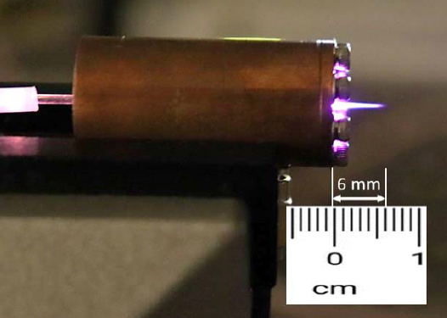
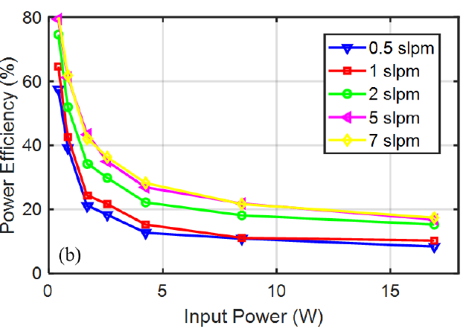
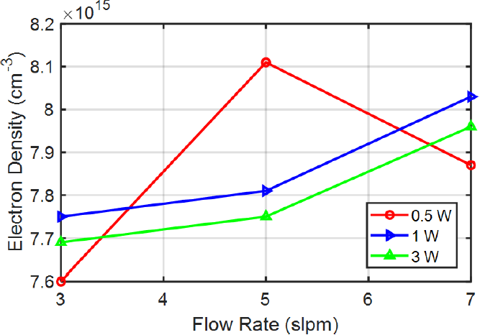
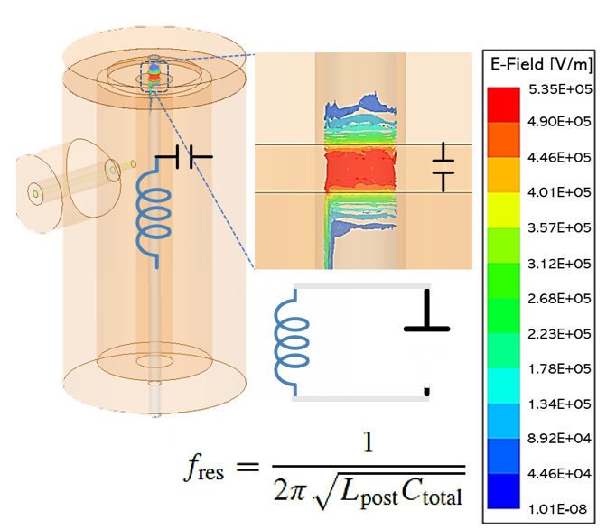
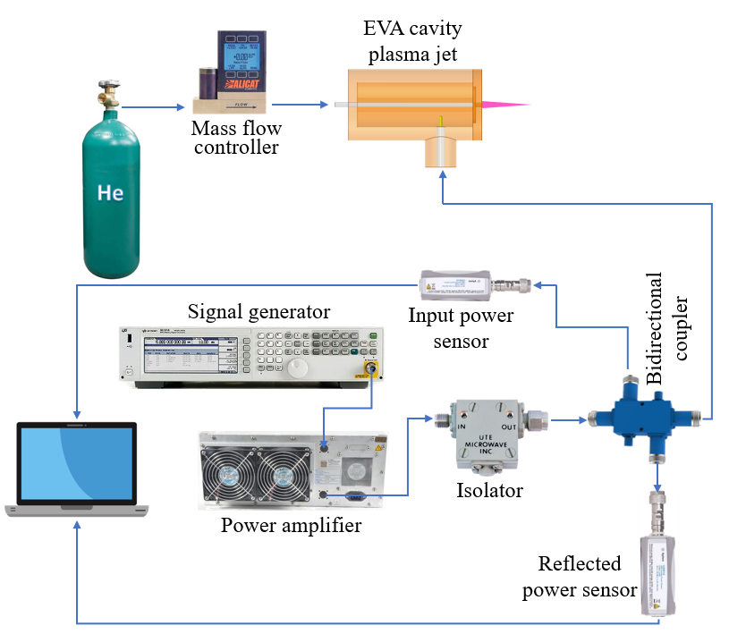
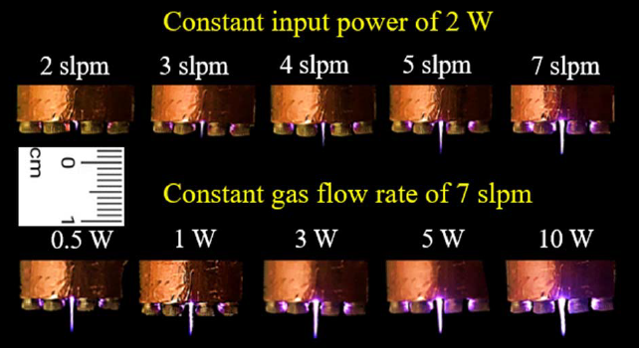
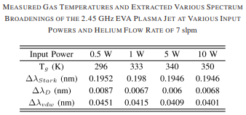
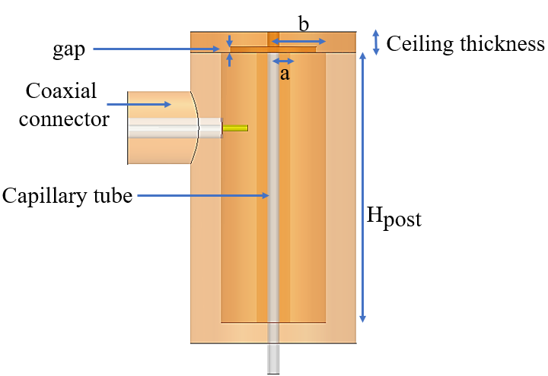
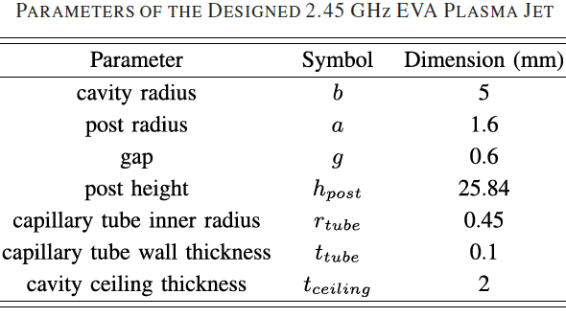
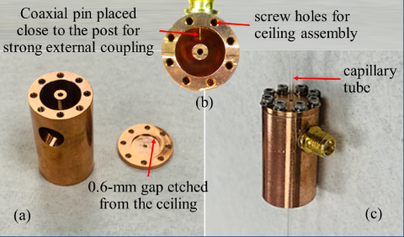
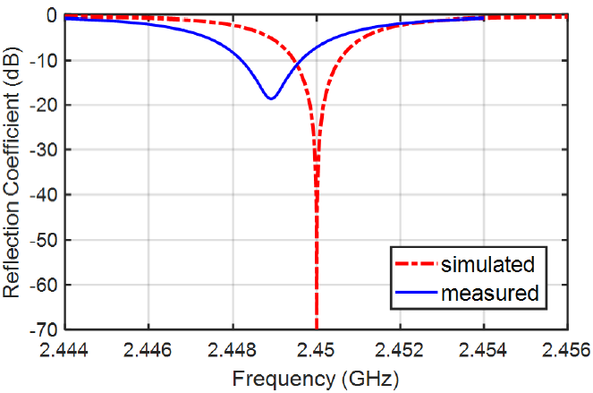
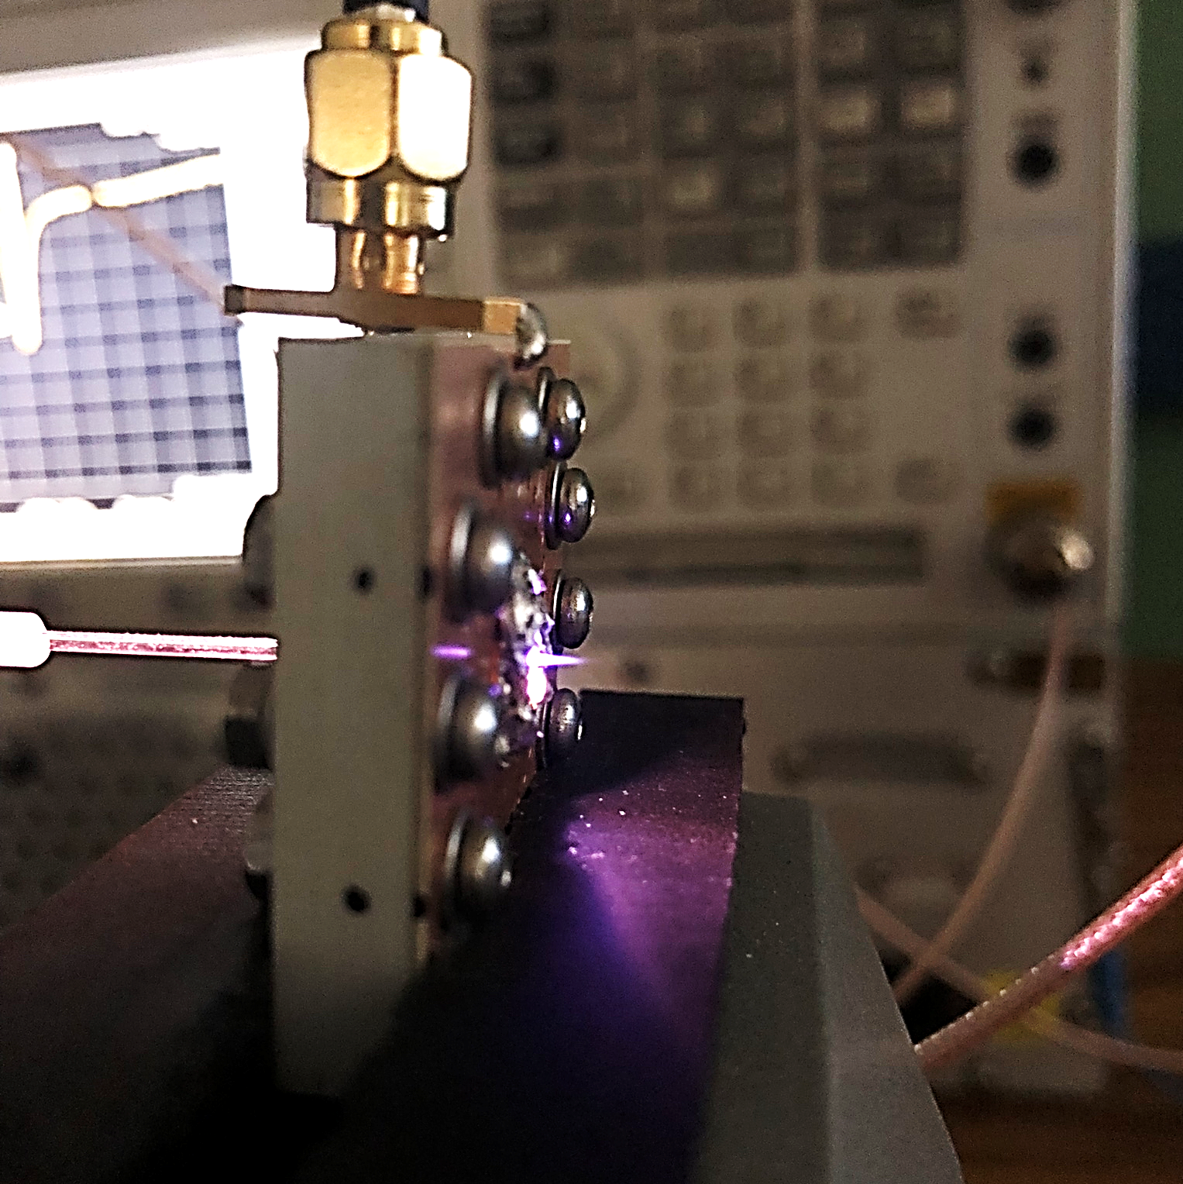
A HIGHLY EFFICIENT ATMOSPHERIC PRESSURE RESONANT MICROWAVE PLASMA JET
Kazi S. Kabir and Abbas Semnani
University of Toledo, Ohio, United States
kkabir@rockets.utoledo.edu
Motivation
Plasma Jet is used in medicine, food, water decontamination, lighting, reconfigurable RF electronics
Current plasma sources are bulky, expensive units and sometimes inefficient in transferring energy to plasma
Microwave resonant structures can store and enhance electromagnetic (EM) energy
Evanescent mode cavity resonator is used for plasma jet creation with low input power and high efficiency
Setup & Measurement
Results & Discussion
Theory, Design & Fabrication
6-mm long He Plasma Jet 5 W and 7 slpm
Measurement Setup
References
A. Semnani, S. O. Macheret, and D. Peroulis, “A quasi-absorptive microwave resonant plasma switch for high-power applications,” IEEE Trans. Microw. Theory Techn., vol. 66, no. 8, pp. 3798–3806, Aug. 2018
L. M. D. Rosario et al., “Characterization of a microwave-induced atmospheric-pressure Ar–N2 plasma pencil,” IEEE Trans. Plasma Sci., vol. 45, no. 2, pp. 301–309, Feb. 2017.
H. J. Van Der Meiden et al., “High sensitivity imaging Thomson scattering for low temperature plasma,” Rev. Sci. Instrum., vol. 79, no. 1, Jan. 2008, Art. no. 013505.
B. L. M. Klarenaar, O. Guaitella, R. Engeln, and A. Sobota, “How dielectric, metallic and liquid targets influence the evolution of electron properties in a pulsed he jet measured by Thomson and Raman scattering,” Plasma Sources Sci. Technol., vol. 27, no. 8, Aug. 2018, Art. no. 085004.
N. Konjevi´c, A. Lesage, J. R. Fuhr, and W. L. Wiese, “Experimental stark widths and shifts for spectral lines of neutral and ionized atoms (A critical review of selected data for the period 1989 through 2000),” J. Phys. Chem. Reference Data, vol. 31, no. 3, pp. 819–927, Sep. 2002
Future works
Reactive species concentration quantification with different background gases
Reactive species manipulation by mixing it with peroxide
Tunable SIW Plasma Jet
Plasma liquid interaction
Cancer cell treatment
This work was funded by the National Science Foundation under Grant number EECS-2102100
SIW based Plasma Jet
Simulated vs Measured $S_{11}$
A. Semnani and K. S. Kabir, “A Highly Efficient Microwave Plasma Jet Based on Evanescent-Mode Cavity Resonator Technology,” IEEE Transactions on Plasma Science, 2022.

